Slide 1
The How-Tos of Engaging Community Stakeholders and
End-users using Advisory Boards
Tracy Neville, BA
Emma L. Narkewicz, MPA
Jinnia Baiye, BSc.
We acknowledge the Transitions to Adulthood Center for Research’s Young Adult Advisory Board (YAB) members for providing feedback and input on this panel presentation.
MAY 21, 2024 | 2024 NARRTC ANNUAL CONFERENCE & BUSINESS MEETING

Slide 2



Acknowledgements
This presentation is made possible with funding from the National Institute on Disability, Independent Living, and Rehabilitation Research, (NIDILRR), United States Departments of Health and Human Services (NIDILRR grant number 90RTEM0005). NIDILRR is a Center within the Administration for Community Living (ACL), Department of Health and Human Services (HHS). The contents of this presentation do not necessarily represent the policy of NIDILRR, ACL, or HHS and you should not assume endorsement by the Federal Government.

Slide 3

Tracy Neville, BA
Research Coordinator II
Co-Facilitator YAB

Slide 4
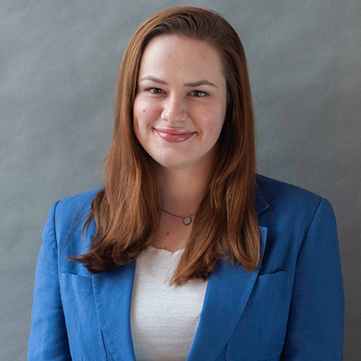
Emma Narkewicz, MPA
Clinical Research Coordinator III
Co-Author YAB Toolkit

Slide 5

Jinnia Baiye, BSc.
Implementation Support Specialist I
Senator Charles E. Shannon, Jr. Community Safety Initiative Local Action Research Partner

Slide 6
Youth Voice in Action: Sustaining Community Engagement through Advisory Boards
Tracy Neville, BA, Research Coordinator II and YAB Co-Facilitator
MAY 21, 2024 | 2024 NARRTC ANNUAL CONFERENCE & BUSINESS MEETING
Notes:
Welcome to our panel! My name is Tracy Neville. I am a white woman with light brown hair, and I am wearing ____. I am a Research Coordinator II and Co-Facilitator of the Young Adult Advisory Board at UMass Chan Medical School within the Transitions to Adulthood Center for Research. Today, I am excited to speak to you about “Youth Voice in Action: Sustaining Community Engagement through Advisory Boards.”

Slide 7
Additional Acknowledgments
We would like to thank the many people who have made the Young Adult Advisory Board (YAB) what it is today, including current and former members, facilitators, faculty, and staff at the Transitions to Adulthood Center for Research.
Notes:
We also would like to take this opportunity to thank the “many people who have made the Young Adult Advisory Board what it is today, which will be referred to as the YAB throughout this presentation. Thank you to our current and former members (some of whom provided feedback on this presentation), facilitators, faculty, and staff at the Transitions to Adulthood Center for Research.

Slide 8
Objectives
The Value of Youth Voice
YAB Fundamentals
Sustaining Engagement
Recent Accomplishments of our YAB
Notes:
I will begin our panel by discussing the following topics:
The value of youth voice
YAB Fundamentals, including the structure of our board and what a typical meeting looks like
Sustaining Engagement, including recruitment, retention, and common challenges we have faced
Recent Accomplishments of our YAB

Slide 9
The Value of Youth Voice
Notes:
The Value of Youth Voice

Slide 10
A Unique Life Stage
“Being young is a great advantage, since we see the world from a new perspective, and we are not afraid to make radical changes.” – Greta Thunberg
Youth bring unique perspectives to advisory councils
Image by Master1305 on Adobe Stock.
License type: Standard.
Notes:
Quote
Let’s begin by reflecting on this quote from 21-year-old climate activist Greta Thunberg, “Being young is a great advantage, since we see the world from a new perspective, and we are not afraid to make radical changes.”
Young and young adults bring...
Youth and young adults bring unique perspectives to advisory councils, as they are experiencing shifts in social and economic norms firsthand.
This is an “in between” stage, as the brain is still developing, including executive functioning skills such as planning and resisting inappropriate behavior (per Mizrahi, 2018; Munsey, 2006).
Engaging youth in advisory councils can be benefit both your organization and the youth engaged (according to Sankofa and colleagues from the The Urban Institute).
Image
The image on the slide is a colorful photo of two young adults for decorative purposes.

Slide 11
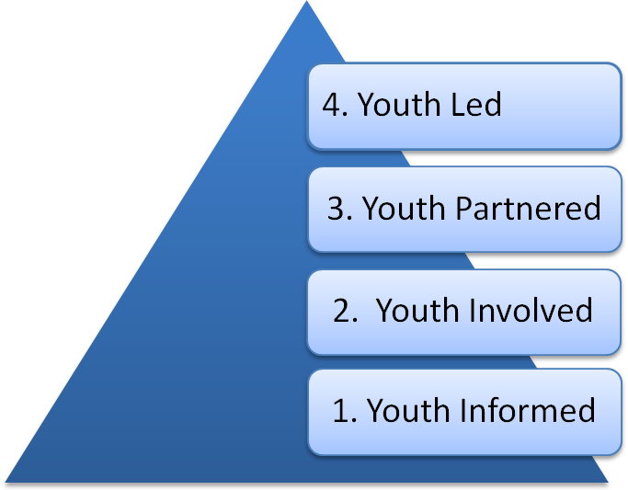
Community-Based Participatory Research (CBPR)
End-user involvement is necessary in research and knowledge translation
Bridging the gap between research and application (April et al., 2023; Silberberg et al., 2011)
Avoiding tokenism
Image from Transitions to Adulthood Center for Research
Notes:
End-user involvement is necessary in both research and knowledge translation
Engaging end-users early and often is key in both research, and in translating knowledge in a way that is accessible and useful.
Bridging the gap between research and application ...
Community-based participatory research, or CBPR, helps to bridge this gap.
There is a growing recognition that public health issues are largely impacted by social and physical contexts, underscoring the importance of end-user perspectives (Silberberg et al., 2011).
Avoiding tokenism
There is always the risk of tokenism, when end-user perspectives are sought “for show” and are not seriously considered.
Can often be unintentional.
To avoid this, there must be trust in the community to make their own decisions and a culture of collaboration (according to Youth Engagement Strategies and Support, or YESS).
Image
On the slide, there is a triangle representing the levels of youth engagement. From top to bottom: “Youth Led,” “Youth Partnered,” “Youth Involved,” and “Youth Informed.”

Slide 12
YAB Fundamentals
Notes:
Next, I will describe how our organization honors the value of youth voice through our YAB.

Slide 13

A Brief History
YAB was established in 2014
Began as part of the 2014-2019 Learning & Working During the Transition to Adulthood RRTC (NIDILRR)
Image from Transitions to Adulthood Center for Research
Notes:
Established in 2024
Our YAB was first established ten years ago, in 2014.
Began as part of ....
The YAB began as part of the 2014-2019 Learning & Working During the Transition to Adulthood RRTC (funded by NIDILRR)
has been carried over into subsequent grant cycles.
Image
On the slide, there is a photo of a group of young people engaged in discussion.

Slide 14
Our Mission
“Provide our organization with input from young adults living with mental health conditions to improve the research, policies, and services designed to meet their needs.”
Notes:
Our mission.
Our YAB aims to, “Provide our organization with input from young adults living with mental health conditions to improve the research, policies, and services designed to meet their needs.”
Highlighted on the slide are two key elements of a good mission statement: in blue, “Reflect your organization’s needs,” and in yellow, “Concisely summarize the purpose of the advisory board,” which is outlined in the Toolkit, which my colleague Emma will discuss more in-depth.

Slide 15

YAB Structure
National board of about 10-20 young adults, ages 18-30
Meet virtually once a month
Provide consultation as needed
Members are paid $40/hour as consultants
Notes:
About 10-20 young adults...
Our YAB consists of about 10-20 young adults between the ages of 18-30 from across the US.
Meet virtually once a month...
We meet as a board virtually once a month on Zoom, which is represented by the icon on the slide.
Provide ...
YAB members also provide consultation as needed.
Members are paid...
We are committed to providing YAB members with equitable compensation for their time and contributions, regardless of educational background. This is built into our grant budget from the beginning.
Members are paid $40/hour as consultants.

Slide 16
Meeting Structure
Icebreakers, such as:
  If you were writing a book, what would it be about?
  What qualities do you appreciate most in a friend?
Comfort Clause, including “Use Preferred Language,” “Vegas Rule,” “Oops and Ouch” clause
Two, 45-minute presentations
Notes:
Icebreakers
Our meetings begin with icebreakers, light-hearted, open-ended questions,
Such as “If you were writing a book, what would it be about?” and “What qualities do you appreciate most in a friend?”
This is an important piece of group cohesion, helping members to identify common interests.
Review
We review our Comfort Clause, or ground rules, at the start of each meeting, some of ours include...
Use preferred language - To mitigate stigma, we encourage person-first language and asking directly how others identify.
Vegas Rule – which comes from the phrase “What happens in Vegas, stays in Vegas.” This emphasizes confidentiality.
The “Oops & Ouch” Clause - Gives people a chance to apologize when they may have upset someone.
Two, 45-minute...
We schedule two 45-minute presentations per meeting.

Slide 17
Member Expectations
Co-creation of expectations increases likelihood of sustained interest and engagement (PMI, 2015)
Active engagement
At least one year commitment
Communicate availability through Doodle Poll
Notes:
Co-creation of expectations...
Expectations are revisited regularly, as we know that the more involved a team member is in the setting of expectations, the more likely they are to demonstrate interest and engagement, according to the Project Management Institute (PMI).
Active engagement:
We expect active engagement, while we understand that members may not always have the capacity to participate to the fullest, whether that’s due to mental health reasons or a particular topic may not resonate.
At least one year commitment:
We ask for at least one year of commitment.
Communicate availability:
We also ask that members communicate their availability ahead of time through the online scheduling tool Doodle Poll.

Slide 18
Sustaining Engagement
Notes:
Next, we will discuss some strategies for sustaining engagement.

Slide 19
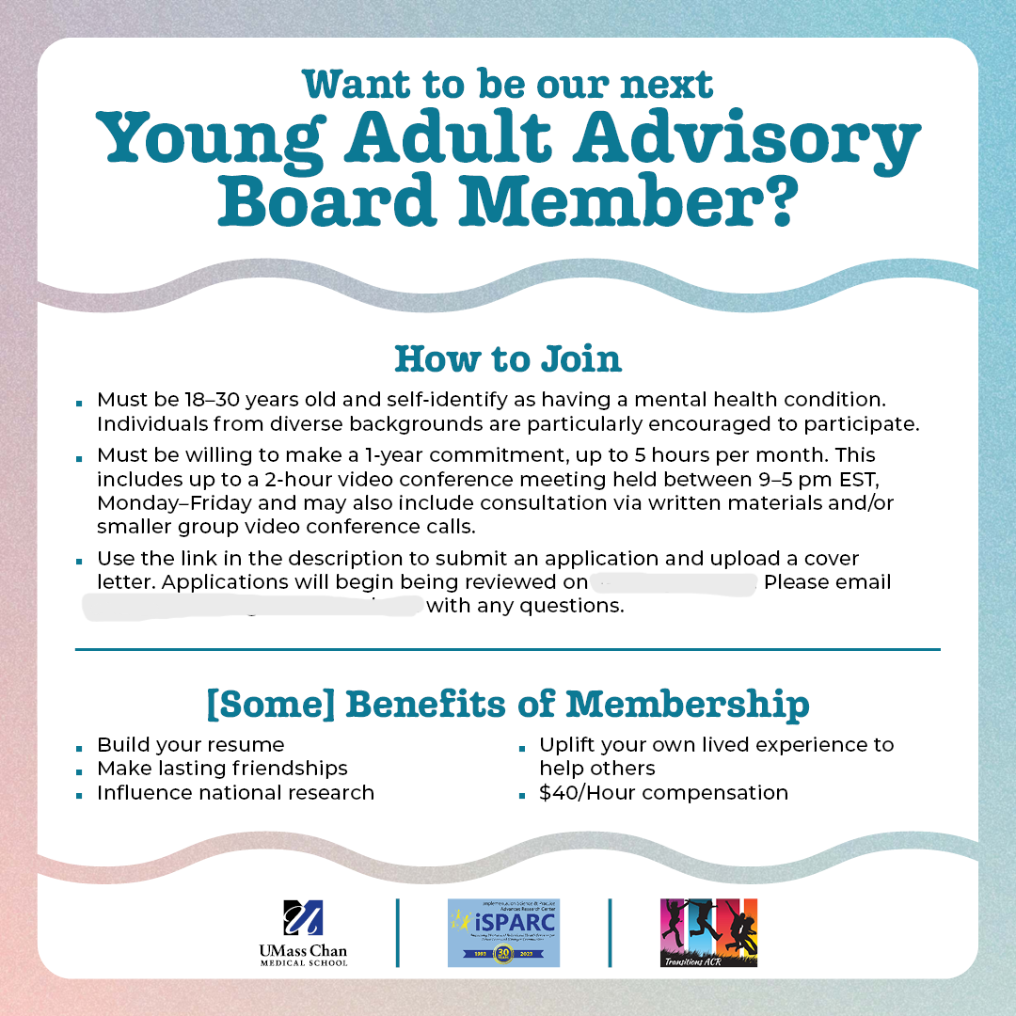
Retention & Recruitment
Cultivate community
Express gratitude
Share opportunities
Recruit periodically
Consider diversity: Whose voices are we missing?
Notes:
Retention & Recruitment
Strategies for Retention & Recruitment.
Cultivate community...
Cultivating community during and outside of meetings (such as through LinkedIn and WhatsApp), helps members to feel a sense of belonging.
Expressing gratitude
Expressing gratitude, and showing how YAB contributions have been acted upon, is key to meaningful engagement.
Share opportunities
Sharing opportunities for further involvement could look like: conference presentations, appearing on our podcast, or have a role on research projects.
Recruit periodically / Consider diversity
It is important to recruit periodically.
Turnover is a natural part of the life cycle of a board and is not always a bad thing.
When recruiting, we consider whose voices are missing, particularly those who are historically underrepresented in research
(e.g., People of Color; the LGBTQIA+ community; those without a formal education; among others).
Image
On the slide, we have a social media post that was used in a recent recruitment campaign.

Slide 20
Challenges in Sustaining Advisory Boards
When time and funding are limited, start by building the YAB into the grant budget.
When minimum requirements are a barrier, consider bringing on members as consultants.
When sustaining participation across grant cycles, focus on building relationships and capacity.
Notes:
Addressing common challenges
Through this work, we are always learning. Here we will describe our approach to some of the common challenges in sustaining CBPR initiatives, such as the YAB.
Limited Resources, like time and funding:
When time and funding are limited, we start by building a realistic YAB commitment into the grant budget.
For us, we have budgeted 5 hours/month for YAB members and two co-facilitators at 10% effort.
Minimum educational requirements for hiring
We bring on YAB members as consultants to address the barrier to hiring YAB members into roles with minimum requirements (e.g., Bachelor’s degree).
Sustaining participation across grant cycles
And finally, to sustain participation across grant cycles, we focus on building relationships and capacity.
We host trainings to help members develop skills that can be applied to future projects and initiatives.

Slide 21
Recent Accomplishments of our YAB
Notes:
I will now highlight recent accomplishments of our YAB.

Slide 22
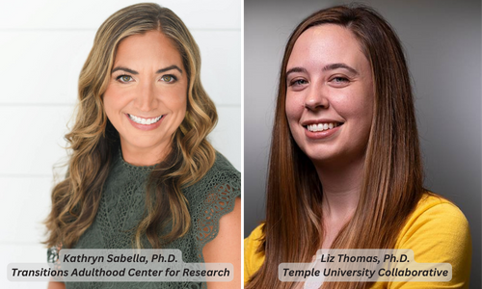
YAB Co-Development of NIDILRR/SAMHSA Grant Proposal
The CIRC Center, funded by NIDILRR and SAMHSA
Co-PIs Kathryn Sabella, PhD and Liz Thomas, PhD
5-year, $4.37M grant
5 studies, 3 training projects
Notes:
The CIRC Center
Discussions with the YAB were key to co-developing a proposal to fund the CIRC Center (The Center for Community Inclusion and Reflective Collaboaration)
a NIDILRR- and SAMHSA-funded Rehabilitation Research and Training Center,
This 5-year, $4.37M grant consists of 5 research studies and 3 training projects focused on advancing community living and participation outcomes for young adults from disadvantaged, marginalized, and vulnerable populations who have serious mental health conditions
Co-PIs...
Co-Principal Investigators Drs. Kathryn Sabella and Liz Thomas are pictured smiling here. They are both white women with long, brown hair and blonde highlights.

Slide 23
Ways the YAB Shaped the Proposal for the CIRC Center
Began discussions a full 9 months before due date
Prioritized short-form video content
Co-designed study to allow in-person or virtual option for all
Notes:
Ways the YAB Shaped the Grant
Co-development helped create a winning proposal in some of the following ways.
Began discussions ....
The Co-PIs began discussions with the YAB on “Community Participation” a full 9 months before the application was due.
Incorporated short-form video....
YAB members endorsed frequently watching YouTube and short-form videos.
From this, a plan to co-produce 18 short-form videos with the YAB to deliver key findings and messages was incorporated into the Center’s Social Media/Dissemination activities.
Co-designed study...
The YAB co-designed a mixed methods research study with the Co-PIs on the conceptualization and experience of community participation, suggesting we offer both an in-person and virtual option for the qualitative interview, which has been incorporated into the study design and IRB materials
We are working to train interviewers (including YAB members) to collect data as part of these in-person or virtual interviews.

Slide 24

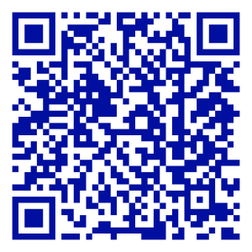
Connecting through Podcasts
STAY Tuned Ep. 13 and 17 feature YAB members
Image from Transitions to Adulthood Center for Research
Notes:
Connecting through Podcasts
Recently, a YAB member joined our STAY Tuned podcast,
short for "Supporting Transition Age Youth with Mental Health Conditions,”
to discuss peer support, mental health, and how community participation has impacted their mental health.
STAY Tuned...
We encourage you to search for STAY Tuned or scan the QR code now to listen to the audio and view the video of the podcast.
Image
On the slide we have the cover illustration for the STAY Tuned podcast, an abstract, colorful representation of a person listening with headphones.

Slide 25
References, Panel Part 1
  April, K., Stenersen, M. R., Deslandes, M., Ford, T. C., Gaylord, P., Patterson, J., & Kaufman, J. S. (2023). "Give up your mic": Building capacity and sustainability within community-based participatory research initiatives. American Journal of Community Psychology, 72(1-2), 203-216. https://doi.org/10.1002/ajcp.12674
  Munsey, C. (2006). Emerging Adults: The in-between age. Monitor on Psychology. Retrieved from https://www.apa.org/monitor/jun06/emerging.
  Mizrahi, R. (2018). What Were You Thinking?: Brain Development in Young Adults. Worcester, MA: UMass Chan Medical School, Department of Psychiatry, Implementation Science and Practice Advances Research Center. Retrieved from https://www.umassmed.edu/TransitionsACR/publication/life-skills/tip-sheets/2018/10/what-were-you-thinking/.
  Project Management Institute (PMI). (2015). Business Analysis for Practitioners: A Practice Guide.
  Silberberg, M., Cook, J., Drescher, C., McCloskey, D. J., Weaver, S., & Ziegahn, L. (Eds.). (2011). Principles of Community Engagement (2nd ed.). National Institutes of Health (NIH). Retrieved from https://www.atsdr.cdc.gov/communityengagement/index.html
  Sankofa, J., Daly, H., & Falkenburger, E. (2021). Community Voice and Power Sharing Guidebook. The Urban Institute. Retrieved from https://www.urban.org/sites/default/files/2024-03/Community%20Voice%20and%20Power%20Sharing%20Guidebook.pdf
  Youth Engagement Strategies and Support (YESS). “Avoiding Tokenism When Engaging Young People.” Retrieved from https://c4innovates.com/wp-content/uploads/2020/01/CDLWR-3476__YESS_Tokenism-TipSheet_v4.pdf.

Slide 26
A Virtual Toolkit: The Building Blocks for Running an Effective Youth Advisory Board
Emma L. Narkewicz, MPA, Clinical Research Coordinator III and Co-Author of the Virtual YAB Toolkit
MAY 21, 2024 | 2024 NARRTC ANNUAL CONFERENCE & BUSINESS MEETING

Slide 27
Acknowledgements
I would like to thank the many people who have contributed to the YAB Toolkit including YAB members, YAB and FAB facilitators, our Shannon Community Safety Initiative partners, and faculty and staff at the Transitions to Adulthood Center for Research at UMass Chan Medical School.
Notes:
I’d I’d like to thank by name Emily McCaffrey who is the toolkit’s first author and a former YAB facilitator, Emily Sudbrock who is co-author of the toolkit
Raphael Mizrahi and Amanda Bazko involved in this project
Jean Wnuk and Maya Ingram who are Fab & YAB facilitators,
Dee Logan who is the project manager of this project and was instrumental to the toolkit and this panel presentation

Slide 28
Your YAB’s goals will be different depending on your organization, its members, and who you are aiming to serve. For example, your members may work towards becoming advocates, developing resources, or running meetings on their own.”
- Creating and Sustaining Youth Advisory Boards (YABs): A Toolkit for Health and Human Services
Notes:
I want to begin with a quote from the YAB Toolkit that highlights an overarching theme throughout the content. The quote is: “Your YAB’s goals will be different depending on your organization, its members, and who you are aiming to serve. For example, your members may work towards becoming advocates, developing resources, or running meetings on their own.”
The toolkit includes examples materials from the Transitions to Adulthood Center for Research’s TACR YAB but the content, resources, and templates can be tailored to your organization's needs, structure, target population, and goals.

Slide 29
YAB Toolkit Design Process
Iterative process requiring time and intentionality
Recognizing lived experience of YAB members and expertise of staff and community partners
Shannon CSI team evaluating and piloting the toolkit
Collaborating with iSPARC’s Communication Specialist on website design
Notes:
This toolkit has taken time and intentionally to get right, develop slide
useful product that accurately reflects experience and new learnings from our YAB members, YAB facilitators, and other staff and faculty involved in working with the YAB.
This meant taking the time to ask for feedback from these been doing the work “on the ground” who really know what’s going on, can truly speak to the needs and challenges, and what works and doesn’t work. Humility, openness to grow, improve, implement edits.
2023 Shannon CSI team agreed to evaluate & pilot the toolkit while designing their own YAB to serve young adults at high risk for gang involvement in Fitchburg MA. It’s been invaluable to have a fresh set of eyes to let us know if content makes sense and give us areas to improve and add especially from Dr. Dara Drawbridge and Jinnia who are trained implementation specialists, Jinnia will provide more information about this process in her portion of the panel.
Our communications specialist Robin Tasca has also been very involved in this process, and has worked with us with bring the toolkit to life on a webpage, and has helped us go through an make many iterative edits

Slide 30
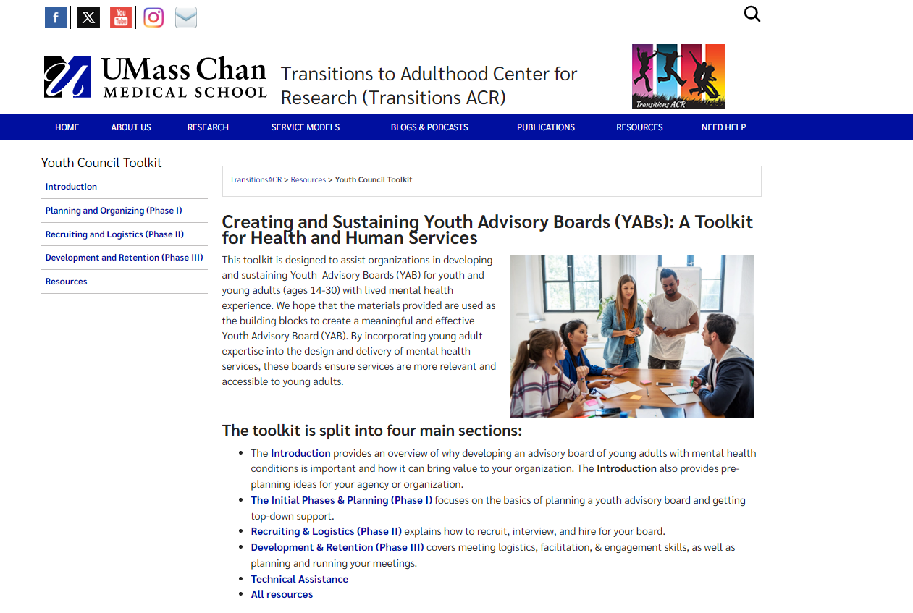
Toolkit Webpage
Notes:
Here is an image of Toolkit web page on the Transitions ACR
There is a main page overviewing the sections and content
On the left there are five clickable sections: Intro, Planning & Organizing, Recruiting & Logistics, Development and Retention, and Resources
Content broken into phases that be read sequentially or you can go through and pick and pull what you need
Resources page with template/examples/guides/ from all

Slide 31
YAB Toolkit Introduction Section
Structure of a YAB
Value of Youth Voice
Information about young adults living with Mental Health Conditions (MHC)
Self-reflection questions about organizational readiness
Notes:
Some of the main topics covered include the Introduction are the Structure of a YAB and Value of Youth Voice, – MHC and self reflection questions
Introduction provides some information and statistics on youth adults with MHC and how MHC can impact many areas of a young person’s daily life and independence. YAB members emphasized when it comes to MH, agencies looking to create a YAB around mental don’t need to be experts, more important to come with open mind, absence of stigma, and willingness to learn.
Shannon community safety initiation
Key question Is your organization willing to change its processes and timelines to meaningfully incorporate youth voice?
Great feedback we got from Shannon CSI team as part of readiness is:
Consider is this the best way for our org to incorporate youth voice? Consider alternatives such as interviews, panels, focus group. Doesn’t have to be YAB or nothing
Consider and openly talk through your fears about what could go wrong with a YAB? Important to acknowledge and address any reservations or fears or they may hold your organization back and prevent your org from fully committing and buying in to a YAB

Slide 32
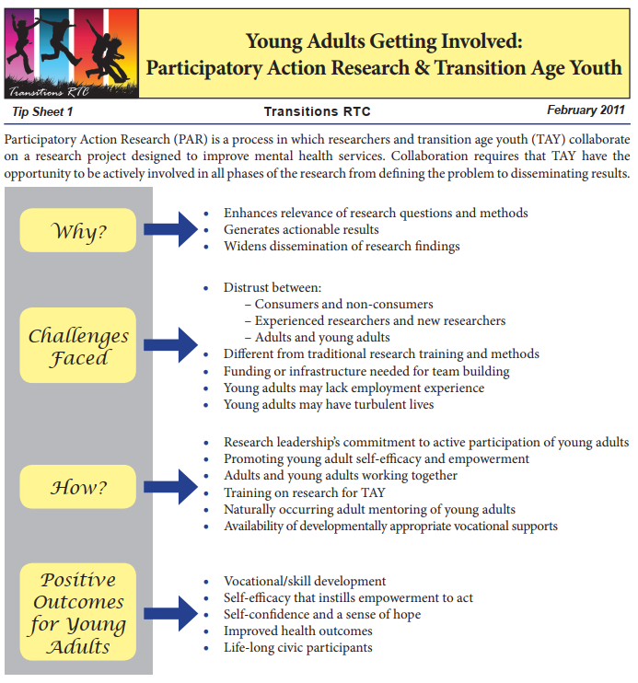
Intro Resources
Information on youth voice and tokenism
Briefs and tip sheets on young adults with MHC
Considerations for starting a YAB
Image from:
(Delman, 2011)
Notes:
Youth voice, tokenism tip sheets & assessments
Organizations tokenize young adults when they showcase their participation but do not give the young adults any real power.
Organizations that include genuine youth voice allow young adults to influence and participate in decision-making.
Briefs and tip sheets for leaving more about young adults with MHC for readers unfamiliar with the population
More information and resources for evaluating a YAB

Slide 33
Phase 1: Planning and Organizing
This planning and organizing phase is key to achieving future success.
Identify a “champion”
Obtain organizational buy-in
Create a mission statement and goals
Consider resource allocation and budget
Notes:
Phase 1 starts out with the identify a champion – this staff member who spear heads the creation of the YAB. This person needs to hand the bandwith, passion, and skillset to get organizational buy-in, pitch the idea, and oversee logistics of YAB start up. project manager/advocate/salesperson for the YAB. not always a YAB facilitator or the person who came up with the idea of a YAB.
Before starting a YAB, importance of getting organizational buy-in, both top-down from leadership in charge ofdecision and bottom-up from staff on the groundwho will be interacting and changing processes. This means educating leadership and staff about the mission of the YAB and the value it will provide to the organization and community.
Your mission statement is an 1-2 sentences that concelisely share the purpose and benefits of your YAB, and should also reflect your orgnaizations needs and values. Accimpanying goals spell out how you will achieve mission statement. Should be reviewed and revised to include YAB feedback, be revised
Clearly describe your organization’s values
Concisely summarize the purpose of an advisory board
Considerations such as
.For resource budgeting consider the frequency and length of meeting, # of members, compensation rate, outside work, staff involvement, number of members, transportation, snacks. As Tracy mentioned, YAB members should be compensated at higher than regular hourly rate for their lived experience and timer Also discusses additionally budgeting consideration likes SSI benefits, if multiple orgs who will be in charge of payment, format of payment such as stipend vs. payment,

Slide 34
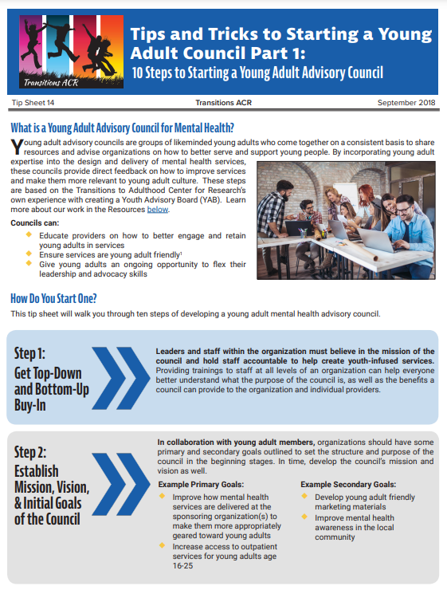
Phase 1 Resources
Budget template and example
Two tip sheets on “tips and tricks” for starting a YAB
Image from:
(Mizrahi & Costa, 2018)
Notes:
Walking through budget considerations consider, tip sheets inspired by our YAB on Tips and Tricks to Starting a Young Adult Council, provide a good high-level summary

Slide 35
Phase 2: Recruiting and Logistics
Considerations for accessibility and inclusion during:
Recruitment planning
Setting membership expectations
Application process
Interviews
Hiring
Notes:
Recruitment planning start with what population your org serves, what identities are underrepresented. For targeted recruitment YAB members recommended meeting young adults where they are by reaching out to university clubs, university events.
Creating recruitment materials that clearly convey your YAB’s mission and well membership expectations, such as responsibilities, time commitment, meeting frequency and attendance policies so prospective members can make an informed decision about membership. When setting policies balance accountability & understanding, example is having cameras on, you want members to engage and participate but members may have internet connectivity issues, clear communication and understanding are important.
Applications to collect information about members unique experiences and identities, ideally virtual to be accessible
Interview are standardized, try to remove bias. Consider scheduling interview times outside of M-F 9-5 to accommodate members with work, school, or care-giving commitments. In YAB interviews we provided interview questions ahead of time to help a participant with anxiety feel more comfortable and prepared
Hiring process, multiple people to be involved, review interview notes, clearly communicate either way and offer rejected members information about other potential opportunities for involvement if available

Slide 36
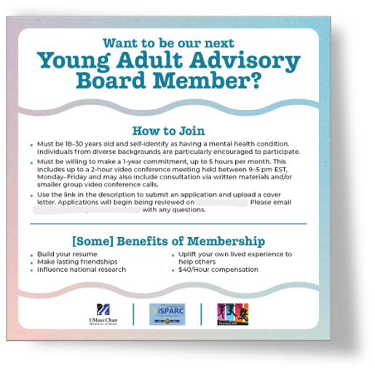
Phase 2 Resources
Recruitment flyers
Job descriptions
Sample application
Interview questions
Offer and rejection letters
Scope of works

Slide 37
Phase 3: Development and Retention
Meeting logistics
Facilitation skills for engaging and sustaining your YAB
Evaluations of YAB processes and outcomes
Life Cycle of a YAB
Notes:
Meeting Logistics will look different based on your YAB’s structure/goals/mission and format. For iSPARC, this involves scheduling meetings, booking presenters and preparing content to share with members for feedback.
Importance of facilitation skills and shared community guidelines and expectations. Comfort clause, addressing conflict proactively, and creating a culture of respectful and psychological safety Active listening, Clear Communication, Inclusion, Community Building, Recognition . \
Our YAB is working towards implementing formal evaluations is something our YAB. Evaluations allow you to operationalize your YAB’s mission and goals and assess areas of strength and for growth. This evaluations section walks through considerations about who you should seek feedback from, format of evals (survey, focus group, interviews), what kind of questions you should ask
YAB Life Cycle -
Turnover is normal,. Which means continued periodic recruitment and considering orienting and welcoming new members to your group. Additionally, some YABs have finite time spans or goals, such as a project specific YAB. If YAB ends, communicate clearly and have meetings dedicated to recognition, reflection, and closure activities such as deleting any access to org materials.

Slide 38

Phase 3 Resources
Meeting agendas
Roles and responsibilities
Evaluation questions and guidance
Webinars on running advisory boards
Image from: Transitions to Adulthood Center for Research

Slide 39
What’s Next
Shannon CSI Partners continuing to pilot and evaluate the toolkit
Consider additional formats to share the toolkit, such as short videos or training modules
Provide technical assistance to agencies looking to start their own YAB

Slide 40
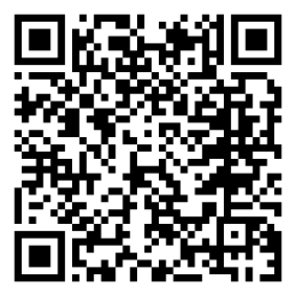
Check Out Our Toolkit
Citation
QR Code
McCaffrey, E., Narkewicz, E. L., & Sudbrock, E. R. (2024). Creating and Sustaining Youth Advisory Boards (YABs): A Toolkit for Health and Human Services. Worcester, MA: UMass Chan Medical School, Department of Psychiatry, Implementation Science and Practice Advances Research Center (iSPARC), Transitions to Adulthood Center for Research.

Slide 41
References, Panel Part 2
Delman, J. (2011). Young Adults Getting Involved: Participatory Action Research and Transition Age Youth. Tip Sheet 1. Worcester, MA: University of Massachusetts Medical School, Department of Psychiatry, Systems and Psychosocial Advances Research Center (SPARC), Transitions Research and Training Center
Mizrahi R, Costa A. (2018). Tips and Tricks to Starting a Young Adult Council Part 1: 10 Steps to Starting a Young Adult Advisory Council [English and Spanish versions]. Psychiatry Information in Brief 2018;15(5):1125. https://doi.org/10.7191/pib.1125. Retrieved from https://escholarship.umassmed.edu/pib/vol15/iss5/1

Slide 42
Youth In Action: Lessons Learned from Building a New Young Adult Advisory Board by Utilizing the Toolkit
Jinnia Baiye, BSc., Implementation Support Specialist I
Senator Charles E. Shannon, Jr. Community Safety Initiative Local Action Research Partner
04.21.2024 | 2024 NARRTC ANNUAL CONFERENCE AND BUSINESS MEETING
Notes:
Hello everyone, my name is Jinnia Baiye and I am a black woman with long black braids and I’m wearing ____. I am an Implementation Support Specialist at the University of Mass. Thank you so much to my co-presenters, Emma and Tracy for speaking about the Umass YAB and the toolkit. As we continue, I’d like to discuss a bit more about my team’s experience piloting the toolkit while building an advisory board and some of the lesson we learned along the way. That is why my section is titled, Youth In Action: Lessons Learned from Building a New Young Adult Advisory Board Utilizing the Toolkit

Slide 43
Acknowledgement
This project is funded by the Office of Grants and Research of The Massachusetts Executive Office of Public Safety and Security, FY24 Shannon Community Safety Initiative: Local Action Research Partner (PI Drawbridge, Contract # E63000000059127).
Thank you to the YAB Working Group, which includes Dara Drawbridge, PhD, UMass Chan Medical School and our Program Manager, Wil Renderos. Our Partner Programs were represented by Donata Martin (Spanish American Center), Shana Fitz, (Making Opportunity Count) and Captain Steven Giannini (Fitchburg Police Department). Thank you all for providing guidance and input throughout the process of creating the YAB.
Notes:
Before we get started, I’d like to say thank you to the Transitions ACR team including Emma, Dee and Marsha allowing us to pilot the toolkit. I'd like to say a major thank you to our YAB Working Group. This includes Dara Draw. and Wil Renderos. We also had leaders from some of our agencies present in this group, this included Donata Martin, Shana Fitz (Director of Youth Services, MOC) and Captain Steven Giannini (Support Services Commander, FPD). We want to thank them for their feedback and input throughout the process of building the YAB.

Slide 44
Overview
Introduction to the Shannon Community Safety Initiative
Tri-City Partnership Young Adult Advisory Board
Piloting the Toolkit
Notes:
Today, I’d like for us to go through three main topics:
First, an Introduction to theShannon Community Safety Initiative, which is the organization that I am a part of.
Second, we’ll look at the structure and process of building our Young Adult Advisory Board
And finally, our experience piloting the toolkit

Slide 45
Introduction to the Shannon Community Safety Initiative (CSI)
Notes:
An introduction the Shannon Community Safety Initiative (CSI). You will hear me use the abbreviation of CSI throughout the presentation.

Slide 46
Program Structure
Shannon Community Safety Initiative (CSI) supports agencies and organization across the Commonwealth of Massachusetts to reduce gang violence and involvement amongst youth and young adults in the community
www.shannoncsi.com
Notes:
Shannon CSI supports agencies and organization across the Commonwealth of Mass. through funding
These agencies and organizations have a goal of reducing gang violence and involvement amongst youth and young adults in the community and empowering the youth and young adults to build the lives that they envision for themselves through providing resorures and supports, skill building opportunities, knowledge and generally a safe and fun space to be young
Funding is given to our agencies to facilitate after school programs, innovation centers, sports training programs and mentoring programs – all intended to prevent and intervene with gang involvement.

Slide 47
Program Structure cont.d
Shannon CSI consists of:
141 Agencies/Organizations
15 Site Managers
15 Local Action Research Partners
1 Statewide Research Partner
www.shannoncsi.com
Notes:
In total Shannon CSI consists of:
141 agencies across Mass.
These organizations are clustered into 15 sites, each of these sites work directly with the youth and young adults in the community
and each site has a site manager (Wil Renderos).
The site manager oversees the activities of the agencies
Each site also has a local action research partner which provides strategic assisstance and implementation support to the site manager and agencies and all organizations within Shannon share one statewide research partner which is Northeastern University.

Slide 48

Our Site
The Tri-City Partnership
Fitchburg, Gardner and Leominster area
7 Agencies
1 Steering Committee
1 Local Action Research Partner
Notes:
We are one of those 15 sites.
Our site covers Fitchburg, Gardner and Leominster and we often refer to ourselves as the Tri-City Partnership.
Within our site we have 7 partner programs that receive funding for their respective programs. A representative from each program sits on our steering committee where we meet monthly. Lastly, myself and Dara serve as the Local Action Research Partner through Umass

Slide 49



Our Programs
Our programs follow the Office of Juvenile Justice and Delinquency Prevention (OJJDP) 5 core strategies:
Opportunity Provision
Suppression
Ex. Youth Innovation Center
Ex. Hot Spot Patrols
Social Intervention
Ex. AMP Program
Notes:
All of the programs that are funded by Shannon align with the Office of Juvenile Justice and Delinquency Prevention (OJJDP) 5 core strategies to address and prevent gang violence and involvement within a community.
The 5 strategies are: Suppression, Opportunity Provision, Social Intervention, Community Mobilization and Organizational Change and Development. Within our site, our agencies facilitate 14 programs, and they all follow 1 of the 3 core strategies listed on the slide. For example, we have hot spot patrols that are conducted by one of our police departments and this falls under the Suppression strategy.
One of our other agencies, MOC (Making Opportunity Count) runs a Youth Innovation Center and this falls under the Opportunity Provision Strategy. The final core strategy that our programs align with is the Social Intervention strategy.

Slide 50
Our Site’s Goal
Assist young people with developing their own personal vision of what they want in life and helping them achieve those goals.
Build partnerships among community agencies and young people.
Deliver programs that support and guide young people in the community and cater to their needs.
Notes:
The agencies within our site service young people in the between 12-24 years old. Our goals are to:
Assist young people with developing their own personal vision of what they want in life and helping them achieve those goals.
Build partnerships among community agencies and young people. (bridging that gap)
Deliver programs that support and guide young people in the community and cater to their various needs.

Slide 51
The Tri-City Partnership
Young Adult Advisory Board
Notes:
Our Young Adult Advisory Board

Slide 52
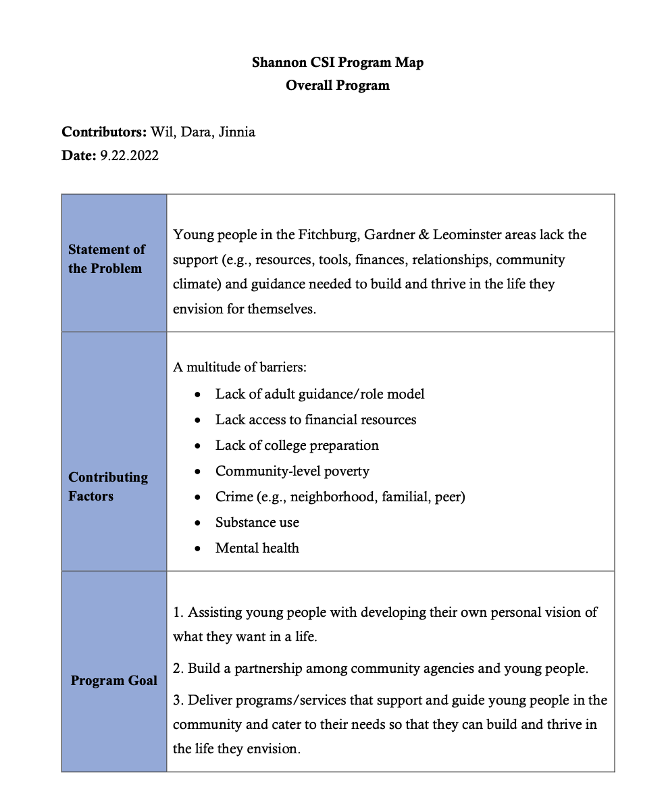
What led to this?
Our 2022 Intervention Map
Notes:
Over the past several years, our site has had discussion about creating an advisory board for the youth and young adults within our site - to engage them and understand ways to better serve them.
In 2022 we conducted intervention maps with all the agencies within our site. An intervention map allowed each organization to articulate their statement of the problem, program goals, clearly identify their target population and create a landscape of the programs that they facilitate.
The intervention maps indicated that the Shannon programs have a lack of engagement from youth and young adults in the community. This was a confirmation of what many of our leaders already felt. This observation coupled with the presence of the appropriate resources allowed us to start the journey of building an advisory board.

Slide 53
Mission
Build an inclusive space where young people have an opportunity to engage in meaningful discussions and provide input on the programmatic activities, policies, and strategies of the Tri-City Partnership and the wider community
Notes:
The mission for our YAB is to build an inclusive space where young people have an opportunity to engage in meaningful discussions and provide input on the programmatic activities, policies, and strategies of the Tri-City Partnership and the wider community. –

Slide 54
Our YAB’s Goals
Provide input on agency programs and policies
2. Share their experiences in agency programs
3. Provide insight on how the Tri-City Partnership can build sustainable relationships with young people in the community
4. Communicate recommendations regarding important issues affecting young people in their schools and communities
Notes:
Read slides

Slide 55
Our Process (2023)
Target Population
__
Roles and Responsibilities
Attend UMass YAB
___
Form YAAB Working Group
Trainer Central Course
___
Digital YAAB Member Application
Create
all Operational Documents
Recruitment
___
Implementation
Find YAAB Toolkit
JAN-FEB
MARCH
APR-MAY
JUN-AUG
SEPT-NOV
DEC
-PRESENT
Notes:
We spent all of 2023 building this YAB and this slide shows the timeline of the focus of each month.
At the beginning of the year, we got connected the Transitions ACR team at UMass because we were looking for resources to get us started on building the YAB. The Center mentioned that their team was working on a toolkit and that is how we were introduced to the opportunity to pilot the their toolkit
Over the first quarter of the year, the toolkit helped to identify and define key components of our YAB including our mission, goals, vision, roles and responsibilities. and our target population. Our target pop. was a discussion that required more attention as we were unsure if we should focus our advisory board on young adults or youth. With the help of our agency leaders, we concluded to start with young adults as they had more autonomy in their schedules, there was no need for parental consent, and they were recently youth which would allow them to have some insight into the youth's experience within the community.
In the second quarter we attended UMass's YAB which is facilitated by my co-presenter, Tracy. Although their YAB informs research, which defers from the purpose of our YAB, this was a great opportunity to see a YAB in action, we were able to see the importance of a great facilitator and witness other important YAB components like meeting ground rules. We also began meeting monthly with our YAB working group at this point, we used this monthly meeting to check in with the partner organizations and get feedback on on our progress.
Over the summer we developed all our operational documents like member policies, job descriptions, member contracts and offer letters.
In the final quarter we consolidated all the documents into an orientation packet to share with our YAB members during the onboarding period. We also created a digital version of this packet in Trainer Central to act a digital guide for members as they work through onboarding.
We are currently working on recruiting and implementing for the YAB.

Slide 56
Piloting the Toolkit

Slide 57
Target Population
Our YAB focuses on young adults who live or lived in the Tri-City area and have experience with Shannon program
The toolkit focuses on youth and young adults with lived mental health conditions
Notes:
Although we were the organization that piloted the toolkit, the first thing we encountered was that the toolkit was intended for an audience different than our target audience. The toolkit was intended for an advisory boards that focused on youth and young adults with mental health experience. Our YAB focused on young adults that are served by our Shannon programs, this often-meant BIPOC youth that lived in low-income neighborhoods and potentially had exposure to gang-violence. Some of these young adults did have experience with mental health challenges, but that was not the focus of Shannon CSI.
Regardless of this, the information and knowledge in the toolkit was high adaptable and transferrable. That's just to say that The toolkit is great for any group who is looking to build an advisory board for a marginalized population as the writers made sure to include the importance of understanding the nuance of your population and how to build an advisory board that will best suit your population.

Slide 58

Working with the Toolkit
Our team was able to create many of our
operational documents with the guidance
of the toolkit:
    Mission/Vision
    Job Descriptions
    Ground rules/ Member polices
    Marketing Material
Notes:
With the guidance of the toolkit we were able to create all of our operational documents including:
Mission/Vision
Job Descriptions for the YAAB members and facilitator
Ground rules/ Member polices
Offer and rejection letter
Interview guide and questions
Elevator pitch, recruitment emails
Marketing Material
flyer we used to share with our networks to get potential candidates excited and involved in our recruitment process

Slide 59
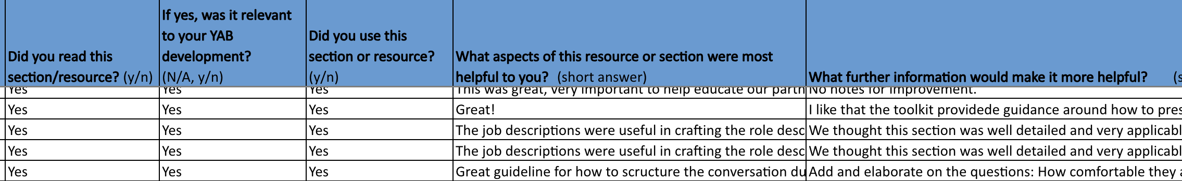
Evaluating the Toolkit
Notes:
As we were piloting the toolkit we would meet once monthly with the team at Transitions ACR to discuss our experience with the toolkit. We created an evaluation and tracking sheet that allowed us to make notes on our experience with each phase of the toolkit. In this tracker we answer questions like, ”Did we use the section?”, “Was it applicable?”, “What did you like or what would you improve?”. This was great because it showed the toolkit team's attention to detail and commitment to improving their toolkit for future users because they wanted to track and record our feedback. Having this tracker also allowed the toolkit team to go back and refer to our suggestions as they made the improvements that they saw fit

Slide 60
Recommendations Pt. 1
Introduction and Phase 1
Advise users to assess organizational readiness
More info on how to appropriately discuss mental health
More information on a ‘Champion’
Notes:
In the intro and Phase 1, titled Planning and Organizing, we had a few suggestions which we have on the screen. Please keep in mind that these suggestions were made some time ago and the team has already done great work to make the appropriate changes to improve the toolkit.
The first suggestion was to include some material regarding organizational readiness, an advisory board is a great method to engage your community, but it may not be the right method for your organization, or you might not have the capacity and/or resources to take on the task. Including some details or links to organizational readiness assessments can allow orgs to understand if this is the right direction for them.
Another suggestion was to include more details on how to appropriately discuss mental health. Mental health is a sensitive topic, and it is important to include guidance about how to respectfully discuss mental health especially since this toolkit is for YABs that will include folks with lived mental health experience.
Lastly, we suggested including more details on the importance of a champion, how to recruit one and how to differentiate this role from that of a facilitator.

Slide 61
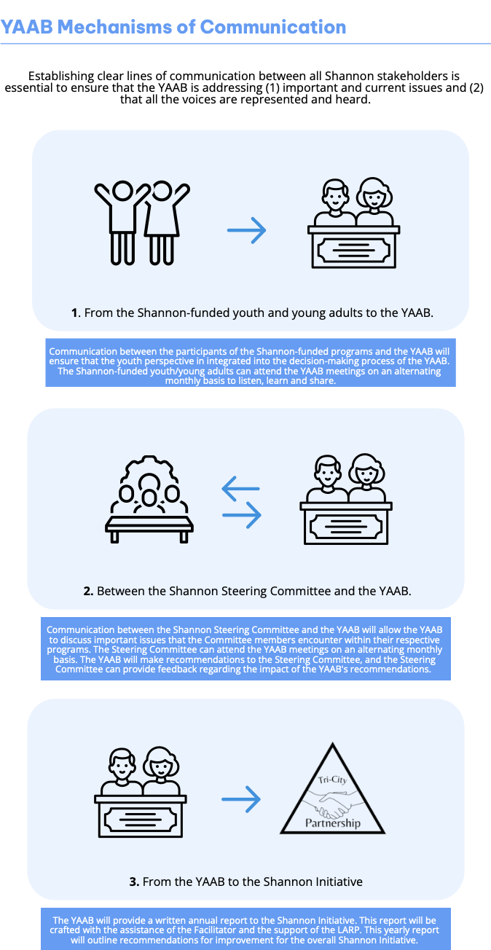
Recommendations Pt. 2
Phase 2
Importance of information sharing
mechanisms
Providing career support to
YAB member candidates
Notes:
Recruiting and Logistics
Our first suggestion in this section was to include details on the importance of identifying your YAAB's information sharing mechanisms or flow of information sharing. This allows each stakeholder in the YAB to clearly understand how decisions made by the YAB are being shared, who they're being shared to and whether they are or aren't being implemented.
Our second suggestion is regarding career support during recruitment . When were were recruiting for our YAB, we included the contact information of a free career support counselor. This was to ensure that applicants had the opportunity to seek free assistance with resume building or interview prep if they needed it. We want to make sure all of our applicants feel comfortable and equipped to apply, and we don’t want anyone shying away if they don’t feel prepared.

Slide 62
Recommendations Pt. 3
Phase 3
Create a ‘central hub’ for YAB members
Onboarding and offboarding process for YAB members and facilitators
Notes:
Development and retention
For this section, we suggested creating central hub for YAB members. This can be a digital platform where members can access their meeting material such as agenda, minutes or other relevant docs. If the chosen platform has the functionality, then members can also communicate with one another and easily keep their internal flow of communication going in a space that can be moderated and reviewed by the facilitator. Sometimes communicating via email with several YAB members can get confusing and it’s easy to lose track of conversations, but a platform like Monday.com, Trello or Jira can allow facilitators to post documents and allow easy access for members.
Our second suggestion was the include more information or resources about how to properly organize and structure your onboarding and offboarding process for YAB members or any other stakeholders involved in the YAB. It’s important that folks that are a part of the YAB are well oriented, they understand the structure, policies and processes of the YAB. In this work, there may also be challenges and conflicts with time commitment or retention for YAB members, so having a clear and solid offboarding plan is key to ensure that if YAB members are no longer able to commit they can be offboarded in a way that is kind and efficient. This may include creating a checklist that YAB members need to complete, it can include all the documents or equipment that needs to be returned to the YAB, or it could be an internal checklist for the facilitator to use to know what platforms they need to remove the member from, and any paperwork that needs to be signed. Offboarding is also a great time to have an exit interview with the member, to gain some insight into their experience and ways the experience can be improved.

Slide 63
Recommendations Pt. 4
Overall
Consider sharing the toolkit in a multi-media format
“What should organizations do if the YAB isn’t successful?”
Notes:
Finally, some overall suggestions for the toolkit:
As the toolkit evolves, I think it would be great for the toolkit to be presented in a multi-media format. Folks learn in different ways and sometimes, reading isn’t the most engaging method of consuming informational content. The toolkit can include more infographics, videos or audio to help cater to the needs of different users.
I think it would be great for the team to reflect the question, “What should an organization do if the YAB isn’t successful?”. Your organization may have done all of the readiness assessments, all stakeholders may have been onboard, but when it’s time to rollout or implement the YAB, there may be obstacles that prevent the YAB from being successful and achieving its intended goals. How should organizations move forward
for some folks it may be trying a different approach to their YAB, others may be dismantling the YAB and for others it may be trying a different form of community engagement. I think it would be valuable to include some information or resources about how to move forward if this is the situation you are in.

