Slide 1
Building Solutions and Breaking Barriers: Advancing Behavioral Health Through Community Collaborations
2026 Annual Conference of the DMH Research Centers of Excellence
Month YEAR
May 6, 2026

Slide 2
Disclosures
Cori Cather​, PhD
  Consultant:​
    NAVIGATE Consultants​
  Co-Investigator on a NIH-SBIR Grant:​
    Charles River Analytics​
  Trainer:​
    Amae Health​

Slide 3
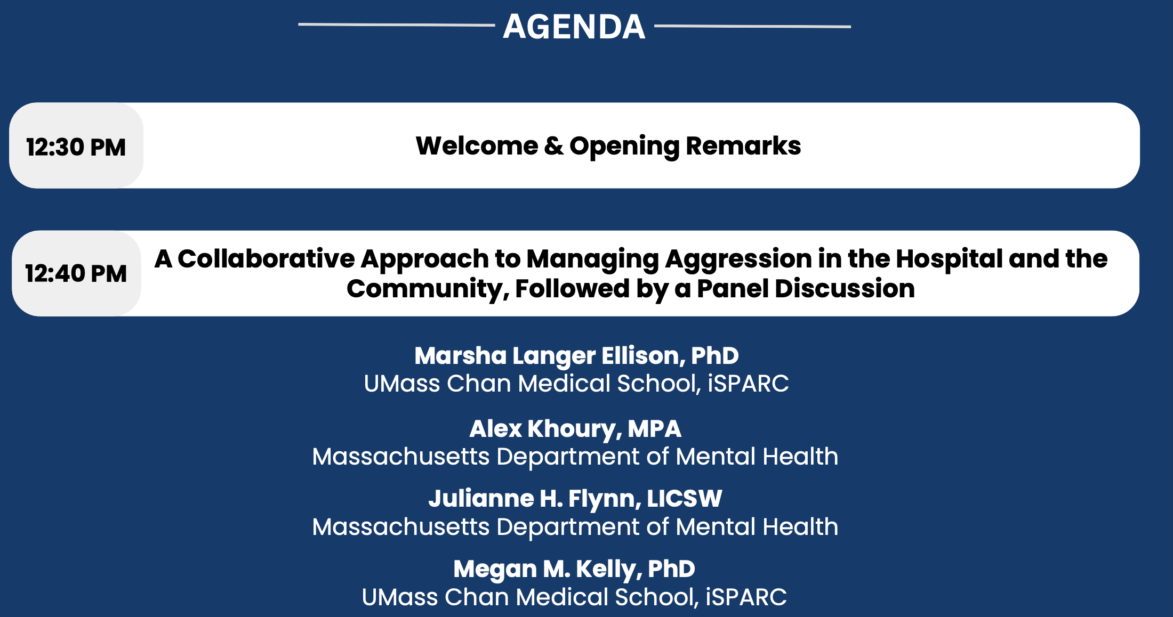
Agenda

Slide 4
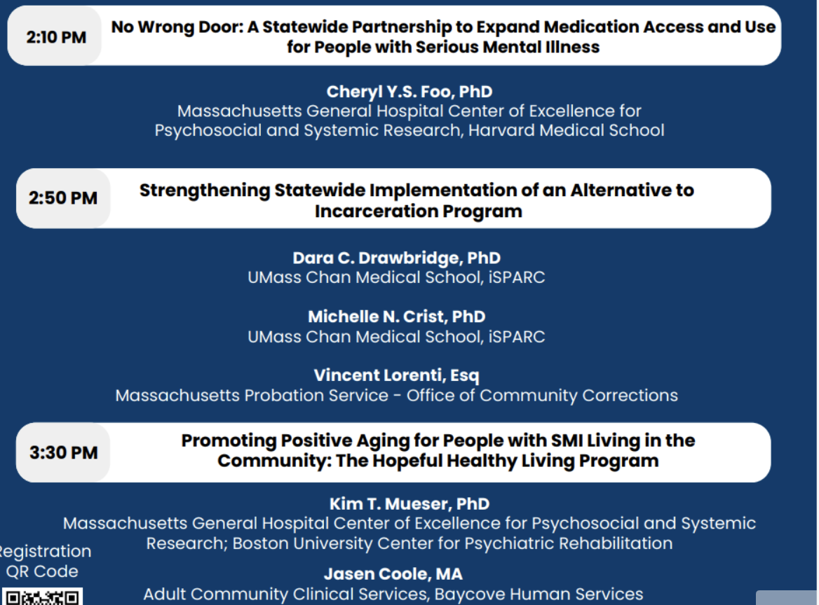
Agenda cont.’d

Slide 5
Continuing Education Units (CEUs)
CEUs are being offered for:
  Psychologists
  Nurses
  Social Workers
  Occupational Therapists
  Licensed Mental Health Counselors
Email dmh-ceap@mass.gov with any CEU questions/concerns.

Slide 6
Continuing Education Units (CEUs)
To receive continuing education credits for this event, participants MUST:
  Join the conference on Zoom with your full name displayed (individuals who only join by phone will not be eligible to receive CEUs).
  Attend the entire program.
  Complete an evaluation upon the conclusion of the program.
Link and a QR code to the evaluation will be shared near the end of the conference.

Slide 7
Continuing Medical Education (CME)
CME Accreditation Statement: The University of Massachusetts Chan Medical School is accredited by the Accreditation Council for Continuing Medical Education to provide continuing medical education for physicians.
Designation Statement: The University of Massachusetts Chan Medical School designates this live activity for a maximum of 4 AMA PRA Category 1 Credit(s)™. Physicians should claim only credit commensurate with the extent of their participation in the activity.
To receive continuing education credits for this event, participants MUST:
  Join the conference on Zoom with your full name (individuals who only join by phone will not be eligible to receive CEUs).
  Attend the entire program.
  Complete an evaluation upon the conclusion of the program.
Link and a QR code to the evaluation will be shared near the end of the conference.
For all CME certificate inquiries, please email continuing.education@umassmed.edu.

Slide 8
Welcome
Cori Cather, PhD, Associate Professor of Psychology, Harvard Medical School
Director of MGH Center of Excellence for Psychosocial and Systemic Research
Megan Kelly, PhD, Professor of Psychiatry and Behavioral Sciences,
Director of the Implementation Science and Practice Advances
Research Center (iSPARC) , UMass Chan Medical School

Slide 9
Opening Remarks
Emily Bailey, LICSW
Commissioner, Massachusetts Department of Mental Health​

Slide 10

Hopeful and Healthy Living Project
Kim T. Mueser and Jasen Coole

Slide 11
HHL Team and Collaborators: BU Center for Psychiatric Rehabilitation
Susan R McGurk, PhD Project Director
Kim T Mueser, PhD Project Co-Director
Alexa Trolley-Hanson, MS OTR/L Co-Project Manager
David Braverman, Co-Project Manager/Assessor
Sarah Pratt, PhD, Co-Investigator
Ben Canter OTD, Assessor
Kathryn Hintz, Stakeholder Group Facilitator
Tori Ingulli, Assessor

Slide 12
HHL Team and Collaborators: Bay Cove Human Services
Bay Cove Leadership:
Lisa Morishanti, Vice President of Mental Health Community Services
Thomas Beaulac, PsyD, MHCS Clinical Director
Jasen Coole, Assistant Integrated Team Director ACCS Team 7
Sabine Mautner, Service Director for Recovery and Clubhouse Services
Walnut House:
Paula Kahn, Integrated Team Director
Sabrina Lopez, Program Manager
Center Club: Mary Gregorio, Program Director
Transitions of Boston: Jean Dorneus, Program Director

Slide 13
Funding Acknowledgement
The contents of this presentation were developed under a grant from the National Institute on Disability, Independent Living, and Rehabilitation Research (NIDILRR grant # 90RTHF0007 to establish a Rehabilitation Research and Training Center on Aging Among Adults with Serious Mental Illnesses: Supporting Individuals to Live As Vibrant Elders in Recovery ( RRTC – S.I.L.V.E.R.). NIDILRR is a Center within the Administration for Community Living (ACL), Department of Health and Human Services (HHS).
The contents of this presentation do not necessarily represent the policy of NIDILRR, ACL, or HHS, and you should not assume endorsement by the Federal Government.

Slide 14
Agenda
Project Background
HHL Development
HHL Curriculum
Phase 1: Feasibility Study
Phase 2: Pilot Randomized Controlled Trial
HHL at Bay Cove
Questions

Slide 15

Background
5 million older adults live with serious mental illness.
Higher rates of:
  Chronic health conditions
  Loneliness and social isolation
  Institutionalization in long term psychiatric hospitals or skilled nursing facilities
  Premature death
(Barak et al., 2023; Bartels et. al. 2014; Correll et al., 2017; Dell et al., 2022; Institute of Medicine, 2012; SAMSHA, 2019)

Slide 16
Healthy Aging
“…the process of developing and maintaining the functional ability that enables wellbeing in older age.”
World Health Organization (2020)
To provide older adults with the skills and support needed to:
Take care of themselves
Make their own decisions
Build and maintain relationships
Manage their health needs
Move within their environment
Belong and contribute to their community

Slide 17
Project Aims and Design
To develop and evaluate a group-based intervention that enhances social connection, health, and cognition in people with SMI over the age of 50
2-phase design:
  Feasibility Open Trial: Develop a standardized Hopeful and Healthy Living (HHL) manual informed by input from multi-stakeholder group and an open trial with 10 participants over the age of 50
  Pilot Randomized Controlled Trial: Conduct a pilot RCT with 60 participants over the age of 50 to evaluate the effect of the HHL program on proximal outcomes (social support and loneliness, cognition, health behaviors) and distal outcomes (psychosocial functioning, mental and physical health functioning) as compared to TAU
Partnering with Bay Cove Human Services:
  Feasibility open trial at Walnut House, a residential program for older adults
  Pilot RCT at 2 psychosocial clubhouses: Center Club and Transitions of Boston

Slide 18
Research Questions
Phase One: Open Feasibility trial to examine the acceptability, appropriateness, and feasibility of the HHL Intervention for older adults with SMI
  Acceptability: How satisfied participants are with the HHL intervention including structure, content, and delivery.
  Appropriateness: How well the HHL intervention fits participant needs/goals and how the participant benefits from HHL.
  Feasibility: How easy was it for participants to attend and participate in HHL including class activities and take-home activities.
Phase Two: RCT to test whether the HHL program is associated with:
  Increased perceived social support and decreased loneliness
  Improved cognition
  Increased healthy lifestyle behaviors
  Improved psychosocial functioning

Slide 19
Project Timeline (2024-2027)
April/May 2024: Conduct stakeholder meetings with older adults with lived experience and Bay Cove staff
Summer 2024: HHL Manual Development
September 2024-February 2025: Pilot HHL Pilot Group Implementation
February-March 2025:
  Pilot participant follow-up assessment and interviews and staff stakeholder feedback
  Manual Revisions
  Recruitment meetings at Bay Cove clubhouses
April 2025-February 2026: RCT HHL Groups
  Center Club Cohort 1: April 2025-August 2025
  Transitions of Boston Cohort 1: May 2025-September 2025
  Center Club Cohort 2: October 2025-January 2026
  Transitions of Boston Cohort 2: November- February 2026
August 2025-September 2026: RCT follow-up Interviews and Assessments
September 2026-June 2027: Data Analysis and Dissemination

Slide 20
Methodology: Assessments
Feasibility Open Trial:
  Baseline, post-treatment (4 months), and 8-month post-randomization
  Semi-structured interviews with participants who complete at least 50% of the classes to assess acceptability (satisfaction with HHL), appropriateness (how HHL meets their needs), and feasibility (can they access and participate in HHL)
RCT:
  Baseline, post-treatment (4 months), 8-, and 12-month post-randomization
  Semi-structured interviews with 50% of Experimental Group Participants and 10 Bay Cove leaders/staff to identify facilitators and barriers to HHL implementation

Slide 21
Methodology: Data Analysis
Feasibility Open Trial:
  Descriptive analysis of attendance, participation, and home activity completion: HHL will be considered feasible and acceptable if 60% of participants attend at least 50% of sessions (8/16 sessions).
  Mixed effects linear regression model will be fit to explore changes from baseline to follow-ups in primary outcomes.
  Content analysis of semi-structured interviews to determine acceptability, appropriateness, and feasibility
RCT:
  Intent-to-treat analyses using 3-level mixed-effects linear regression models. Fixed effects: Group (HHL vs. TAU only), Time (baseline, 4, 8, and 12 months), and Group*Time interaction. Covariates: Site, Gender. Intervention effect test: significance of the group*time interaction.
  Content analysis of both staff and participants to identify facilitators and barriers to implementing HHL

Slide 22
HHL Development
Drew from 2 evidence-based practices
  Class structure and social skills training from the Helping Older People Experience Success (HOPES) program
  Cognitive self-management strategies from Thinking Skills for Work program

Slide 23
Hopeful and Healthy Living Intervention outline
Hopeful and Healthy Living (HHL) Intervention
Healthy Aging
Capacity Building: Social Skills Training, Cognitive Remediation
Social Skills
Cognitive Skills
Healthy Lifestyle Routines
Social Connection/ Participation
Health/Illness Management
Performance: Embedded Skills Practice
Outcome
Healthy Aging
(Avieli et al., 2016; Cohen & Talavera, 2000; Graham et al., 2002; Lowenstein et al., 2012; McGurk et al., 2000; Miller et al., 2021)
Notes:
Intervention

Slide 24
HHL Classes
16 weekly, 90-minute classes
Co-facilitated with Bay Cove staff
Handouts are provided for students in a binder
Welcome
Action Plan Review
Warm-up Activity
Discussion about class topic
Movement Break
Skills Teaching
Skills Practice
Development of an Action Plan

Slide 25
HHL Classes Outline
Healthy Aging
Class 1: Introduction to Healthy Living
Cognitive strategy: Self-assessment
Social skill: Sharing with others
Social Connection
Class 4: Having Conversations
Class 5-Active Listening
Class 2-Recognizing Your Strengths
Cognitive strategies: Using personal strengths to develop a goal
Social skill: Sharing goal with others
Class 3-The Power of Positive Thinking
Cognitive skill: Positive thinking strategies
Social Skill: Sharing with others
Cognitive Strategies: Attention strategies
Cognitive Strategies: Strategies for remembering what someone said
Class 6-Extending an Invitation
Cognition: Planning social activities
Class 7-Compromise and Negotiation
Class 8-The Power of Empathy
Cognitive Strategy: Perspective-taking
Healthy Lifestyle Activities
Class 9-Healthy Movement
Classes 10 and 11-Healthy Eating
Cognitive Strategies: Mindful eating, planning eating routines, problem-solving
Class 12-Healthy Sleep
Leisure
Class 13-The Power of Leisure Activities
Class 14-Remembering and Sharing Leisure Activities
Cognitive Strategy: Memory strategies
Class 15-Planning Leisure Activities
Cognitive Strategies: identifying new leisure activities, planning leisure routines
Class 16-Wrap-up
Cognitive strategies: planning, problem-solving, goal setting
Social Skills: Starting and maintaining conversations
Social Skill: Active listening
Social Skill: Extending an invitation
Cognitive Strategy: Problem-solving
Social Skill: Active listening, self-advocacy
Social Skill: Active listening; Steps for demonstrating empathy
Cognitive Strategy: Goal Setting; Planning movement routines, organization
Social Skills: Inviting others to healthy movement activities
Social Skill: Healthy eating with others
Cognition: Planning sleep routines, organization
Social Skill: Talking to providers about sleep
Cognitive Strategy: Attending to leisure activities
Social Skill: Inviting others to leisure activities
Social Skill: Sharing memories with others
Social Skill: Collaborating with others, compromise and negotiation
Social skills: sharing with others

Slide 26
Active and Engaging
Tailored to individual goals
Warm-up activities include trivia games, group brainstorming activities, team-based activities
Class topics are introduced through discussion
Movement Break- 15 to 20 minutes of exercise and breathing with music
Skills are modelled and then actively practiced
Action Plans are co-developed with students
Light snacks and tea/coffee provided

Slide 27
Warm-up Activity Example
Class 3-Warm-Up: Aging Beliefs Trivia
Older people can’t learn new things.
More life experience makes you wiser.
All older adults should limit the amount of exercise they do.
Once you’re a certain age, your mind and body just start declining and there is nothing you can do about it.
Older people are not good at technology.
Many older people are happier than younger people.
Most older people are lonely and socially isolated.
Older people can’t get a good nights’ sleep.
It's normal for people to be more depressed as they age.
Older people have more empathy than younger people.
Notes:
False
True
False
False
False
True
False
False
False
True

Slide 28
Open Feasibility Trial Results
Participants: N=8
  Mean age: 67 (60-73)
  Gender: Male- 7/Female-1
  Race: African American-6/White-2
  Primary Psychiatric Condition: Schizophrenia-5/Schizoaffective Disorder-2
Results:
  1 person dropped out due hospitalization
  High degree of participation in class activities (games, discussion, skills practice, and movement activities)
  Low participation in action plans
Outcome | Results
Retention in Research | 7/8 (87.5%)
Class Attendance | 75.28%
Class Exposure: 8 classes Class Completion: 12 classes | Exposure: 7/7 (100%) Completion: 5/7 (71.4%)
Avg. Take-Home Activity Completion | 28.9%

Slide 29
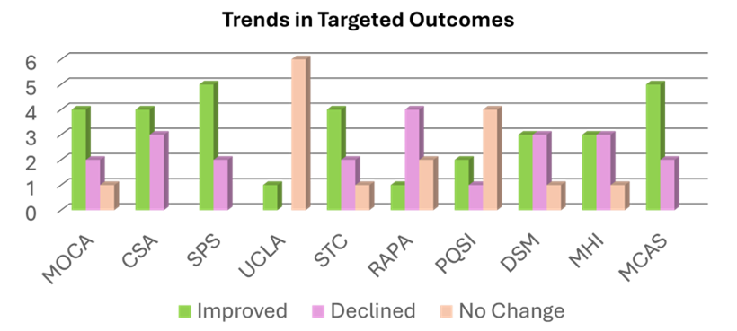
Open Feasibility Trial Results cont’d
Follow-up Assessment Results (baseline to 8-months)
  Social support (SPS): 5/7 (71%) improved
  Loneliness (UCLA): 6/7 (88%) no change
  Cognition (MOCA/CSA: 4/7 (57%) improved
  Healthy Behaviors
    Healthy Eating (STC): 4/7 (57%) improved
    Physical Activity (RAPA): 4/7 (57%) declined
    Sleep (PQSI): 4/7 (57%) no change
  Psychosocial functioning (DSM/MHI/MCAS):
    DSM/MHI: 3/7 (43%) improved
    MCAS: 5/7 (71%) improved

Slide 30
Open Feasibility Trial Qualitative Results
Acceptability:
  Participants enjoyed HHL structure, delivery, and content
    Healthy eating, movement, and sleep topics
  Participants enjoyed the opportunity to engage in learning and discussion activities
    Movement to music and games
Appropriateness:
  All participants benefited in some way-identifying improvements in social skills and participating in healthy lifestyle routines
  Challenged by group activities that required high cognitive and social demands (e.g. ground problem-solving in Stranded on a Deserted Island game)
Feasibility:
  Participants felt supported in getting to class, participating in class, and taking breaks when needed
“It was intriguing. And I didn't know what we were going to do next, and these are all part of hopeful, healthful living. ” Participant 7
“I look forward to it every Wednesday. Healthy or not healthy I look forward to it. It was a joy to be there” Participant 2
“We exercise in the group and listened to music. To just stretch your body 'cuz it's good to stretch your body, like to exercise.” Participant 5
“I kind of enjoyed that class a lot…Nothing much happens around [here]. But I did enjoy that class.” Participant 3

Slide 31
Modifications after Feasibility Trial
Replaced outcome measure for physical activity to one that that measures physical activity more broadly
Created facilitation strategies to promote completion of Home Action Plans
Updated Participant handouts to highlight skills learned in each class
Tweaked activities in 5 classes based on participant response and facilitator feedback

Slide 32
Pilot RCT Progress
Recruitment: Recruited 64 participants, 60 were randomized
Completed 4 HHL cohorts (2 at each clubhouse)
Follow-up assessments are ongoing-no data yet
Semi-structured interviews and data analysis are ongoing
  14/15 participants
  9/10 staff

Slide 33
Pilot RCT Progress cont’d
Descriptive results
  Average attendance across all groups:
    Without makeups: 81.5%
    With makeups: 94.8%
Preliminary qualitative results (what are barriers and facilitators to implementation?)
  Facilitators:
    Participants enjoy HHL and find it helpful
    Staff found that HHL helped clients and themselves
  Barriers:
    Participants who speak English as a second language struggled with some of the activities
    Staff spoke about the need for staff training and funding to support sustainability

Slide 34

HHL at Bay Cove
Jasen’s experience co-facilitating the classes and the impact of HHL on Bay Cove programs.

Slide 35
Lessons Learned So Far…
High demand for psychosocial programming like HHL from both older adults with lived experience and staff
While sometimes challenging, older adults are eager to engage in new social activities, and lifestyle activities
Older adults need support in getting to groups and completing take home activities
Future steps include:
  Developing a staff training program
  Translating HHL curriculum to increase accessibility to non-native English speakers

Slide 36

Questions?
Kim Mueser: Mueser@bu.edu
Jasen Coole: jcoole@baycove.org

Slide 37
References
Avieli, H., Mushkin, P., Araten-Bergman, T., & Band-Winterstein, T. (2016). Aging with schizophrenia: A lifelong experience of multidimensional losses and suffering. Archives of Psychiatric Nursing, 30(2), 230-236. DOI: https://doi.org/10.1016/j.apnu.2015.11.005
Barak, Y., Greco, P., & Glue, P. (2023). Aging among persons with Serious Mental Illness: policy implications for earlier onset of frailty. GeroPsych, 36(2), 92-96. https://doi.org/10.1024/1662-9647/a000302
Bartels, S. J., Pepin, R., & Gill, L. E. (2014a). The paradox of scarcity in a land of plenty: Meeting the needs of older adults with mental health and substance use disorders. Generations, 38(3), 6–13. https://pubmed.ncbi.nlm.nih.gov/25663741/
Cohen, C.I., & Talavera, N. (2000). Functional impairment in older schizophrenic persons: Toward a conceptual model. American Journal of Geriatric Psychiatry, 8(3), 237–244. https://doi.org/10.1097/00019442-200008000-00010
Correll, C. U., Ng-Mak, D. S., Stafkey-Mailey, D., Farrelly, E., Rajagopalan, K., & Loebel A. (2017). Cardiometabolic comorbidities, readmission, and costs in schizophrenia and bipolar disorder: A real-world analysis. Annals of General Psychiatry, 16(9). https://doi.org/10.1186/s12991-017-0133-7
Dell, N. A., Pelham, M., & Murphy, A. M. (2019). Loneliness and depressive symptoms in middle aged and older adults experiencing serious mental Illness. Psychiatric Rehabilitation Journal, 42(2), 113-120. https://doi:10.1037/prj0000347
Graham, C., Arthur, A., & Howard, R. (2002). The social functioning of older adults with schizophrenia. Aging & Mental Health, 6(2), 149–152. https://doi.org/10.1080/13607860220126772

Slide 38
References-cont.
Institute of Medicine. (2012). The mental health and substance use workforce for older adults: In whose hands? Washington, DC: The National Academies Press.
Loewenstein, D. A., Czaja, S. J., Bowie, C. R., & Harvey, P. D. (2012). Age-associated differences in cognitive performance in older patients with schizophrenia: a comparison with healthy older adults. American Journal of Geriatric Psychiatry, 20(1), 29-40. https://doi.org/10.1097/JGP.0b013e31823bc08c
McGurk, S. R., Moriarty, P. J., Harvey, P. D., Parrella, M., White, L., & Davis, K. L. (2000). The longitudinal relationship of clinical symptoms, cognitive functioning, and adaptive life in geriatric schizophrenia. Schizophrenia Research, 42(1), 47–55. https://doi.org/10.1016/s0920-9964(99)00097-3
Miller, M. M, Strassnig, M. T., Bromet, E., Depp, C. A., Jonas, K., Lin, W., Moore, R. C., Patterson, T. L., Penn, D. L., Pinkham, A. E., Kotov, R. A., & Harvey, P. D. (2021). Performance-based assessment of social skills in a large sample of participants with schizophrenia, bipolar disorder and healthy controls: Correlates of social competence and social appropriateness. Schizophrenia Research, 236, 80-86. https://doi.org/10.1016/j.schres.2021.08.012
Scott, D. & Happell, B. (2011) The high prevalence of poor physical health and unhealthy lifestyle behaviours in individuals with severe mental illness. Issues in Mental Health Nursing, 32(9), 589-597. https://doi.org/10.3109/01612840.2011.569846
Substance Abuse and Mental Health Services Administration (2019). Older adults living with serious mental illness. https://store.samhsa.gov/sites/default/files/d7/priv/pep19-olderadults-smi.pdf
World Health Organization (2020). Healthy aging and functional ability. https://www.who.int/news-room/questions-and-answers/item/healthy-ageing-and-functional-ability

Slide 39
Closing Remarks
Cori Cather, PhD, Associate Professor of Psychology,
Director of MGH Center of Excellence for Psychosocial and Systemic Research
Megan Kelly, PhD, Professor of Psychiatry and Director of iSPARC ​​

Slide 40
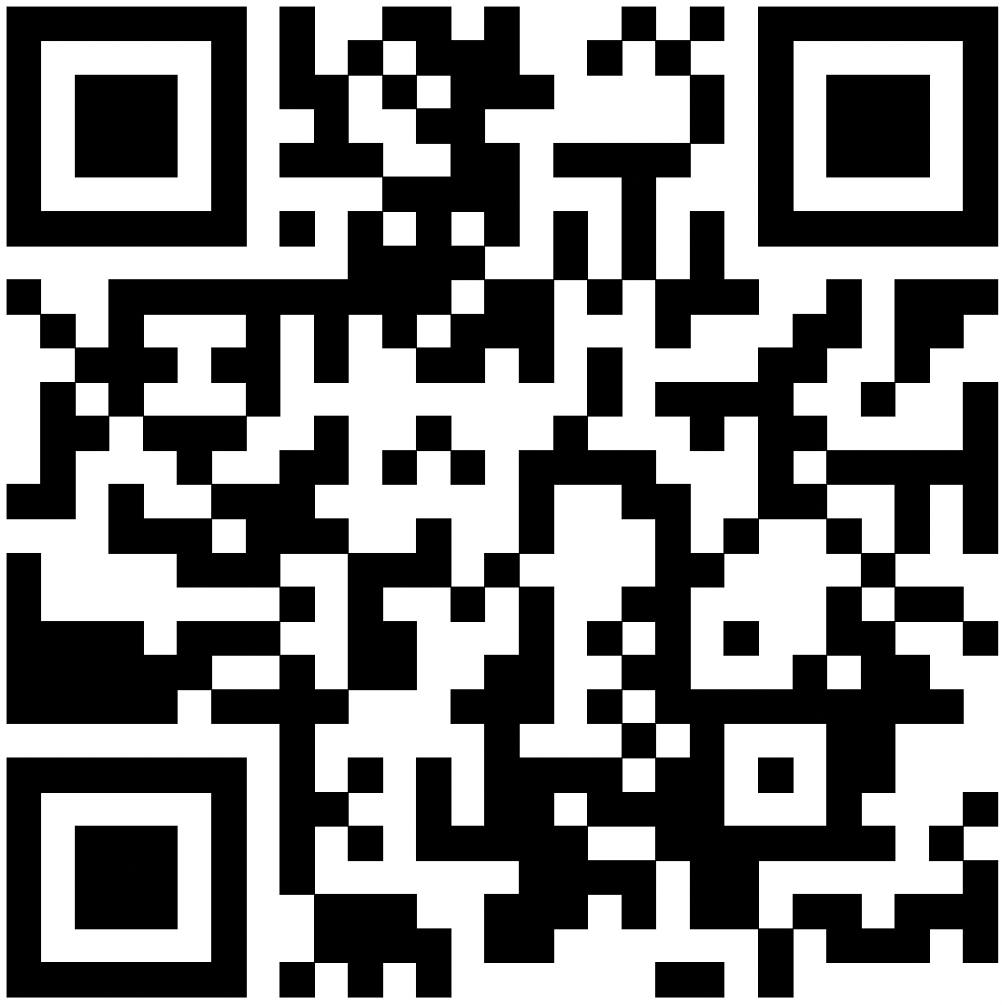
Evaluation Form
Link: https://lms.mghcme.org/BuildingSolutions

Slide 41
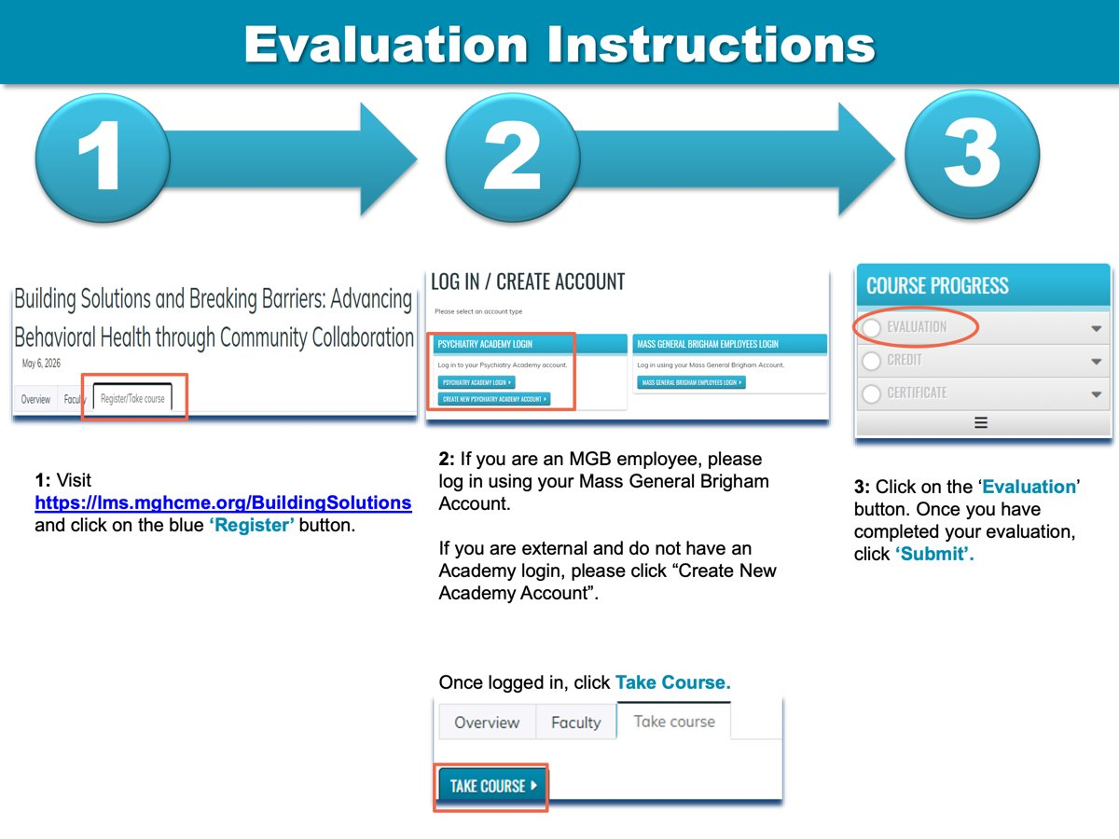
Evaluation instructions

Slide 42

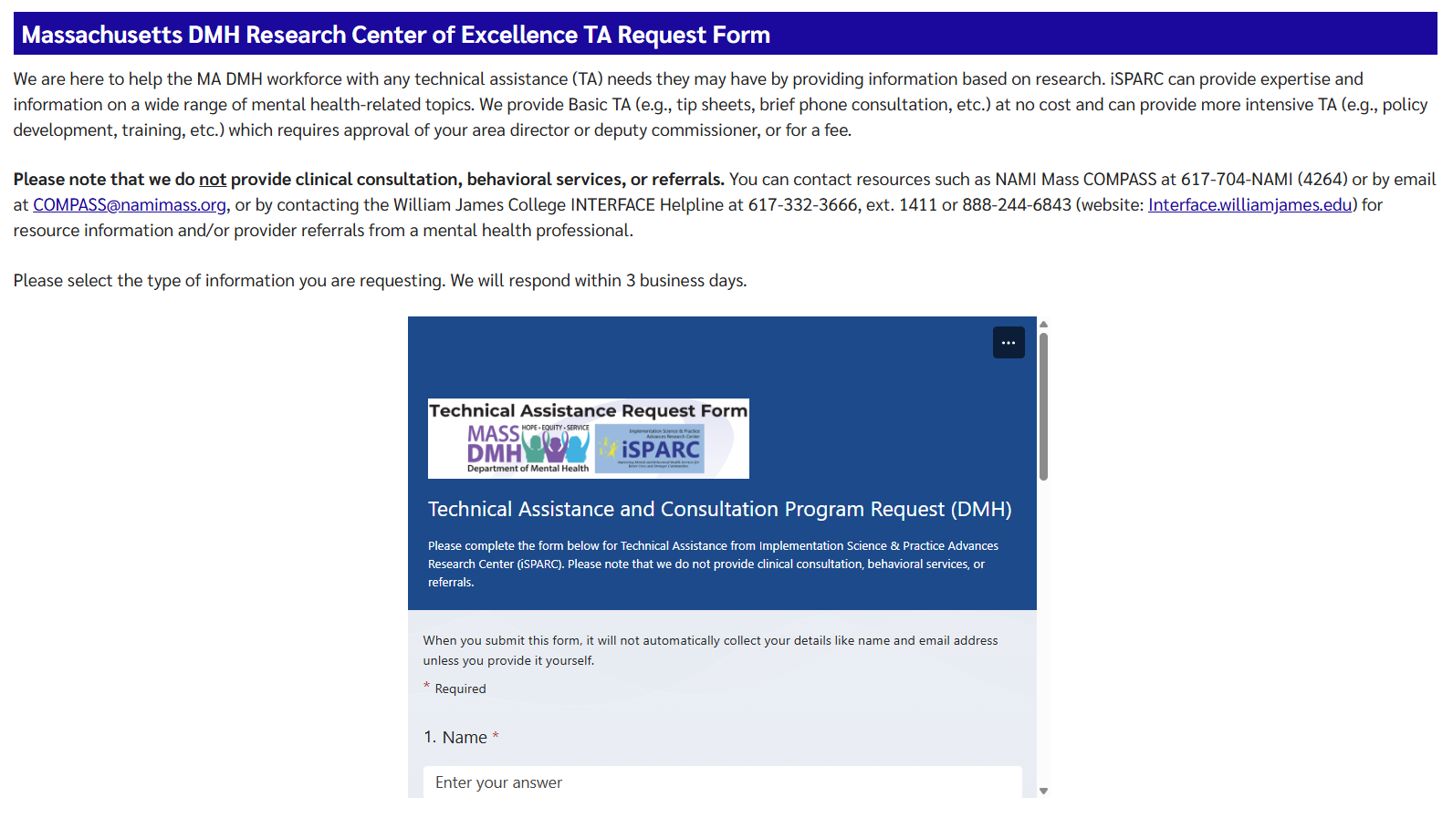
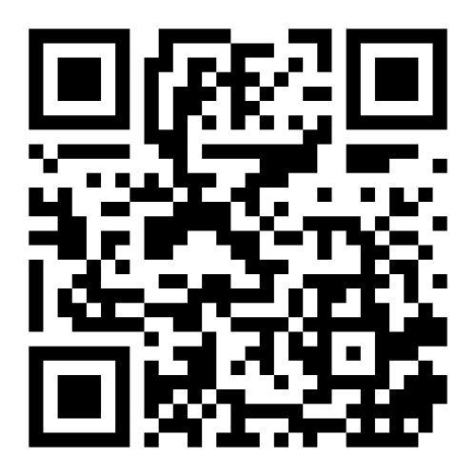
iSPARC Technical Assistance Program www.umassmed.edu/sparc/sparc-ta/

Slide 43
Thank you for attending!

