Slide 1
Building Solutions and Breaking Barriers: Advancing Behavioral Health Through Community Collaborations
2026 Annual Conference of the DMH Research Centers of Excellence
Month YEAR
May 6, 2026

Slide 2
Disclosures
Cori Cather​, PhD
  Consultant:​
    NAVIGATE Consultants​
  Co-Investigator on a NIH-SBIR Grant:​
    Charles River Analytics​
  Trainer:​
    Amae Health​

Slide 3
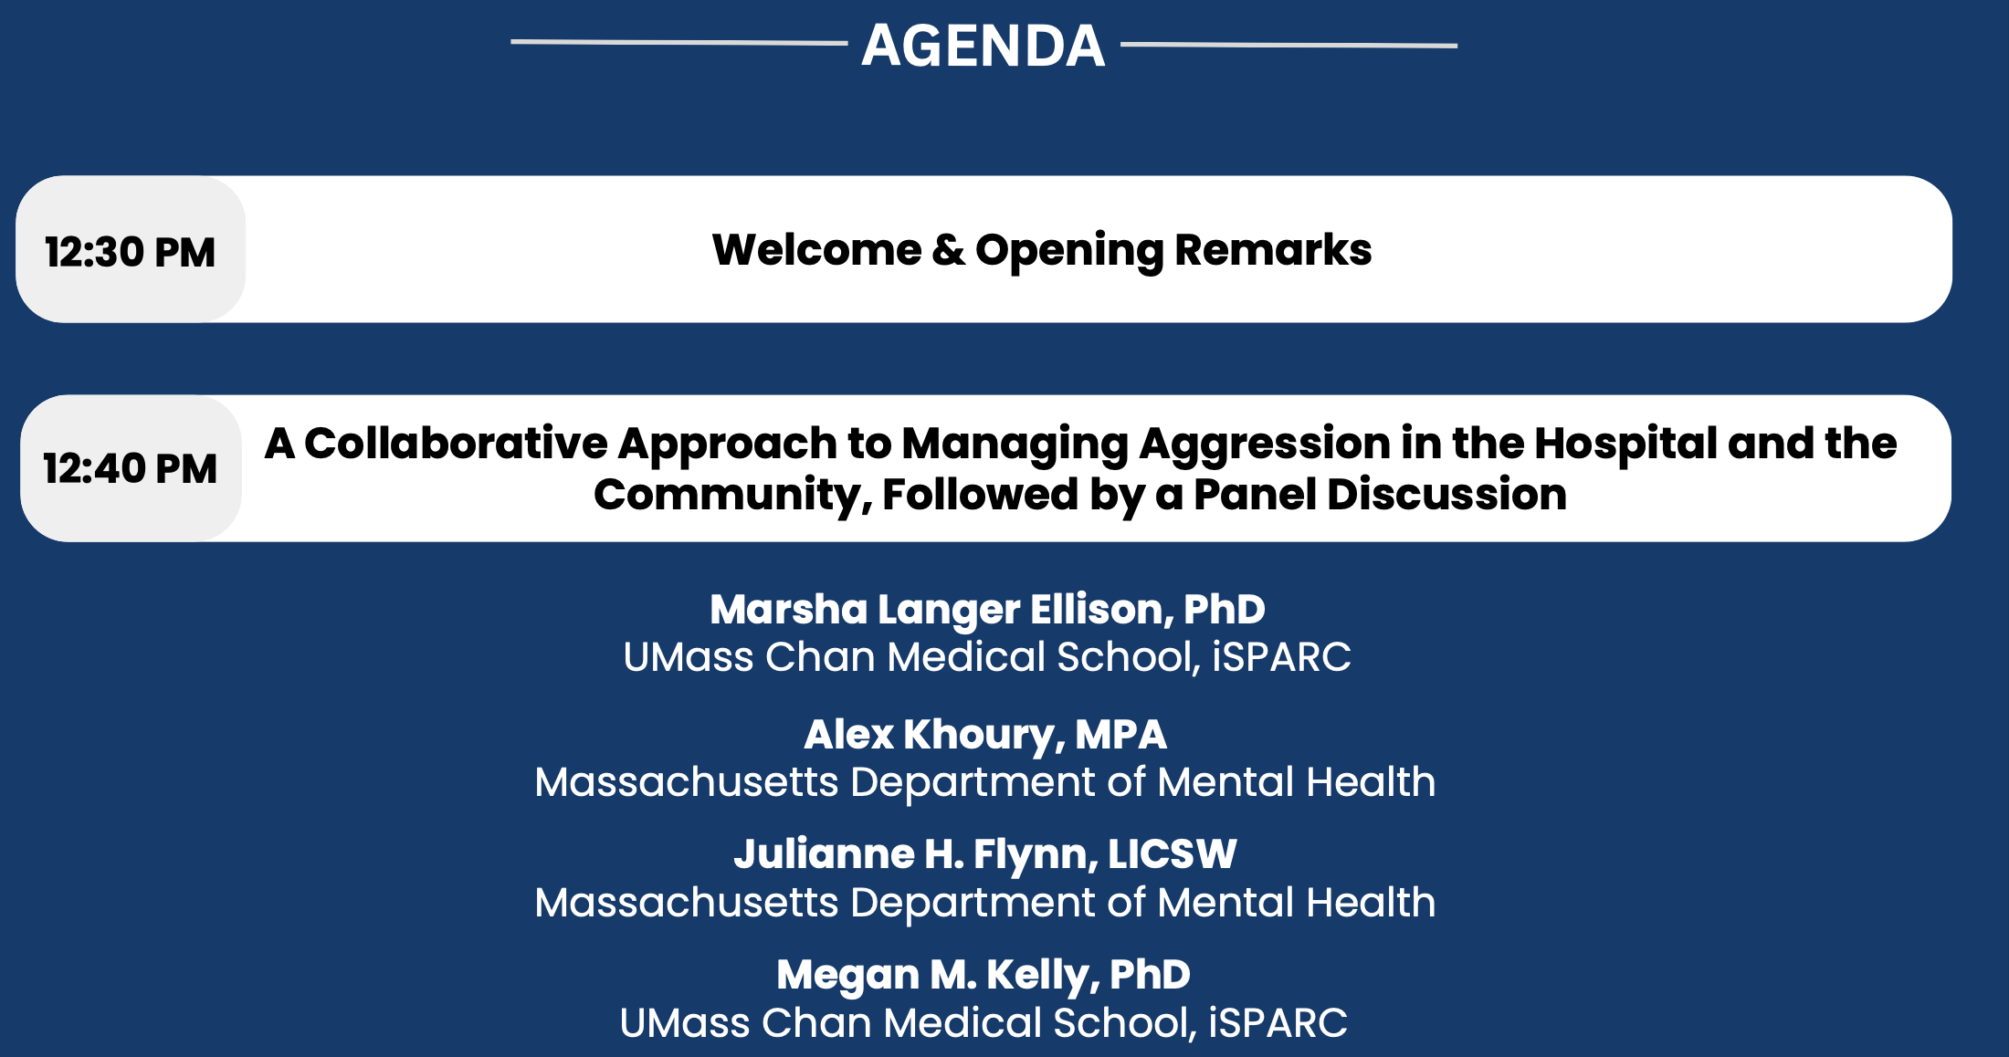
Agenda

Slide 4
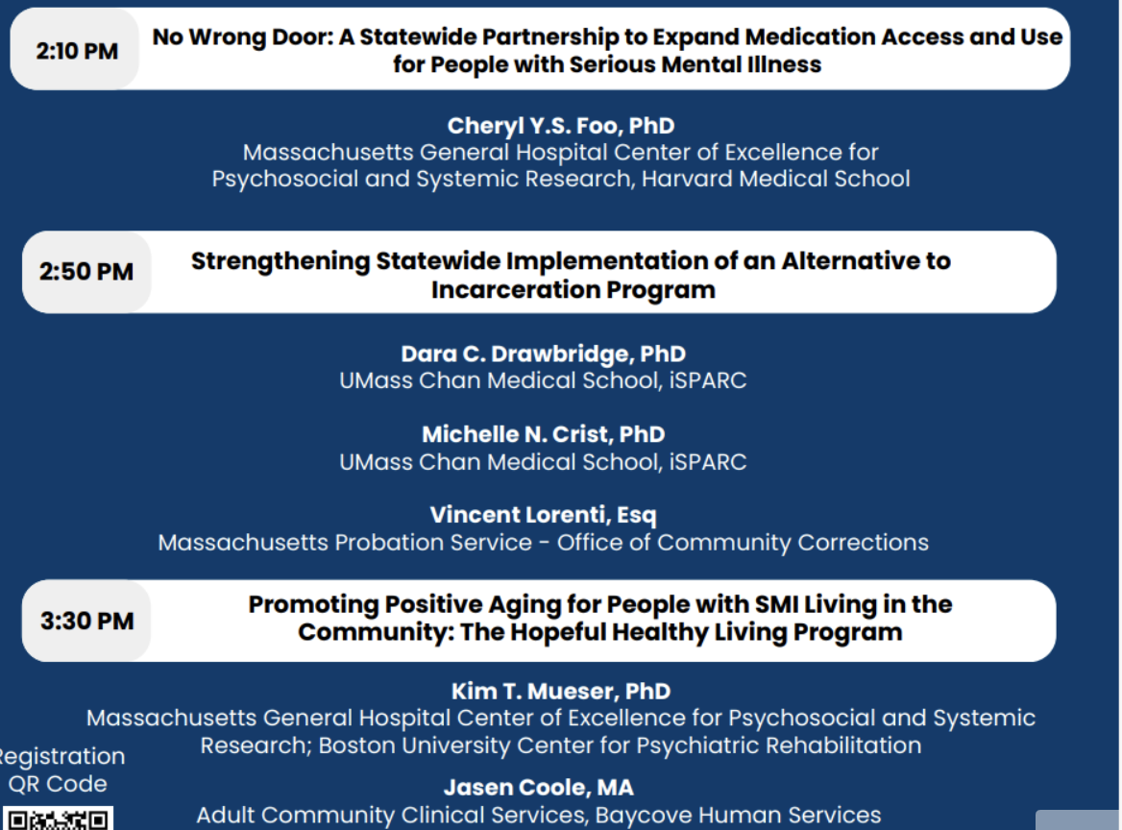
Agenda cont.’d

Slide 5
Continuing Education Units (CEUs)
CEUs are being offered for:
  Psychologists
  Nurses
  Social Workers
  Occupational Therapists
  Licensed Mental Health Counselors
Email dmh-ceap@mass.gov with any CEU questions/concerns.

Slide 6
Continuing Education Units (CEUs)
To receive continuing education credits for this event, participants MUST:
  Join the conference on Zoom with your full name displayed (individuals who only join by phone will not be eligible to receive CEUs).
  Attend the entire program.
  Complete an evaluation upon the conclusion of the program.
Link and a QR code to the evaluation will be shared near the end of the conference.

Slide 7
Continuing Medical Education (CME)
CME Accreditation Statement: The University of Massachusetts Chan Medical School is accredited by the Accreditation Council for Continuing Medical Education to provide continuing medical education for physicians.
Designation Statement: The University of Massachusetts Chan Medical School designates this live activity for a maximum of 4 AMA PRA Category 1 Credit(s)™. Physicians should claim only credit commensurate with the extent of their participation in the activity.
To receive continuing education credits for this event, participants MUST:
  Join the conference on Zoom with your full name (individuals who only join by phone will not be eligible to receive CEUs).
  Attend the entire program.
  Complete an evaluation upon the conclusion of the program.
Link and a QR code to the evaluation will be shared near the end of the conference.
For all CME certificate inquiries, please email continuing.education@umassmed.edu.

Slide 8


No Wrong Door: A Statewide Partnership to Expand Medication Access and Use for People with Serious Mental Illness
Cheryl Y. S. Foo, PhD
Associate Director, Center of Excellence for Psychosocial and Systemic Research
Director of Family Services, First Episode and Early Psychosis Program
Massachusetts General Hospital
Assistant Professor of Psychology, Harvard Medical School
Department of Mental Health Research Centers of Excellence Annual Conference
May 6, 2026

Slide 9
SMI-REACH Coalition Members
SMI-REACH: Expanding Serious Mental Illness Treatment Reach through Research, Education, Access, and Community Health Partnerships
Behavioral Health Organization and Agency Partners
CBHC CMOs, Directors, Providers, and Exec. Leadership
MassHealth Office of Behavioral Health
Department of Mental Health (DMH)
Department of Public Health (DPH): Bureau of Substance Addiction Services (BSAS), Bureau of Health Professions Licensure, Bureau of Health Care Safety and Quality
Massachusetts Behavioral Health Partnership (MBHP): CBHC Network and Massachusetts Behavioral Health Help Line
Association of Behavioral Healthcare
Massachusetts Pharmacists Association
Key Leadership & Steering Committee
Dr. Amam Saleh, DMH Deputy Commissioner
Dr. Jessica Zeidman, DPH Deputy Commissioner
Dr. Lee Robinson, MassHealth Associate Chief for Behavioral Health
Donna Frates, LICSW, Director of CBHC Programs, MBHP
Deirdre Calvert, MSW LICSW, BSAS Director
Kevin Beagan, Deputy Commissioner of Health Care Access Bureau, Division of Insurance
Dr. Margaret Guyer-Deason, DMH Director of Workforce Development
Christine Goldrick, DMH Senior Director of Strategy
Dr. David Hoffman, DMH Metro Boston Area Medical Director
Dr. Michael Angelini, Professor of Pharmacy Practice, MCPHS University
Dr. Ryann Abrams, MA Pharmacists Association President
Sarah MacLaurin, PMHNP-BC, Associate Medical Director Freedom Trail Clinic of North Suffolk Community Services
Dr. Cori Cather, MGB Public and Community Psychiatry Division Chief
Dr. Cheryl Foo (Lead Facilitator), Associate Director of MGH Center of Excellence for Psychosocial and Systemic Research
MGH SMI-REACH
Work Group
Abigail Donovan, MD
Alex Keuroghlian, MD
Carol Lim, MD, MPH
Cheryl Foo, PhD
Cori Cather, PhD
Collin O’Neill
Eden Evins, MD, MPH
Kim Mueser, PhD
Oliver Freudenreich, MD
Samuel Kohrman, MD
Sarah MacLaurin, PMHNP-BC
Thao Le, MD, PhD
Amir Hassan, MD
Ashlee Guzman, MD
David Coelho, MD

Slide 10

Preventing Relapse with Long-Acting Psychiatric Medications
THE EVIDENCE-TO-PRACTICE GAP
People with serious mental illness and substance use disorders experience multiple hospitalizations and are at risk for early mortality
Medication is first-line treatment, but accessing and adhering to it is difficult
Schizophrenia spectrum disorders: Antipsychotics
Opioid use disorder: Naltrexone (Vivitrol), Buprenorphine (Sublocade, Brixadi), Methadone
Alcohol use disorder: Naltrexone (Vivitrol), Disulfiram (Antabuse), Acamprosate (Campral)
Poor adherence is the leading, preventable cause of relapse/hospitalizations
1 in 3 schizophrenia-related hospitalizations are due to antipsychotic nonadherence
Over $100M/year in inpatient costs
Lacro et al., J Clin Psych 2002; Marcus & Olfson, Schiz Bull 2007
Presented by Foo CYS, 2026
Notes:
4% with schizophrenia or bipolar disorder; 8% AUD; 6% OUD of 7million Massachusetts population
But contribute to 1 in 8 ED visits and >30% of frequent psychiatric hospitalizations
>1500 opioid-related and >1500 alcohol related disorders
40-60 % of patients with psychotic disorders have poor medication adherence, even more for SUD
37% schizophrenia-related hospital admissions are attributable to antipsychotic nonadherence
For those with AUD or OUD, nonadherence contributes to recurrent substance use. elevated health risks, including higher likelihood of overdose, complications from illicit drug use and untreated comorbidities. Medication adherence reduces inpatient addiction treatment and acute care usage by as much as 25% while also boosting outpatient engagement.
Decades of research have demonstrated the life- changing potential of long-acting medications (LAMs) to prevent relapse, reduce hospitalizations and improve long-term outcomes.

Slide 11
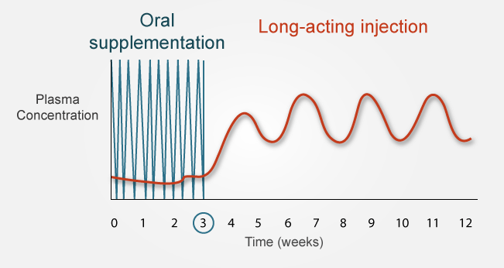
Preventing Relapse with Long-Acting Psychiatric Medications
THE EVIDENCE-TO-PRACTICE GAP
Long-acting antipsychotics superior to pills:
Medication discontinuation ↓ 67%
Hospitalization ↓ 30%-45%
Relapse ↓ 20%-30%
All-cause mortality ↓ 30%
Suicide ↓ 50%
Work disability ↓ 30%
Long-acting naltrexone and buprenorphine show greater treatment persistence and lower healthcare utilization (↓ 13-25%) vs. oral forms
Rubio et al., Schiz Bull 2021; Kishimoto et al., Lancet Psych 2021; Solmi et al., Am J Psych 2022; Taipale et al., World Psych 2020;
Elmosalamy et al. Drug Alcohol Depend 2025; Mark et al., Am J Managed Care 2010; Lee et al., JAMA Netw Open 2021
Presented by Foo CYS, 2026
Notes:
Relapses are preventable, and long-acting medication is a proven solution
Reduce burden of taking pills daily and ensure consistent medication levels in bloodstream
LAMs can help address adherence by ensuring consistent medication levels and reducing the burden of taking pills daily.
Main mechanism for relapse prevention: facilitating medication adherence, allows for stable medication levels and slightly longer grace period, ability to detect missed doses and intervene early
Other benefits: reducing family stress and caregiver burden; downstream effects on healthcare costs
While research on LAMs for OUDs and AUDS is less extensive than research on LAMs for psychotic disorders, we can see clear parallels in the challenges of nonadherence and poor retention. On the whole medications to treat Aud and Oud are underprescribed.
Extended-release naltrexone has demonstrated superior adherence compared to oral AUD medications, leading to better long-term treatment success (Hartung et al., 2014). Other research indicates that extended- release naltrexone reduces health care utilization by 13%-25% compared to oral medications (Mark et al., 2010).
.

Slide 12
Underutilization of Long-Acting Psychiatric Medications
THE EVIDENCE-TO-PRACTICE GAP
U.S. Average Use Rate
(Medicaid, 2018)
National Benchmark
(National Council for Mental Wellbeing, 2025)
Long-Acting Antipsychotic
for schizophrenia spectrum disorders
13%
(4%-26%)
30%
Long-Acting Naltrexone
for alcohol/opioid use disorder
4%
10%
Long-Acting Buprenorphine
for opioid use disorder
10%
Patel et al. J Med Econ 2022; National Council for Mental Wellbeing, 2025
Presented by Foo CYS, 2026
Notes:
The rate is even lower for early-phase illness --- has not been used as first-line treatment.
From J&J sponsored market research, 620 pt charts collected from 161 healthcare providers from Aug – Sept 2016.
Findings: On average, patients are prescribed 4 different oral antipsychotic medications before initiating their first LAI antipsychotic. Even though the average age of onset of schizophrenia is ~18-30 years, respectively, the average age of LAI initiation is not until 38 years.

Slide 13
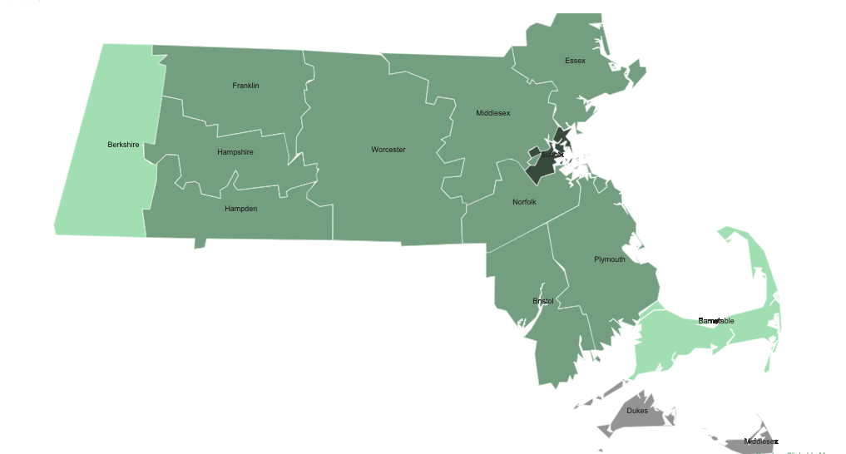
Underutilization of Long-Acting Antipsychotic Medication in Massachusetts
THE EVIDENCE-TO-PRACTICE GAP
Average LA-AP use
<5%
5%-9%
10%-14%
2018 Massachusetts Medicaid Data (N=25,127)
Age: 50.1 ± 15.4 years; 60% male; 43% white; 10% Black
Average Long-Acting Antipsychotic Use: 7%
Data from Patel et al., J Med Econ 2022
Map created and presented by Foo CYS, 2026
Notes:
The rate is even lower for early-phase illness --- has not been used as first-line treatment.
From J&J sponsored market research, 620 pt charts collected from 161 healthcare providers from Aug – Sept 2016.
Findings: On average, patients are prescribed 4 different oral antipsychotic medications before initiating their first LAI antipsychotic. Even though the average age of onset of schizophrenia is ~18-30 years, respectively, the average age of LAI initiation is not until 38 years.

Slide 14
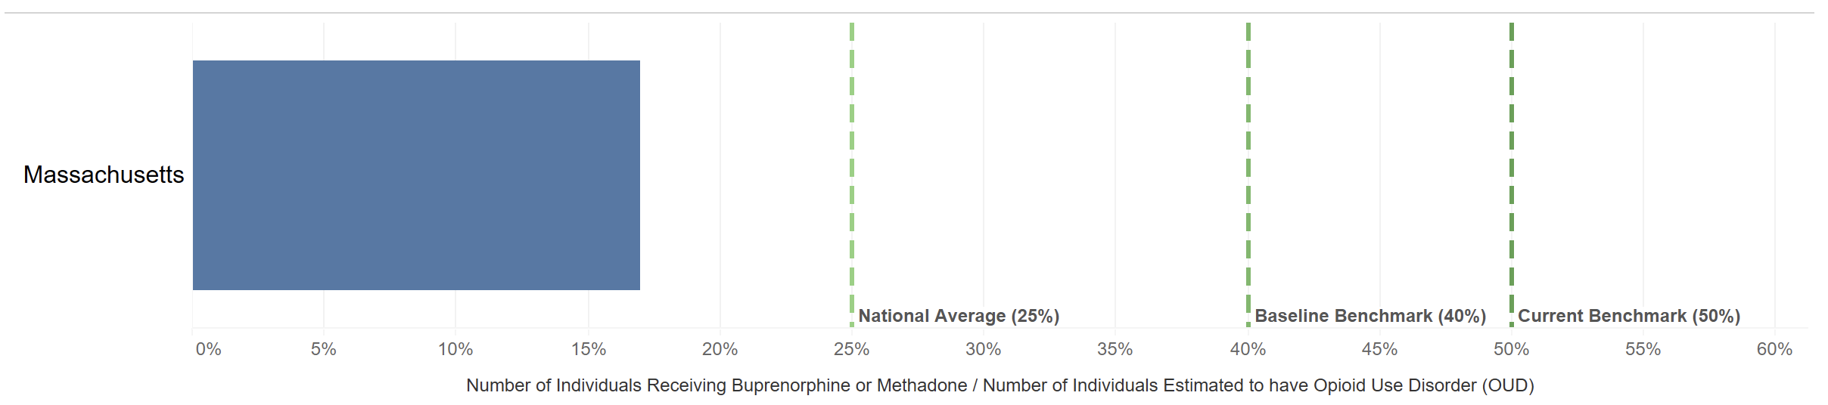
Underutilization of Medication for Opioid Use Disorder in Massachusetts
THE EVIDENCE-TO-PRACTICE GAP
In 2024, approximately 17% of individuals in MA with Opioid Use Disorder received buprenorphine or methadone, below the 25% national average and 50% recommended benchmark.
Baseline benchmark (40%)
Current benchmark (50%)
National Average (25%)
Presented by Foo CYS, 2026
Data and figure from Massachusetts Bureau of Substance Addiction Services Dashboard, 2026
Notes:
The rate is even lower for early-phase illness --- has not been used as first-line treatment.
From J&J sponsored market research, 620 pt charts collected from 161 healthcare providers from Aug – Sept 2016.
Findings: On average, patients are prescribed 4 different oral antipsychotic medications before initiating their first LAI antipsychotic. Even though the average age of onset of schizophrenia is ~18-30 years, respectively, the average age of LAI initiation is not until 38 years.
https://datavisualization.dph.mass.gov/views/BSAS_Dashboard_Phase_3_Community_Profile/CP_Data_to_Action?%3Aembed=y&%3Alinktarget=_self&Select%20Community%20Detail=State%20of%20Massachusetts&Town%20List=Boston&County%20List=Suffolk%20County

Slide 15
Underutilization of Long-Acting Medications for Addiction Treatment in Massachusetts
THE EVIDENCE-TO-PRACTICE GAP
MA Substance Use Treatment Facilities
(N=438, 2019)
Data from SAMHSA, 2022
Presented by Foo CYS, 2026

Slide 16
Multilevel Barriers → Innovative Solutions
THE EVIDENCE-TO-PRACTICE GAP
PATIENT
PROVIDER
SYSTEM
Lack of awareness or education about LAM treatment
Concerns about injection pain and side effects
Stigma or negative perceptions about injectable medications
Illness-related and SDOH factors compromising adherence
Severity/adherence-dependent prescribing norms
Perceived patient refusal and challenging conversation
Limited knowledge or training on LAM administration
Limited community sites with administration capabilities
Cost, reimbursement, insurance coverage gaps
Fragmented care systems and poor care coordination (e.g., inpatient-to-outpatient)
90% accept when offered
Presented by Foo CYS, 2026
Carroll et al., Front Health Serv 2024; Velligan et al., BMC Psych 2025; Weiden et al., J Clin Psych 2015; Kane et al., J Clin Psych 2019
Notes:
Sense of coerceiveness, mistrust of medical professionals due to illness, mistrust of medical proffessionals due to history/recent experiences (Jimmy & Jose, 2011); I’llness-related factors like lack of insight and substance use
Providers therefore are not having that conversation and offering LAIs
Licensing and regulation hurdles
Clinic capacity: staffing, infrastructure, clinical workflow
Systemic barriers are the rate-limiting factor

Slide 17



Improving Access to and Use of Long-Acting Psychiatric Medications in Massachusetts
IMPLEMENTATION SCIENCE APPROACH
PRE-IMPLEMENTATION
Data to Knowledge
IMPLEMENTATION
Knowledge to Practice
Phase 1
Phase 2
Phase 3
ENGAGE & MOBILIZE STAKEHOLDERS
PREPARE FOR IMPLEMENTATION
DEVELOP, TAILOR, & EVALUATE SOLUTIONS
Build a system-wide coalition for impactful and sustained change
Create a Massachusetts Strategic Plan
Develop and pilot scalable strategies targeted to address multilevel barriers
Presented by Foo CYS, 2026
Foo et al., 2026 [Poster]
Notes:
Organized into a three-phase, implementation science-guided approach for improving access to and use of evidence-based pharmacotherapies in Massachusetts’ community care settings.
theory-based approach -- Guided by: Learning Health System Knowledge to Action Framework and ERIC (Expert Recommendations for Implementing Change) Strategies
Processes and strategies are designed for feasibility and sustainability through stakeholder engagement, participatory co-design, and assessing fit to different contexts.

Slide 18
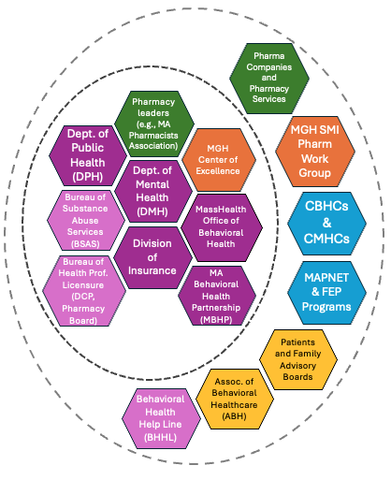
Building a System-Wide Coalition for Impact
PHASE 1: ENGAGING AND MOBILIZING STAKEHOLDERS
SMI-REACH: Expanding Serious Mental Illness Treatment Reach through Research, Education, Access, and Community Health Partnerships
“If you want to go far, go together.”
Cross-agency and multidisciplinary collaboration with champions
Presentations and discussions with CBHC CMOs and providers
Monthly Steering Committee and Quarterly Leadership Meetings for cross-agency strategic alignment
Monthly Work Group on research/academic outputs
Shared Commitment and Coordinated Action:
No Wrong Door to Life-Saving Treatment
Presented by Foo CYS, 2026
Foo et al., 2025 [Poster]
Notes:
Impactful and sustained change
Practice pearls for “developing stakeholder relationships”
ERIC Strategies to Develop Stakeholder Relationships:
• Build a coalition • Promote network weaving • Conduct local consensus discussion • Develop academic partnerships • Obtain formal commitments
• Use advisory boards and workgroups
STRUCTURE, PROCESS, & LESSONS
To date we have built a cross-sector coalition that includes leadership, representatives, and champions from state agencies, community behavioral health centers (CBHCs), and multidisciplinary clinical and research experts, aligned on the goal of ensuring ”no wrong door to life-saving treatments”.
Broad spectrum of stakeholders: policy, psychiatry, pharmacy, nursing, academic, advocacy, for-profit
Mission-critical, high-priority goals/interest – really about treatment access and better patient care, even aligned with for-profit pharmaceutical companies
Life-saving treatments – including LAI MAUD and MOUD (naltrexone, buprenorphine) and clozapine
Formal commitment from key agencies: MassHealth, DMH, DPH, and MBHP
Consensus on priority focus
Generate interest and buyin, building trust
Making sure every part understands its purpose within the network/group, serves both personal motivations and organizational aspirations
Building relationships take time, more people you involved, things go at a slower pace
“Deliberate process, emergent results.”
Vs. A priori protocol, hypothesis-driven research --> deliberate process /strategy /approach, but flexible and open enough to let the group and results guide you --- PROCESS OF DISCOVERY AND LEARNING
Approach that everyone has expertise, experience, and knowledge; (I’m not coming in with the ”right answer” or “right way” of doing things) – humility that I don’t know, that you have wisdom and I want to learn from you, that we can learn from each other, share knowledge and resources – not adding demands (not an additional KPI to meet), but helping you do the work you want to do easier. Reminded that, lead with the basic assumption, and inspire that: People want to do their best work (things bigger than your individual control gets in the way like system-level barriers), so let us help make it easier to do the work you want to do).
Shared commitment, priority goal, collective/coordinated action towards –
People want to do their best work, our job is to be create the conditions for the best care/work to happen. Not an additional demand, ”how can I make things easier for you”.
Plan the path but let people redraw it

Slide 19











Building a System-Wide Coalition for Impact
PHASE 1: ENGAGING AND MOBILIZING STAKEHOLDERS
DPH, Bureau of Health Professions Licensure
- Drug Control Program
- Board of Registration in Pharmacy
DPH, Bureau of Health Care Safety and Quality
Presented by Foo CYS, 2026

Slide 20


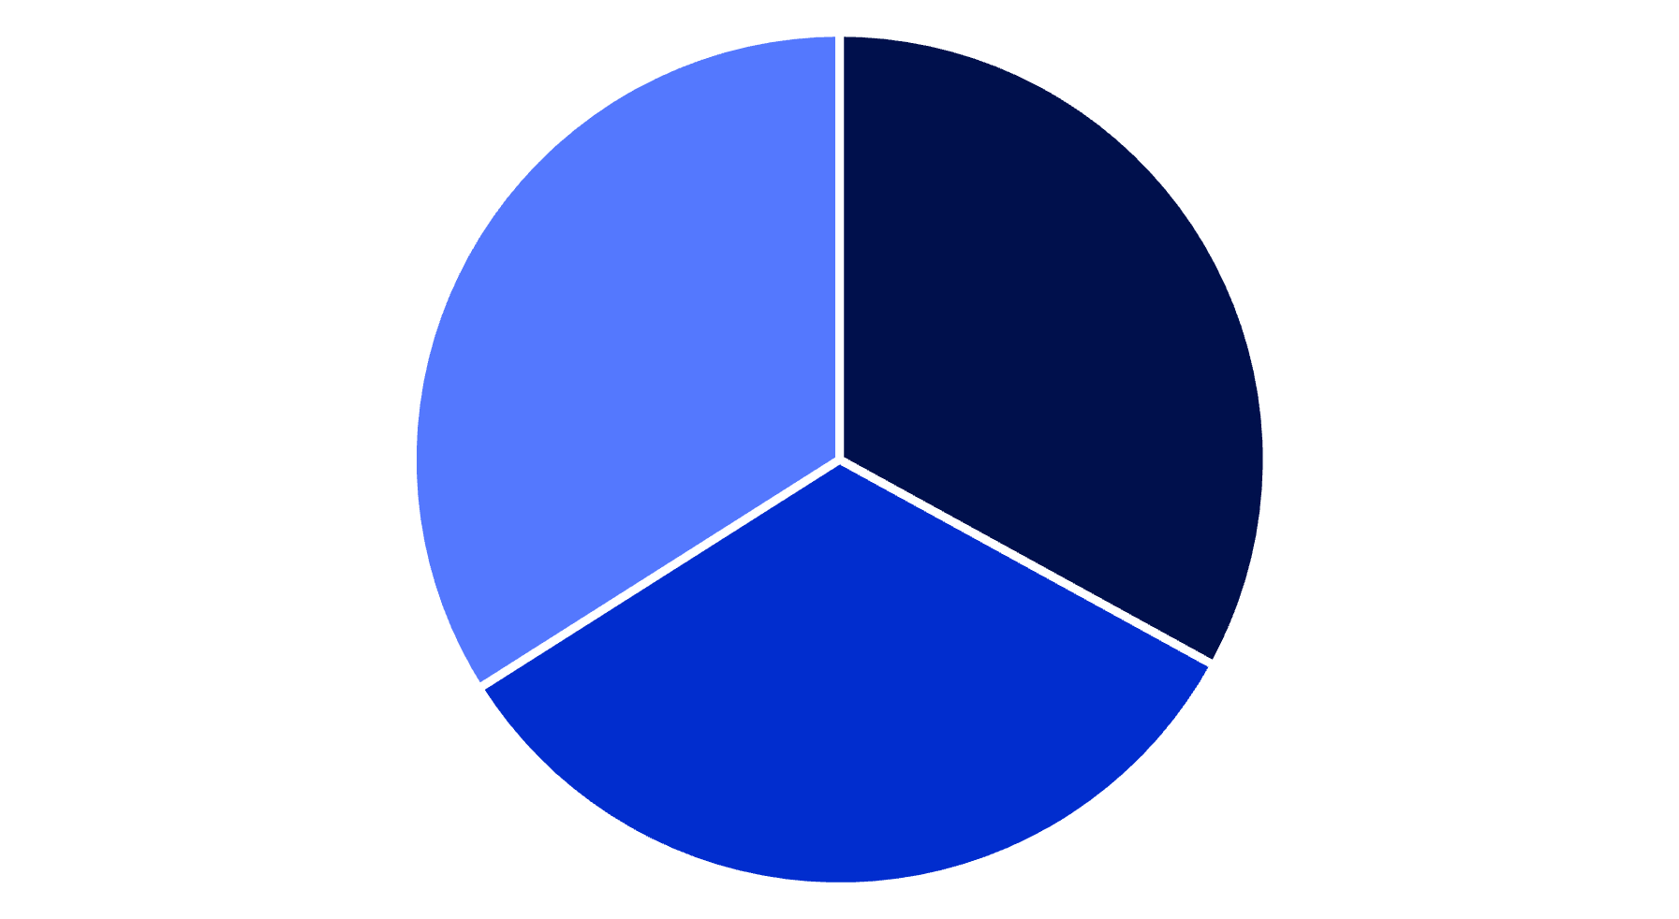



Ensuring No Wrong Door
Across the Care Continuum
GOALS
Psychiatric Inpatient Hospitals
CBHCs
Equitable and sustained availability and access
Emergency Room/Urgent Care
Outpatient MH Clinics
Improve provider knowledge
and confidence
LA-AP
LA-Nalt
Mobile Crisis/ACT
Teams
LA-Bup
Specialized Outpatient Treatment Programs (e.g., FEP)
Enhance implementation of
best practices
Group Homes/Street Teams
Behavioral Health Pharmacies
Improve patient outcomes with the use of effective treatments
Presented by Foo CYS, 2026

Slide 21





Towards a Strategic Plan for Expanding Access and Use of Long-Acting Medication for SMI in Massachusetts CBHCs
PHASE 2: PREPARE FOR IMPLEMENTATION
STRATEGIC PLANNING
LANDSCAPE ANALYSIS
To understand multi-level contextual factors that influence long-acting medication use
CBHC Clinic-Level Survey and Listening Tours
Statewide Summit and Strategic
Planning
Understand current practice needs, challenges, and effective workflows
Establishing Baseline Medication Use Rates
Patient & Family Interviews
Barrier prioritization and strategy selection to develop multi-year strategic plan with stakeholder input
Evidence, Regulatory, and Policy Analysis
Presented by Foo CYS, 2026
Notes:
Systematic Literature Review on interventions and implementation strategies for long-acting antipsychotic medication initiation and continuation
Identify feasible, evidence- and practice-informed improvements to licensing, practice regulations, and insurance barriers through dialogue with state agencies
STAKEHOLDER/COMMUNITY-ENGAGED throughout
Processes and strategies are designed for feasibility and sustainability through stakeholder engagement, participatory co-design, and assessing fit to different contexts
Landscape analysis: needs, readiness, implementation determinants assessment
Strategic plan development
Understand patient and caregiver perspectives on their treatment experiences and preferences
Establish baseline performance and quality monitoring protocol
Conduct regulatory and policy analysis around licensing, practice regulations, insurance barriers to identify feasible policy-level changes

Slide 22
Preliminary Findings from Landscape Analysis
Clinic Survey with 29 CBHCs

Slide 23
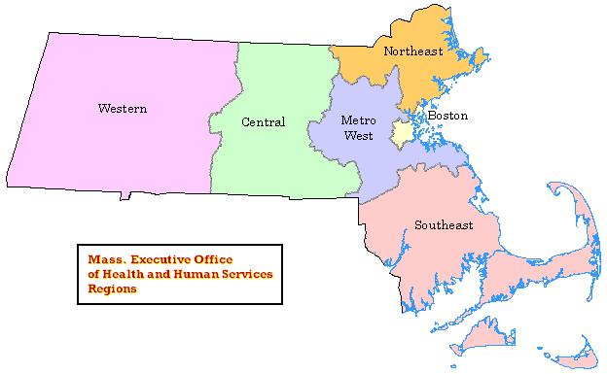
Map of Massachusetts Community Behavioral Health Centers (CBHCs)
Participating Clinic
Planned Clinic Transfer; did not participate
Northeast
Western
Central
Metro Boston
Metro
West
Southeast
All CBHC Leaders were highly committed to expanding access and use of long-acting psychiatric medications in the next year
Map created and presented by Foo CYS, 2026
Notes:
• Median est. patient volume at each site: 2500-5000 individuals last year (range: 1000-2500 to ≥10,000 individuaals)
- Median est. % of individuals on public insurance: 80-100% (More than 80% of sites [24/29[ serve predominantly publicly insured populations: ≥60%)
- 3.9/4 for LAI-AP; 3.8/4 for LAI-MAT (average)

Slide 24
Prescribing Capability of Long-Acting Medications in Massachusetts CBHCs
PHASE 2: LANDSCAPE ANALYSIS
90% prescribe
86% prescribe
66% prescribe
Ability to Prescribe Follows Access
Lack of onsite administration capability and workflows was top reason for infrequent or no prescribing of all long-acting medications.
Presented by Foo CYS, 2026
Notes:
Characterizing capability etc.
Highlight for buprenorphine – low capability sites report <5% actual pt volume need. But may not be detecting and treating properly.
Access drives prescribing gaps – over patient and provider reasons/barriers.
> Licensing reform (DPH Medical designation) highest leverage to clos practice/prescribing gap
All 5 sites with infrequent or no long-acting antipsychotic prescribing cited lack of onsite administration capability and workflows as the main barrier to routine prescribing. 9/20 sites with infrequent or no long-acting MAT prescribing reported main reason as lack of onsite administration capability and workflows.

Slide 25
Administration Capability of Long-Acting Medications in Massachusetts CBHCs
PHASE 2: LANDSCAPE ANALYSIS
66%
administer onsite
62%
administer onsite
45%
administer onsite
Presented by Foo CYS, 2026
Notes:
AP: Only 10 (34%) store AND administer onsite. Only 7 sites (24%) store and administer both LAI-Bup and LAI-Nalt.
AP: Most sites used a combination of referral pathways, typically through VNA (6), group living environments (5), or through other hospital outpatient clinics, injection clinics, or other CBHCs (5). Other less frequent pathways included administration at specialized pharmacies or patient’s PCP
MAT: 11 sites (38%) have no onsite LAI-MAT storage or administration and typically refer to OTP/Methadone/OBAT clinics or other hospitals/FQHCs; among them, 3 did not have any established pathways for referrals.
13 CBHCs refer patients externally for LAI-Bup (vs 7 for LAI-AP). External pathways: OTP / methadone / OBAT clinics, other hospitals, FQHCs.
The same 3 CBHCs report no onsite administration AND no established referral pathway for LAI-AP, LAI-Nalt, or LAI-Bup — patients in these catchments face the steepest access barriers.
Only 24% of CBHCs store AND administer LAI-Bup onsite (vs 34% for LAI-AP). The biggest LAI-Bup workflow is external referral (45% of sites) — pointing to storage/licensing as the primary lever.

Slide 26
Long-Acting Medication Implementation Profiles and Support Needs Across CBHCs
PHASE 2: LANDSCAPE ANALYSIS
Prescribe
A
Fully Ready: Sustain
High capability for all LAM
6 (21%)
B
Capable: Optimize
Asymmetric capability or onsite administration w/o storage for all LAM
8 (28%)
Administer
Store
C
Scaling Capability: Targeted
Onsite administration for LA-antipsychotic, with challenges for LA-Buprenorphine and LA-Naltrexone
5 (17%)
Antipsychotic
D
Developing Capability: Build
Prescribe with external administration pathways for most LAM
6 (21%)
Buprenorphine
Naltrexone
E
Initiating Capability: Foundation
Establishing prescribing and administration workflows
4 (14%)
Presented by Foo CYS, 2026
Notes:
How it looks when you drop sites with <5% Pt Volume – signal for underserving
SES of different regions?
READINESS TO SERVE score? Needs dimension
Tier 5: Capability limited by lack of access
Pharmacy – related to size of practice? Co-location with pharmacy facilitates greater administration capability (to an extent) – but there are highly effective places doing it co-location and their methods need to be better understood
High capability without pharmacy – effective workarounds
Pharmacy collaborations as a low-hanging fruit (for Tiers 4 and 5) – a prominent strategy that has a lot of promise (segue into systematic review) – collaboration with pharmacy can bring in expertise

Slide 27
Regional Capability Pattern
PHASE 2: LANDSCAPE ANALYSIS
Northeast
Western
Central
Metro
West
Metro Boston
Southeast
Categories (Implementation Stage)
Western
Central & Metro-West
Metro Boston
Northeast
Southeast
n = 8
n = 4
n = 5
n = 4
n = 8
Fully Ready
2
3
1
1
2
1
Capable
3
Scaling
1
1
1
4
1
1
2
Developing
1
Initiating
3
1
Presented by Foo CYS, 2026
Notes:
Reflection of socio-economic factors?
Southeast concentrates access gaps; Western (cluster Tier 3)/Northeast is bimodal

Slide 28
Promising Facilitator: Pharmacy Collaboration
PHASE 2: LANDSCAPE ANALYSIS
Pharmacy Roles and Supports Provided
Navigating Prior Authorizations
Insurance and Benefits Verification
Applying for Patient Assistance Programs
Patient Care Coordination
Medication Storage
Medication Procurement and Delivery
Medication Administration
Provider Education and Consultation
62% (18) have a pharmacy partnership
41% (12) have a co-located pharmacy
Presented by Foo CYS, 2026
Notes:
How it looks when you drop sites with <5% Pt Volume – signal for underserving
SES of different regions?
Pharmacy – related to size of practice? Co-location with pharmacy facilitates greater administration capability (to an extent) – but there are highly effective places doing it co-location and their methods need to be better understood
High capability without pharmacy – effective strategies
Pharmacy collaborations as a low-hanging fruit (for Tiers 4 and 5) – a prominent strategy that has a lot of promise (segue into systematic review) – collaboration with pharmacy can bring in expertise

Slide 29
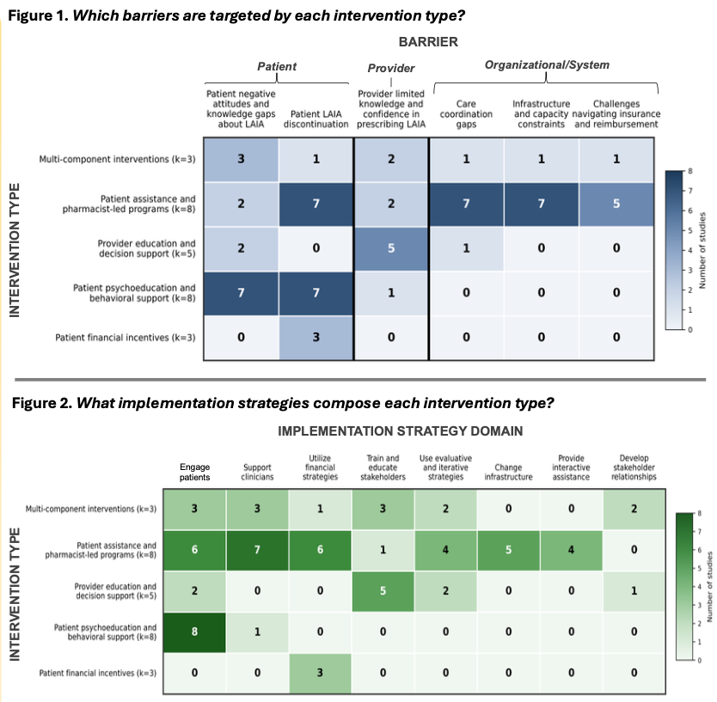
Promising Facilitator: Pharmacy Collaboration
PHASE 2: LANDSCAPE ANALYSIS
27 studies tested interventions designed to promote long-acting antipsychotic medication initiation and continuation
Pharmacist-led administration programs were most common (8 studies)
Pharmacists play a broad-based role in these comprehensive programs:
  Uniquely addressing barriers across patient, provider, and system levels
  Employed the broadest range of strategies to support uptake and adherence
Foo, Le et al., 2026 [Poster]
Presented by Foo CYS, 2026

Slide 30
Promising Facilitator: Pharmacy Collaboration
PHASE 2: LANDSCAPE ANALYSIS
Co-located pharmacy
Informal/Formal Partnerships with local pharmacies
No pharmacy partnership
A
Fully Ready: Sustain
High capability for all LAM
50%
—
50%
B
Capable: Optimize
Asymmetric capability or onsite administration w/o storage for all LAM
62.5%
25%
12.5%
C
Scaling Capability: Targeted
Onsite administration for LA-antipsychotic, with challenges for LA-Buprenorphine and LA-Naltrexone
80%
—
20%
D
Developing Capability: Build
Prescribe with external administration pathways for most LAM
—
80%
20%
E
Initiating Capability: Foundation
Establishing prescribing and administration workflows
—
—
100%
Presented by Foo CYS, 2026
Notes:
How it looks when you drop sites with <5% Pt Volume – signal for underserving
SES of different regions?
Pharmacy – related to size of practice? Co-location with pharmacy facilitates greater administration capability (to an extent) – but there are highly effective places doing it co-location and their methods need to be better understood. Suggesting forming these partnerships may be a strategic approach
High capability without pharmacy – effective strategies
Pharmacy collaborations as a low-hanging fruit (for Tiers 4 and 5) – a prominent strategy that has a lot of promise (segue into systematic review) – collaboration with pharmacy can bring in expertise

Slide 31
Significant Challenge: Inpatient-to-CBHC
Care Transitions
PHASE 2: LANDSCAPE ANALYSIS
Main Reasons Reported:
1
Patient difficulty continuing on long-acting medication during care transition
2
Prior Authorization and Insurance challenges
% of 29 CBHCs reporting significant inpatient–outpatient care transition challenges
Presented by Foo CYS, 2026

Slide 32
Top CBHC Needs Around Long-Acting Medications
PHASE 2: LANDSCAPE ANALYSIS
1
Reduce prior authorization, insurance coverage, and billing challenges
66%
2
Inpatient–outpatient care coordination protocols
57%
3
EHR / digital tools for tracking, reminders, and patient care coordination
52%
4
Funding for storage, equipment, and supplies to improve onsite administration
50%
5
More pathways to bill for long-acting medication administration/services
50%
6
Peer learning and resource-sharing with other CBHCs
47%
7
Quality improvement, technical assistance, and implementation supports
47%
8
Prescriber and nurse education and training
45%
9
Patient and family educational resources and decision aids
45%
Presented by Foo CYS, 2026
Notes:
Top 5: operational, regulatory supports > implementation and learning collaborative supports > provider and patient-facing education and tools
Indications of what we need to take action around

Slide 33
Lived Experience and Provider Perspectives
Disclosure and Acknowledgements
With permission from interviewees, audio and video recording were done using encrypted and HIPAA-compliant Zoom (zoom.us). I (Cheryl Y. S. Foo, PhD) acknowledge the use of Descript (descript.com) to help with transcribing, editing, generating images for, and captioning the video. Images generated of interviewees are not in their likeness, other than race, gender, and approximate age that interviewees provided permission to disclose. I selected all video/audio content, and reviewed and edited the final output. All prompts and outputs are available upon request.
This video will not be recorded and will not be accessible online beyond today’s presentation.
With permission from interviewees, this video may be used in future presentations by Cheryl Y. S. Foo, PhD.
Notes:
The data tells us where the gaps are. The people who live with them tell us why those gaps matter. Before we turn to what the coalition can do, let's hear from the people this work is for
Katie intro: I am a psychiatrist at Boston Healthcare for the Homeless Program in Mass General at VHHP. I'm on the street team, so I focus my clinical care on patients who live unsheltered through a combination of street outreach clinic sessions and home visits to patients once they're housed. And I also do research focused on homelessness and mental illness through MGH.

Slide 34
What We Heard: Some Reflections
VOICES FROM THE FIELD
1
2
3
“I wish I had known this sooner.”
Practice change can be simple, and can quickly spread
Access is important for patients, families, and providers
Opportunities for earlier offering (before struggles with adherence and hospitalizations) and discussing potential side effects and drawbacks
Presented by Foo CYS, 2026
Notes:
More to come from listening tours and patient/caregiver interviews
Proactive systematic offering – acceptance higher than expected, and practice spread quickly

Slide 35




Translating Insights into Action:
Strategies in Development
PHASE 3: DEVELOP, TAILOR, & EVALUATE SOLUTIONS
Statewide LA-AP Administration Site Directory
Whole-Team Training and Education
Training across psychiatry, psychology, nursing, and pharmacy on evidence-based prescribing, administration, and shared decision making
Licensing Roadmap and Supports
Clinic and Provider Toolkit
Guides for PA and applying for patient assistance programs
SOP for administration and clinic workflows
Decision aids and clinical decision support tools
Pharmacy Collaboration Pathways
Co-location models and easing of regulatory challenges for pharmacist-led administration of long-acting medications
Presented by Foo CYS, 2026
Notes:
for providers, patients, and families to feel equipped with making decisions about long-acting medication treatment
"What we heard from the survey, and what we heard in those voices, points us toward where the coalition needs to build. Implementation strategies and tools are in development — not finished. Each of these will be refined with service-user feedback and piloted in sites with higher implementation readiness. The same methods will extend to LAI-MAT and clozapine. Here's what's currently on the workbench."
The landscape analysis will surface additional ideas and priorities. We want to hear what would actually work in your setting.

Slide 36
Ensuring No Wrong Door to Life-Saving Medications for People with Serious Mental Illness
SUMMARY AND KEY TAKEAWAYS
We are beginning to measure, understand, and address the practice gaps that keep long-acting psychiatric medications hard to access in MA.
Strategies are being co-developed from the ground up.
A roadmap built on community-academic partnerships and engagement, implementation strategies, and data-driven quality improvement.
Multilevel barriers are addressed not with a single intervention – but with coordinated action through a cross-agency, multidisciplinary coalition.
Presented by Foo CYS, 2026
Notes:
Massachusetts now has the first statewide picture of where LAI access breaks down — and where it works.
Licensing, prior authorization, billing, care transitions, and clinical workflows sit across agencies, CBHCs, pharmacy partners, and payers. No one stakeholder can fix them alone.
with the people impacted: State agencies, CBHC leadership, providers, patients, and families are shaping each strategy from the ground up. Implementation will be piloted with sites that are ready, then refined and scaled.
Our approach offers a roadmap for bridging practice gaps in pharmacological treatments for serious mental illness — one that centers community-academic partnerships, evidence-based implementation strategies, and data-driven quality improvement.

Slide 37
Thank You!
Email: cfoo1@mgh.harvard.edu

Slide 38
REFERENCES
1. Lacro JP, Dunn LB, Dolder CR, Leckband SG, Jeste DV. Prevalence of and risk factors for medication nonadherence in patients with schizophrenia: a comprehensive review of recent literature. J Clin Psychiatry. 2002 Oct;63(10):892–909. doi:10.4088/jcp.v63n1007 PubMed PMID: 12416599.
2. Marcus SC, Olfson M. Outpatient Antipsychotic Treatment and Inpatient Costs of Schizophrenia. Schizophr Bull. 2007 Jun 19;34(1):173. doi:10.1093/schbul/sbm061 PubMed PMID: 17578893.
3. Rubio JM, Taipale H, Tanskanen A, Correll CU, Kane JM, Tiihonen J. Long-term Continuity of Antipsychotic Treatment for Schizophrenia: A Nationwide Study. Schizophr Bull. 2021 Oct 21;47(6):1611–20. doi:10.1093/schbul/sbab063 PubMed PMID: 34129663; PubMed Central PMCID: PMC8530382.
4. Kishimoto T, Hagi K, Kurokawa S, Kane JM, Correll CU. Long-acting injectable versus oral antipsychotics for the maintenance treatment of schizophrenia: a systematic review and comparative meta-analysis of randomised, cohort, and pre-post studies. Lancet Psychiatry. 2021 May;8(5):387–404. doi:10.1016/S2215-0366(21)00039-0 PubMed PMID: 33862018.
5. Solmi M, Taipale H, Holm M, Tanskanen A, Mittendorfer-Rutz E, Correll CU, et al. Effectiveness of Antipsychotic Use for Reducing Risk of Work Disability: Results From a Within-Subject Analysis of a Swedish National Cohort of 21,551 Patients With First-Episode Nonaffective Psychosis. Am J Psychiatry. 2022 Dec 1;179(12):938–46. doi:10.1176/appi.ajp.21121189 PubMed PMID: 36200276.
6. Taipale H, Tanskanen A, Mehtälä J, Vattulainen P, Correll CU, Tiihonen J. 20-year follow-up study of physical morbidity and mortality in relationship to antipsychotic treatment in a nationwide cohort of 62,250 patients with schizophrenia (FIN20). World Psychiatry Off J World Psychiatr Assoc WPA. 2020 Feb;19(1):61–8. doi:10.1002/wps.20699 PubMed PMID: 31922669; PubMed Central PMCID: PMC6953552.
7. Elmosalamy A, Sirohi A, Moustafa A, Masoud O, Hassett LC, Kolla BP, et al. Extended-release naltrexone versus oral naltrexone for substance use disorders: A systematic review and meta-analysis. Drug Alcohol Depend. 2025 Sep 1;274:112789. doi:10.1016/j.drugalcdep.2025.112789 PubMed PMID: 40660643; PubMed Central PMCID: PMC12289340.
8. Mark TL, Montejano LB, Kranzler HR, Chalk M, Gastfriend DR. Comparison of healthcare utilization among patients treated with alcoholism medications. Am J Manag Care. 2010;16(12):879–88. PubMed PMID: 21348558; PubMed Central PMCID: PMC4160801.
9. Lee JD, Malone M, McDonald R, Cheng A, Vasudevan K, Tofighi B, et al. Comparison of Treatment Retention of Adults With Opioid Addiction Managed With Extended-Release Buprenorphine vs Daily Sublingual Buprenorphine-Naloxone at Time of Release From Jail. JAMA Netw Open. 2021 Sep 1;4(9):e2123032. doi:10.1001/jamanetworkopen.2021.23032 PubMed PMID: 34495340; PubMed Central PMCID: PMC8427378.a
10. McCutcheon RA, Pillinger T, Varvari I, Halstead S, Ayinde OO, Crossley NA, et al. INTEGRATE: international guidelines for the algorithmic treatment of schizophrenia. Lancet Psychiatry. 2025 May;12(5):384–94. doi:10.1016/S2215-0366(25)00031-8 PubMed PMID: 40179920.
11. Kane JM, Schooler NR, Marcy P, Correll CU, Achtyes ED, Gibbons RD, et al. Effect of Long-Acting Injectable Antipsychotics vs Usual Care on Time to First Hospitalization in Early-Phase Schizophrenia: A Randomized Clinical Trial. JAMA Psychiatry. 2020 Dec 1;77(12):1217–24. doi:10.1001/jamapsychiatry.2020.2076
12. Williams AR, Mauro CM, Chiodo L, Huber B, Cruz A, Crystal S, et al. Buprenorphine treatment and clinical outcomes under the opioid use disorder cascade of care. Drug Alcohol Depend. 2024 Oct 1;263:112389. doi:10.1016/j.drugalcdep.2024.112389 PubMed PMID: 39154558; PubMed Central PMCID: PMC11384240.
13. Patel C, Pilon D, Gupta D, Morrison L, Lafeuille MH, Lefebvre P, et al. National and regional description of healthcare measures among adult Medicaid beneficiaries with schizophrenia within the United States. J Med Econ. 2022;25(1):792–807. doi:10.1080/13696998.2022.2084234 PubMed PMID: 35635250.
Presented by Foo CYS, 2026

Slide 39
REFERENCES (CONTINUED)
14. National Council for Mental Wellbeing. Improving Utilization of Long-acting Medications: Toward Standardized Measures [Internet]. National Council for Mental Wellbeing; 2025 Nov [cited 2026 Mar 4]. Available from: https://www.thenationalcouncil.org/wp-content/uploads/2025/11/3645_MDI-LAM-Report-25.10.31-v1-3.pdf
15. Massachusetts Bureau of Substance Addiction Services Dashboard. Workbook: BSAS_Dashboard_Phase_3_Community_Profile [Internet]. [cited 2026 May 3]. Available from: https://datavisualization.dph.mass.gov/views/BSAS_Dashboard_Phase_3_Community_Profile/CP_Data_to_Action?%3Aembed=y&%3Alinktarget=_self&Select%20Community%20Detail=State%20of%20Massachusetts&Town%20List=Boston&County%20List=Suffolk%20County
16. Substance Abuse and Mental Health Services Administration (SAMHSA). Key Substance Use and Mental Health Indicators in the United States: Results from the 2022 National Survey on Drug Use and Health [Internet]. Center for Behavioral Health Statistics and Quality, SAMHSA.; 2023 [cited 2026 Jan 29]. Report HHS Publication No. PEP23-07-01-006. Available from: https://www.samhsa.gov/data/sites/default/files/reports/rpt42731/2022-nsduh-nnr.pdf
17. Carroll AJ, Robinson DG, Kane JM, Kordon A, Bannon J, Walunas TL, et al. Multi-level barriers and facilitators to implementing evidence-based antipsychotics in the treatment of early-phase schizophrenia. Front Health Serv. 2024 Oct 14;4. doi:10.3389/frhs.2024.1385398
18. Velligan D, Salinas GD, Belcher E, Franzenburg KR, Suett M, Thompson S, et al. Clinician differences in attitudes and perceptions on the use of long-acting injectable antipsychotic agents in treating patients with schizophrenia: results from the US DECIDE survey. BMC Psychiatry. 2025 Mar 11;25:232. doi:10.1186/s12888-025-06565-1 PubMed PMID: 40069675; PubMed Central PMCID: PMC11899160.
19. Weiden PJ, Roma RS, Velligan DI, Alphs L, DiChiara M, Davidson B. The challenge of offering long-acting antipsychotic therapies: a preliminary discourse analysis of psychiatrist recommendations for injectable therapy to patients with schizophrenia. J Clin Psychiatry. 2015 Jun;76(6):684–90. doi:10.4088/JCP.13m08946 PubMed PMID: 25939027.
20. Kane JM, Schooler NR, Marcy P, Achtyes ED, Correll CU, Robinson DG. Patients With Early-Phase Schizophrenia Will Accept Treatment With Sustained-Release Medication (Long-Acting Injectable Antipsychotics): Results From the Recruitment Phase of the PRELAPSE Trial. J Clin Psychiatry. 2019 Apr 23;80(3):18m12546. doi:10.4088/JCP.18m12546 PubMed PMID: 31050233.
21. Foo CYS, MacLaurin SA, Angelini MC, Abrams R, Hoffman D, Guyer-Deason M, Saleh A, Massachusetts General Hospital Long-Acting Injectable Antipsychotic Working Group, and Cather C. Building a System-Wide Coalition to Improve Long-Acting Injectable Antipsychotic Use in Massachusetts. Poster presented for The 6th Annual Mass-STEP Conference: Building Bridges for Psychosis, Waltham, MA; November 3, 2025. Available online from: https://www.mapnet.online/2025-massstep-posters/2025/11/3/building-a-systems-wide-coalition-to-improve-long-acting-injectable-antipsychotic-use-in-massachusetts
22. Foo CYS, MacLaurin SA, SMI-REACH Steering and Leadership Committees, MGH SMI-REACH Workgroup, Mueser KT, Zeidman J, Guyer-Deason M, Saleh A, Cather C. An implementation science approach to addressing underutilization of evidence-based pharmacotherapies for serious mental illness in Massachusetts. Poster presented for The 14th Annual MGB AMC Public and Community Psychiatry Spring Symposium, Boston, MA; March 18, 2026. Available upon request from Foo CYS.
23. Foo CYS, Le TD, Leonard CJ, Monroe I, Mueser KT, Cather C. A systematic review of interventions and implementation strategies to promote long-acting antipsychotic medication use. Poster presented for The 14th Annual MGB AMC Public and Community Psychiatry Spring Symposium, Boston, MA; March 18, 2026. Available upon request from Foo CYS.
Presented by Foo CYS, 2026

Slide 40
Closing Remarks
Cori Cather, PhD, Associate Professor of Psychology,
Director of MGH Center of Excellence for Psychosocial and Systemic Research
Megan Kelly, PhD, Professor of Psychiatry and Director of iSPARC ​​

Slide 41

Evaluation Form
Link: https://lms.mghcme.org/BuildingSolutions

Slide 42
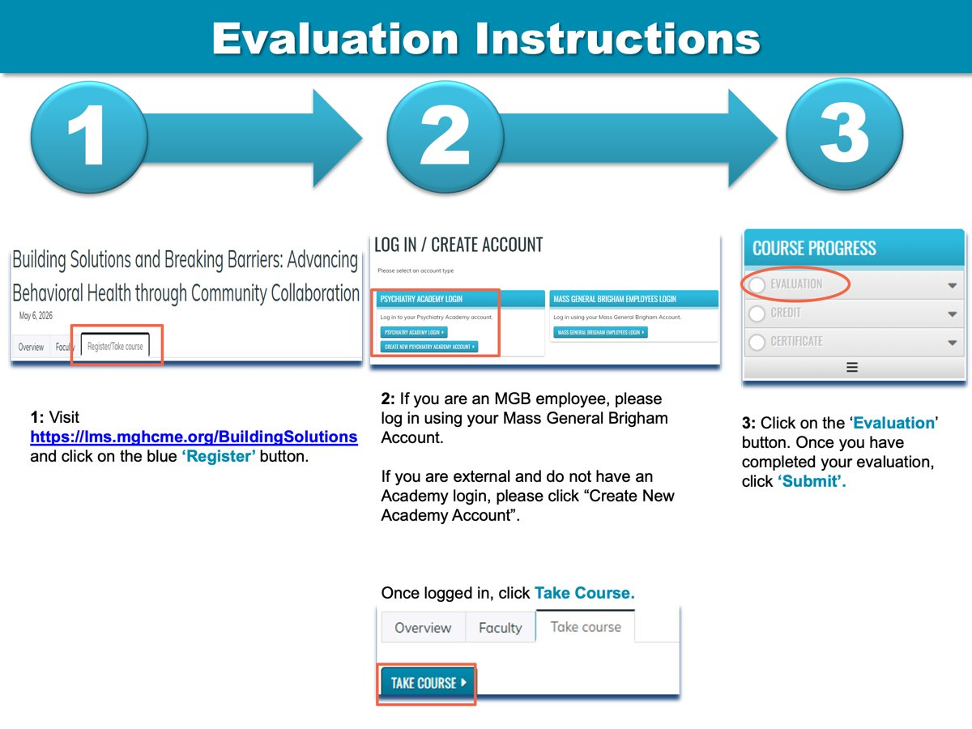
Evaluation instructions

Slide 43

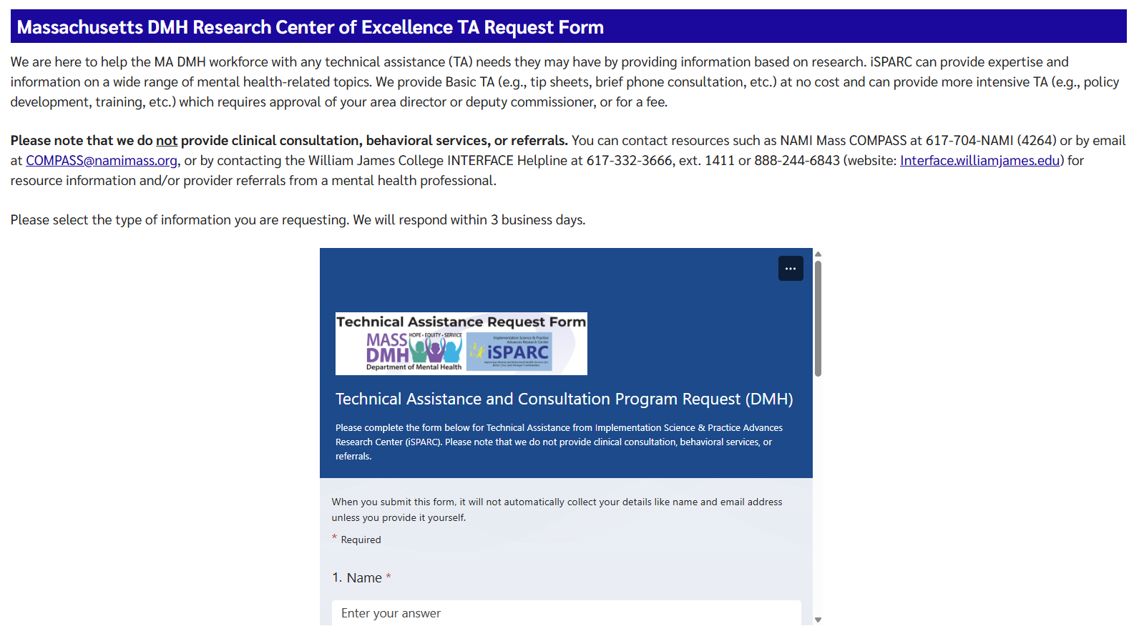

iSPARC Technical Assistance Program www.umassmed.edu/sparc/sparc-ta/

Slide 44
Thank you for attending!

