Slide 1
Building Solutions and Breaking Barriers: Advancing Behavioral Health Through Community Collaborations
2026 Annual Conference of the DMH Research Centers of Excellence
Month YEAR
May 6, 2026

Slide 2
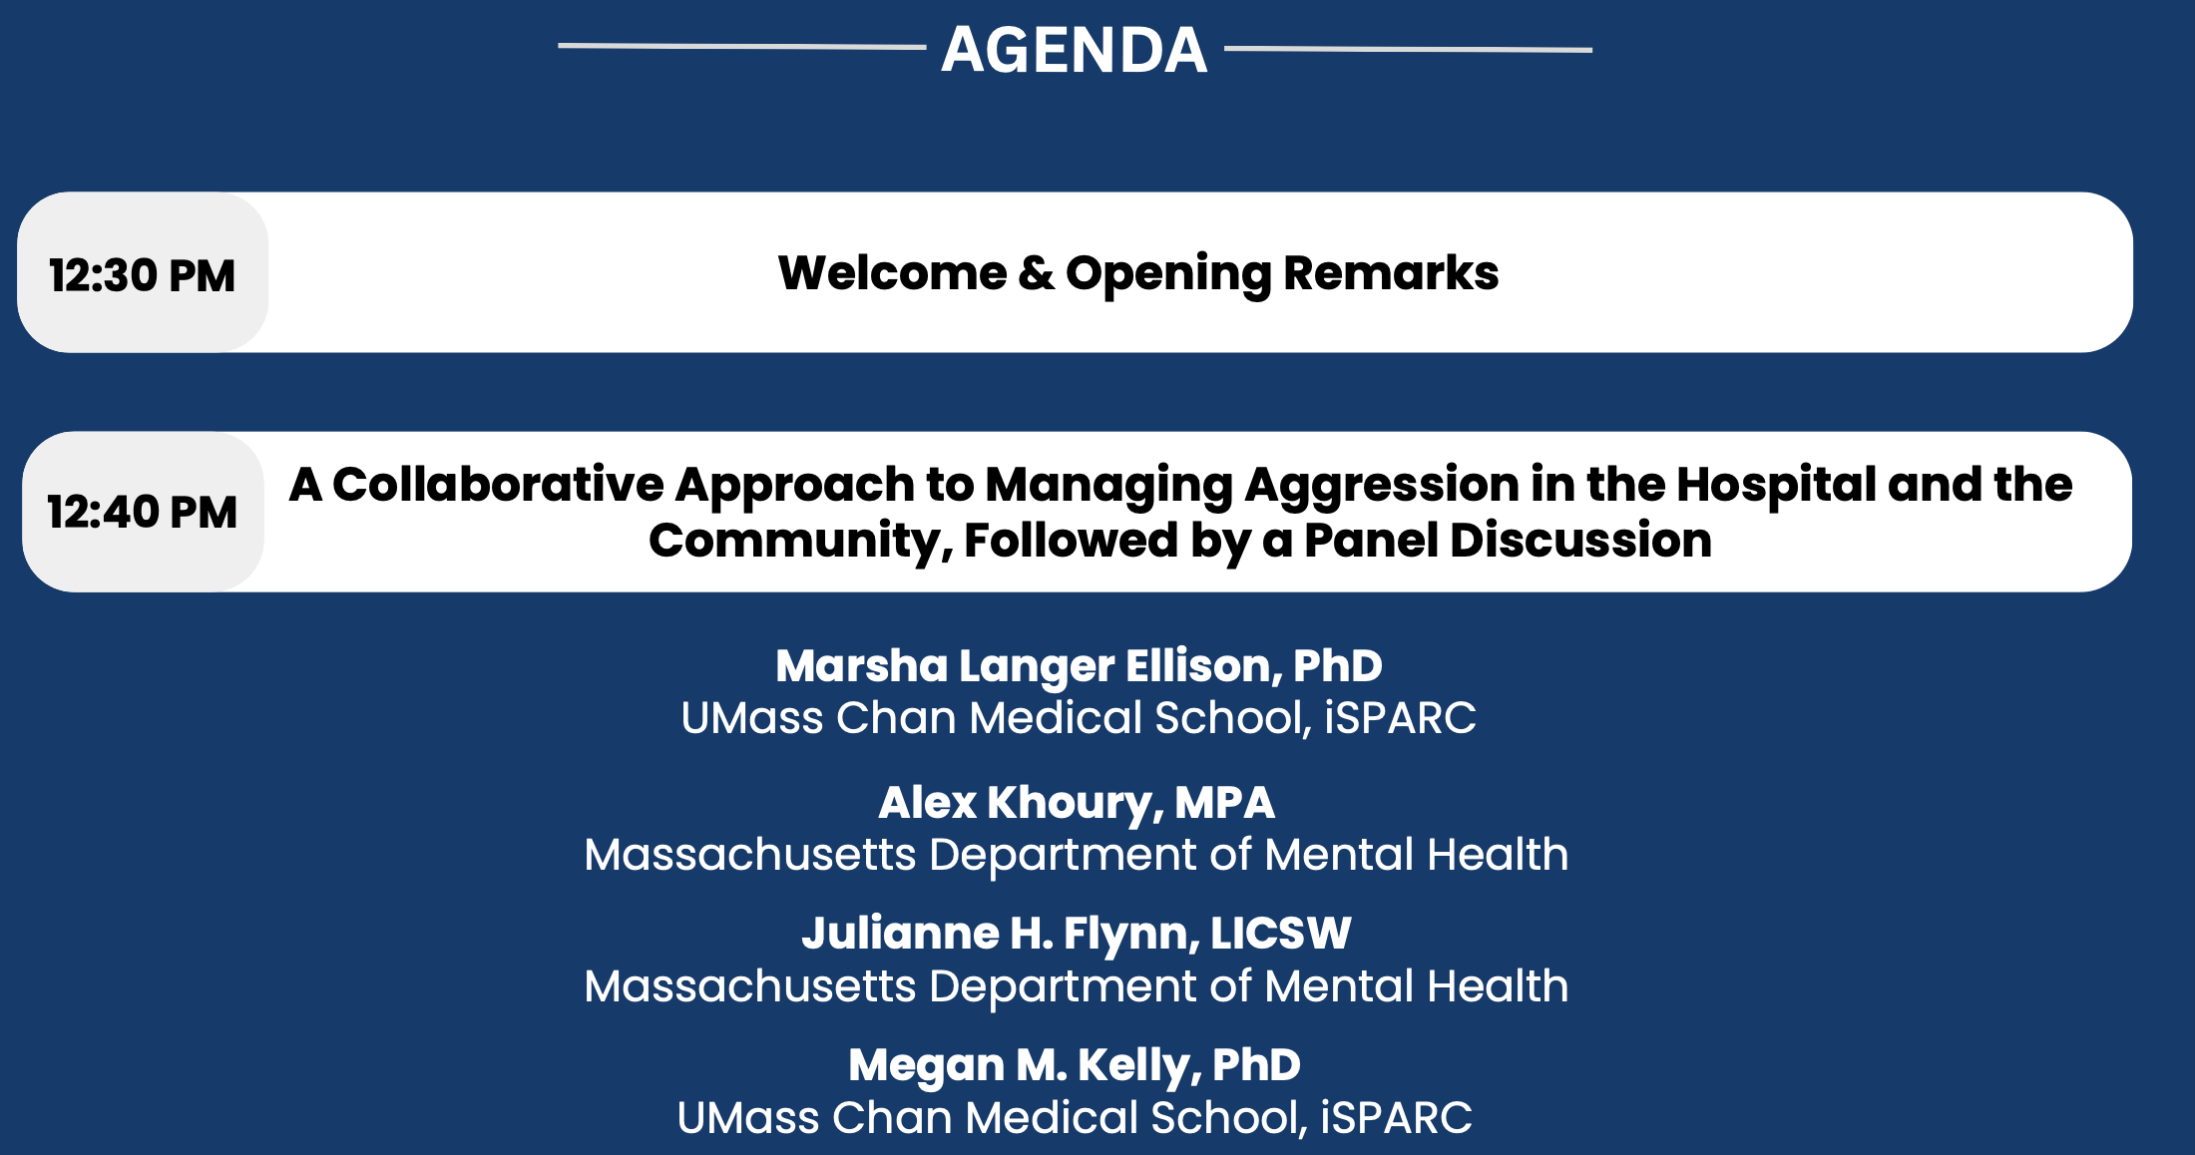
Agenda

Slide 3
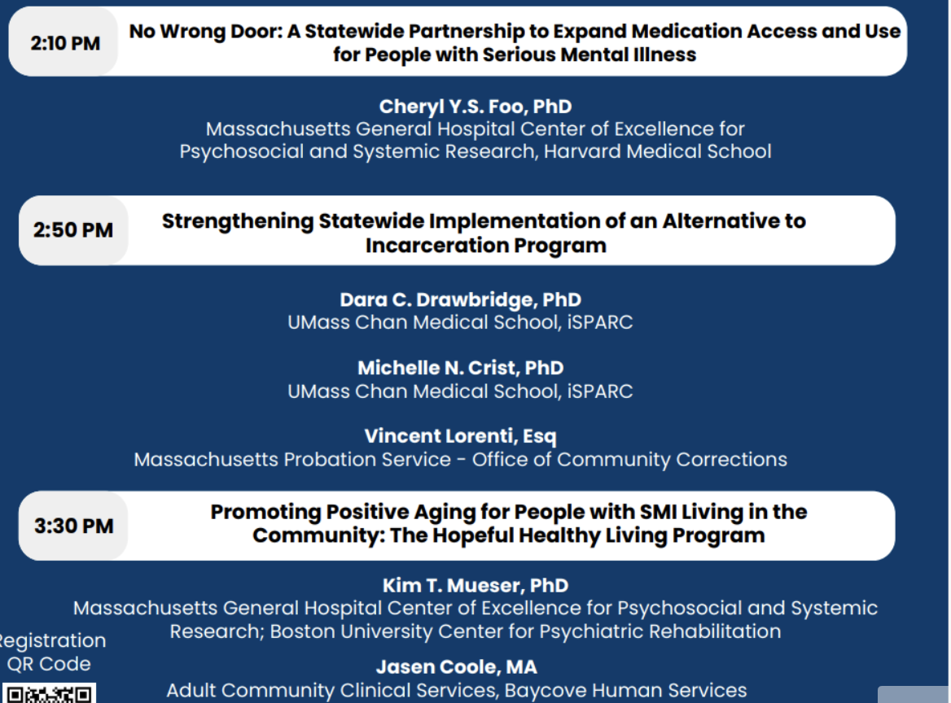
Agenda cont.’d

Slide 4
Continuing Education Units (CEUs)
CEUs are being offered for:
  Psychologists
  Nurses
  Social Workers
  Occupational Therapists
  Licensed Mental Health Counselors
Email dmh-ceap@mass.gov with any CEU questions/concerns.

Slide 5
Continuing Education Units (CEUs)
To receive continuing education credits for this event, participants MUST:
  Join the conference on Zoom with your full name displayed (individuals who only join by phone will not be eligible to receive CEUs).
  Attend the entire program.
  Complete an evaluation upon the conclusion of the program.
Link and a QR code to the evaluation will be shared near the end of the conference.

Slide 6
Continuing Medical Education (CME)
CME Accreditation Statement: The University of Massachusetts Chan Medical School is accredited by the Accreditation Council for Continuing Medical Education to provide continuing medical education for physicians.
Designation Statement: The University of Massachusetts Chan Medical School designates this live activity for a maximum of 4 AMA PRA Category 1 Credit(s)™. Physicians should claim only credit commensurate with the extent of their participation in the activity.
To receive continuing education credits for this event, participants MUST:
  Join the conference on Zoom with your full name (individuals who only join by phone will not be eligible to receive CEUs).
  Attend the entire program.
  Complete an evaluation upon the conclusion of the program.
Link and a QR code to the evaluation will be shared near the end of the conference.
For all CME certificate inquiries, please email continuing.education@umassmed.edu.

Slide 7
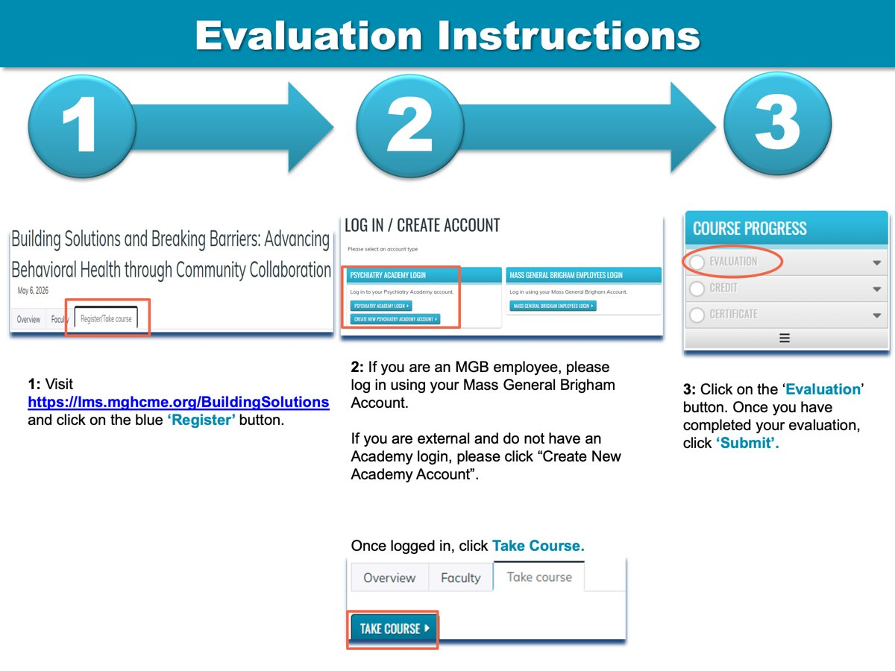
Evaluation instructions

Slide 8

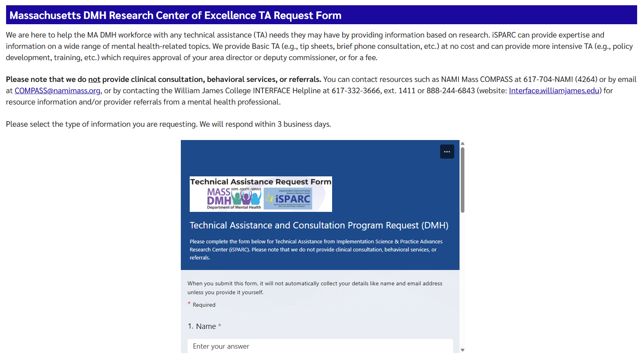

iSPARC Technical Assistance Program www.umassmed.edu/sparc/sparc-ta/

Slide 9
Thank you for attending!

