Slide 1
Building Solutions and Breaking Barriers: Advancing Behavioral Health Through Community Collaborations
2026 Annual Conference of the DMH Research Centers of Excellence
Month YEAR
May 6, 2026

Slide 2
Disclosures
Cori Cather​, PhD
  Consultant:​
    NAVIGATE Consultants​
  Co-Investigator on a NIH-SBIR Grant:​
    Charles River Analytics​
  Trainer:​
    Amae Health​

Slide 3
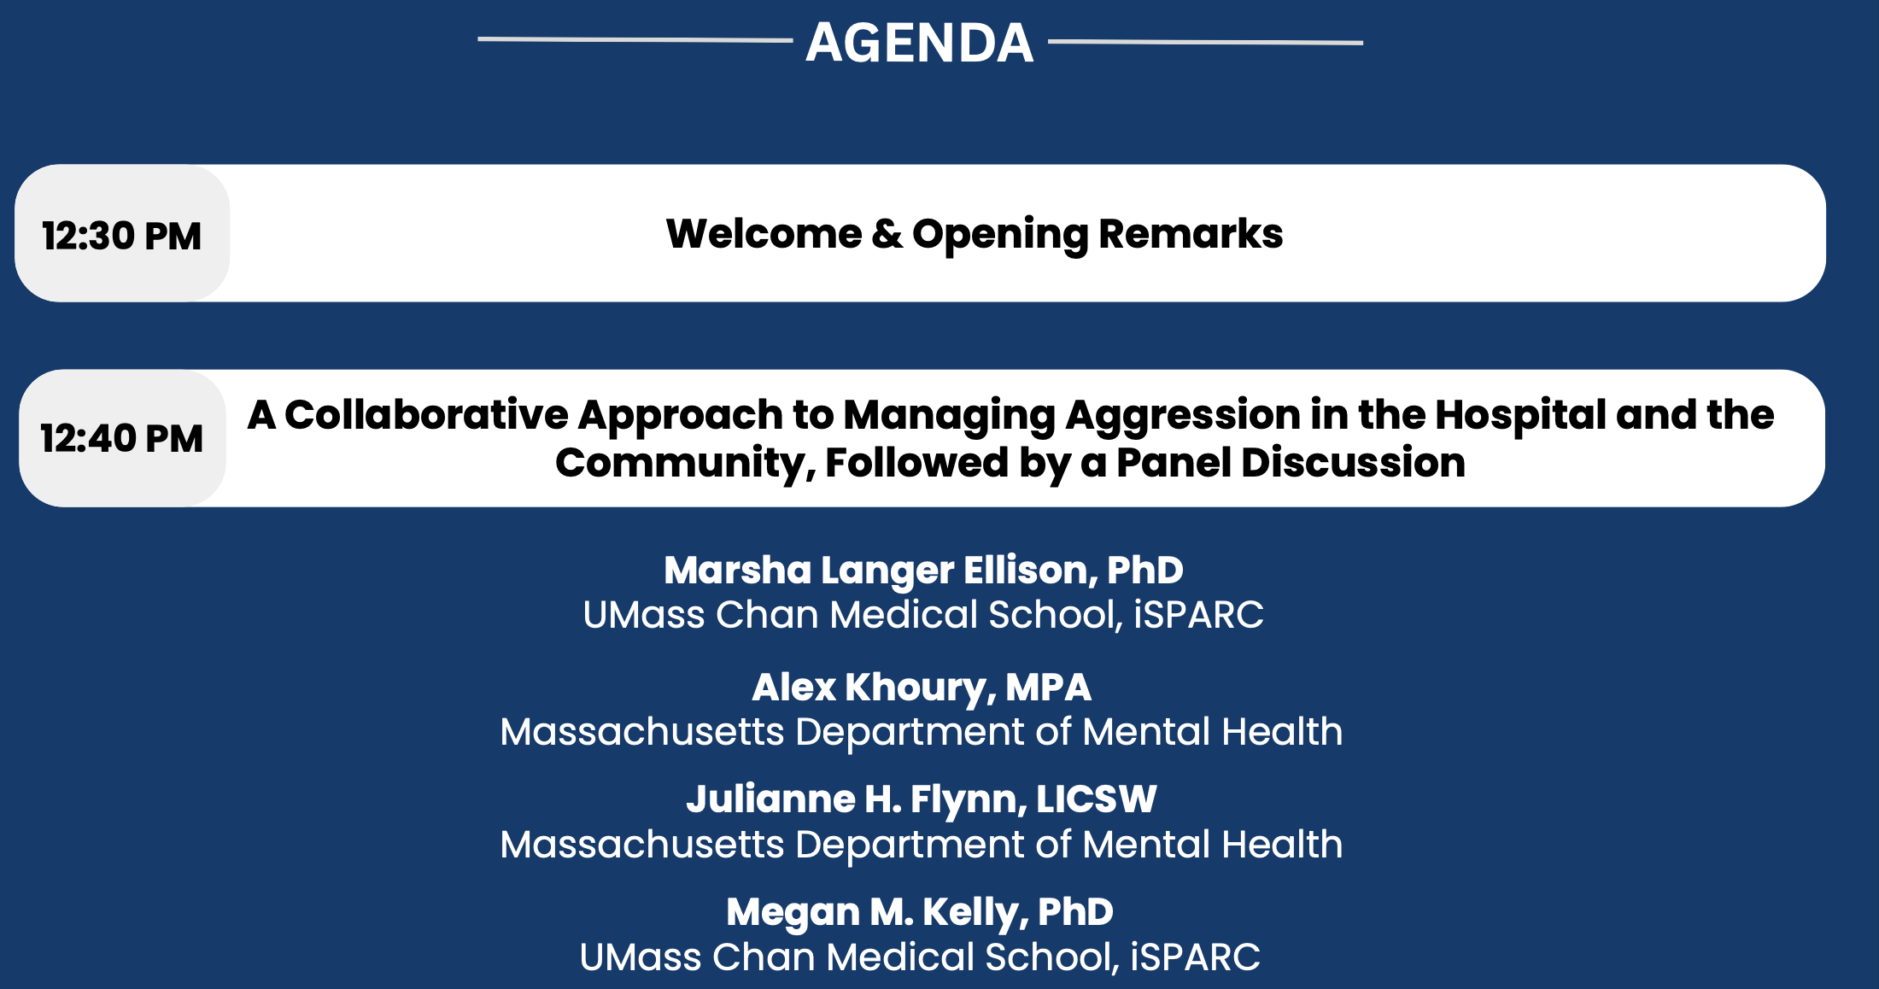
Agenda

Slide 4
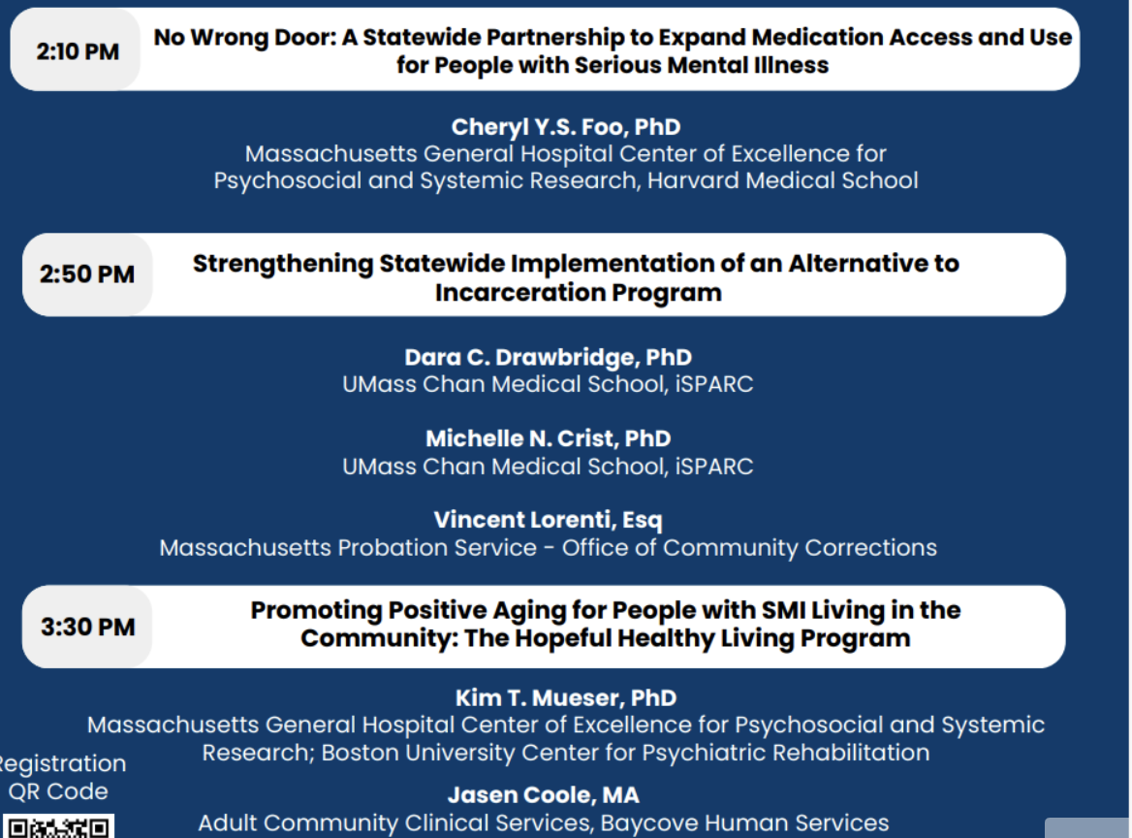
Agenda cont.’d

Slide 5
Continuing Education Units (CEUs)
CEUs are being offered for:
  Psychologists
  Nurses
  Social Workers
  Occupational Therapists
  Licensed Mental Health Counselors
Email dmh-ceap@mass.gov with any CEU questions/concerns.

Slide 6
Continuing Education Units (CEUs)
To receive continuing education credits for this event, participants MUST:
  Join the conference on Zoom with your full name displayed (individuals who only join by phone will not be eligible to receive CEUs).
  Attend the entire program.
  Complete an evaluation upon the conclusion of the program.
Link and a QR code to the evaluation will be shared near the end of the conference.

Slide 7
Continuing Medical Education (CME)
CME Accreditation Statement: The University of Massachusetts Chan Medical School is accredited by the Accreditation Council for Continuing Medical Education to provide continuing medical education for physicians.
Designation Statement: The University of Massachusetts Chan Medical School designates this live activity for a maximum of 4 AMA PRA Category 1 Credit(s)™. Physicians should claim only credit commensurate with the extent of their participation in the activity.
To receive continuing education credits for this event, participants MUST:
  Join the conference on Zoom with your full name (individuals who only join by phone will not be eligible to receive CEUs).
  Attend the entire program.
  Complete an evaluation upon the conclusion of the program.
Link and a QR code to the evaluation will be shared near the end of the conference.
For all CME certificate inquiries, please email continuing.education@umassmed.edu.

Slide 8
Welcome
Cori Cather, PhD, Associate Professor of Psychology, Harvard Medical School
Director of MGH Center of Excellence for Psychosocial and Systemic Research
Megan Kelly, PhD, Professor of Psychiatry and Behavioral Sciences,
Director of the Implementation Science and Practice Advances
Research Center (iSPARC) , UMass Chan Medical School

Slide 9
Opening Remarks
Emily Bailey, LICSW
Commissioner, Massachusetts Department of Mental Health​

Slide 10
A Collaborative Approach to Managing Aggression in the Hospital and the Community
May 6th, 2026
2026 ANNUAL CONFERENCE OF THE DMH RESEARCH CENTERS OF EXCELLENCE

Slide 11
Disclosures
The presenters of this session and subsequent panel have no actual or potential conflicts of interest in relation to this presentation.

Slide 12
OVERVIEW OF SESSION
Introduction - Marsha Ellison, Ph.D. Director of the Technical Assistance Program, iSPARC, UMass Chan Medical School, Department of Psychiatry and Behavioral Sciences.
Listening Sessions - Megan Kelly, Ph.D. Director of iSPARC, UMass Chan Medical School, Department of Psychiatry and Behavioral Sciences.
DMH Strategic Plan to Manage Aggression in the Hospital and Roll-out –Julianne H. Flynn, LICSW, Office of Inpatient Management, Clinical Training Specialist
Evaluation of Pilot to Manage Inpatient Aggression-
  Quantitative Results - Alex Khoury, Senior Strategy Manager, MA Dep’t. of Mental Health
  Qualitative Results - Marsha Ellison, iSPARC
Training to Manage Aggression in the Community - Marsha Ellison, iSPARC

Slide 13
In-Patient “Listening Sessions”
Megan Kelly, PhD

Slide 14
Purpose of Facilitated Listening Sessions
The intention was to elicit narrative feedback from hospital and inpatient program staff regarding:
  a) the nature and frequency of aggressive, assaultive, and/or hostile behavior from patients
  b) what practices work to manage or treat the behavior
  c) what practices are ineffective
  d) what supports are needed to improve the situation

Slide 15
Development of Listening Session Questions
The interview included questions and prompts based on research and clinical experience, and a literature review on predictors of inpatient aggression.
The interview questions were selected in collaboration with DMH, iSPARC, and MGH.
  Changes in the level of patient aggression experienced in the past five years
  The level and types of patient aggression experienced
  Factors that contribute to patient aggression
  Helpful and unhelpful strategies and other factors used to prevent or manage patient aggression.
  Staff also made recommendations for reducing patient aggression.

Slide 16
Facilitated Listening Sessions: Staff and Locations
iSPARC conducted 17 listening sessions with 89 staff across three DMH inpatient settings or hospitals:
  Worcester Recovery Center and Hospital (WRCH)
  Taunton State Hospital (TSH)
  Recovery Addictions Program at Taunton (RAP)
MGH conducted 12 listening sessions with 84 staff across three DMH inpatient settings or hospitals:
  Tewksbury Hospital,
  Lemuel Shattuck Hospital
  Solomon Carter Fuller Hospital

Slide 17
Facilitated Listening Sessions: Procedures
Listening sessions lasted for 60 minutes each, conducted by an iSPARC or MGH facilitator and note-taker.
  Sessions were held virtually and in person.
Facilitators and notetakers documented notes by hand or on laptop computers.
No sessions were audio or video recorded.
Attendees included Mental Health Workers, Psychiatric Nurse Practitioners, Psychiatrists, Psychologists, Nurses, Social workers, Rehabilitation Staff, Occupational Therapists, and Peer specialists/recovery coaches

Slide 18
What Factors, Actions, or Practices Work Well for Preventing or Managing Aggression/Hostility?
Offering more recreation and therapeutic options for patients
De-escalation and early intervention
Maintaining “problem behavior lists”
Stronger staff-patient relationships and consistency with staff
Stronger communication and teamwork across staff
Having adequate staff-to-patient ratios
Specialized training for staff that is matched to their units
Hold patients accountable and provide consistent training on restraint policies

Slide 19
What Procedures Do Not Work? What Gets in the Way of Effective Practices?
Not classifying or matching patients well to units or hospitals
Acuity of patients/refractory illness
Ineffective restraint policies
Staffing issues
Staff are afraid of responding to incidents
Lack of structured time for patients
Lack of consequences for patients when they assault staff

Slide 20
What Supports Do Staff Want for Assessing/Preventing, Treating, Managing or Coping with Aggression?
More presence, communication, and support/value from administration
Improved staffing and training
Clear institutional policies to respond to violence against staff
Personnel incentives
Addressing systems issues
  Court processes
  Lack of community resources

Slide 21
Recommendations for Short-Term Changes
Solicit input from staff at all levels prior to instituting any new policies, training curriculum/procedures, and interventions.
Develop consistent procedures for leadership to be present more often (e.g., leadership rounding on the units), and support staff with compassionate debriefings, regular phone calls, or other incentives (going home early) when they are assaulted by patients.
Continue with procedures for ensuring that patient triggers, characteristics, and program plans are listed and accessible for every patient on the unit.
Manage staff workloads so that they can attend all team meetings to promote more cohesion and consistency
Implement on-going training and coaching for all staff around a) the restraint/patient accountability procedures for each unit, b) Broset c) MANDT, and d) positive behavioral supports and incentives.

Slide 22
The DMH Strategic Plan to Manage Aggression in the Inpatient Setting
Julianne Flynn, LICSW
Office of Inpatient Management

Slide 23
KEY GOALS
SAFETY – STANDARDZATION – SUSTAINABILITY
AGGRESSION
  Identify and address drivers of aggression
APPROACH
  Develop training approach specific to discipline
COMUNICATION
  Develop and reinforce effective communication process
COMPETENCY
  Define foundational competencies
POLICY
  Align policy, workflow and practice
SUSTAINABLITY
  Develop sustainable practice and develop culture of safety and competence

Slide 24
Core Elements
ENGAGEMENT, APPROACH, and FEEDBACK
APPROACH:
PHASED APPROACH –UNIT BASED – ON SHIFT
SCENARIO BASED
MILIEU ENGAGMENT
INTEGRATION OF CLINCAL WITH DIRECT CARE
IDENTIFY AND PLAN FOR RESOLUTION IN GAPS IN PRACTICE OR IKNOWLEDGE
LEADERSHIP INVOLVMENT, COMMUNICATION AND SUPPORT

Slide 25
PHASE 1
Reinforce foundational safety elements and practices within milieu:
METHOD: PHASED APPOACH
FOUNDATIONAL ELEMENTS
  COMMUNICATION
  MILIEU PRACTICE
    -Shift Change
    Treatment Team involvement
    Broset ratings
    Safety Checks
    Levels of Observation
    RADAR,
    Cycle of Escalation

Slide 26
PHASE 1
Reinforce foundational safety elements and practices within milieu:
METHOD: PHASED APPOACH CONT.’D
  TOOLKIT binder on each unit of reference tools:
    Shift report communication
    Broset Job Aid
    Safety checks
    Mock code gray checklist and training tool
    Mandt – RADAR, Cycle of Escalation, SODA Huddle form
  INTEGRATION
    TREATMENT TEAM TRAINING
LEADERSHIP SUPPORT and COMMUNICATION

Slide 27
PHASE 2A
SUBSTANCE USE
Substance use awareness (Identification of commonly abused substances, behavioral indicators of use /withdrawal, harm reduction and post-acute withdrawal considerations),
Increased awareness of behaviors connected to MH and or SU
Improved identification of priority areas – improved treatment and successful engagement
Identified need for change in ADMISSIONS and VISTORS POLICIES - addressed at statewide meetings
Reinforced (RN’s) COWS-CIWA – use of withdrawal order sets
Standardized protocols and workflows developed to increase safety and decrease potential for medication diversion
CONSULTATION

Slide 28
PHASE 2B
CO-OCCURRING DISORDERS
Increased awareness of substances and impact on behavior and psychiatric symptoms
Interconnection of MH and Substance use Developed standardized order sets for Withdrawal, agitation, aggression (pending activation in META)
Job Aids with re-training for COWS/CIWA-AR

Slide 29
CLINICAL TRANING & CONSULTATION
Virtual Training provided by external subject mater experts
  Aggression and Psychopharmacology
  Aggression and connection to Substance use
Monthly Consultation x2 ( in person)
  Psychopharmacology :
    Goal: How to approach and structure assessment and intervention – direct care staff involved in discussion and planning
  Substance Use:
    Goal: Team approach to identify challenging behaviors/symptoms related to substance use and ways to address as team

Slide 30
DBT For Inpatient Setting
DBT TRAINING APPROACH
  Intensive Training provided for select staff
  Facility specific DBT Implementation teams to build capacity
  Ongoing DBT Consultation to inform implementation, support training initiatives at facility level
VIRTUAL TRAINING:
  DBT Skills Training provided statewide
  DBT for Individual Therapy – 6 part series delivered for inpatient therapists
Resources:
  Access to external DBT experts for consultation and training
  Repository of DBT resources shared among facility implementation teams
  Two day Conference scheduled to share implementation strategies and resources among facilities

Slide 31
SUMMARY – KEY ELEMENTS
Communication Pathways:
  Enhanced communication channels for greater clarity and efficiency
Integration:
  Integrated existing milieu tools to operationalize concepts
Accessible:
  Offered sessions on all shifts
Validation:
  Acknowledged and appreciated staff contributions, validating efforts, experience and credibility
Engagement:
  Actively engaged staff gather feedback on effective practices and areas for improvement

Slide 32
SUMMARY – KEY ELEMENTS CONT.’D
Culture:
  Cultivated a culture receptive to change by encouraging experimentation, adopting best practices, and continuous learning
Resource:
  Provided necessary resources to support team success
Pro-active:
  Identified potential obstacles, discussed barriers, and explored strategies to address them.

Slide 33
Aggression Pilot Results
Broset Scores, Assaults & Aggression Incidents, Restraints & Seclusions
Department of Mental Health

Slide 34
The aggression treatment pilot units showed promising results as measured by Broset scores, assault and aggression events, and restraint and seclusion episodes.
Over the course of the pilot, the frequency of high Broset scores dropped 73%, Aggression and Assault Incidents dropped 62%, and Restraints and Seclusions dropped 42%.
  Comparing the first month of pilot participation to the last month of pilot participation, averaging across units.
One of the three pilot units saw substantial decreases in Broset scores, aggression, and assaults during the clinical training phase.
One pilot unit saw the substantial reductions in aggression, restraints, and seclusions in the unit staff training phase.
  This may indicate that the unit staff training (including enhanced training on existing policy and practices) were more impactful for these units.
Notes:
Notes – recap of the pilot setup
The goal of the pilot units was to reduce incidence of aggression on three OIM units using…
Clinical trainings and consultations from external experts on aggression related-psychopharmacology, SUD management and DBT skills
Improved milieu management practices through i) trainings for direct care staff on SUD, DBT, and other behavioral crisis management and ii) use of Broset (aggression risk assessment tool) & COWs/CIWA (SUD assessment)

Slide 35
WRCH Pilot Unit: Indicators of aggression and assaults decreased substantially over the pilot period - Broset Scores
Unit Staff Trainings/Prep Period
Clinical Trainings/ Consultation Period
Dec 2024 to July 2025
  Key Takeaways:
  Aggression and assaults dropped precipitously over the clinical period.
  Restraints and seclusions did not decrease over the pilot period.

Slide 36
Incidents of aggression and assault dropped during the clinical phase of the pilot
Unit Staff Trainings/Prep Period
Clinical Trainings/Consultation Period
WRCH
Pilot Unit
-60%

Slide 37
Fuller Pilot Unit: Aggression, assaults, restraints and seclusions all dropped during the pilot period – Broset Scores
Pilot Participation Period
Dec 2024 to July 2025
  Considerations:
  The Fuller pilot unit joined the pilot in Mid-March coinciding directly with the drop in all indicators of aggression, assault, restraint and seclusion.

Slide 38
Fuller Pilot Unit: Aggression, assaults, restraints and seclusions all dropped during the pilot period – Aggression and Assault Incidents
Pilot Participation Period
-90%
-68%
Dec 2024 to July 2025
  Considerations:
  The Fuller pilot unit joined the pilot in Mid-March coinciding directly with the drop in all indicators of aggression, assault, restraint and seclusion.

Slide 39
Fuller Pilot Unit: Aggression, assaults, restraints and seclusions all dropped during the pilot period – Restraints and Seclusions
Pilot Participation Period
-84%
Dec 2024 to July 2025
  Considerations:
  The Fuller pilot unit joined the pilot in Mid-March coinciding directly with the drop in all indicators of aggression, assault, restraint and seclusion.

Slide 40
Taunton Pilot Unit: Aggression, assaults, and restraints all dropped in the preparatory phase of the pilot and stayed relatively level during the period peak pilot activity – Broset Scores
Unit Staff Trainings/
Prep Period
Clinical Trainings/ Consultation Period
  Considerations:
  The drop in aggressive incidents in the unit staff training phase contrasts with trends across the rest of the facility.
  Because of the particular mix of patient population needs, the unit did not participate in all expert clinical consultations to the same degree as the other pilot units

Slide 41
Taunton Pilot Unit: Aggression, assaults, and restraints all dropped in the preparatory phase of the pilot and stayed relatively level during the period peak pilot activity – Assault and Aggression Incidents
Unit Staff Trainings/
Prep Period
Clinical Trainings/ Consultation Period
-72%
  Considerations:
  The drop in aggressive incidents in the unit staff training phase contrasts with trends across the rest of the facility.
  Because of the particular mix of patient population needs, the unit did not participate in all expert clinical consultations to the same degree as the other pilot units

Slide 42
Taunton Pilot Unit: Aggression, assaults, and restraints all dropped in the preparatory phase of the pilot and stayed relatively level during the period peak pilot activity – Restrains and Seclusions
Unit Staff Trainings/
Prep Period
Clinical Trainings/ Consultation Period
-66%
  Considerations:
  The drop in aggressive incidents in the unit staff training phase contrasts with trends across the rest of the facility.
  Because of the particular mix of patient population needs, the unit did not participate in all expert clinical consultations to the same degree as the other pilot units

Slide 43
Evaluation of Pilot to Manage Inpatient Aggression
Qualitative Results iSPARC Technical Assistance team:
Marsha Ellison
MaryAnn Preskul-Ricca
Colleen McKay

Slide 44
Qualitative Evaluation of Inpatient Aggression Management
Methods
Structured in-person interviews conducted by iSPARC
39 staff at all 3 pilot units
Interviews included Mental Health Workers, clinical staff, and leadership
Questions on major pilot initiatives and overall experience of safety on the floor and of the trainings
Notes were taken and then reviewed, analyzed, and summarized by iSPARC.
Findings presented to the Office of Inpatient Management

Slide 45
Overall Staff Experience with Pilot
De-escalation approaches are valued and used in everyday practice.
Staff reported that they felt safe on the floor
Early patient engagement helps identify triggers and calming strategies
Focus on de-escalation instead of seeing patients as threats
Shift from restraint to staff presence, reducing hands-on interventions
Some believed there was little real change in patient aggression, and improvements were mainly due to patient characteristics.

Slide 46
Experience with De-Escalation Training
Training boosted staff to manage agitation and aggression by:
  Intentionally reminding patients to use coping strategies
  Approaching aggressive situations with de-escalation first in mind
  Improving communication strategies with persons served and with staff
  Many staff noted appreciation for the trainers
  Scheduling and coverage difficulties prevented all staff from attending
  Some trainings were not set to the educational level of trainees.
  Staff would have liked more time to learn techniques and see techniques in action
Management support, effective scheduling, and regular refreshers increase the likelihood of staff attending and benefitting

Slide 47
Dialectical Behavior Therapy (DBT) Training
DBT boosted staff confidence in managing patients
Provided concrete strategies and reinforced using evidence-based practices
It was described as “great,” “helpful,” and a “thing to believe in”
Staff requested that future DBT training be locally and accessible via public transportation

Slide 48
Broset Scores Training
Broset assessment tool was first seen as a “waste of time” “just another form,” “numbers don’t matter,” and “redundant”
The score’s timing and reporting requirements were seen as burdensome
Some staff struggle to understand the tool, determining what is a “normal” score vs. an escalated score
Scoring procedure changed: now used for new/high-risk patients, not all patients
Broset use remains inconsistent; discussion during shift changes is encouraged but rarely happens

Slide 49
Mental Health Worker (MHW) Involvement in Treatment Planning
MHWs value involvement in treatment planning.
All staff learn more about persons served through shared communication
Structured shift reports and communication at shift change improve staff preparedness and a sense of safety.
However not all MHW consistently participate
Some still experience a divide between MHWs and nurses that can occur in front of persons served undermining morale

Slide 50
Mandt Training & Psychopharm Consults
Staff perceive Mandt training as thorough and offering good communication
Some staff described Mandt training as overwhelming (“they teach you everything – hard to absorb/remember”).
Some felt Mandt did not address needed physical management effectively
Mixed reviews for psychopharmocology consults
Some staff highly valued “could listen all day”
Others described the training as too remote from daily issues

Slide 51
iSPARC Technical Assistance team
Marsha Ellison
MaryAnn Preskul-Ricca
Colleen McKay
Training to Manage Escalated Behavior
in the Community

Slide 52
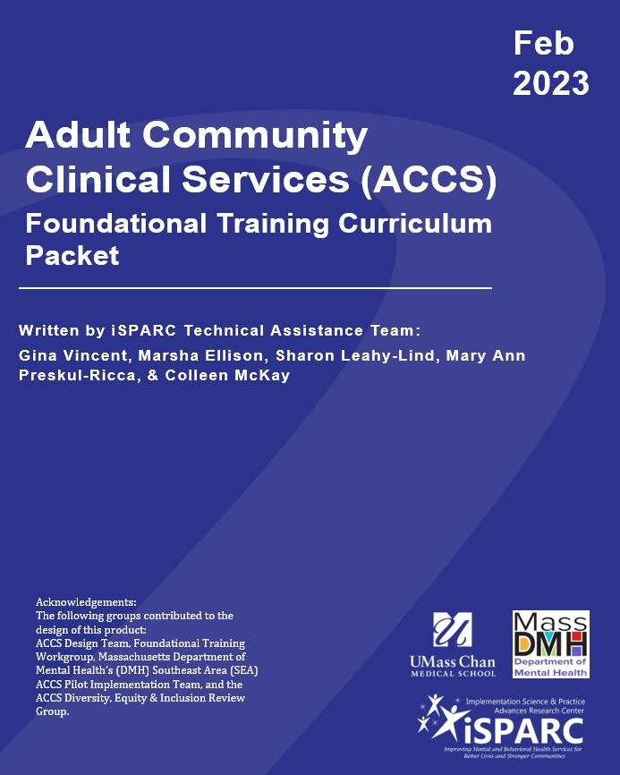
DMH Request to the iSPARC TA Team
Managing Escalated Behavior in ACCS Community Settings
Based on prior ACCS training modules
  Integrated Treatment Teams
  Person-Centered Care
  Recovery Oriented Approach
  Coordination with Systems of Care
  Importance of Evidence-based Practices
  Trauma-Informed Care
  Risk Management
  Basics of Motivational Interviewing
  Suicide Prevention
  Substance Use 101

Slide 53
The Training Module Design Team
Reporting to the DMH Risk Management Workgroup and Association for Behavioral Health
Process:
  Inventory of Existing Agency Resources
  Request for Participation in Design Team
  Design Team membership:
    Aspire Health and Community Services
    Open Sky Community Services
    BAMSI
    Bay Cove Human Services
    Behavioral Health Network
    The Edinburg Center
    Community Healthlink
  4 Meetings
  Content Development and Literature Review
  Reviews by ABH and DMH
Notes:
Janna Ayoub, Aspire Health and Community Services
Karen Duby, LICSW, Open Sky Community Services
Ghita Jaouhari, LCSW, BAMSI
Ryan Johnston, MS, Bay Cove Human Services
Maureen Perreault, LMHC, Behavioral Health Network
Lili Schwan-Rosenwald, LICSW, The Edinburg Center
Ashley Stolitza, LICSW, Community Healthlink
Suzy Waas, LMHC, Aspire Health and Community Services

Slide 54
Resulting Module
Seven sections:
1. Introduction and Foundational Principles
2. Prevention Strategies
3. Core De-escalation Techniques
4. Team-based De-escalation
5. Reporting Incidents with Escalated Behavior
6. Post Incident Procedures
7. De-escalation in Specific Situations

Slide 55
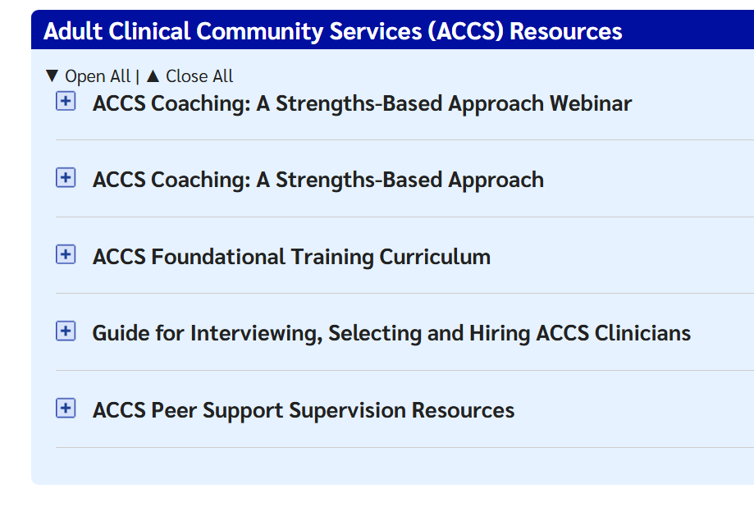
iSPARC Technical Assistance Program
We are here to help the MA DMH workforce with any technical assistance (TA) needs
Submit Request Form at:
DMH Technical Assistance (TA) Program

Slide 56
OIM Aggression Management PANEL: Perspectives on Aggression Management in the Hospital and Community
DMH PILOT UNITS
Worcester Recovery Center and Hospital –B1 ( CEU)
Taunton State Hospital – C3 West
Office of Inpatient Management -
Solomon Carter Fuller Mental Health Center 8 East:
Kara Sousa, RN Informatics Nurse
Kristen Toepfer, RN Nurse Manager
Jean Abulin, MHW 3
Isaac Okai, MSN,PMHNP-BC
Nilsa Baez, MHW 3
Tilly Feliciano, RN Nurse Manager
Donna Brewer, MHW 4

Slide 57
Closing Remarks
Cori Cather, PhD, Associate Professor of Psychology,
Director of MGH Center of Excellence for Psychosocial and Systemic Research
Megan Kelly, PhD, Professor of Psychiatry and Director of iSPARC ​​

Slide 58

Evaluation Form
Link: https://lms.mghcme.org/BuildingSolutions

Slide 59
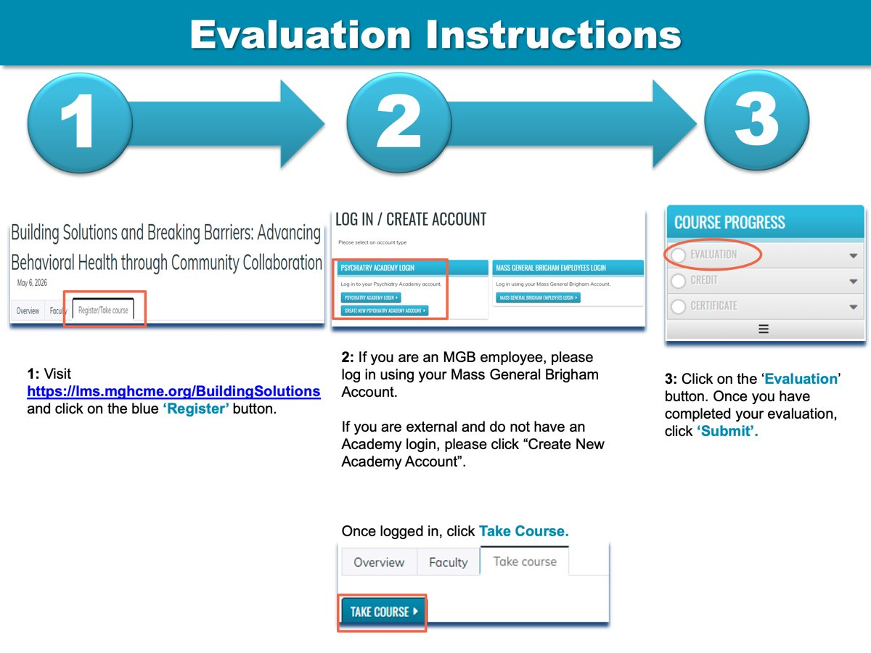
Evaluation instructions

Slide 60

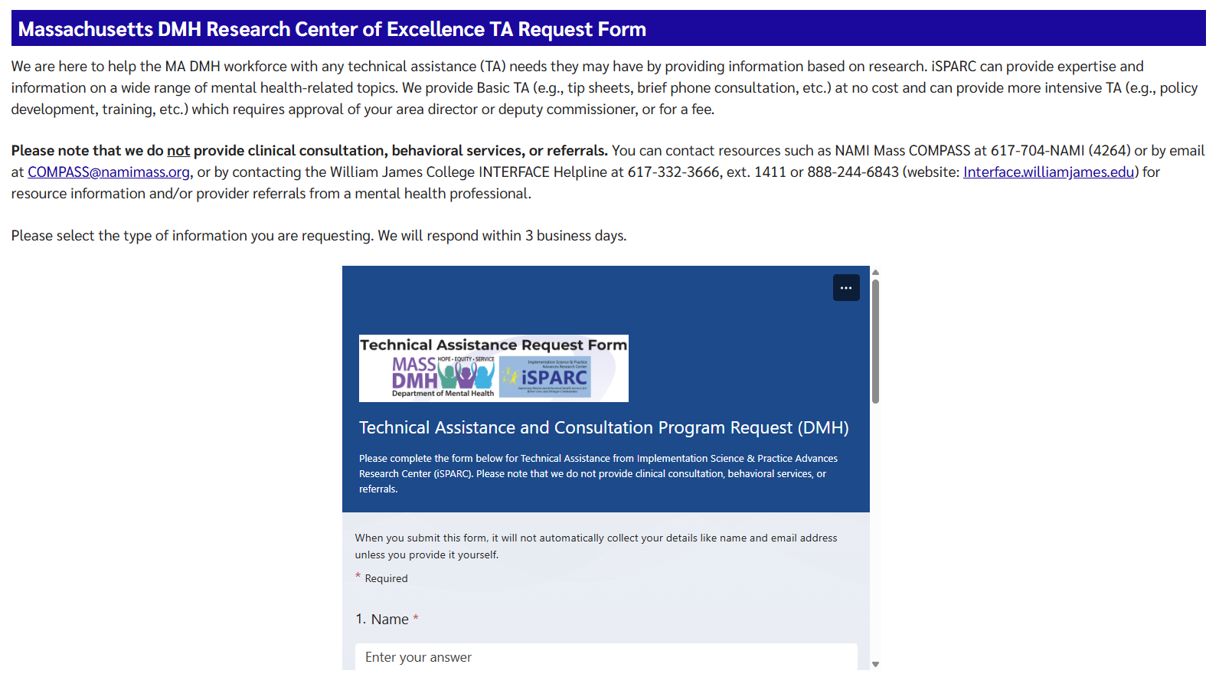

iSPARC Technical Assistance Program www.umassmed.edu/sparc/sparc-ta/

Slide 61
Thank you for attending!

