Slide 1
Peak Calling with LanceOtron
ChIP/ATAC tutorial
Lance Hentges - 11.05.2020
Hughes Group and AVI (Taylor) Group
MRC Weatherall Institute of Molecular Medicine
University of Oxford

Slide 2
Outline
Background and brief intro on peak calling
Perform peak call using LanceOtron
Explore some previously called peaks from ENCODE

Slide 3
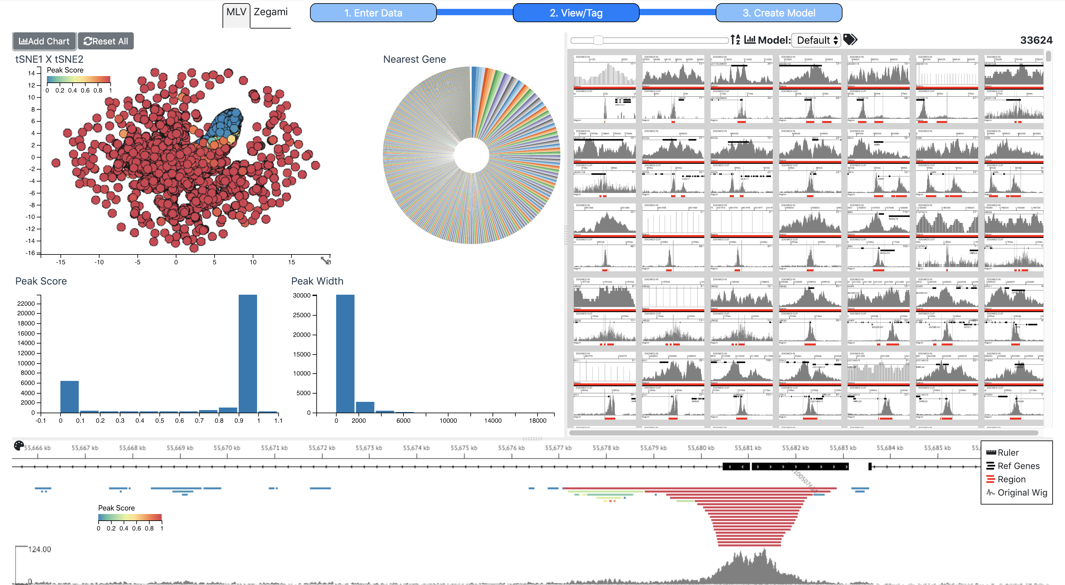
Background
DPhil student
  Focus on machine learning bioinformatics
Developing ChIP/ATAC/DNase-seq analysis software – LanceOtron
  Collaboration with Martin Sergeant
These are location-based assays – i.e. they give the coordinates within a genome where a biological event is occurring
  TF binding, histone associations, open chromatin

Slide 4
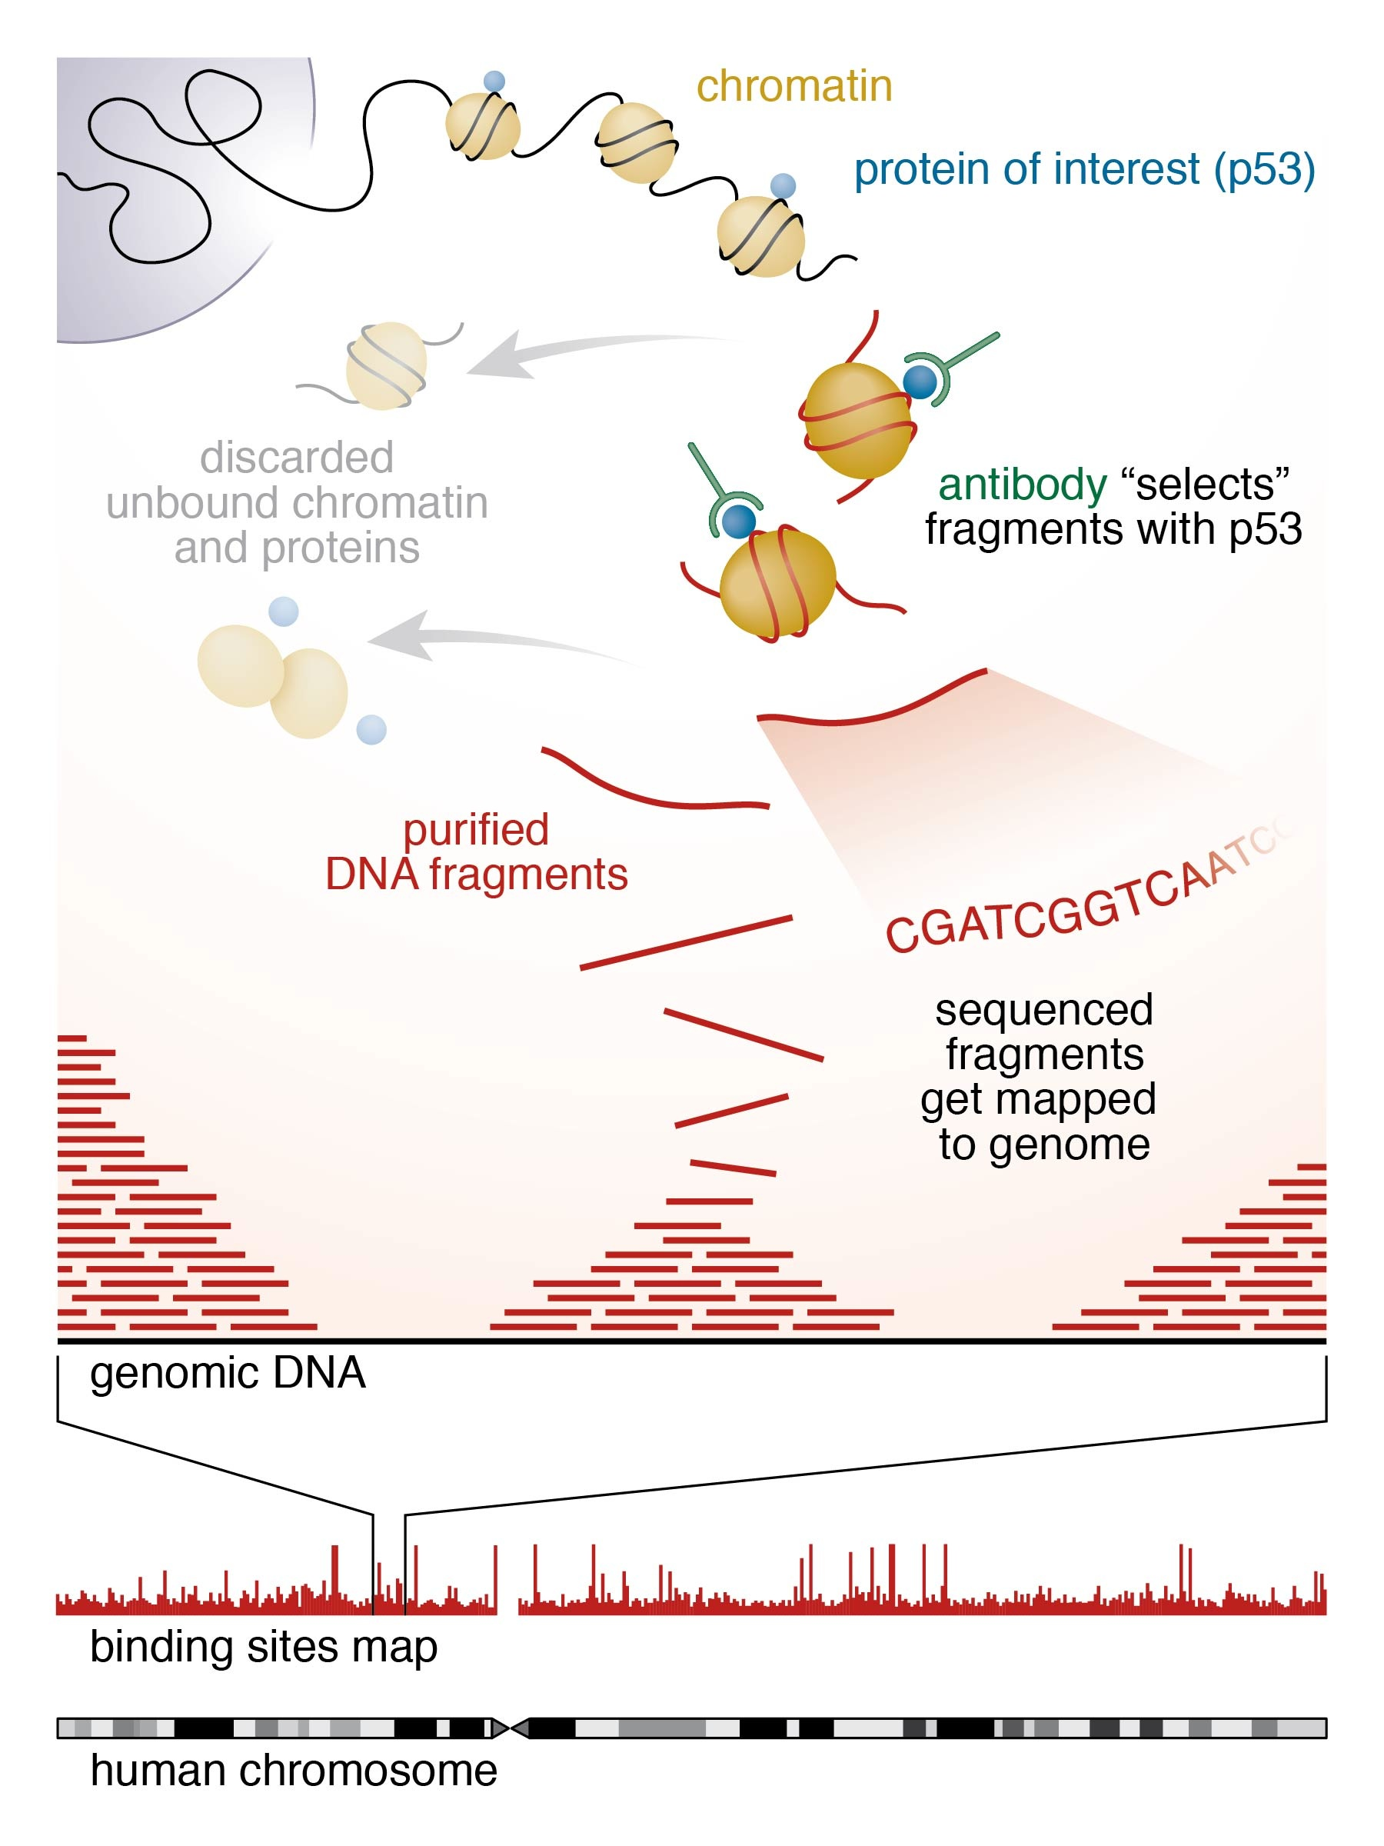
Background
Exploring gene regulation
  ChIP-seq
  ATAC-seq
  DNase-seq
Same analytical problem:
What pattern of DNA fragments correspond with biological event?
Image adapted from Brookhaven National Laboratory

Slide 5
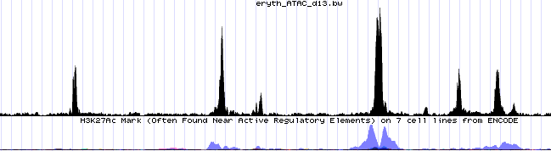
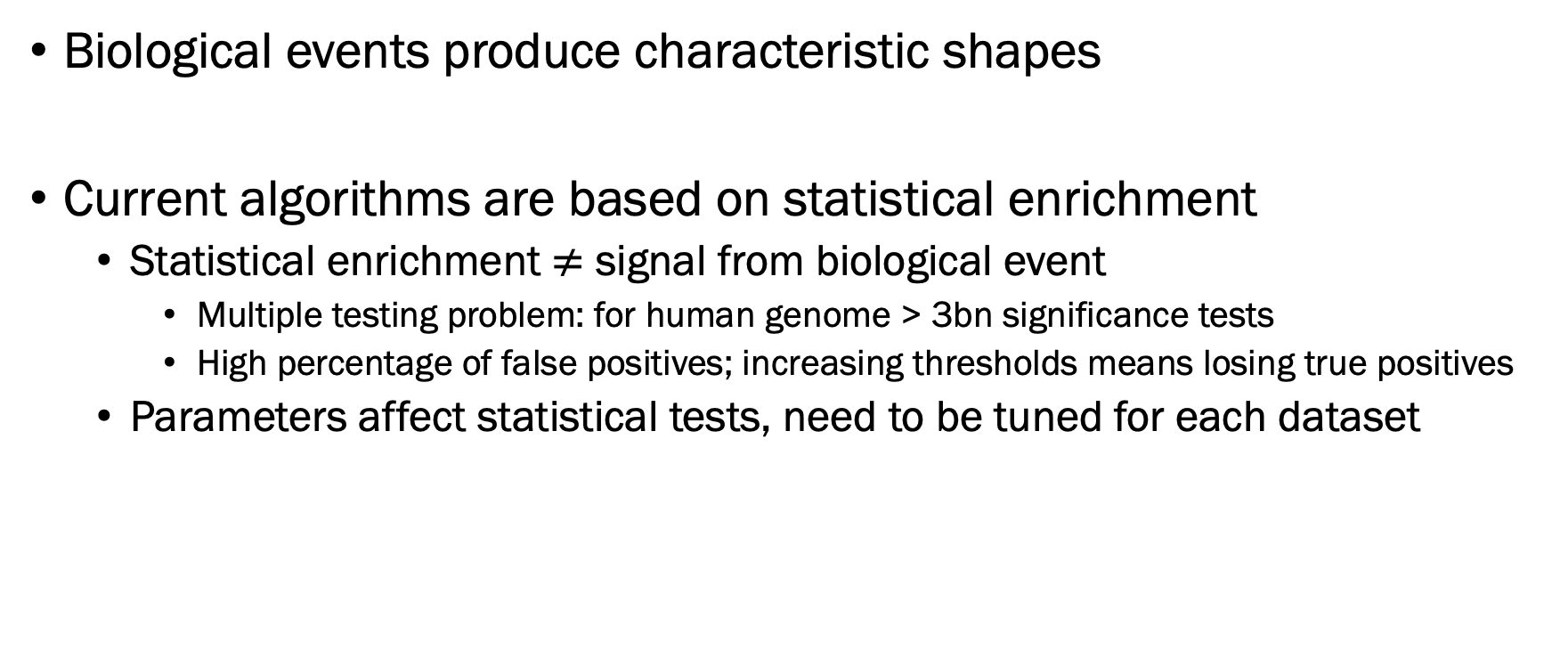
Chromatin assay analysis
Biological events produce characteristic shapes
Current algorithms are based on statistical enrichment
  Statistical enrichment $≠$ signal from biological event
    Multiple testing problem: for human genome > 3bn significance tests
    High percentage of false positives; increasing thresholds means losing true positives
  Parameters affect statistical tests, need to be tuned for each dataset

Slide 6
New peak caller
Started by considering peak calling with unlimited resources
  Run dataset through peak caller multiple times with different parameters
  Visually inspect and hand-classify the regions as good or bad
Guiding principles when developing our peak caller: LanceOtron

Slide 7
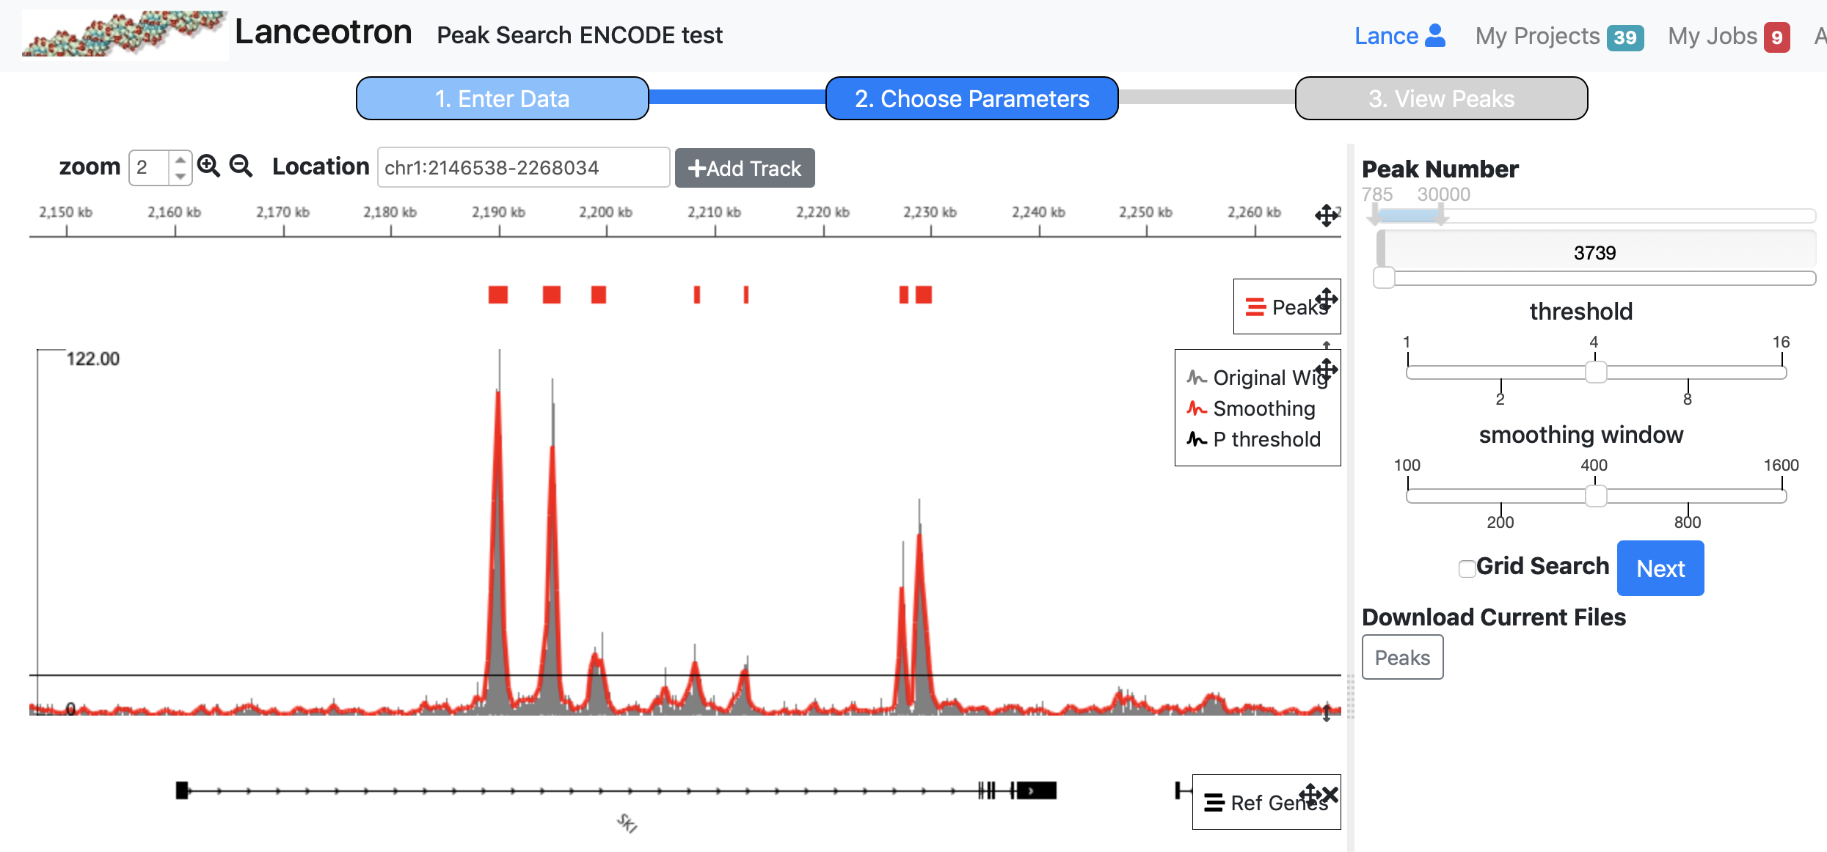
LanceOtron features
Visual parameter selection
Peak selection by shape
  Deep neural network trained on examples of peaks and noise
Graphical user interface

Slide 8
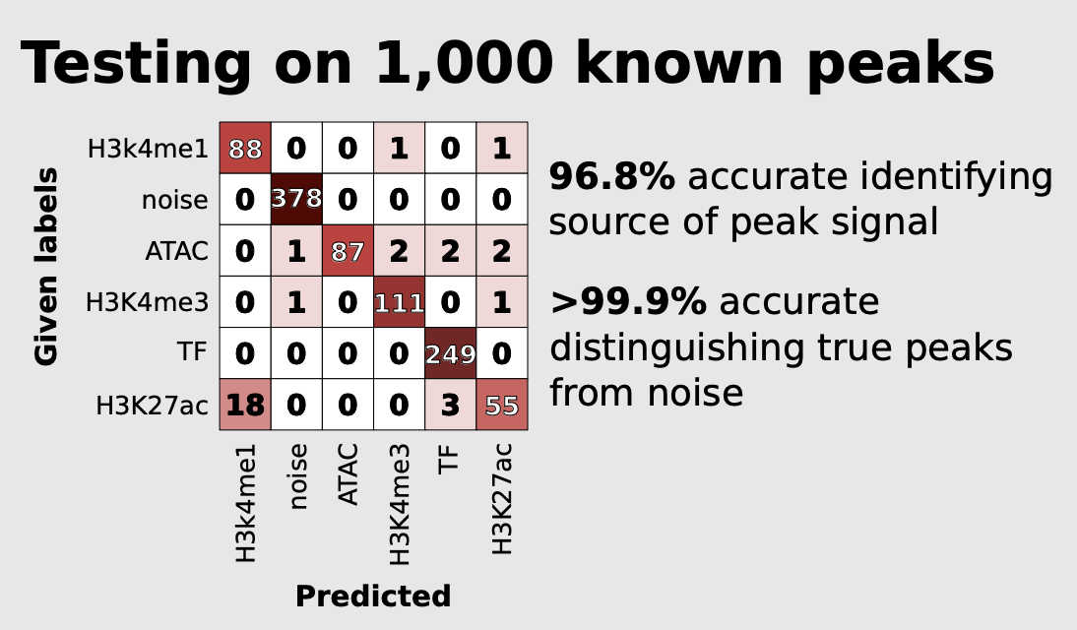
LanceOtron
Very very accurate

Slide 9
Review so far
Download FASTQs from GEO
Align FASTQs to genome
  Bowtie2
  Creates SAM file
Convert SAM to BAM; sort and index BAM
  SAMTOOLS
  Creates BAM and BAM.BAI files
Make coverage map
  DeepTools
  Creates BigWig file

Slide 10
Making coverage map
Calling peaks with modified coverage map
  Whole chromosome
  No blacklist
http://sara.molbiol.ox.ac.uk/public/sergeant/lanceotron_tut/G1E_ChIP_Gata1_24h.chr11.bw
bamCoverage -b aligned_reads/G1E_ATAC_0h_rep1.sorted.bam --binSize 1 --normalizeUsing RPKM --extendReads -o bigwigs/G1E_ATAC_0h_rep1.bw

Slide 11
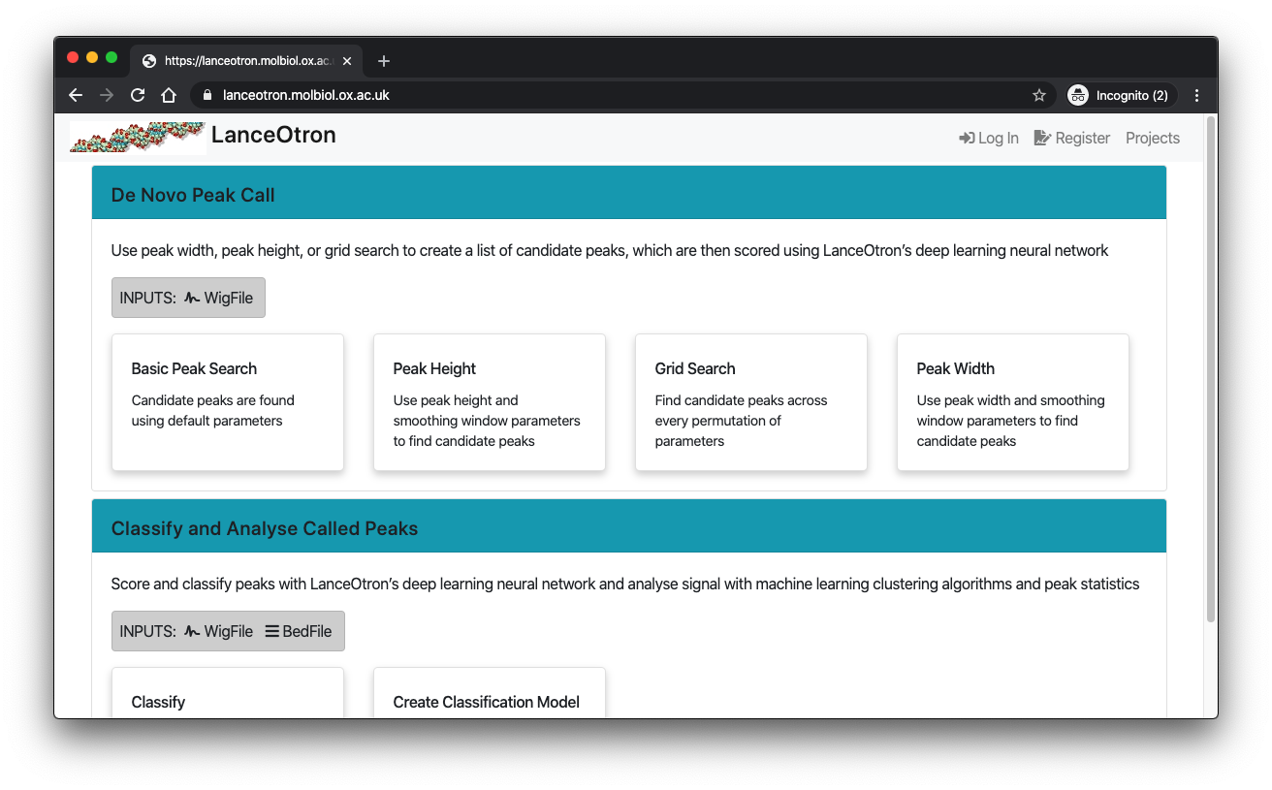
LanceOtron
To use LoT:
  Go to site https://lanceotron.molbiol.ox.ac.uk/
  Register email
  Upload files

Slide 12
Blacklists
Need to download blacklist
  https://www.encodeproject.org/annotations/ENCSR636HFF/
  https://github.com/Boyle-Lab/Blacklist/blob/master/lists/mm10-blacklist.v2.bed.gz
  Blacklist publication
    https://www.ncbi.nlm.nih.gov/pmc/articles/PMC6597582/

Slide 13
Peak search
http://lanceotron.molbiol.ox.ac.uk/projects/peak_search/2459

Slide 14
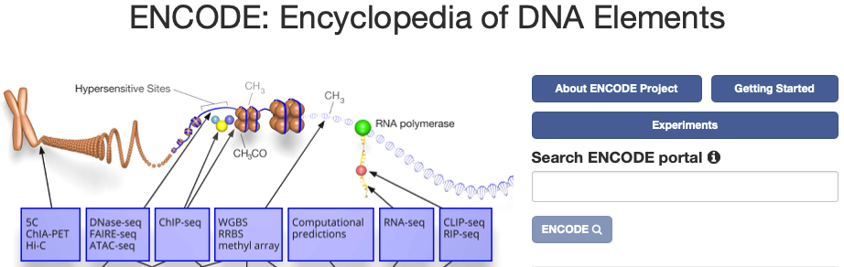
Case study
ENCODE - database of functional elements in the human genome
Experiment ENCSR391NPE – Feb 2017
  ChIP-seq of H3K27ac (mark associated with active enhancers)
  Homo sapiens 22Rv1 (prostate carcinoma cell line)
  2 biological replicates – consensus peaks
  https://www.encodeproject.org/experiments/ENCSR391NPE/

Slide 15
Peak classification
https://lanceotron.molbiol.ox.ac.uk/projects/peak_classification/1674

Slide 16
Acknowledgements
Special thanks to Steve, Jim, Martin
  Damien, Ron, Jelena, Ewan
  Nick Crump and Tom Milne Group
  Hughes and AVI Group
  Rob and Higgs Group
  CCB
  WIMM
  Thank you!

