Slide 1

The Recorded Home Oximetry (RHO) Program
Monthly Investigator Meeting
November 3, 2022

Slide 2

RHO Program Implementation Timeline
Feb - Mar 2021
Baseline data collection begins
Mar - May 2021
Initiate site training
Initiate monthly phone calls
May - Aug 2021
Jun 2021 - Feb 2022
Feb - Aug 2022
Aug 2022 - Feb 2023
Complete site training
Reach 33% of eligible families
Reach 66% of eligible families
Feb - Aug 2023
Reach 100% of eligible families
Initiate 18-month implementation
Begin providing monthly feedback reports
Notes:
- Unchecked the goal to reach 66% as we have not fulfilled throughout the milestone period but are on our way

Slide 3



 | - Enrolling
 | - Activated but not enrolling
 | - Patient identified, not yet enrolled

Slide 4
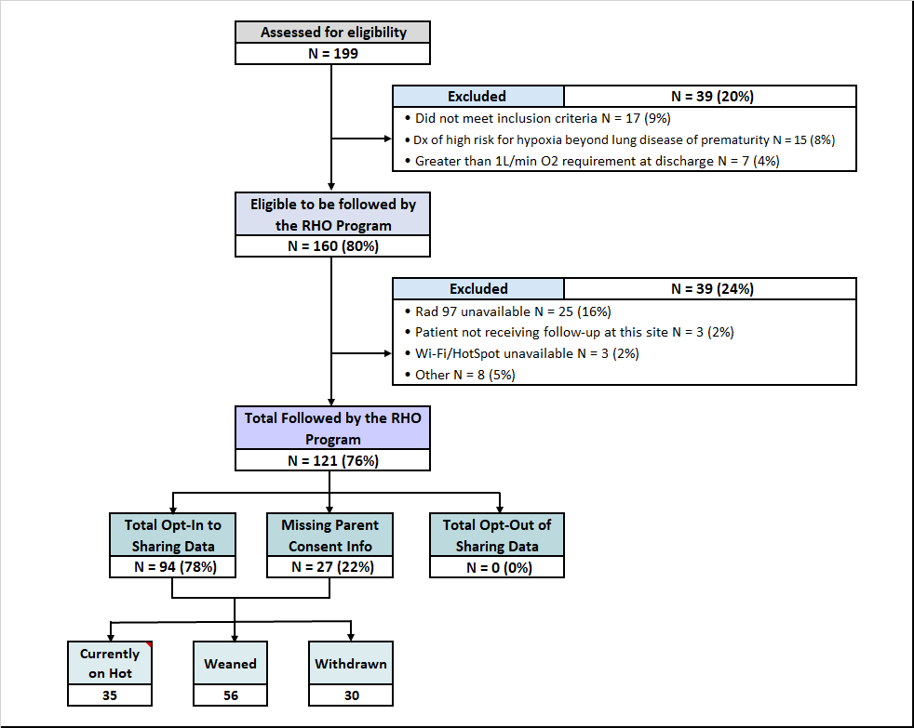
RHO Implementation Trial Consort Diagram
Average HOT Duration:
72 ± 23

Slide 5
Goal

Slide 6
Enrollment by Site
Site Name | 1st Patient Enrolled | Duration of Implementation | Estimate Per Year | Estimate Per Month | Current Per Month | Followed | Withdrawn | Weaned from HOT | Active on HOT | Average | SD
Boston Children's | 7/8/2021 | 15.37 | 40 | 3 | 0.7 | 12 | 1 | 8 | 3 | 101.63 | 72.76
Dartmouth-Hitchcock | 1/1/2022 | 9.47 | 20 | 2 | 1.8 | 18 | 1 | 12 | 5 | 71.25 | 73.72
Maria Fareri Children's Hospital | 11/18/2021 | 10.93 | 14 | 1 | 0.2 | 2 | 0 | 2 | 0 | 90.00 | 37.00
Massachusetts General Hospital | 7/8/2021 | 15.37 | 13 | 1 | 0.4 | 6 | 1 | 4 | 1 | 112.00 | 59.33
University of Maryland | 8/21/2021 | 13.90 | 20 | 2 | 1.2 | 17 | 6 | 9 | 2 | 57.67 | 37.75
Vanderbilt | 4/28/2021 | 17.73 | 70 | 6 | 0.1 | 2 | 2 | 0 | 0
Arkansas Children's Hospital | 10/20/2021 | 11.90 | 48 | 4 | 1.0 | 13 | 5 | 4 | 4 | 98.00 | 59.55
Children's Hospital of Philidelphia | 5/26/2021 | 16.80 | 50 | 4 | 0.2 | 3 | 1 | 2 | 0 | 51.00 | 27.36
Cincinnati Children's Hopsital | 9/21/2022 | 0.70 | 50 | 4 | 0.7 | 1 | 0 | 0 | 1
National Jewish Health | 8/24/2022 | 1.63 | 250 | 21 | 3.8 | 9 | 0 | 0 | 9
Nationwide Children's Hospital | 3/4/2022 | 7.40 | 75 | 6 | 3.2 | 26 | 8 | 9 | 9 | 46.33 | 38.86
Payton Manning Children's Hospital | 7/19/2022 | 2.83 | 25 | 2 | 1.7 | 6 | 3 | 2 | 1 | 11.00 | 6.24
U. of California, San Diego | 11/10/2021 | 11.20 | 65 | 5 | 0.5 | 6 | 2 | 3 | 1 | 91.67 | 78.45
U. of Kentucky Children's Hospital |  | 1494.87 | 50 | 4 | 0.0 | 0 | 0 | 0 | 0
Total |  |  |  |  |  | 121 | 25 | 55 | 36 | 73.05 | 23.78

Slide 7
Implementation Trial Outcomes

Slide 10
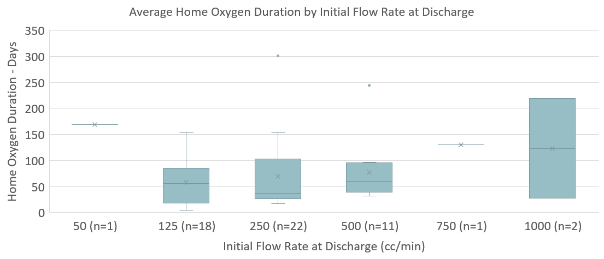
Duration By Starting Flow Rate

Slide 11
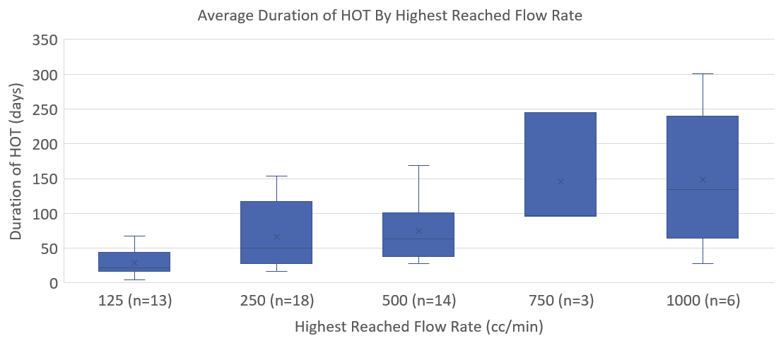
Duration by Highest Flow Rate Reached

Slide 12
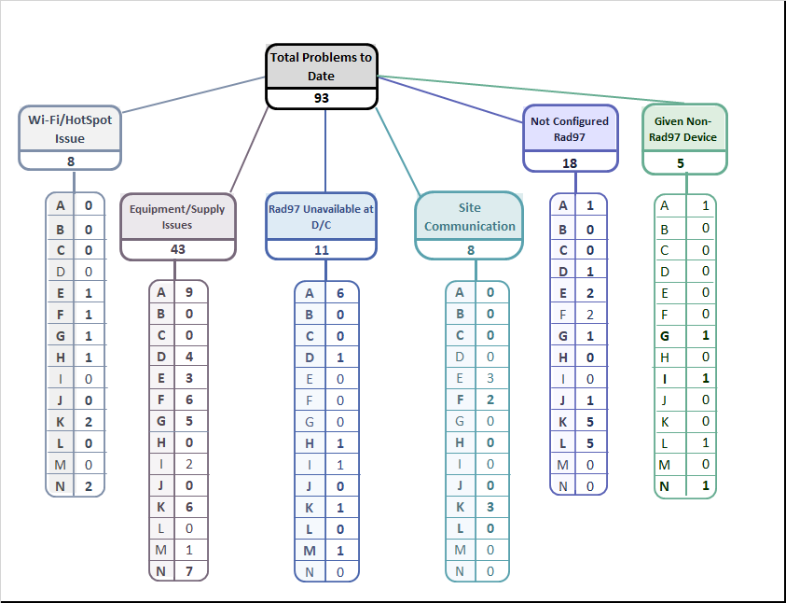
Implementation Related Problems

Slide 14
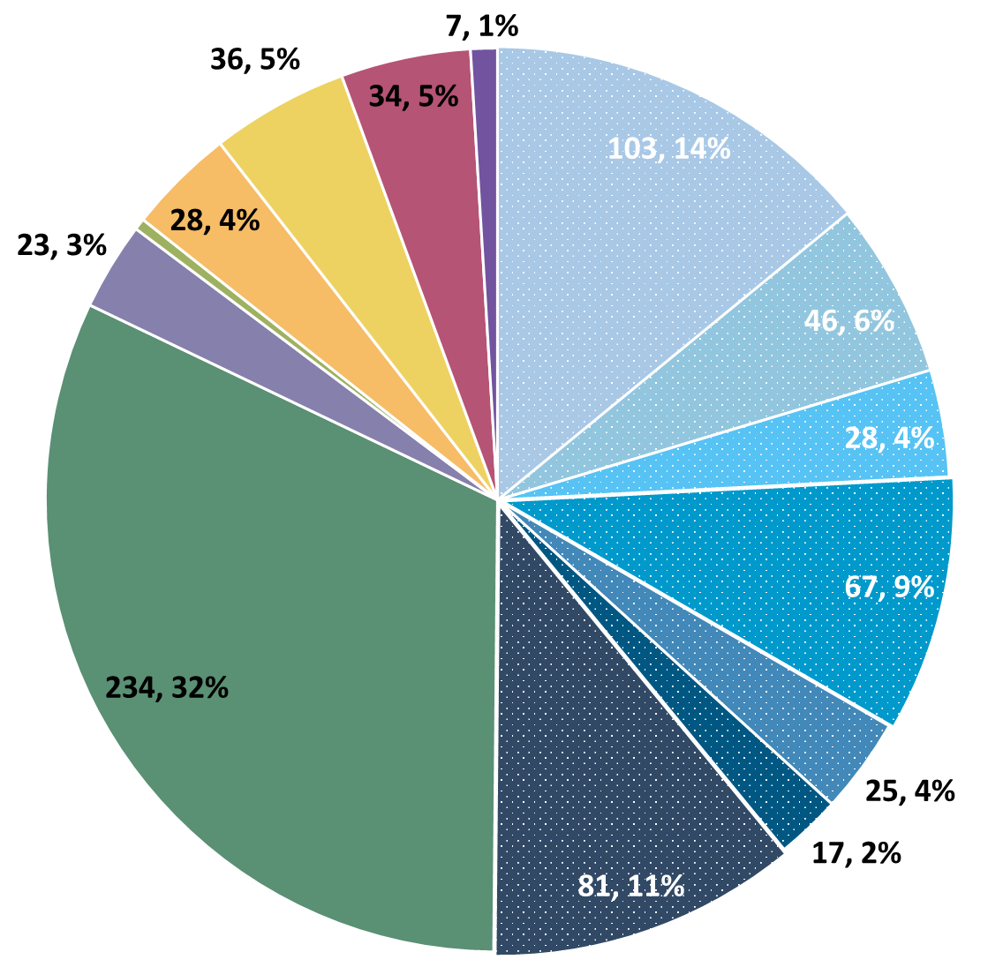
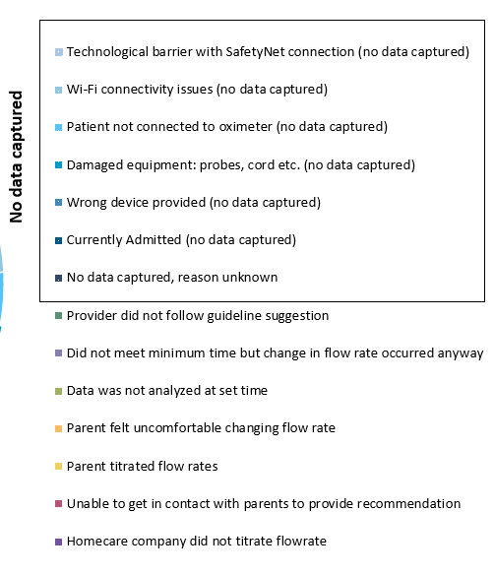
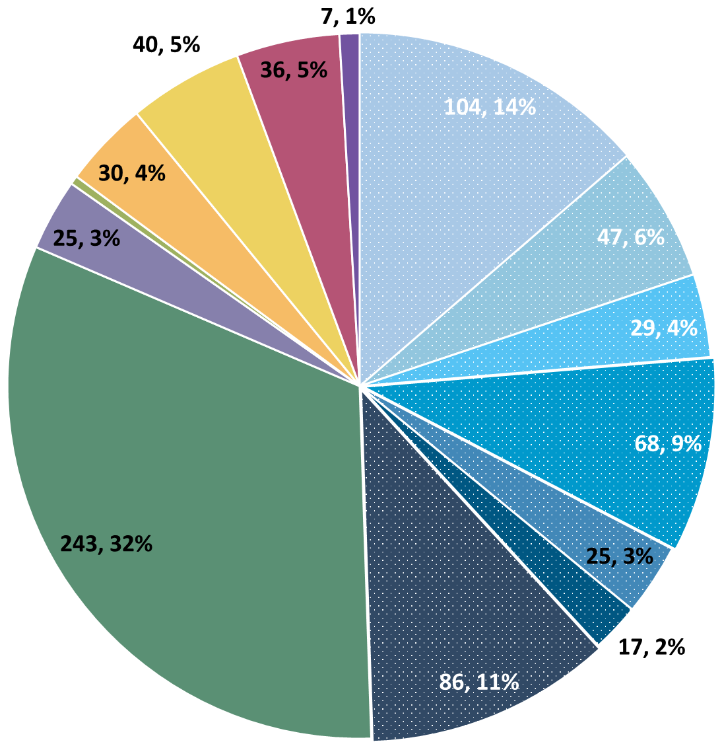
Deviation Types
Total Reports | Reports with Deviations | Reports with Deviations (excluding no data captured)
2,230 | 693 | 377
Last Months

Slide 15
Goal

Slide 16
Updates

Slide 17
PCORI Funding
Heather Working on Budget
Stay Tuned!

Slide 18
Low-Quality Signal Exclusion
New Algorithm Started Last Week
Automatically Removes Signal Marked as “Low-Quality”
Still Perfecting the Process

Slide 19
Importance of Changing Probes
Put in an image of data that is affected by probe
Have at least three separate babies who were seeing data like this and then switched probes and everything was fine

Slide 20
Discussion Points

Slide 21
Reminders

Slide 22
Data Queries
Early December
Missing Values and Forms in REDCap

Slide 23
Upper Respiratory Infections
RSV Season
If Serious Enough for Hospital Visit
  Please fill out REDCap AE form
If Not Serious Enough for Hospital Visit
  Please still inform us in download response emails
  We are looking to record this data incase it has a future impact

Slide 24
No Heather
Heather in on vacation through December
Please email Katie if you need anything
Emails to Heather will not be answered swiftly

Slide 25
Family Engagement Survey
For Sites w/out IRB Approval:
Instructions to submit to local IRBs sent out on 6/7
Please reach out to Heather and Katie with any questions/concerns/barriers
For Sites w/ IRB Approval:
Please Send Survey Links At Initial Discharge and After HOT Weaning
Spanish Version Coming very soon!

Slide 26


RHO Program Website
All resources, including training documents, the RHO manual, and other templates can be found on the RHO website at www.umassmed.edu/rho-program
Navigate to “Member Login” and log in with the following credentials to access the documents
  Username: RHO
  Password: Oximetry14

Slide 27



Closing Thoughts
Questions or Comments?
Are there any suggestions and/or feedback on the progress of the program that you would like to share with the team at this time?

