Slide 1

The Recorded Home Oximetry (RHO) Program
Monthly Investigator Meeting
August 3, 2023

Slide 2

RHO Program Implementation Timeline
Feb - Mar 2021
Baseline data collection begins
Mar - May 2021
Initiate site training
Initiate monthly phone calls
May - Aug 2021
Jun 2021 - Feb 2022
Feb - Aug 2022
Aug 2022 - Feb 2023
Complete site training
Reach 33% of eligible families
Reach 66% of eligible families
Feb - Aug 2023
Reach 100% of eligible families
Initiate 18-month implementation
Begin providing monthly feedback reports
Notes:
- Unchecked the goal to reach 66% as we have not fulfilled throughout the milestone period but are on our way

Slide 3
RHO Implementation Trial Consort Diagram
Average HOT Duration:
79 ± 63

Slide 4
Goal

Slide 5
Enrollment by Site
Site Name | 1st Patient Enrolled | Duration of Implementation | Estimate Per Year | Estimate Per Month | Current Per Month | Followed | Withdrawn | Weaned from HOT | Active on HOT | Average | SD
Boston Children's | 7/8/2021 | 25.10 | 40 | 3 | 0.9 | 23 | 7 | 10 | 6 | 68.60 | 54.60
Dartmouth-Hitchcock | 1/1/2022 | 19.20 | 20 | 2 | 1.2 | 23 | 1 | 19 | 3 | 75.42 | 75.50
Maria Fareri Children's Hospital | 11/18/2021 | 20.67 | 14 | 1 | 0.4 | 8 | 1 | 4 | 3 | 87.00 | 48.47
Massachusetts General Hospital | 7/8/2021 | 25.10 | 13 | 1 | 0.5 | 12 | 1 | 10 | 1 | 77.30 | 51.09
University of Maryland | 8/21/2021 | 23.63 | 20 | 2 | 1.5 | 36 | 11 | 19 | 6 | 42.95 | 29.69
Vanderbilt | 4/28/2021 | 27.47 | 70 | 6 | 0.2 | 5 | 3 | 0 | 2
Arkansas Children's Hospital | 10/20/2021 | 21.63 | 48 | 4 | 1.3 | 29 | 9 | 14 | 6 | 101.57 | 64.53
Children's Hospital of Philadelphia | 5/26/2021 | 26.53 | 50 | 4 | 0.2 | 4 | 1 | 3 | 0 | 105.33 | 77.86
Cincinnati Children's Hospital | 9/21/2022 | 10.43 | 50 | 4 | 1.8 | 19 | 3 | 11 | 5 | 67.36 | 47.58
National Jewish Health | 8/24/2022 | 11.37 | 250 | 21 | 2.2 | 25 | 8 | 4 | 13 | 123.50 | 49.84
Nationwide Children's Hospital | 3/4/2022 | 17.13 | 75 | 6 | 2.6 | 45 | 12 | 29 | 4 | 92.07 | 70.16
Payton Manning Children's Hospital | 7/19/2022 | 12.57 | 25 | 2 | 0.9 | 11 | 4 | 7 | 0 | 77.00 | 71.81
U. of California, San Diego | 11/10/2021 | 20.93 | 65 | 5 | 0.4 | 9 | 2 | 6 | 1 | 77.00 | 65.25
U. of Kentucky Children's Hospital | 11/21/2022 | 8.40 | 50 | 4 | 0.0 | 0 | 0 | 0 | 0
Total |  |  | 790 | 66 | 14 | 249 | 63 | 136 | 50 | 78.68 | 63.10

Slide 6

Barriers to Enrollment
Wave 1 Sites to have reached 100% enrollment of eligible families by August 2023
Only about 85% eligible infants being enrolled
Equipment exclusions have greatly decreased since the beginning of wave 1

Slide 7
Implementation Trial Outcomes

Slide 9
Average HOT Duration:
114 ± 91

Slide 10
Implementation Related Problems

Slide 11
Implementation Month-Year

Slide 12
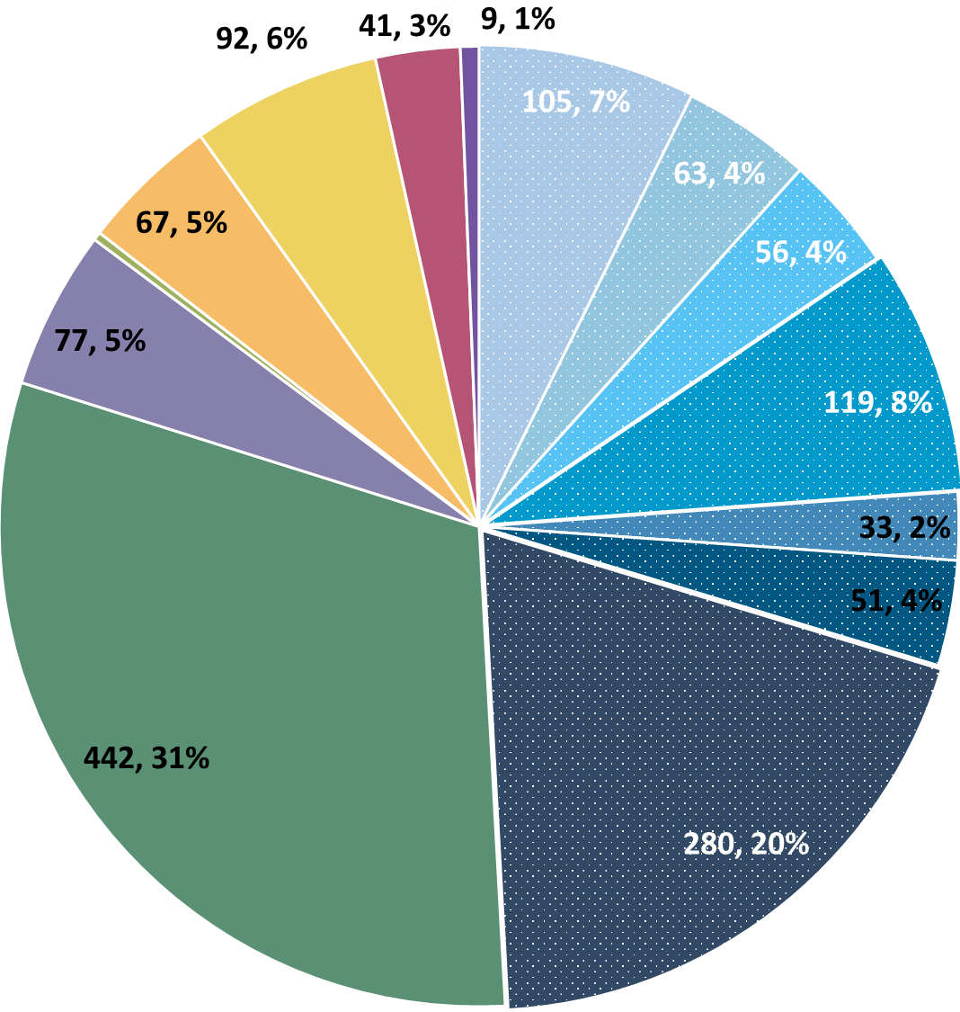
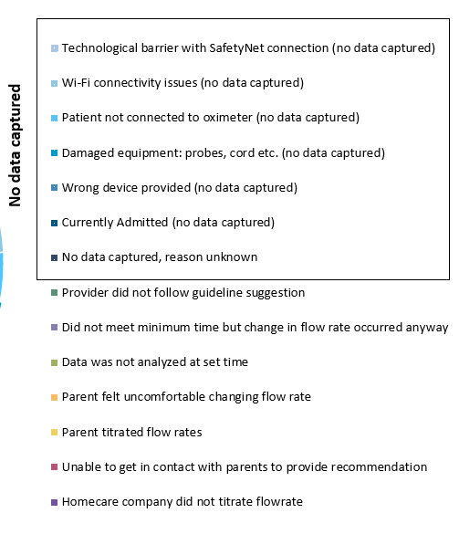
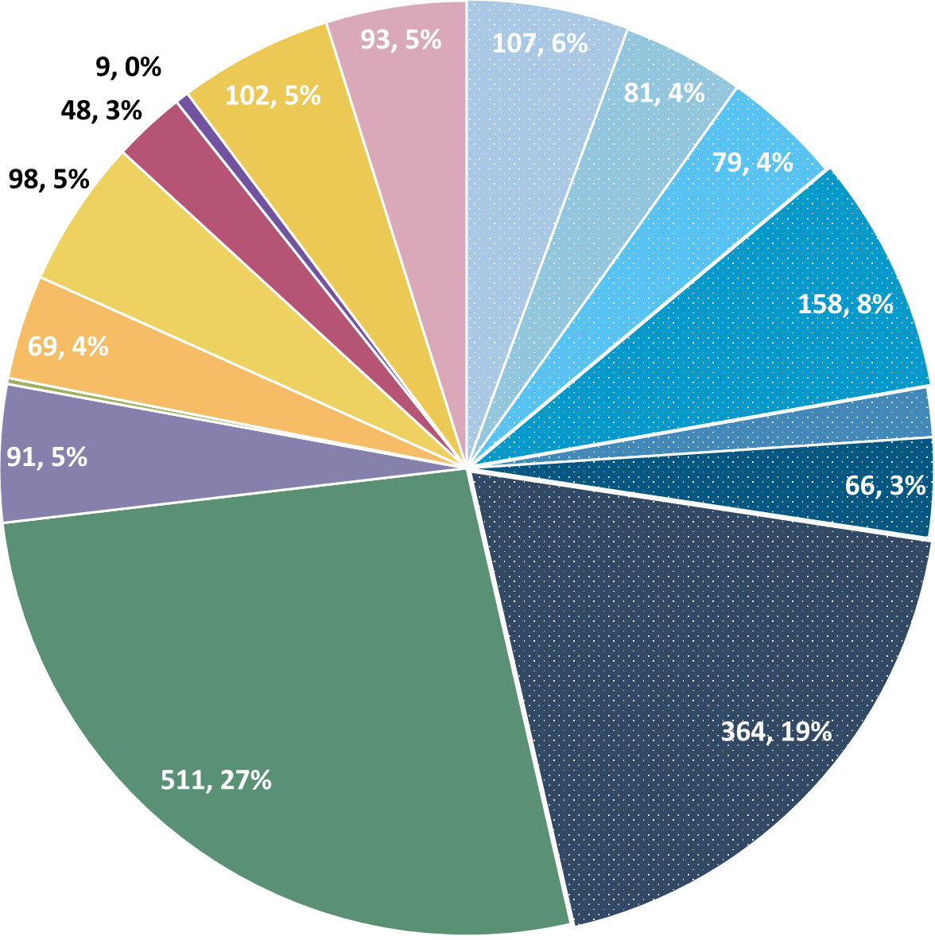
Deviation Types
Total Reports | Reports with Deviations | Reports with Deviations (excluding no data captured)
5765 | 1913 | 1025
Last Months

Slide 13
Goal

Slide 14
Updates

Slide 15
Withdrawal Breakdown

Slide 16
Withdrawal Breakdown
Family-Oriented
  Family Noncompliant w/ Recommendations
  Family Unwilling to Record Data at Home
  Family Self-Weaned
Equipment-Oriented
  Equipment Broke, No Replacement Available
  Wi-Fi Quality Incompatible w/ RAD97
Never Got Data
Screening Failure
  Infant Enrolled in Program Subsequently Found to be Ineligible
Unavoidable
  Family Switch to Non-Study Follow-Up Clinic
  New Clinical Findings Changed Patient Treatment Plan
  Patient Death
Other

Slide 17
Discussion

Slide 18
Reminders

Slide 19
Kristen Richard’s Project
Impact of SDoH on duration of HOT
Data due September 1st
Please reach out to Kristen or Heather with any questions/concerns

Slide 20
Contacting Patients Through the EMR
If the RHO recommendation is a maintain, you can contact patients using your EMR instead of a phone call if you prefer.

Slide 21
Family Engagement Survey
Reminder for all sites that have IRB approval that survey links should be sent to all families enrolled
Defined project milestone
Severely behind enrollment schedule

Slide 22
Reporting AEs
To Confirm Safety, We Are Looking for All AE Data Until 6 Months Post-Wean
We Require This For All Babies On Program Including Controls
The AE Form Is Available on REDCap (Katie Can Help w/ REDCap Access)

Slide 23
DSMB Meeting
Third meeting hosted on July 10th
DSMB found no issues and recommended that the trial progresses as planned

Slide 24
Katie Vacation
Katie will be on vacation until August 14th
RHO downloads + new enrollments → RHO Email (monitored by Tyler Allcroft) + Heather
All other inquiries → Heather

Slide 25



Closing Thoughts
Questions or Comments?
Are there any suggestions and/or feedback on the progress of the program that you would like to share with the team at this time?

Slide 26
Controls
Reminder: subjects withdrawn are still counted as controls if possible
Control Infant REDCap Forms
Screening
Demographics
AEs
Implementation Discharge
6 Months Post-Wean = Forms Complete
Controls Needed for Further Analysis

Slide 27
Importance of Changing Probes
Minutes Valid SpO2 | Mean SpO2 | Minimum SpO2 | Maximum SpO2 | Seconds Below 96% SpO2 | Minutes Below 96% SpO2 | % Time Below 96% SpO2 | Seconds Below 93% SpO2 | Minutes Below 93% SpO2 | % Time Below 93% SpO2 | Seconds Below 90% SpO2 | Minutes Below 90% SpO2 | % Time Below 90% SpO2
1713.183 | 97.8144 | 71 | 100 | 53496 | 891.6 | 52.04347 | 49650 | 827.5 | 48.30189 | 49581 | 826.35 | 48.23477
SpO2 > 96% | 90% - 96% SpO2 | SpO2 < 90%
822 Minutes | 65 Minutes | 826 Minutes
Notes:
Reading the above spit-out it says that the baby in question spen…
822 Minutes Above 96% SpO2
65 Minutes Between 90-96% SpO2
826 Minutes Below 90% SpO2
The above information, logically does not make sense… if you see data like this CHANGE THE PROBE… we as coordinating site cannot make this recommendation as that would bias the data… all we can do is report on what the algorithm tells us, and it is up to individual sites to interpret that recommendation in the unique situation of each baby

Slide 28


RHO Program Website
All resources, including training documents, the RHO manual, and other templates can be found on the RHO website at www.umassmed.edu/rho-program
Navigate to “Member Login” and log in with the following credentials to access the documents
  Username: RHO
  Password: Oximetry14

