Slide 1

The Recorded Home Oximetry (RHO) Program
Monthly Investigator Meeting
April 6, 2023

Slide 2

RHO Program Implementation Timeline
Feb - Mar 2021
Baseline data collection begins
Mar - May 2021
Initiate site training
Initiate monthly phone calls
May - Aug 2021
Jun 2021 - Feb 2022
Feb - Aug 2022
Aug 2022 - Feb 2023
Complete site training
Reach 33% of eligible families
Reach 66% of eligible families
Feb - Aug 2023
Reach 100% of eligible families
Initiate 18-month implementation
Begin providing monthly feedback reports
Notes:
- Unchecked the goal to reach 66% as we have not fulfilled throughout the milestone period but are on our way

Slide 3
RHO Implementation Trial Consort Diagram
Average HOT Duration:
76 ± 61

Slide 4
Goal

Slide 5
Enrollment by Site
Site Name | 1st Patient Enrolled | Duration of Implementation | Estimate Per Year | Estimate Per Month | Current Per Month | Followed | Withdrawn | Weaned from HOT | Active on HOT | Average | SD
Boston Children's | 7/8/2021 | 21.13 | 40 | 3 | 0.8 | 16 | 5 | 10 | 1 | 87.50 | 67.81
Dartmouth-Hitchcock | 1/1/2022 | 15.23 | 20 | 2 | 1.5 | 23 | 1 | 16 | 6 | 73.13 | 77.37
Maria Fareri Children's Hospital | 11/18/2021 | 16.70 | 14 | 1 | 0.3 | 5 | 0 | 2 | 3 | 90.00 | 49.92
Massachusetts General Hospital | 7/8/2021 | 21.13 | 13 | 1 | 0.5 | 10 | 1 | 8 | 1 | 86.75 | 48.46
University of Maryland | 8/21/2021 | 19.67 | 20 | 2 | 1.2 | 24 | 7 | 12 | 5 | 50.17 | 33.72
Vanderbilt | 4/28/2021 | 23.50 | 70 | 6 | 0.1 | 3 | 2 | 0 | 1
Arkansas Children's Hospital | 10/20/2021 | 17.67 | 48 | 4 | 1.2 | 22 | 9 | 10 | 3 | 90.60 | 54.15
Children's Hospital of Philidelphia | 5/26/2021 | 22.57 | 50 | 4 | 0.2 | 4 | 1 | 2 | 1 | 51.00 | 27.90
Cincinnati Children's Hopsital | 9/21/2022 | 6.47 | 50 | 4 | 1.5 | 10 | 1 | 3 | 6 | 88.33 | 46.22
National Jewish Health | 8/24/2022 | 7.40 | 250 | 21 | 2.2 | 16 | 5 | 3 | 8 | 99.67 | 42.09
Nationwide Children's Hospital | 3/4/2022 | 13.17 | 75 | 6 | 3.2 | 42 | 10 | 26 | 6 | 75.70 | 63.44
Payton Manning Children's Hospital | 7/19/2022 | 8.60 | 25 | 2 | 1.2 | 10 | 4 | 4 | 2 | 49.75 | 35.05
U. of California, San Diego | 11/10/2021 | 16.97 | 65 | 5 | 0.5 | 8 | 2 | 4 | 2 | 88.25 | 70.74
U. of Kentucky Children's Hospital | 11/21/2022 | 4.43 | 50 | 4 | 0.0 | 0 | 0 | 0 | 0
Total |  |  |  |  |  | 193 | 25 | 100 | 45 | 76.13 | 61.05

Slide 6
Implementation Trial Outcomes

Slide 9
Implementation Related Problems

Slide 11
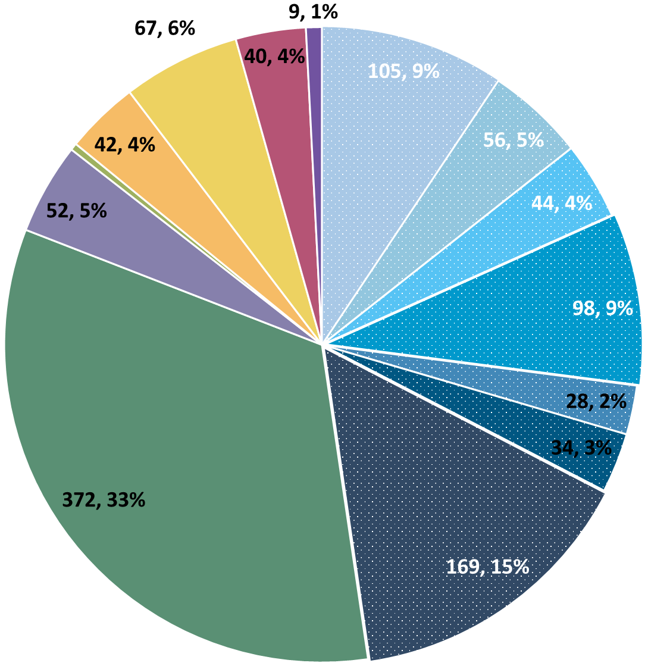
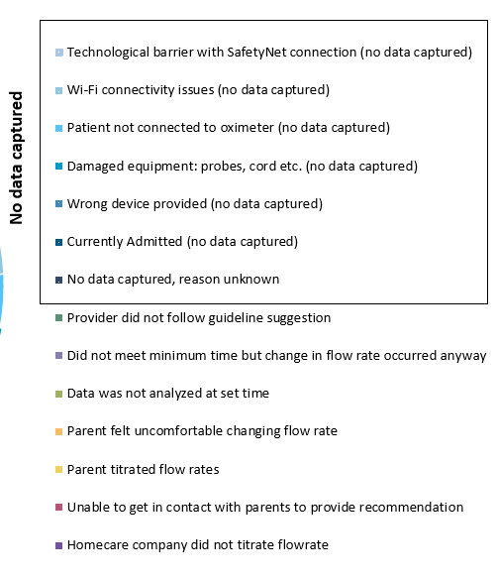
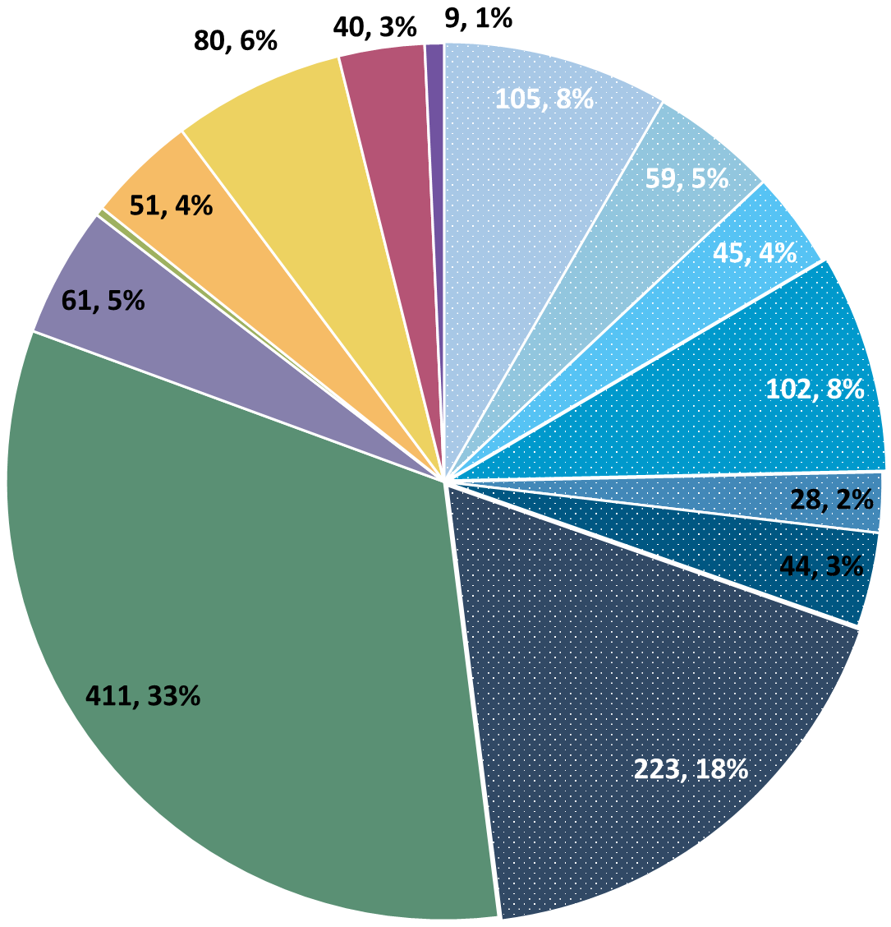
Deviation Types
Total Reports | Reports with Deviations | Reports with Deviations (excluding no data captured)
4278 | 1262 | 647
Last Months

Slide 12
Goal

Slide 13
Updates

Slide 14
Upcoming
Asks
Publications Committee
We are beginning to look at publishing some of our RHO data
Cost-Analysis Survey
Coming up
Expenses related to start-up and maintenance of RHO
We will be forming a publications committee soon to help with these projects

Slide 15
New RHO Data

Slide 16
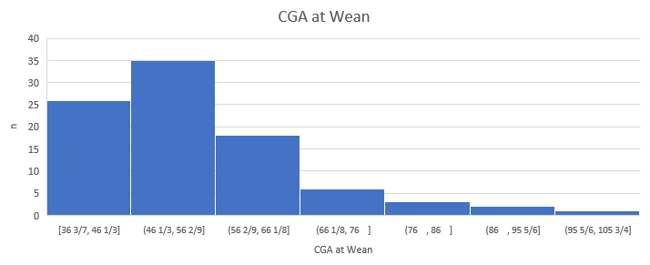
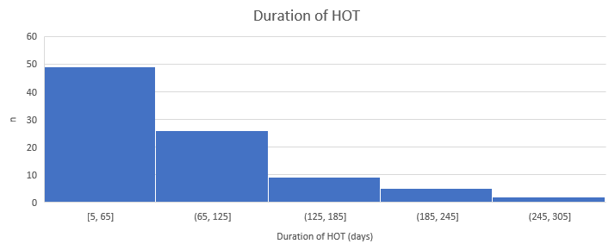
General Trends

Slide 17
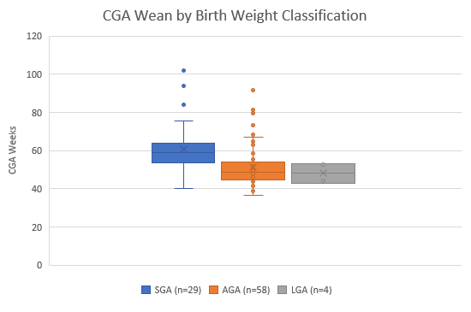
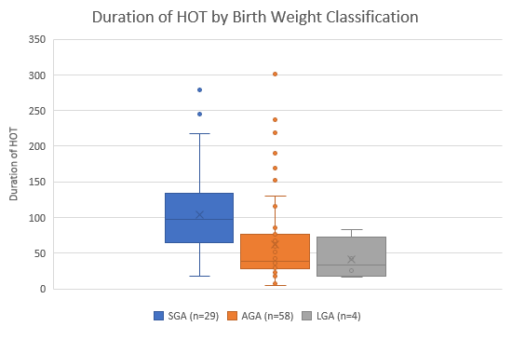
Birth Weight Classification

Slide 18
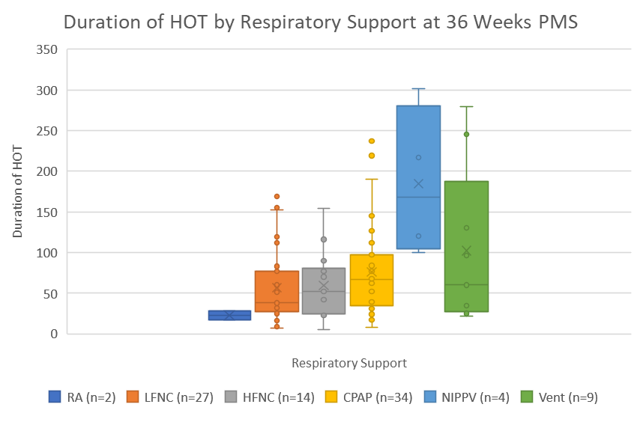
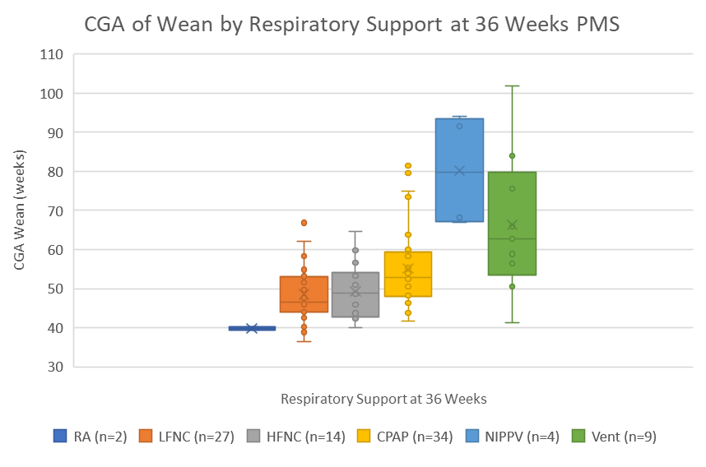
Respiratory Support at 36 Weeks PMS

Slide 19
Birth Weight

Slide 20
NICU LoS

Slide 21
Birth GA

Slide 22
CGA Discharge

Slide 23
Conclusions
 | Shorter Duration | Longer Duration
Birth Weight Classification | AGA | SGA
Oxygen Support @ 36 Weeks | Less Severe | More Severe
Birth Weight | Higher (↑) | Lower (↓)
NICU LoS | Lower (↓) | Higher (↑)
Birth GA | Higher (↑) | Lower (↓)
CGA Discharge | Lower (↓) | Higher (↑)

Slide 24
Discussion Points

Slide 25
Altitude Related Protocol Change
Our infants at higher altitudes are having generally lower O2 saturations, take longer to wean, and are more likely to require an increase.
Three options…
Change standards for requesting an increase
Change check-in frequency
No change to protocol
Things to think about
Are there safety concerns?
Is our algorithm too strict?

Slide 26
Reminders

Slide 27
Controls
Reminder: subjects withdrawn are still counted as controls if possible
Control Infant REDCap Forms
Screening
Demographics
AEs
Implementation Discharge
6 Months Post-Wean = Forms Complete
Controls Needed for Further Analysis

Slide 28
Importance of Changing Probes
Minutes Valid SpO2 | Mean SpO2 | Minimum SpO2 | Maximum SpO2 | Seconds Below 96% SpO2 | Minutes Below 96% SpO2 | % Time Below 96% SpO2 | Seconds Below 93% SpO2 | Minutes Below 93% SpO2 | % Time Below 93% SpO2 | Seconds Below 90% SpO2 | Minutes Below 90% SpO2 | % Time Below 90% SpO2
1713.183 | 97.8144 | 71 | 100 | 53496 | 891.6 | 52.04347 | 49650 | 827.5 | 48.30189 | 49581 | 826.35 | 48.23477
SpO2 > 96% | 90% - 96% SpO2 | SpO2 < 90%
822 Minutes | 65 Minutes | 826 Minutes
Notes:
Reading the above spit-out it says that the baby in question spen…
822 Minutes Above 96% SpO2
65 Minutes Between 90-96% SpO2
826 Minutes Below 90% SpO2
The above information, logically does not make sense… if you see data like this CHANGE THE PROBE… we as coordinating site cannot make this recommendation as that would bias the data… all we can do is report on what the algorithm tells us, and it is up to individual sites to interpret that recommendation in the unique situation of each baby

Slide 29
Reporting AEs
To Confirm Safety, We Are Looking for All AE Data Until 6 Months Post-Wean
We Require This For All Babies On Program Including Controls
The AE Form Is Available on REDCap (Katie Can Help w/ REDCap Access)

Slide 30
Family Engagement Survey
For Sites w/out IRB Approval:
Instructions to submit to local IRBs sent out on 6/7
Please reach out to Heather and Katie with any questions/concerns/barriers
For Sites w/ IRB Approval:
Please Send Survey Links At Initial Discharge and After HOT Weaning
Spanish Version Coming Very Soon! (waiting on IRB)

Slide 31


RHO Program Website
All resources, including training documents, the RHO manual, and other templates can be found on the RHO website at www.umassmed.edu/rho-program
Navigate to “Member Login” and log in with the following credentials to access the documents
  Username: RHO
  Password: Oximetry14

Slide 32



Closing Thoughts
Questions or Comments?
Are there any suggestions and/or feedback on the progress of the program that you would like to share with the team at this time?

