Slide 1

The Recorded Home Oximetry (RHO) Program
Monthly Investigator Meeting
April 4th, 2024

Slide 2

RHO Program Implementation Timeline
Feb - Mar 2021
Baseline data collection begins
Mar - May 2021
Initiate site training
Initiate monthly phone calls
May - Aug 2021
Jun 2021 - Feb 2022
Feb - Aug 2022
Aug 2022 - Feb 2023
Complete site training
Reach 33% of eligible families
Reach 66% of eligible families
Feb - Aug 2023
Reach 100% of eligible families
Initiate 18-month implementation
Begin providing monthly feedback reports
Notes:
- Unchecked the goal to reach 66% as we have not fulfilled throughout the milestone period but are on our way

Slide 3
RHO Implementation Trial Consort Diagram
Average HOT Duration:
78 ± 67

Slide 4
Goal
Notes:
Only 4 enrollments in December

Slide 6
Enrollment by Site
Site Name | 1st Patient Enrolled | Duration of Implementation | Estimate Per Year | Estimate Per Month | Current Per Month | Followed | Withdrawn | Weaned from HOT | Active on HOT | Average | SD
Boston Children's | 7/8/2021 | 33.27 | 40 | 3 | 1.0 | 33 | 10 | 19 | 3 | 65.79 | 51.18
Dartmouth-Hitchcock | 1/1/2022 | 27.37 | 20 | 2 | 1.1 | 29 | 1 | 27 | 1 | 81.19 | 85.29
Maria Fareri Children's Hospital | 11/18/2021 | 28.83 | 14 | 1 | 0.4 | 12 | 5 | 6 | 1 | 76.50 | 44.22
Massachusetts General Hospital | 7/8/2021 | 33.27 | 13 | 1 | 0.4 | 12 | 1 | 11 | 0 | 111.64 | 106.36
University of Maryland | 8/21/2021 | 31.80 | 20 | 2 | 1.6 | 51 | 18 | 33 | 0 | 55.03 | 43.53
Vanderbilt | 4/28/2021 | 35.63 | 70 | 6 | 0.2 | 6 | 6 | 0 | 0
Arkansas Children's Hospital | 10/20/2021 | 29.80 | 48 | 4 | 1.2 | 35 | 13 | 20 | 2 | 102.25 | 64.33
Children's Hospital of Philadelphia | 5/26/2021 | 34.70 | 50 | 4 | 0.1 | 4 | 1 | 3 | 0 | 105.33 | 77.86
Cincinnati Children's Hospital | 9/21/2022 | 18.60 | 50 | 4 | 1.9 | 35 | 8 | 22 | 5 | 58.73 | 42.83
National Jewish Health | 8/24/2022 | 19.53 | 250 | 21 | 1.5 | 29 | 19 | 6 | 4 | 165.17 | 76.25
Nationwide Children's Hospital | 3/4/2022 | 25.30 | 75 | 6 | 2.5 | 62 | 25 | 35 | 2 | 74.80 | 57.89
Payton Manning Children's Hospital | 7/19/2022 | 20.73 | 25 | 2 | 0.7 | 15 | 5 | 9 | 1 | 67.11 | 63.89
U. of California, San Diego | 11/10/2021 | 29.10 | 65 | 5 | 0.4 | 13 | 4 | 7 | 2 | 89.00 | 66.85
U. of Kentucky Children's Hospital | 11/21/2022 | 16.57 | 50 | 4 | 0.0 | 0 | 0 | 0 | 0
Total |  |  | 790 | 66 | 13 | 336 | 116 | 198 | 21 | 77.95 | 67.03

Slide 7
Implementation Trial Outcomes

Slide 8
Average HOT Duration:
78 ± 67
Goal

Slide 11
Starting to Look at Different Phenotypes of Weaning Patterns
Decrease
Increase
No Change
Variable
Defined as requiring at least 1 decrease in O₂ flow rate in first 10 epochs
Defined as requiring at least 1 increase in O₂ flow rate in the first 10 epochs
Defined as no change made to O₂ flow rate in the first 10 epochs
Defined as a mix of increases and decreases in the first 10 epochs
Data presented at ESPR and will be an oral presentation at SPR
Infants were broken into 4 distinct groups based on their weaning pattern within the first 10 epochs following NICU discharge.

Slide 12
Results
Table 1: Flow Rate Fluctuation Groups and Factors Possibly Impacting Duration | Flow Rate Fluctuation Groups and Factors Possibly Impacting Duration
 | Decrease 60 (47%) | Increase 14 (11%) | No Change 3 (2%) | Variable 52 (40%) | P-Value
Male | 36 (60) | 5 (38) | 3 (100) | 32 (65) | 0.17
Small for Gestational Age | 9 (20) | 5 (63) | 2 (100) | 10 (29) | 0.05
Race |  |  |  |  | 0.83
White | 37 (61) | 9 (69) | 2 (67) | 27 (56)
Black | 16 (27) | 3 (23) | 1 (33) | 11 (23)
Asian | 4 (7) | 0 (0) | 0 (0) | 5 (10)
Other | 3 (5) | 0 (0) | 0 (0) | 2 (4)
Ethnicity |  |  |  |  | 0.06
Hispanic | 6 (10) | 0 (0) | 0 (0) | 3 (6)
Severe BPD, Ventilation at 36 wks CGA | 2 (4) | 1 (11) | 0 (0) | 5 (14) | 0.63
Discharge Flow Rate |  |  |  |  | 0.53
125 cc/min | 11 (24) | 4 (44) | 0 (0) | 12 (33)
250 cc/min | 9 (20) | 2 (22) | 1 (50) | 5 (14)
500 cc/min | 10 (22) | 0 (0) | 1 (50) | 6 (17)
750 cc/min | 1 (2) | 0 (0) | 0 (0) | 0 (0)
1000 cc/min | 1 (2) | 0 (0) | 0 (0) | 1 (2)
A total of 129 infants were included in the analyses.
The majority of infants fell into either the decrease or variable cohort groups.
  Most common timing of an increase in the variable group was within the first two epochs following NICU discharge.
Of baseline characteristics collected, being SGA at birth was associated with requiring increases or fluctuations in O₂ flow rate.
BPD severity, discharge flow rate, and gender were not associated with longer HOT duration.

Slide 13
Results
Infants requiring one or more flow rate increase were more likely to have longer durations of HOT.
Infants discharged on mid-level support had the smoothest weaning trajectory.
Infants that had a flow rate weaned within the first 10 epochs had the shortest duration of HOT (p < 0.0001).

Slide 14
Average Control HOT Duration:
123 ± 97

Slide 15
Implementation Related Problems

Slide 16
Implementation Quarter-Year

Slide 17
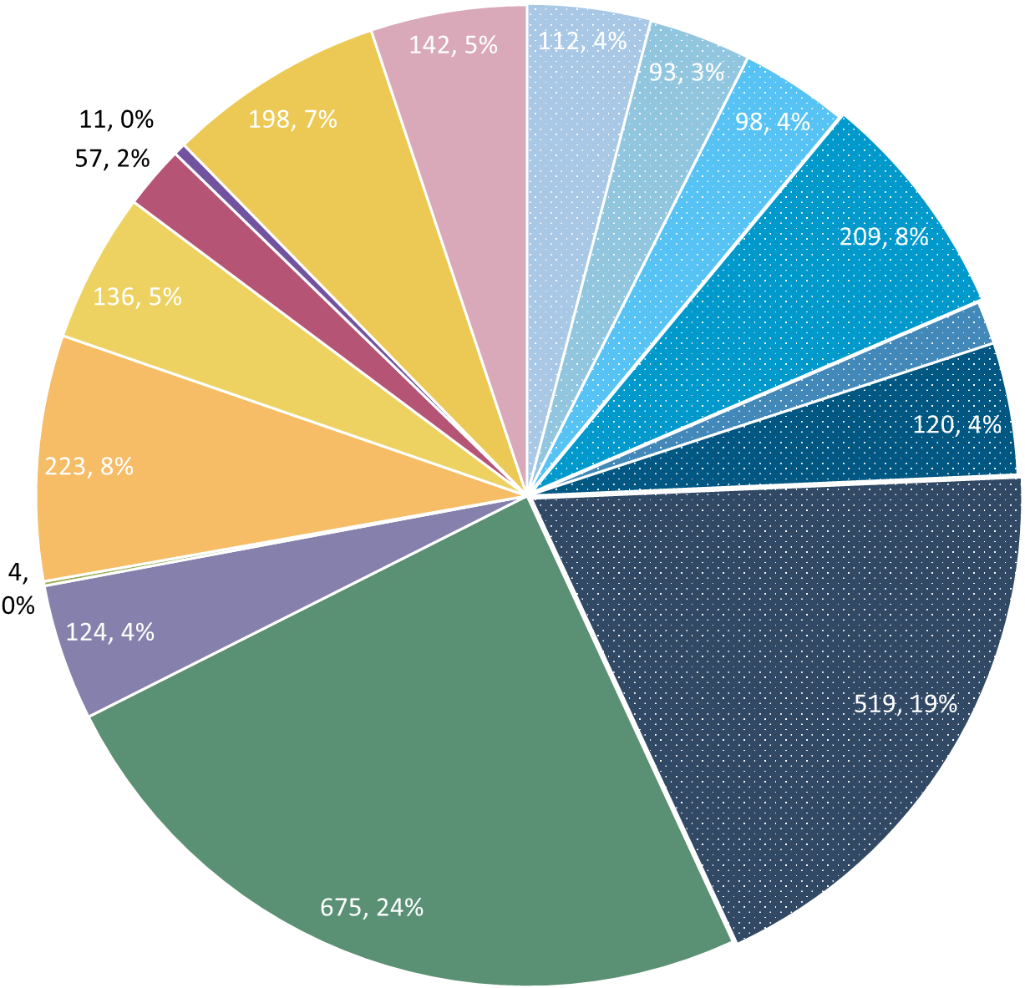
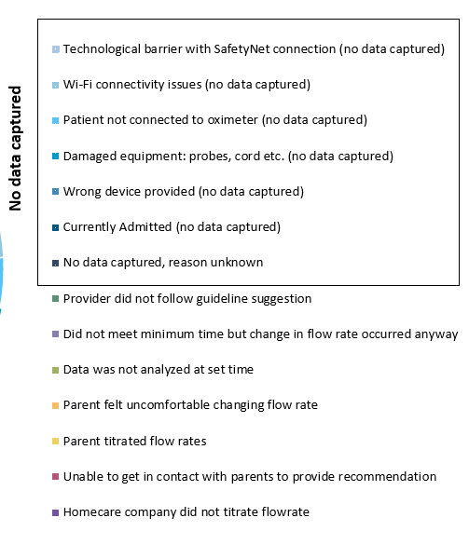
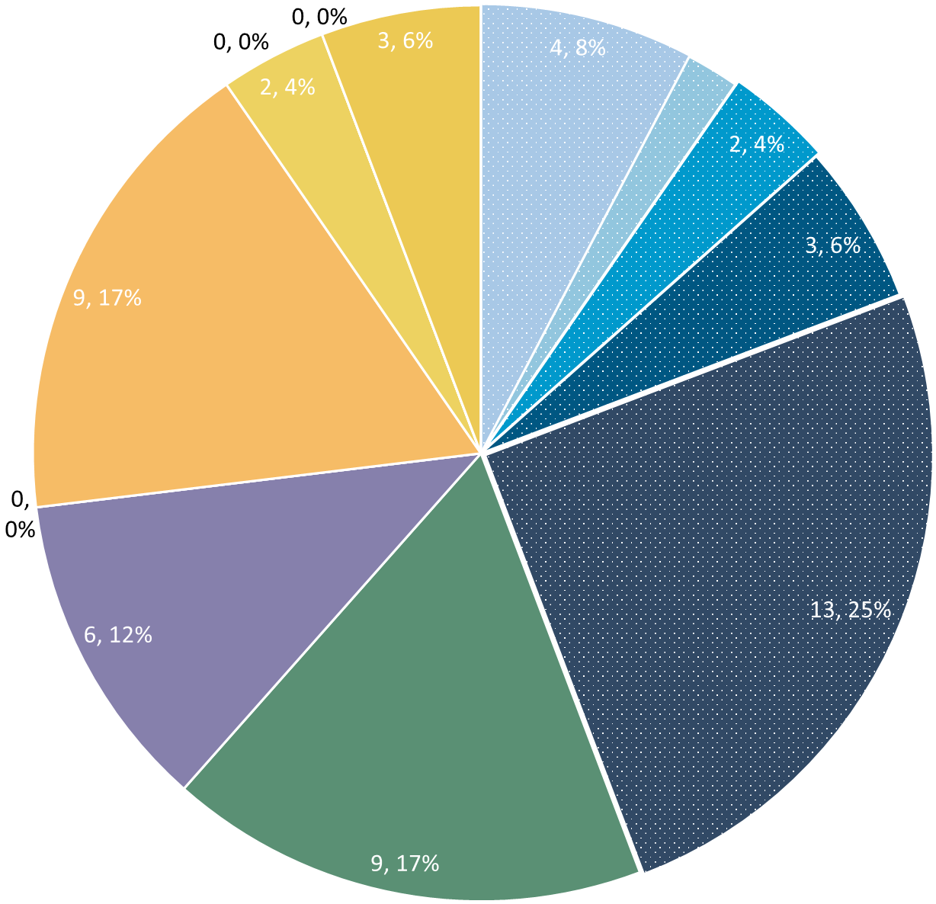
Deviation Types
Total Reports | Reports with Deviations | Reports with Deviations (excluding no data captured)
8669 | 2714 | 1570
Total
Last Month

Slide 18
Goal

Slide 19
Updates

Slide 20
Katie is Leaving
Katie will be starting medical school at UMASS this fall
Tentative last day is Friday, August 2nd
Maddie and Samia taking over
  Be on the look out for introductory email
Taking over downloads starting end of May
Transition period over the summer

Slide 21
Quantitative Cost Analysis Surveys
Sent to PI’s today
Necessary to know how best to continue RHO after study ends
Questions about volume, start-up costs, and operating costs at your site
Should be filled out with/by someone knowledgeable about the budget at your site

Slide 22
Discussion

Slide 23
Reminders

Slide 24
New Variables (Not Mandatory)
New Variables
COI
Growth/Nutrition
Pulmonary Medications
Contact Heather/Katie w/ Questions

Slide 25
Family Engagement Survey
Reminder for all sites that have IRB approval that survey links should be sent to all families enrolled
Defined project milestone
Severely behind enrollment schedule (0.01% response rate)

Slide 26



Closing Thoughts
Questions or Comments?
Are there any suggestions and/or feedback on the progress of the program that you would like to share with the team at this time?

Slide 27
Consenting Reminders
OKAY to consent at first pulmonary follow-up if missed at NICU discharge.
Consent is for SHARING data not USING program.
If RHO not feasible, please still present fact sheet and ask for permission to use data as control.

Slide 28
Controls
Reminder: subjects withdrawn are still counted as controls if possible
Control Infant REDCap Forms
Screening
Demographics
AEs
Implementation Discharge
6 Months Post-Wean = Forms Complete
Controls Needed for Further Analysis

Slide 29
Contacting Patients Through the EMR
If the RHO recommendation is a maintain, you can contact patients using your EMR instead of a phone call if you prefer.

Slide 30
Reporting AEs
To Confirm Safety, We Are Looking for All AE Data Until 6 Months Post-Wean
We Require This For All Babies On Program Including Controls
The AE Form Is Available on REDCap (Katie Can Help w/ REDCap Access)

Slide 31
Importance of Changing Probes
Minutes Valid SpO2 | Mean SpO2 | Minimum SpO2 | Maximum SpO2 | Seconds Below 96% SpO2 | Minutes Below 96% SpO2 | % Time Below 96% SpO2 | Seconds Below 93% SpO2 | Minutes Below 93% SpO2 | % Time Below 93% SpO2 | Seconds Below 90% SpO2 | Minutes Below 90% SpO2 | % Time Below 90% SpO2
1713.183 | 97.8144 | 71 | 100 | 53496 | 891.6 | 52.04347 | 49650 | 827.5 | 48.30189 | 49581 | 826.35 | 48.23477
SpO2 > 96% | 90% - 96% SpO2 | SpO2 < 90%
822 Minutes | 65 Minutes | 826 Minutes
Notes:
Reading the above spit-out it says that the baby in question spen…
822 Minutes Above 96% SpO2
65 Minutes Between 90-96% SpO2
826 Minutes Below 90% SpO2
The above information, logically does not make sense… if you see data like this CHANGE THE PROBE… we as coordinating site cannot make this recommendation as that would bias the data… all we can do is report on what the algorithm tells us, and it is up to individual sites to interpret that recommendation in the unique situation of each baby

Slide 32


RHO Program Website
All resources, including training documents, the RHO manual, and other templates can be found on the RHO website at www.umassmed.edu/rho-program
Navigate to “Member Login” and log in with the following credentials to access the documents
  Username: RHO
  Password: Oximetry14

