Slide 1
Gadolinium Induced Fibrosis
Physician-Scientist Forum
Science Consult
Grace Masters; Eric Ding
Kevin Gao; Jefferey Zhou; Nick Peterson

Slide 2
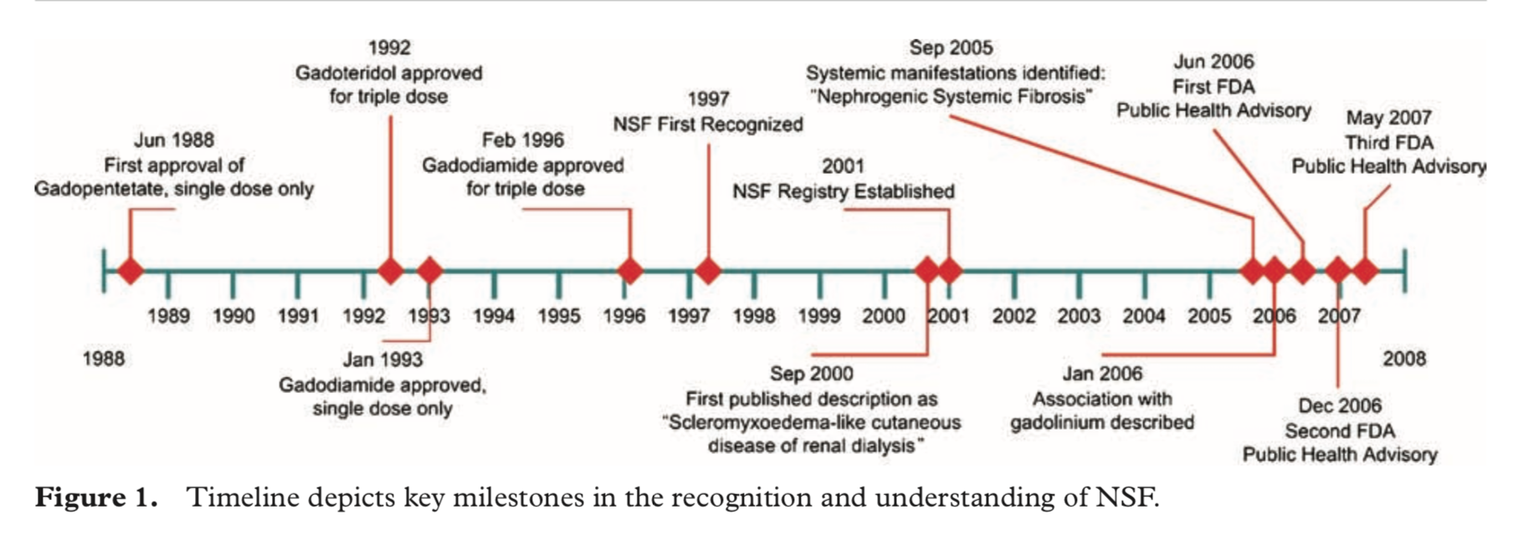
History of NSF
Juluru et al. MR Imaging in Patients at Risk for Developing Nephrogenic Systemic Fibrosis: Protocols, Practices, and Imaging Techniques to Maximize Patient Safety. RadioGraphics 2009; 29:9–22
Notes:
As you just heard, NSF is a serious disease that has an interesting and rather circumscribed history. It’s interesting because it follows a somewhat “traditional” epidemiological path from discovery to research and understand and, ultimately, prevention and population level management.
Late 80s/early 90s
The first gadolinium-based contrast agents (GBCA) were approved by FDA in the late 80s and early 90s to be used in MRI scans with contrast.
GBCAs became commonplace in the 1990s and early 2000s in patients with any degree of renal impairment b/c GBCAs were not associated with the same rates of nephrotoxicity as iodinated contrast agents
However, with this uptake - a new disease entity was observed and described in patients with kidney disease
--
1997 – first observation
First cases of NSF observed in 1997 at Sharp Memorial Hospital in San Diego, California.
--
2000 – first case series published

Slide 3
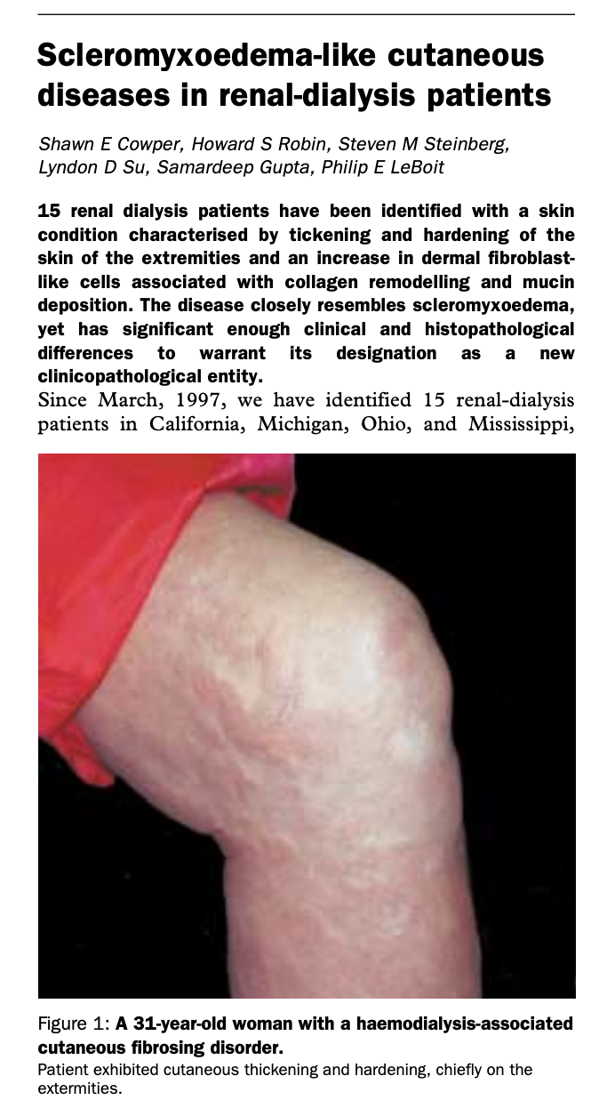
THE LANCET • Vol 356 • September 16, 2000
Notes:
Case series of several patients undergoing hemodialysis with stage 5 CKD who developed NSF after exposure to gadolinium contrast agents, calling it nephrogenic fibrosing dermopathy b/c only originally saw the skin manifestations
Noticed in patients that were recipients of renal transplants and those with stage 5 CKD

Slide 4
Stages of Chronic Kidney Disease
Stage | Description | GFR (mL/min/1.73 m²) | N (1000s) | %
1 | Kidney damage with normal or ↑ GFR | ≥90 | 3,600 | 1.8
2 | Kidney damage with mild ↓ GFR | 60-89 | 6,500 | 3.2
3 | Moderate ↓ GFR | 30-59 | 15,500 | 7.7
4 | Severe ↓ GFR | 15-29 | 700 | 0.4
5 | Kidney failure | <15 (or dialysis or transplant) | 580 | 0.3
Prevalence*
*Data for Stages 1-4 from NHANES IV (1999-2004). Population of 200 million adults age ≥20 years. Data for Stage 5 from USRDS (2008) include approximately 355,000 patients treated by dialysis and approximately 151,000 patients treated with renal transplantation and assume 74,000 additional patients not on dialysis.
National Kidney Foundation. K/DOQI Clinical practice guidelines for chronic kidney disease: evaluation, classification, and stratification. Am J Kidney Dis. 2000; 39 [Suppl 1]: 1–237;
J Coresh et al. JAMA 2007;298:2038-2047; USRDS 2008.
Slide courtesy of Dr. Jonathan Kay
Notes:
4
Just to remind you the stages of CKD…

Slide 5
History of NSF
Juluru et al. MR Imaging in Patients at Risk for Developing Nephrogenic Systemic Fibrosis: Protocols, Practices, and Imaging Techniques to Maximize Patient Safety. RadioGraphics 2009; 29:9–22
Notes:
Early 2000-2005
Within just a few years, scores of NFD cases were published from around the globe
Thought that renal impairment alone may
Found not just limited to skin but multiple organ systems involved
Renamed NSF
--
2006 – first association

Slide 6
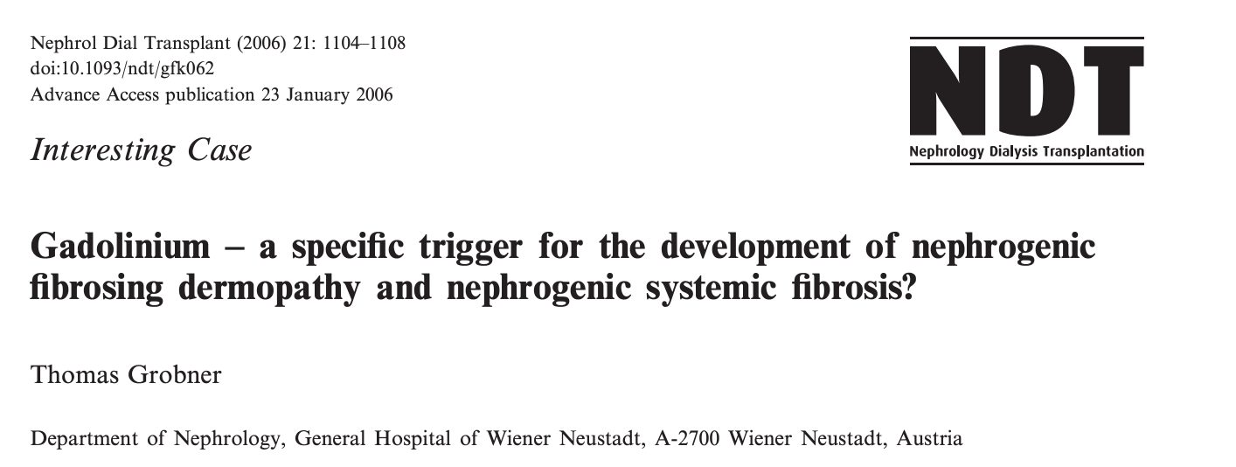
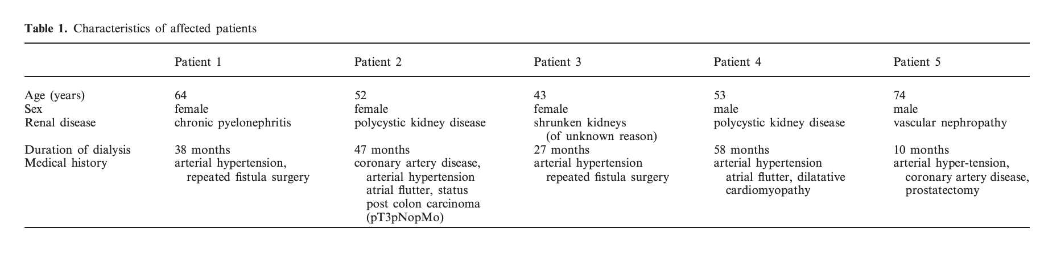
Notes:
Seminal report in Austria on 5 patients (of 9) with dialysis dep CKD that got NSF within weeks for receiving gad contrast

Slide 7
24-Month Survival for Patients With and Without Cutaneous Evidence of NSF
Among patients with clinical evidence of NSF, 24-month mortality was increased significantly as compared to those without (48% versus 20%, respectively)
Mortality was not associated with HD site or shift
No cutaneous changes of NSF
p=0.0004
Cutaneous changes of NSF
Months
DJ Todd, A Kagan, L Chibnik, J Kay. Arthritis Rheum 2007; 56:3433-3441
Slide courtesy of Dr. Jonathan Kay
Notes:
And in 2007 - Todd et al – established first suggestion of causal association and increased mortality rate
prospective case–control cohort study, Todd and colleagues observed skin changes characteristic of NSF in 13% of 186 patients with stage 5 chronic kidney disease who were receiving haemodialysis in community-based centres. Among these patients, prior exposure to a gadolinium- containing contrast agent was strongly associated with the subsequent development of NSF skin changes (OR 14.7).
Kaplan-Meier curve showing 24-month survival of patients in cohort 2 following skin examination. The solid line represents patients without cutaneous changes of nephrogenic systemic fibrosis (NSF), and the broken line represents patients with cutaneous changes of NSF.

Slide 8
History of NSF
Juluru et al. MR Imaging in Patients at Risk for Developing Nephrogenic Systemic Fibrosis: Protocols, Practices, and Imaging Techniques to Maximize Patient Safety. RadioGraphics 2009; 29:9–22
Notes:
2006 and beyond
Following Grobner’s insightful suggestion that NSF might be a complication of gadolinium-containing contrast agent administration in patients with stage 5 chronic kidney disease, several lines of investigation have established a strong causal relationship between exposure to gadolinium-containing contrast agents used in imaging procedures and the subsequent development of NSF
Between 2006 and 2008, more than 300 cases linking gadolinium with NFD were published.
Most published cases of NSF were associated with formulated gadodiamide, the least stable of the various GBCAs
Eric will talk about later but starting in 2006 is when the FDA stepped in
2006 – letters warning
2007 – black box risks for gad
The FDA revised the boxed warning in 2010, advising practitioners against the use of gadodiamide, gadoversetamide, and gadopentetate dimeglumine (all linear agents) in patients with acute kidney injury (AKI) or chronic kidney disease (CKD) with eGFR <30 mL/min/1.73 m2.

Slide 9
Studies Reporting Prevalence of NSF in Patients with Stage 5 CKD
Study (Location) | Year Published | Type | GBCA exposure | NSF cases/ total patients | NSF cases/ GBCA- exposed patients
Marckmann et al. (Denmark) | 2006 | Retrospective | Gadodiamide | N/A | 13/370 (3.5%)
Broome et al. (Loma Linda, CA) | 2007 | Retrospective | Gadodiamide | 10/168 (6%) | N/A
Collidge et al. (Scotland) | 2007 | Retrospective | Gadodiamide | 14/1826 (0.8%) | 13/421 (3.1%)
Deo et al. (Bridgeport, CT) | 2007 | Retrospective | Gadodiamide | 3/467 (0.6%) | 3/87 (3.4%)
Lauenstein et al. (Atlanta, GA) | 2007 | Retrospective | Gadodiamide | N/A | 8/312 (2.6%)
Othersen et al. (Charleston, SC) | 2007 | Retrospective | Gadodiamide | 4/849 (0.5%) | 4/261 (1.5%)
Todd et al. (Boston, MA) | 2007 | Cross-sectional & prospective | Gadopentetate dimeglumine | 25/186 (13.4%) | 16/54 (29.6%)
Prince et al. (New York, NY) | 2008 | Retrospective | Gadodiamide, gadopentetate dimeglumine, gadobenate dimeglumine, gadoteridol | N/A | 11/398 (2.8%)
Rydahl et al. (Denmark) | 2008 | Retrospective | Gadodiamide | N/A | 18/102 (17.6%)
EJ Bernstein, C Schmidt-Lauber, J Kay Best Pract Res Clin Rheumatol. 2012;26:489-503 .
Slide courtesy of Dr. Jonathan Kay
Notes:
Several of the studies conducted to examine the association
9

Slide 10
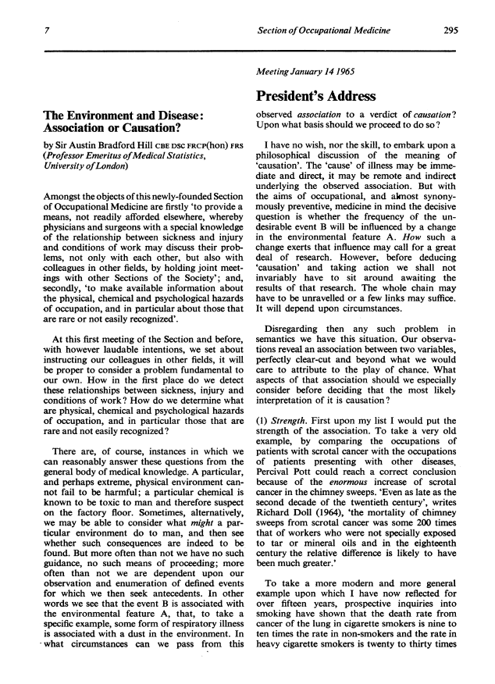
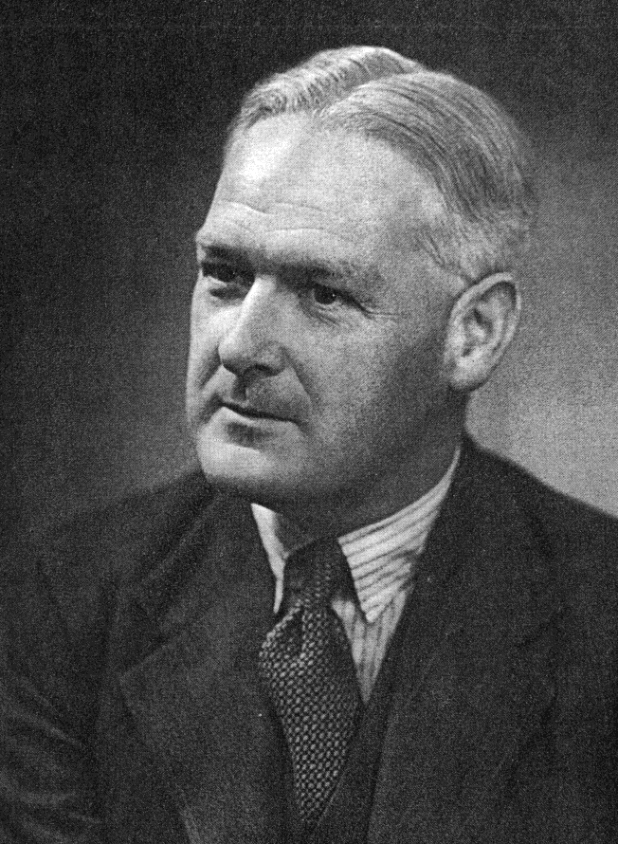
Bradford Hill Criteria for Causation
Strength of the association
Consistency (repeatedly observed)
Specificity of the association
Temporal relationship
Biological gradient (dose-response)
Plausibility (biological mechanism)
Coherence with observed epidemiologic data
Experiment (preventive action)
A Bradford Hill. Proc Royal Soc Med 1965; 58:295-300.
Slide courtesy of Dr. Jonathan Kay
Notes:
Because of the number of observational studies linking association between administration of gadolinium-containing contrast agents to individuals with chronic kidney disease and the subsequent development of NSF satisfies most of the Bradford–Hill criteria for causality
We can go over how this data supports causality now first.
This is important because observational studies have a number of limitations, but it is important to note how they can be used together for powerful conclusions
Limitations include: retrospect chart reviews and limits of med records
Biological mechs later further strengthend
To start, can people name the criteria for causation?
The nine Bradford Hill criteria for causation are strength of association, consistency, specificity, temporality, a biologic gradient, biologic plausibility, coherence, experiment, and analogy.

Slide 11
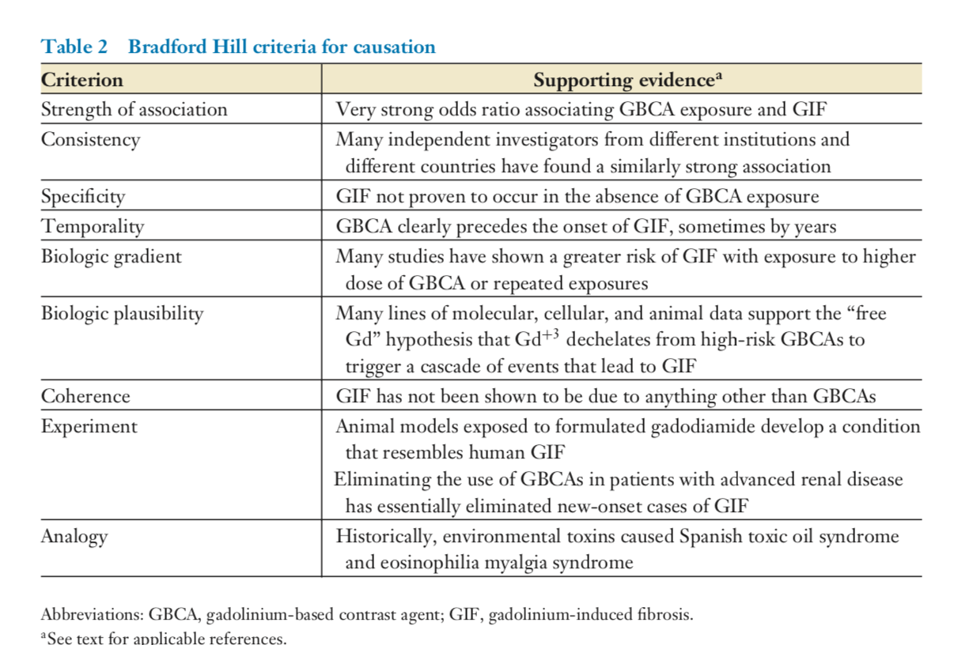
Gadolinium and GIF/NSF
Todd & Kay. Annu. Rev. Med. 2016. 67:273–91
Notes:
Dr. Kay and others have nicely applied Bradford Hill criteria to contend that the relationship between high-risk GBCAs and NSF is not just an association but reflects causation
Strength of association,
Odds ratio of 26.7 for the association between GBCA exposure and subsequent NSF, comparable to the odds ratio associating heavy cigarette smoking with lung cancer
Consistency,
many independent investigators working at different institutions in different countries identified similarly strong associations between exposure to high-risk GBCAs and NSF
Specificity
fulfilled by the lack of convincing cases of NSF that have occurred without known GBCA exposure;
Almost all reports of NSF cases have confirmed temporality of the relationship in that GBCA exposure occurred prior to the development of NSF.
The time to disease onset may be days to years after the last GBCA exposure (9, 10, 20).
This is perhaps the most compelling evidence that high-risk GBCAs cause NSF
Before GBCAs, NSF did not exist as a disease entity. Shortly after GBCA use became widespread in patients with renal dysfunction, NSF appeared.
After restrictions were placed on the use of high-risk GBCAs in patients with renal dysfunction, NSF essentially ceased to exist.
The biologic gradient criterion
fulfilled by the many studies that have shown an inverse relationship between the cumulative GBCA dose and the time to onset
Biologic plausibility is supported by the
many molecular, cellular, and animal studies substantiating the hypothesis that free Gd+3 dissociates from the least stable GBCAs and triggers a series of cellular events that result in tissue fibrosis.
Coherence
No strong data that would contradict the conclusion that high-risk GBCAs cause NSF
Experiment
Data from animal models of NSF also contribute to fulfillment of the experiment criterion; formulated gadodiamide induces NSF-like changes in the skin and other organs of treated animals.
Clearly, it would be unethical to attempt to fulfill the experiment criterion with a randomized clinical trial administering high-risk GBCAs to patients with renal dysfunction.
However, guide- lines that proscribe the administration of high-risk GBCAs to patients with renal dysfunction have effectively eliminated incident cases of NSF (23, 57, 60, 62, 87–90).
Analogy
fulfilled by the historic observation that other environmental triggers, such as contaminated rapeseed oil and L-tryptophan, caused the fibrosing disorders Spanish toxic oil syndrome (91) and eosinophilia myalgia syndrome (92), respectively.
Fulfilling the Bradford Hill criteria for causation does not imply that GBCA exposure alone is sufficient to cause the disease.
Not all patients with renal dysfunction develop NSF following GBCA exposure and, in those who do, the onset of disease is highly variable.

Slide 12
Epidemiology of NSF
Several hundred cases since 1997
  Over 400 cases worldwide reported to the International NSF Registry at Yale University
Prevalence ranges widely depending on study criteria and methods used
Notes:
Several hundred cases since 1997
As of January 2013, over 400 cases of NSF had been reported to the International NSF Registry at Yale University
Prevalence ranges widely depending on study criteria and methods (e.g., physician identified vs. self-report, retro vs. prospective)

Slide 13
Studies Reporting Prevalence of NSF in Patients with Stage 5 CKD
Study (Location) | Year Published | Type | GBCA exposure | NSF cases/ total patients | NSF cases/ GBCA- exposed patients
Marckmann et al. (Denmark) | 2006 | Retrospective | Gadodiamide | N/A | 13/370 (3.5%)
Broome et al. (Loma Linda, CA) | 2007 | Retrospective | Gadodiamide | 10/168 (6%) | N/A
Collidge et al. (Scotland) | 2007 | Retrospective | Gadodiamide | 14/1826 (0.8%) | 13/421 (3.1%)
Deo et al. (Bridgeport, CT) | 2007 | Retrospective | Gadodiamide | 3/467 (0.6%) | 3/87 (3.4%)
Lauenstein et al. (Atlanta, GA) | 2007 | Retrospective | Gadodiamide | N/A | 8/312 (2.6%)
Othersen et al. (Charleston, SC) | 2007 | Retrospective | Gadodiamide | 4/849 (0.5%) | 4/261 (1.5%)
Todd et al. (Boston, MA) | 2007 | Cross-sectional & prospective | Gadopentetate dimeglumine | 25/186 (13.4%) | 16/54 (29.6%)
Prince et al. (New York, NY) | 2008 | Retrospective | Gadodiamide, gadopentetate dimeglumine, gadobenate dimeglumine, gadoteridol | N/A | 11/398 (2.8%)
Rydahl et al. (Denmark) | 2008 | Retrospective | Gadodiamide | N/A | 18/102 (17.6%)
EJ Bernstein, C Schmidt-Lauber, J Kay Best Pract Res Clin Rheumatol. 2012;26:489-503 .
Slide courtesy of Dr. Jonathan Kay
Notes:
Ranges from 0.5-30%, though retrospective series have reported a lower prevalence of NSF, the types of patients included in many of these reports are quite variable
Some studies, for example, do not limit inclusion to patients with stage 5 CKD and instead include as the denominator all patients exposed to a GBCA, regardless of CKD status
Moreover, in most of these studies, patients were not examined by the investigators for the presence or the absence of clinical features of NSF but rather chart or self-report
So likely to be on the higher side
13

Slide 14
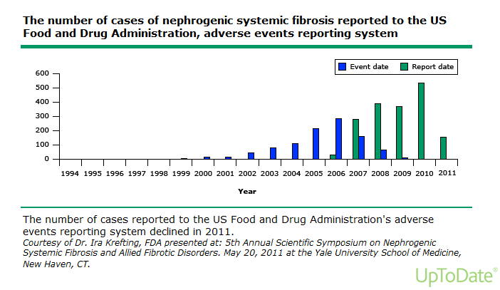
Notes:
Number of reported cases peaked in 2010 (almost 500), though most of those were quite old

Slide 15
Epidemiology of NSF
Several hundred cases since 1997
  Over 400 cases worldwide reported to the International NSF Registry at Yale University
Prevalence ranges widely depending on study criteria and methods used
Main risk factor = stage 5 CKD
  Type of GBCA is an established factor in determining risk
  Risk of disease has not been found to be associated with gender, race, age, etiology or length of kidney disease
  Peritoneal (vs hemo) dialysis may be a risk factor
Does appear to be an inverse correlation with first symptom onset and dose
Notes:
Associated risk factors have also been studied a lot
Obviously main = Stage 5 CKD/dialysis
Although NSF predominantly affects patients with stage 5 CKD, cases have been reported in individuals with stage 4 and stage 3 CKD and in patients with acute kidney injury
Also, type of gad-based contrast agent is important
Most a/w gadodiamide (Omniscan) - (linear non-ionic GBCA) and some with gadopentetate (Magnevist - linear ionic GBCA)
a retrospective study of the Veterans Affairs Electronic Medical Records found no cases of NSF among 141 patients with 198 single-agent exposures to gadoteridol (a macrocyclic agent)
Risk of disease has not been found to be associated with gender, race, age, etiology or length of kidney disease
Type of dialysis may make a difference?
Some studies found that , e.g., a case-control study found that, over a four-year period, the attack rate after exposure to gadolinium was higher for peritoneal dialysis than for hemodialysis patients (4.6 cases per 100 peritoneal dialysis patients versus 0.61 cases per 100 hemodialysis patients)
Additionally, there does appear to be a dose response. Patients were at greater risk for developing NSF if they had been exposed to multiple doses of a high-risk GBCA or if a single high-risk GBCA infusion had been administered at a higher-than-standard dose
Though they can occur after only a single dose of a high-risk GBCA.
The odds ratio for the development of NSF after a double versus single dose of gadodiamide was calculated at 22.3 (95% CI 1.3-378).

Slide 16
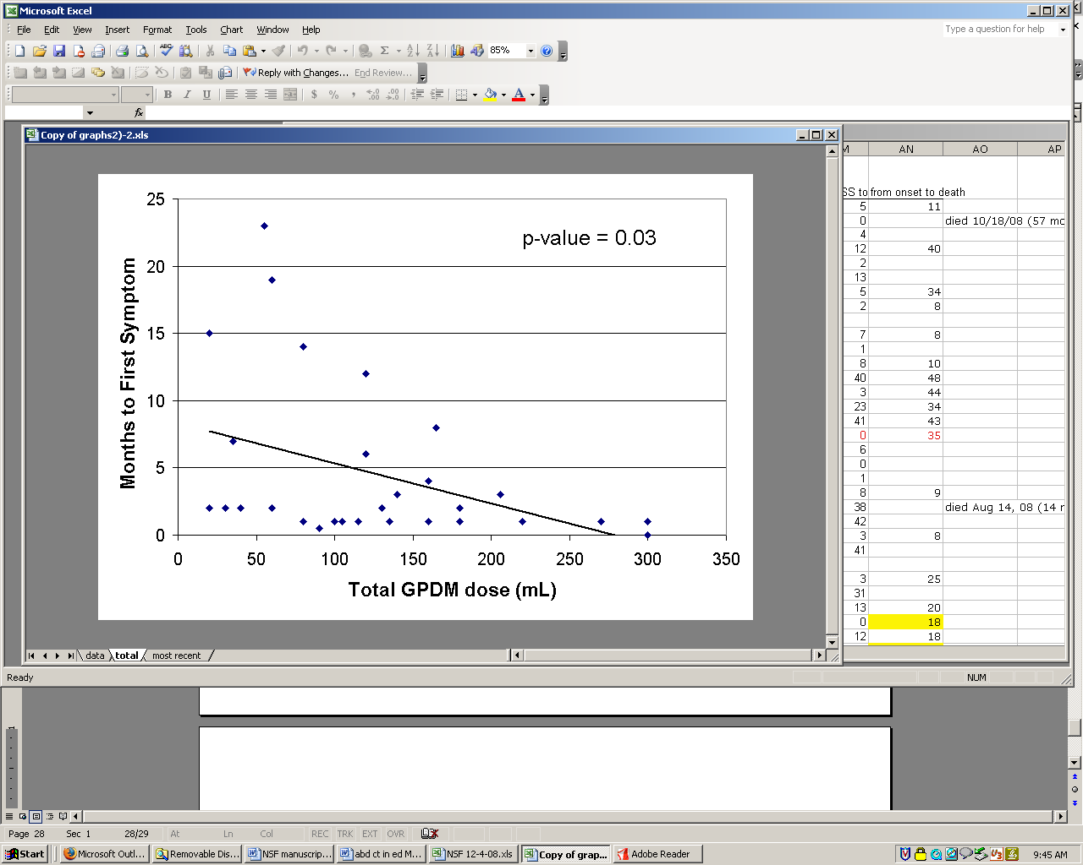
Negative Correlation Between Total Cumulative GPDM Exposure and Time to First NSF Symptom
(n=30)
(n=30)
H Abujudeh,…, J Kay. Radiology. 2009; 253:82-89.
Slide courtesy of Dr. Jonathan Kay

Slide 17
Basic Science Part I: Learning Objectives
How does Gadolinium cause tissue injury?
How do macrophages promote tissue injury and fibrosis?
How do macrophages and monocytes respond to Gadolinium?
Notes:
The goal of this first section is to introduce how
Gadolinium causes tissue injury
The role of macrophages in tissue injury and fibrosis
And how macrophages and monocytes respond to Gd to promote inflammation

Slide 18
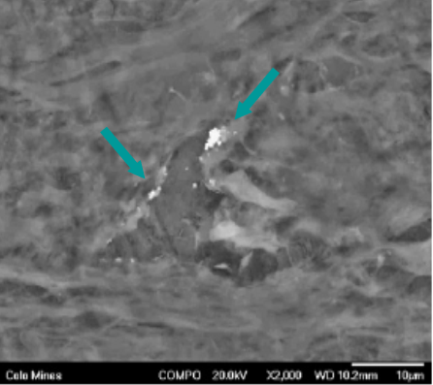
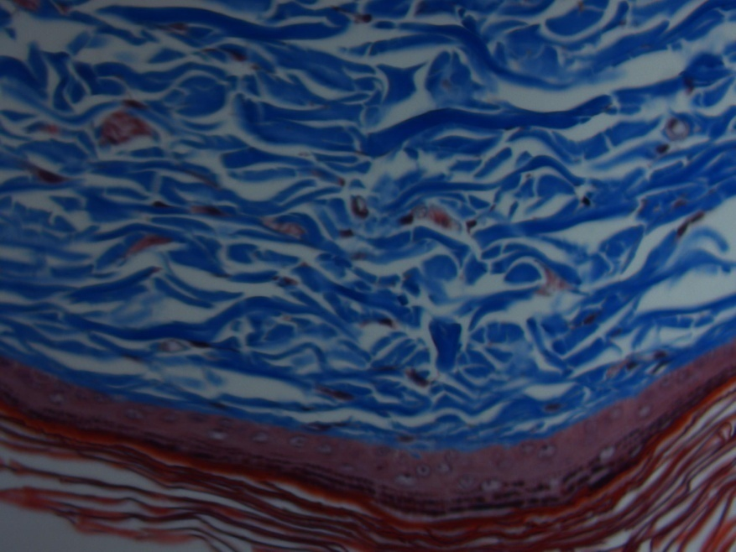
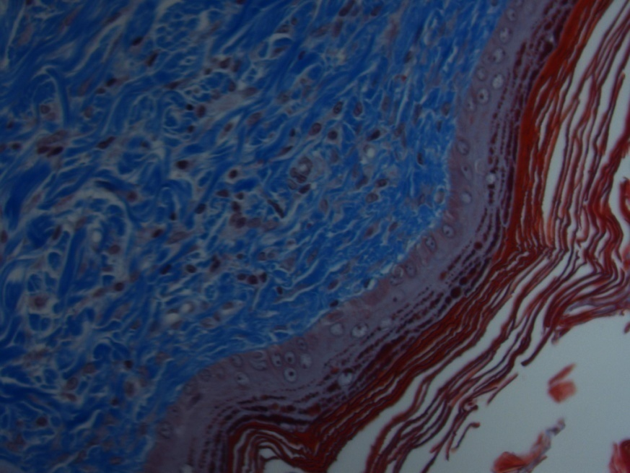
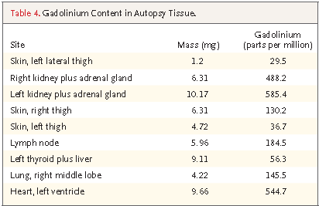
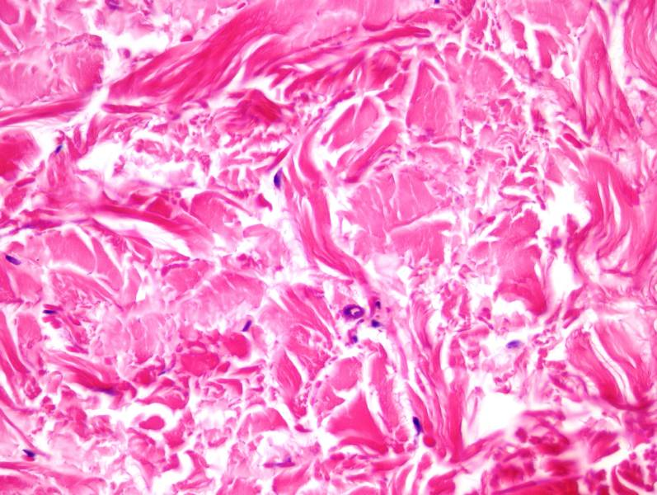
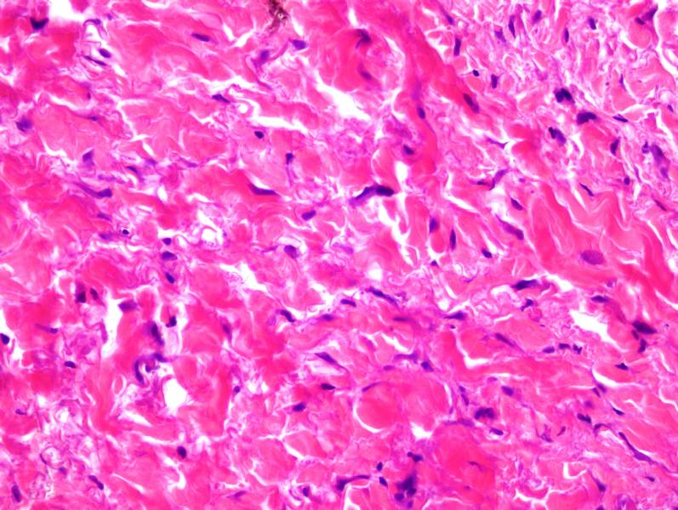
Highly toxic free Gadolinium found in tissues of exposed patients
Gd detected by field emission scanning electron microscopy (SEM)
Rat
WA High et al. J Am Acad Dermatol. 2007; 56:21-26.
No Gadodiamide
Gadodiamide
Gadolinium Content in Autopsy Tissue
Human
Normal Control
NSF
Todd and Kay 2016
April Cox, Array BioPharma
J Kay et al. N Engl J Med. 2008; 358:827-38.
Notes:
Gadolinium is a lanthanide metal contrast agent
it is typically bound to a chelating agent, but can become unbound and deposit in tissues
it is found in skin of patients (SEM shows insoluble precipitate), but also can be diffusely distributed throughout the body (esp @ highly vasc tissue)
Supporting its role as the causative of disease, IV Injection of gadolinium into the skin of rats induces morphologic changes similar to what is seen in patients
Gd has multiple mechanisms of toxicity including
Blockade of voltage gated calcium channels
Formation of insoluble precipitates
And the induction of pro-fibrotic cytokines

Slide 19
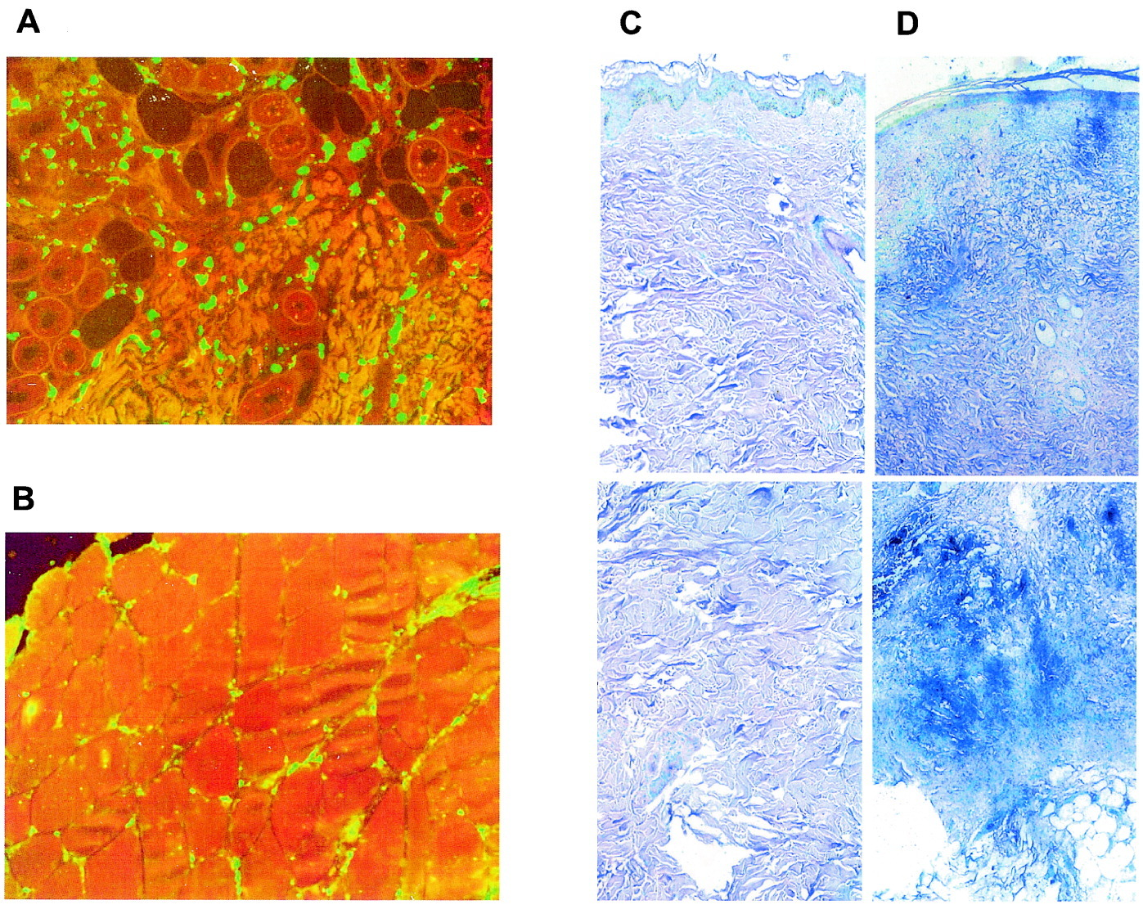
Macrophages and TGF-B in lesional tissue of GIF patients
CD68 Immunofluorescence
TGF-B transcript in situ hybridization
Gadolinium Patient Skin
Healthy
Gadolinium Patient
CD68+ Macrophages infiltrate observed in lesional skin of Gadolinium exposed patients
TGF-B transcript also detected in histology from these patients
Gadolinium Patient Muscle
Jimenez et al. 2004
Notes:
Early on, it was noted that the skin of patients with GIF displayed
a macrophage infiltrate
As well as expression of the fibrotic cytokine TGF-B
At lesional sites

Slide 20
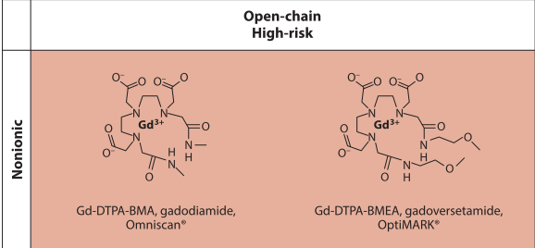
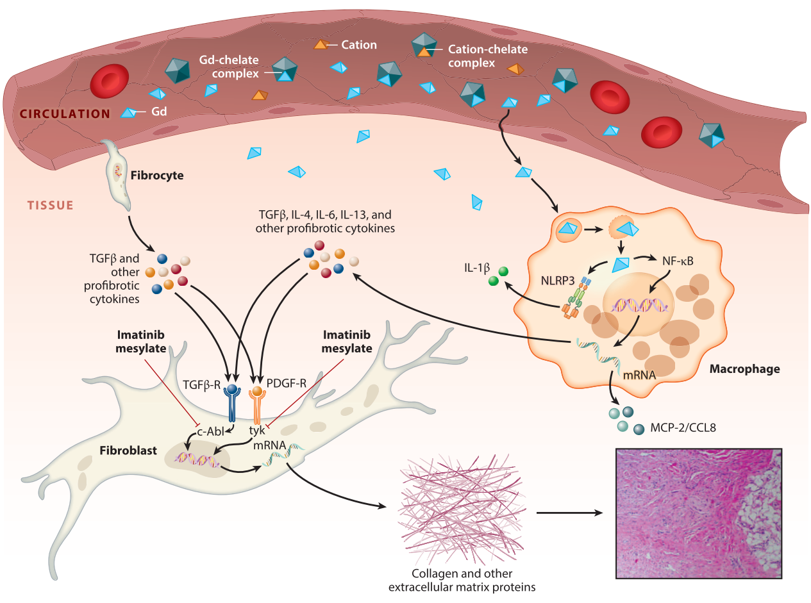
Etiology of Gadolinium Induced Fibrosis
How do macrophages promote tissue injury and fibrosis?
Todd and Kay 2016
Notes:
To put it all together, it is thought that
The release of free gadolinium from unstable chelating agents
Leads to Gd deposition in tissue
Which requires macrophages for clearance
But that uptake of insoluble Gd by macrophages initiates a fibrotic response that causes disease
This raises the question of how macrophages promote tissue injury and fibrosis

Slide 21
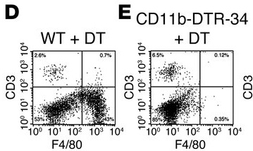
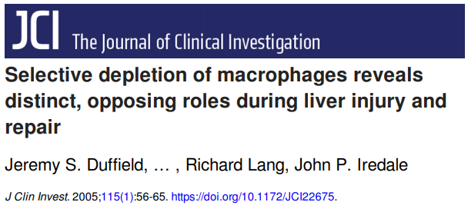
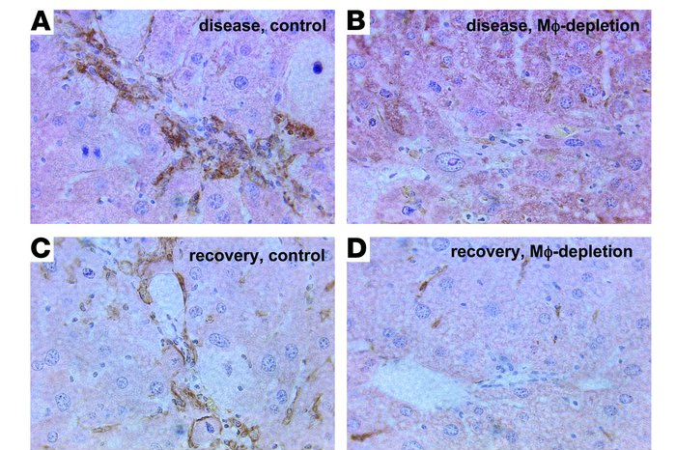
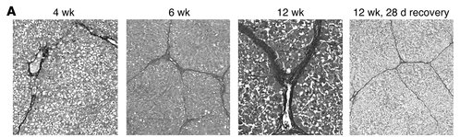
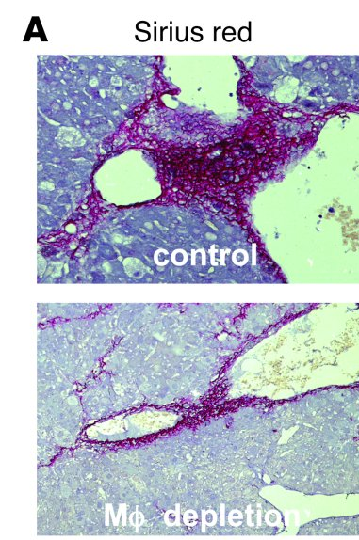
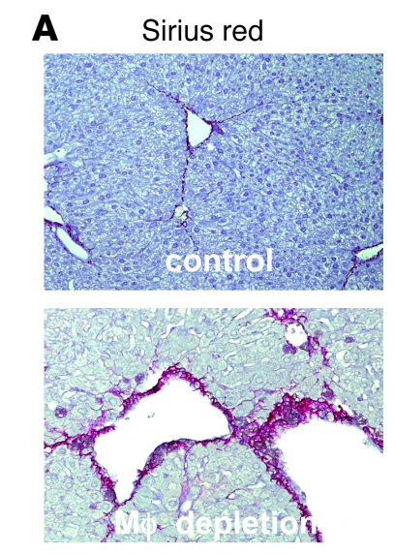
Macrophage Functional Heterogeneity During and Post Injury
Mouse
Splenocytes
Liver (F4/80 IHC)
Macrophages can play two roles!
  Enhance liver injury during insult
  Promote liver recovery after insult
+Carbon tetrachloride to induce liver injury
(Sirius red – Collagen/Fibrosis)
MP Depletion @
12 weeks of CCl4
(peak of injury)
7 days of recovery
Duffield et al 2005
Notes:
Early mouse studies by Duffield and colleagues in 2005 demonstrated that
macrophages have functional heterogeneity and are involved in both tissue injury AND recovery
They demonstrated this using a conditional depletion model of macrophages using a mice with a transgene that expresses the diptheria toxin receptor under the control of CD11b promoter in combination with a model of acute liver injury by Carbon tetrachloride
They found that depletion of macrophages during injury mitigated fibrosis and damage
Whereas depletion of macrophages following injury lead to impaired recovery!
Indicating that macrophage populations play different context dependent roles

Slide 22
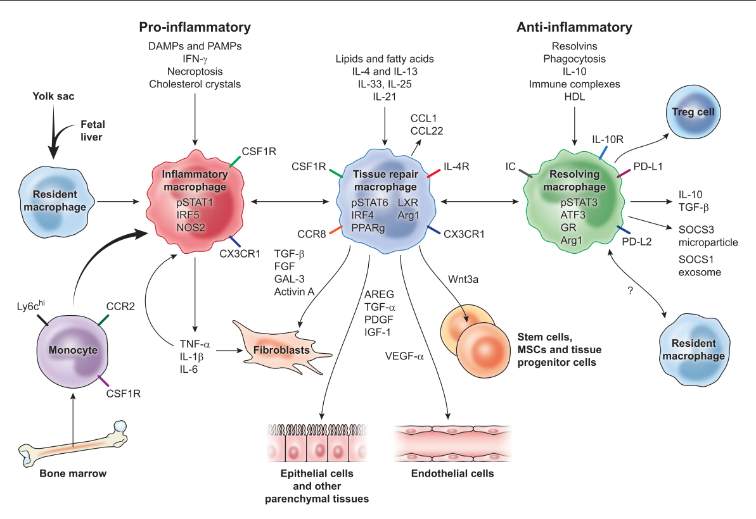
Macrophages – mediators and resolvers of inflammation
“M1”
“M2”
Resident
Functional Classification
M1/Pro-inflammatory
vs
M2/Anti-inflammatory
  Tissue repair
  Inflammation resolving
Ontogenic Classification
Embryonic derived tissue resident
vs
Monocyte derived recruited
Relationship of Macrophage ontogeny and function are related is an area of active research!
Recruited
Wynn and Vannella 2016
Notes:
Since then, macrophage heterogeneity has been elaborated into at least two frameworks based on either function or ontogeny:
Under the functional framework:
M1 macrophages are thought to be involved in exacerbating inflammation
Whereas M2 macrophages play a role in wound repair and resolving inflammation
But are also involved in initiating fibrosis
A parallel framework that has been gaining attention is based on ontogeny:
Tissue resident macrophages have been shown to be derived from embryonic cells and are primarily self repleting
This population has been associated with tissue protection during injury
In contrast, recruited macrophages are derived from circulating monocytes
And this population has been shown to be involved in enhancing inflammation
It remains controversial how these functional and ontogenic classification systems are related

Slide 23
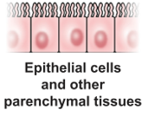
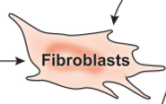
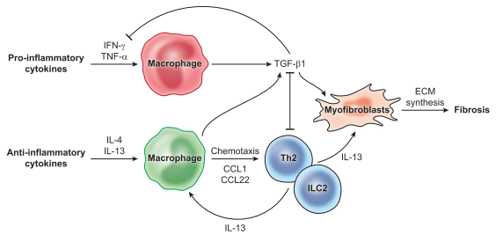

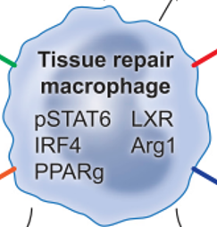
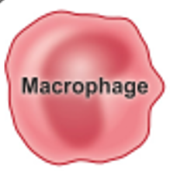
Macrophage mediated mechanisms of Fibrosis
Parenchymal Stem Cell Expansion
Fibrosis
Macrophage TGF-B
  Activates Extra Cellular Matrix (collagen) production by Fibroblasts
M2 macrophages can recruit a Th2 response to reinforce a pro-fibrotic response
  IL-13; IL-4
INJURY
WOUND REPAIR
M1
M2
Wynn and Vannella 2016
Notes:
Macrophage coordinate repair to injury by balancing
the expansion of parenchymal stem cells to return function to the tissue
And the expansion of fibroblasts to return structural integrity to the tissue
In Fibrosis, this latter response dominates
This is proposed to arise through cytokine feedback responses
Wherein, macrophage derived TGF-B activates myofibroblasts to secrete collagen
Which is reinforced by recruitment of Th2 responses and the inhibition of M1 macrophages by TGF-B

Slide 24
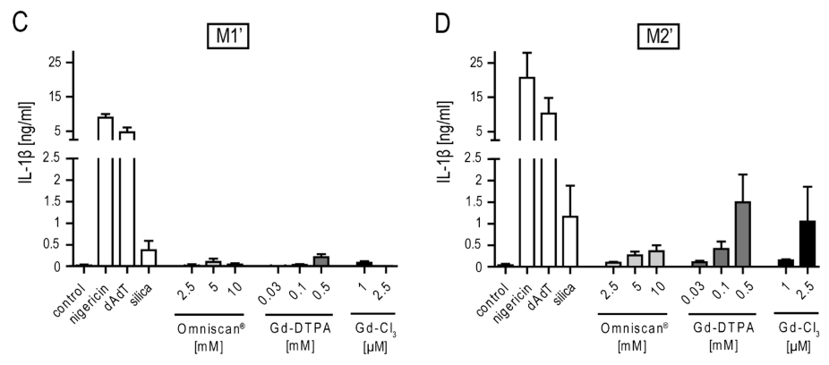
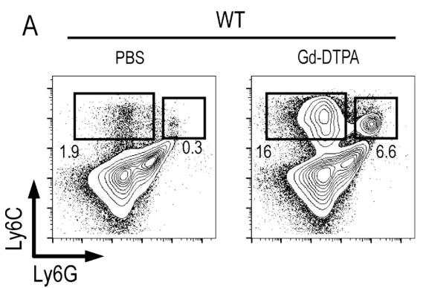
Gd promotes M2 Macrophage activation and Monocyte recruitment
In vitro Mouse Macrophage response to Gd
Mouse In vivo response to intraperitoneal Gd
Peritoneal Exudates
Production of pro-inflammatory IL-1B, particularly in M2 skewed macrophages
Recruitment of Inflammatory Monocytes and Granulocytes
Schmidt-Lauber et al. 2015
Notes:
To better study the effect of Gd on macrophages and whether this could promote tissue injury and fibrosis,
Researchers at Umass exposed murine bone marrow derived macrophages
skewed to M1(+IFNy) or M2 (+IL4) states by cytokine exposure
And further Primed with LPS (to induce pro-IL-1B production)
Surprisingly, they found that Gd enhanced release of pro-inflammatory cytokine IL-1B by “injury resolving” M2 macrophages
Moreover, using an in vivo model of IP Gd exposure in mice, they found
That Gd led to recruitment of circulating inflammatory monocytes into peritoneal exudates.
Providing evidence for enhanced inflammatory responses by macrophages in response to Gd
And for dysregulation of normally “anti-inflammatory” M2 macrophages towards exacerbation of injury

Slide 25
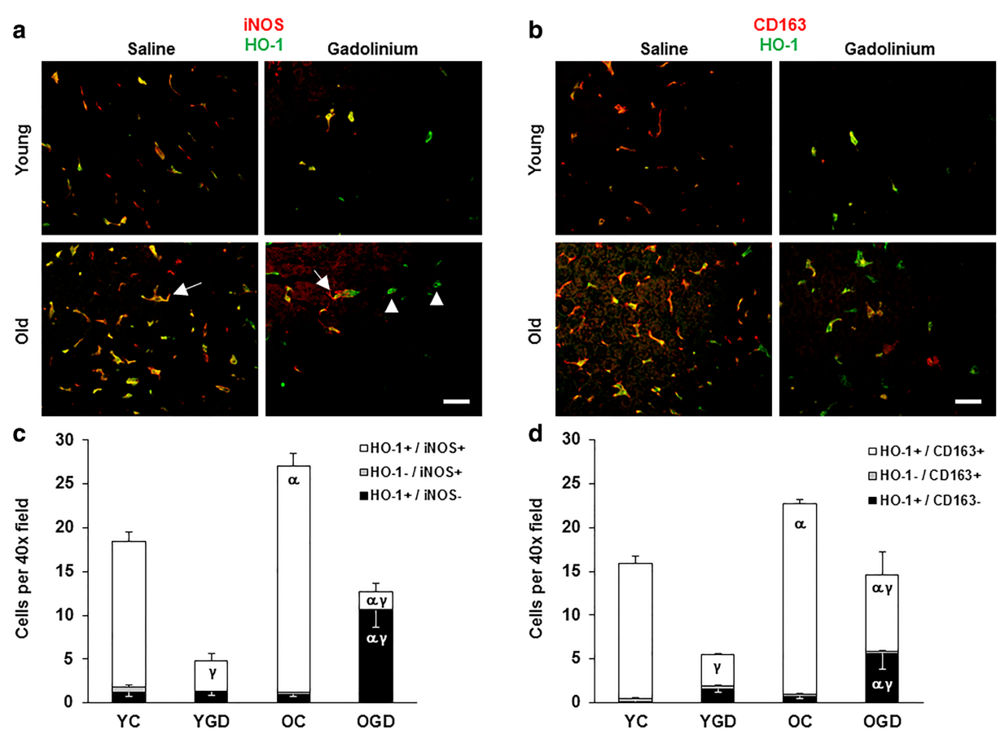
Aging enhances Gd skewing of hepatic macrophages towards M2
6mo and 24mo Rats
IP injected with Gadolinium Chloride
Sacked 2 days later
“M1”
“M2”
Bloomer et al. 2019

Slide 26
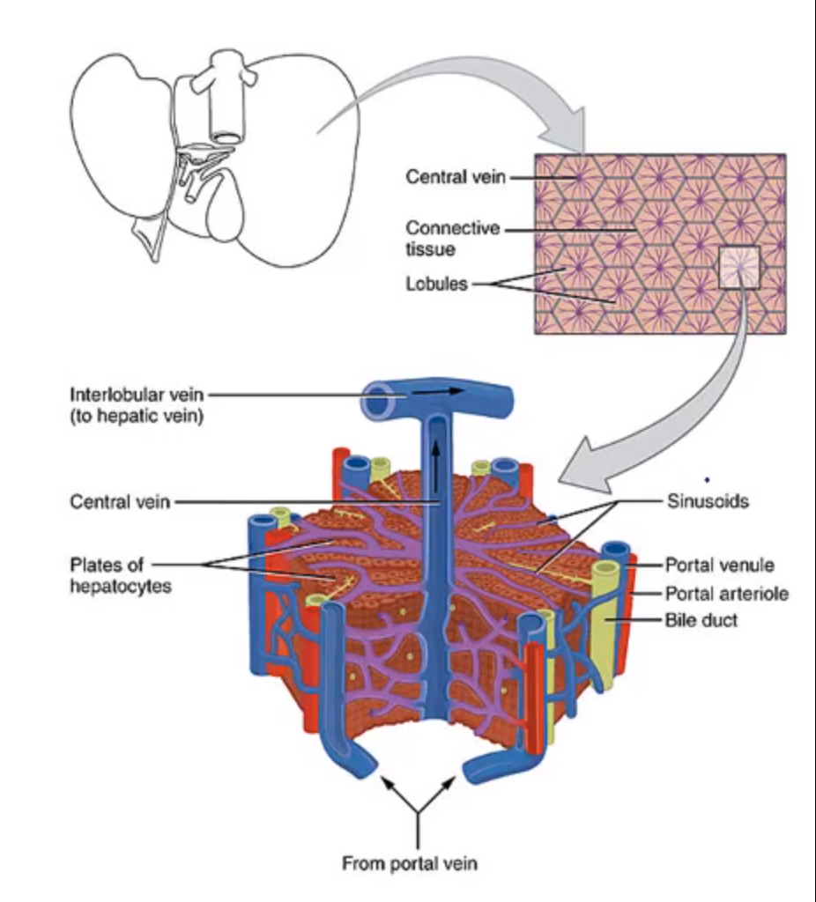
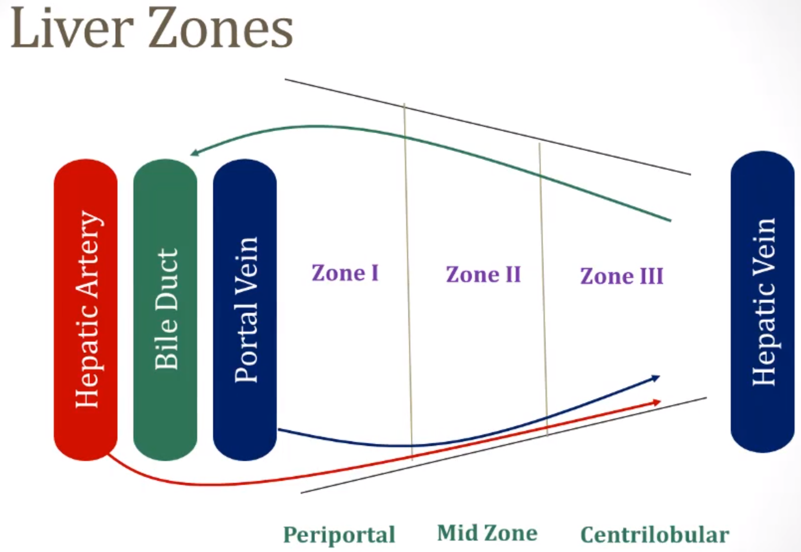
Liver Anatomy

Slide 27
Etiology of Gadolinium Induced Fibrosis
How are Macrophages sensing tissue deposited Gd?
Todd and Kay 2016
Notes:
This led researchers to ask further:
How are macrophages sensing this tissue deposited Gd upon uptake?

Slide 28
Basic Science Part II: Learning Objectives
How do macrophages sense Gadolinium?
What clues regarding innate immune sensing can we glean from silicosis induced fibrosis?
What are inflammasomes and how are they involved in gadolinium induced fibrosis?

Slide 29
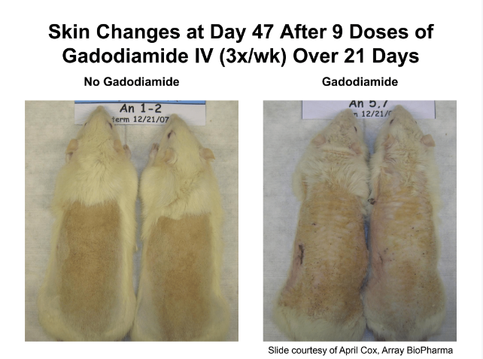
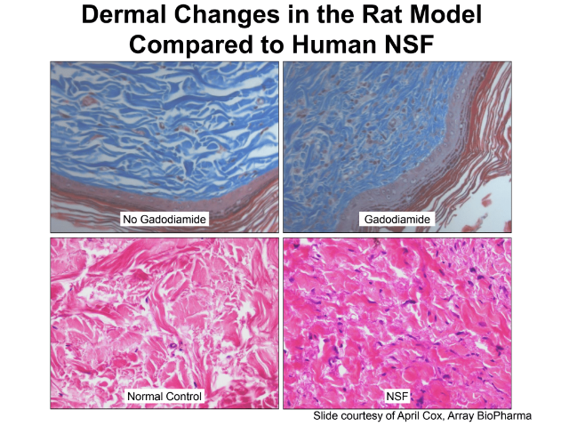
Gadodiamide induces skin fibrosis in rat model
Kay Slides (2015)

Slide 30
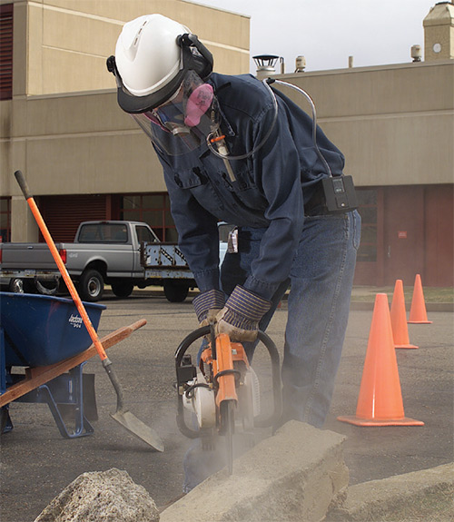
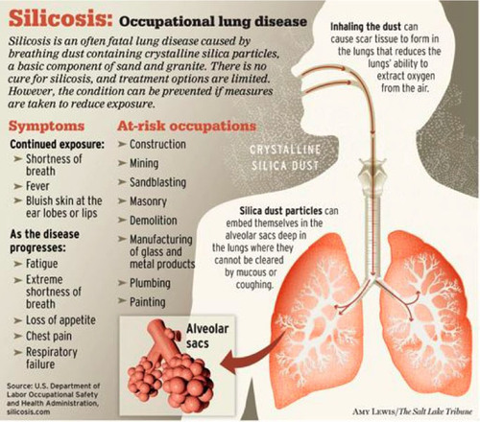
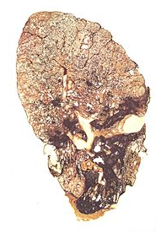
Particulate matter diseases can demonstrate fibrosis
Occupational exposure to silica, asbestos, and fine particulate matter
Images credit: Safety + Health Mag, Wikimedia Commons, The Salt Lake Tribune
Notes:
Images:
https://www.safetyandhealthmagazine.com/articles/12507-silicosis-what-it-is-and-how-to-avoid-it
http://extras.sltrib.com/china/graphics/Silicosis_graphic.jpg

Slide 31
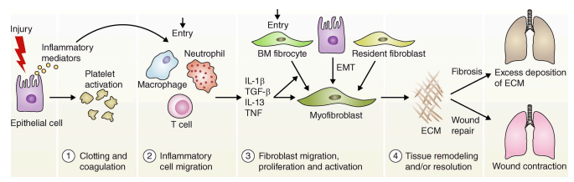
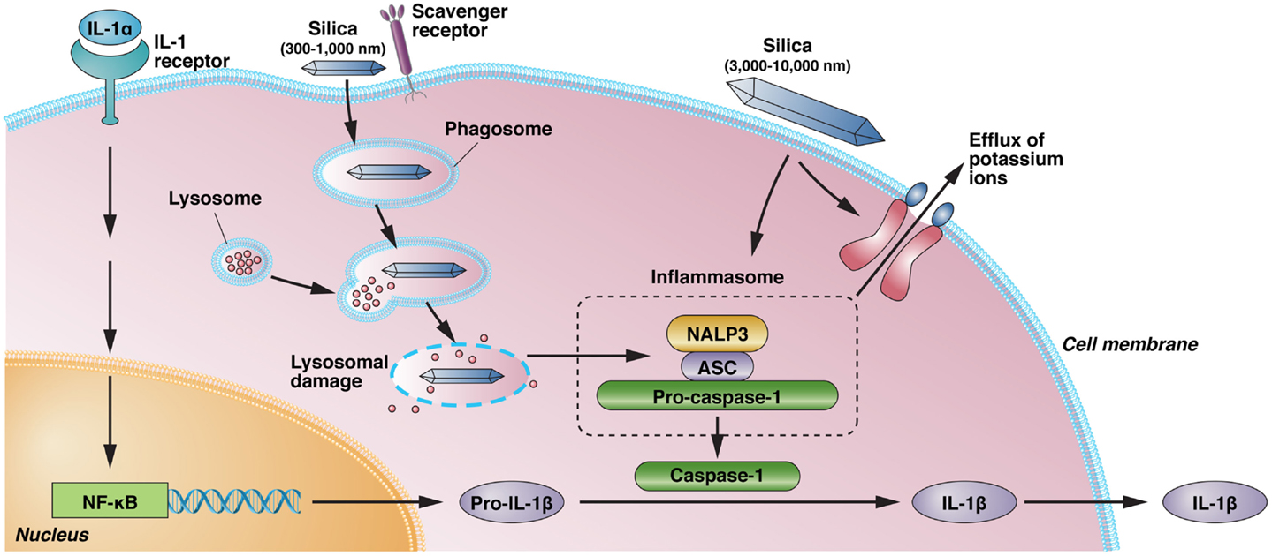
Silica is sensed by the inflammasome
Lung “injury” produces inflammatory mediators and cytokines that promote fibrosis
Silica is phagocytosed by macrophages
2008: The Nlrp3 (Nalp3) inflammasome mediates the IL-1β cytokine response to silica and is critical for the murine model of silicosis
Wynn (2011), Pollard 2016
Notes:
Images:
https://www.safetyandhealthmagazine.com/articles/12507-silicosis-what-it-is-and-how-to-avoid-it

Slide 32
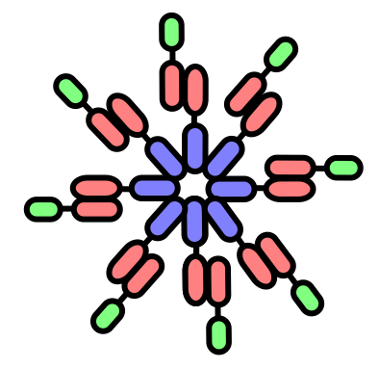
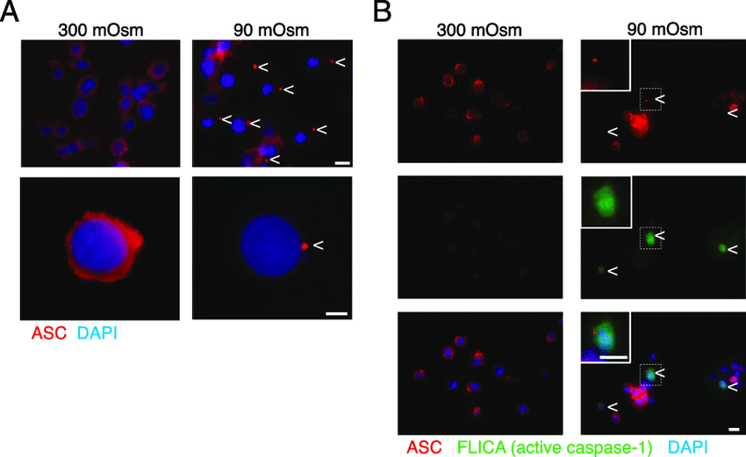
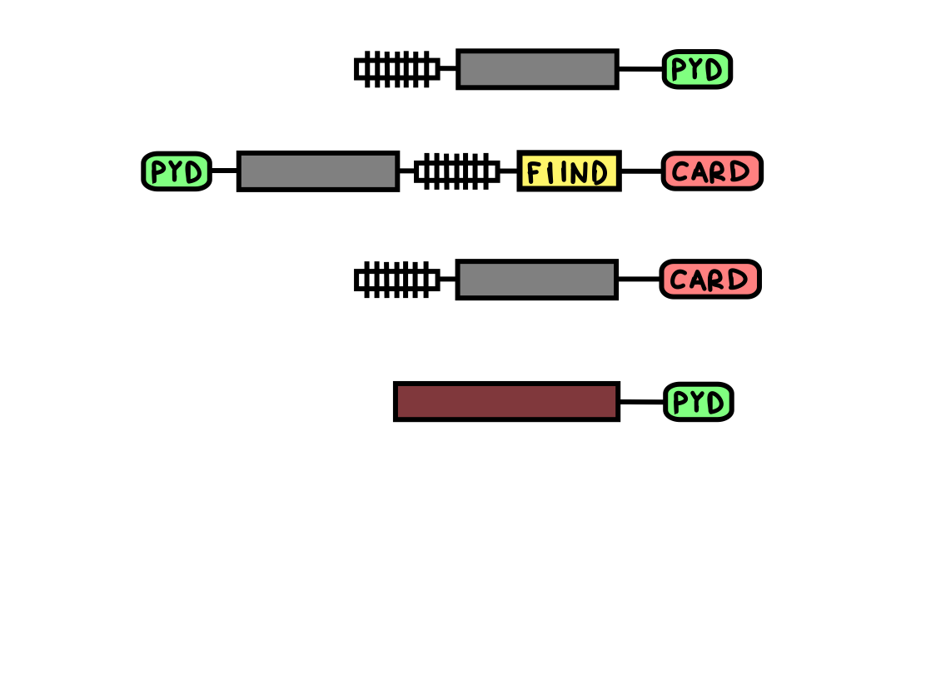

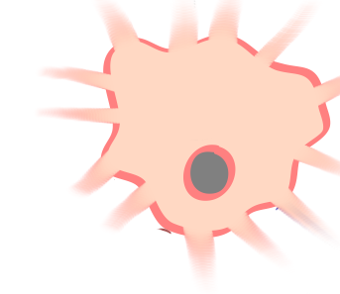
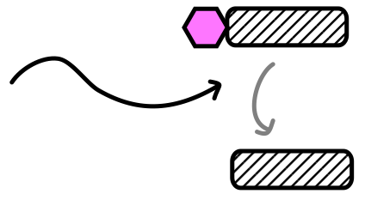
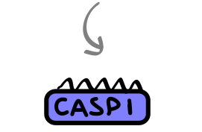
What are inflammasomes?
Inflammasomes are sensors of pathogens and danger signals
Oligomerize into large cytosolic complexes
Structure
Stimulus
NLRP3
K+ efflux, ROS
NLRP1
anthrax toxin
NLRC4
flagellin
AIM2
dsDNA
Activate inflammatory caspases
Cleave inflammatory cytokines
Lytic cell death
Full-length
(p48)
Full-length
(p31)
Pro-IL-1β
Active
(p20)
Mature
(p17)
IL-1β
Sharma and Kanneganti (2016), Compan et al. (2015)
Notes:
Images:
https://www.safetyandhealthmagazine.com/articles/12507-silicosis-what-it-is-and-how-to-avoid-it

Slide 33
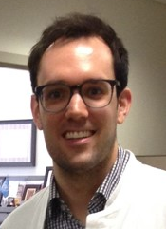


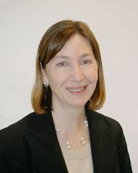



Investigators at UMass asked if there was a link?
Model: Murine Bone Marrow-derived Macrophages (BMDMs)
Mouse Knockouts:
Asc^{-/-} - Inflammasome adapter protein
Nlrp3^{-/-} - Inflammasome sensor protein
Images credit: Ying et al. (2013)

Slide 34



Gadolinium activates the NLRP3 inflammasome
Gd-containing compounds induce IL-1β secretion
Gd-induced IL-1β release depends on Nlrp3
In vivo peritoneal inflammation with Gd is Nlrp3-dependent
Schmidt-Lauber et al. (2014)

Slide 35
Summary
Gadolinium deposits in skin of patients with NSF
Gadodiamide induces skin fibrosis in a rat model
Gadolinium-containing compounds activate the Nlrp3 inflammasome in a mouse model

Slide 36
Basic Science Part III: Learning Objectives
How is Gadolinium induced fibrosis treated?
What are the mechanisms by which these medications are thought to work?
How can we apply our current understanding of mechanism to propose new treatments for patients?
What remains to be understood about Gadolinium induced fibrosis?

Slide 37
Prevention of GIF
In patients with decreased renal function consider alternative imaging modalities that do not use GBCAs
If GBCAs use is necessary, avoid high-risk GBCAs (i.e. open-chain nonionic) and use the lowest dose possible
In patients with severe renal failure perform hemodialysis immediately after GBCA exposure
Todd and Kay 2016

Slide 38

Treatment of GIF
Potential treatments
  Extracorporeal photopheresis with UVA
Kitko et al. 2015
Notes:
- ECP – unproven 3 patients demonstrated improvement in skin tightness and mobility, ECP has successfully been used for cutaneous T cell lymphoma, scleroderma, scleromyxoderma, and chronic GVHD
- Pentoxfylline – treat,ent of claudication, decreases blood viscosity and increases RBC membrane flexibility -> increases microcirculation flow, non-selective adenosine receptor antagonist, inhibits RBC PDE (phosphodieterases) breakdown activity -> increases cAMP activity, decreases TNFalpha expression
UVA – Decreases procollagen synthesis, UVA longest segment of UV spectrum required to reach dermis, Inconsistent results, ? about whether UVA penetrates to the dermis
Alefacept
Sodium thiosulfate

Slide 39
Treatment of GIF
Potential treatments
  Extracorporeal photopheresis with UVA
  Ultraviolet A phototherapy
    Decreased procollagen synthesis
Notes:
- ECP – unproven 3 patients demonstrated improvement in skin tightness and mobility, ECP has successfully been used for cutaneous T cell lymphoma, scleroderma, scleromyxoderma, and chronic GVHD
- Pentoxfylline – treat,ent of claudication, decreases blood viscosity and increases RBC membrane flexibility -> increases microcirculation flow, non-selective adenosine receptor antagonist, inhibits RBC PDE (phosphodieterases) breakdown activity -> increases cAMP activity, decreases TNFalpha expression
UVA – Decreases procollagen synthesis, UVA longest segment of UV spectrum required to reach dermis, Inconsistent results, ? about whether UVA penetrates to the dermis
Alefacept
Sodium thiosulfate

Slide 40

Treatment of GIF
Potential treatments
  Extracorporeal photopheresis with UVA
  Ultraviolet A phototherapy
  Pentoxifylline
pentoxifylline
Palladino, MA et al. 2003
Notes:
- ECP – unproven 3 patients demonstrated improvement in skin tightness and mobility, ECP has successfully been used for cutaneous T cell lymphoma, scleroderma, scleromyxoderma, and chronic GVHD
- Pentoxfylline – treat,ent of claudication, decreases blood viscosity and increases RBC membrane flexibility -> increases microcirculation flow, non-selective adenosine receptor antagonist, inhibits RBC PDE (phosphodieterases) breakdown activity -> increases cAMP activity, decreases TNFalpha expression
UVA – Decreases procollagen synthesis, UVA longest segment of UV spectrum required to reach dermis, Inconsistent results, ? about whether UVA penetrates to the dermis
Alefacept
Sodium thiosulfate

Slide 41

Treatment of GIF
Potential treatments
  Extracorporeal photopheresis with UVA
  Ultraviolet A phototherapy
  Pentoxifylline
  Sodium thiosulfate
    Direct chelation of Gd⁺³
    Antioxidant effect
    Reduced TGFβ signaling leading to decreased tissue fibrosis
Wynn and Vannella 2016
Notes:
- ECP – unproven 3 patients demonstrated improvement in skin tightness and mobility, ECP has successfully been used for cutaneous T cell lymphoma, scleroderma, scleromyxoderma, and chronic GVHD
- Pentoxfylline – treat,ent of claudication, decreases blood viscosity and increases RBC membrane flexibility -> increases microcirculation flow, non-selective adenosine receptor antagonist, inhibits RBC PDE (phosphodieterases) breakdown activity -> increases cAMP activity, decreases TNFalpha expression
UVA – Decreases procollagen synthesis, UVA longest segment of UV spectrum required to reach dermis, Inconsistent results, ? about whether UVA penetrates to the dermis
Alefacept
Sodium thiosulfate – used to treat toxicity of cisplatin and cyanide poisoning. Mixed results case reports. Some demonstrate no improvement other improvement. 3 cases all showed improvement in skin tightness and mobility. May chelate Gd, decrease inflammation through antioxidant effect -> increasing endothelial function and decreasing tissue fibrosis, reduce TGFβ signaling leading to decreased tissue fibrosis

Slide 42

Treatment of GIF
Potential treatments
  Extracorporeal photopheresis with UVA
  Ultraviolet A phototherapy
  Pentoxifylline
  Sodium thiosulfate
  Alefacept
alefacept
Effector T-cell
apoptosis
Hall, BM 2015
Notes:
- ECP – unproven 3 patients demonstrated improvement in skin tightness and mobility, ECP has successfully been used for cutaneous T cell lymphoma, scleroderma, scleromyxoderma, and chronic GVHD
- Pentoxfylline – treat,ent of claudication, decreases blood viscosity and increases RBC membrane flexibility -> increases microcirculation flow, non-selective adenosine receptor antagonist, inhibits RBC PDE (phosphodieterases) breakdown activity -> increases cAMP activity, decreases TNFalpha expression
UVA – Decreases procollagen synthesis, UVA longest segment of UV spectrum required to reach dermis, Inconsistent results, ? about whether UVA penetrates to the dermis
Alefacept
Sodium thiosulfate – used to treat toxicity of cisplatin and cyanide poisoning. Mixed results case reports. Some demonstrate no improvement other improvement. 3 cases all showed improvement in skin tightness and mobility. May chelate Gd, decrease inflammation through antioxidant effect -> increasing endothelial function and decreasing tissue fibrosis, reduce TGFβ signaling leading to decreased tissue fibrosis

Slide 43
Treatment of GIF
Potential treatments
  Extracorporeal photopheresis with UVA
  Ultraviolet A phototherapy
  Pentoxifylline
  Sodium thiosulfate
  Alefacept
  Imatinib
    Reduces transcription of COL1A1 and COL1A2 and fibronectin 1 in dermal fibroblasts
    Reduced lesion severity in rat model of GIF
    Treatment of 2 GIF patients with imatinib led to improvement in skin tightening and joint contractures
Distler 2007
Kay and High 2008
Todd and Kay 2016
Notes:
- ECP – unproven 3 patients demonstrated improvement in skin tightness and mobility, ECP has successfully been used for cutaneous T cell lymphoma, scleroderma, scleromyxoderma, and chronic GVHD
- Pentoxfylline – treat,ent of claudication, decreases blood viscosity and increases RBC membrane flexibility -> increases microcirculation flow, non-selective adenosine receptor antagonist, inhibits RBC PDE (phosphodieterases) breakdown activity -> increases cAMP activity, decreases TNFalpha expression
UVA – Decreases procollagen synthesis, UVA longest segment of UV spectrum required to reach dermis, Inconsistent results, ? about whether UVA penetrates to the dermis
Alefacept
Sodium thiosulfate – used to treat toxicity of cisplatin and cyanide poisoning. Mixed results case reports. Some demonstrate no improvement other improvement. 3 cases all showed improvement in skin tightness and mobility. May chelate Gd, decrease inflammation through antioxidant effect -> increasing endothelial function and decreasing tissue fibrosis, reduce TGFβ signaling leading to decreased tissue fibrosis

Slide 44
Treatment of GIF
Ineffective treatments
  Topical, lesional or oral steroids
  Cyclophosphamide
  Cyclosporin
  Plasmapheresis

Slide 45
Future treatment of fibrosing disease
NLRP3 inhibitors
  MCC950 – inhibits ATPase domain of NLRP3 preventing oligomerization of NLRP3 adaptor protein ASC
  IFN-2427 – Phase I clinical study
  Pirfenidone
IL-1Ra antagonists – anakinra
anti-IL-1 MAb – canakinumab
Apremilast – PDE4 inhibitor

Slide 46
Open questions in GIF and fibrosing disease
Consequences of gadolinium accumulation
  Gadolinium accumulates in brain and bone tissue
  Deposition correlates with stability of gadolinium chelates, increased stability less deposition
  Proposed mechanism of action - transmetalation in which Gd³⁺ dissociates from chelator and forms insoluble deposites
  Increased risk of deposition in patients with reduced renal function
  Unknown the pathogenicity of Gd³⁺ depositions
Role of IL-1β in driving procollagen production in fibroblasts
Todd and Kay 2016

Slide 47


So what do we do about it?
CKD, AKI, high/repeated dosing puts a patient at risk
Notes:
Elevated gadolinium in the system clearly puts patient at risk - solution is simple, minimize gadolinium exposure, esp in patients w/ renal dysfxn

Slide 48
American College of Radiology Guidelines
Obtain informed consent from referring physician and patient
Consider alternative examinations that don’t require GBCAs
Use lowest amount possible to obtain clinical info
Avoid multiple dosing if possible
Don’t use group I agents (ESPECIALLY in severe renal dysfunction)

Slide 49

Gadolinium Based Contrast Agents
Notes:
ACR guidelines for use of GBCA, use group 2 agents

Slide 50
Screening for renal function?
Should we be getting blood samples for ALL patients undergoing GBCA-enhanced MRI just for eGFR?
Guidelines
  For group II agents, screening for renal function is OPTIONAL*
  For group I/III agents, should screen w/ questionnaire and/or blood work depending on setting
Notes:
For group 2 agents, american guidelines say optional but canadian guidelines say should screen w/ questionnaire

Slide 51

Questionnaire applied at time of MRI scheduling

Slide 52

Notes:
Screening for renal function in patients receiving GBCA

Slide 53

Institutional Guidelines
Heterogeneity in institutional practices may result in differential outcomes
MGH instituted restrictive GBCA guidelines in May 2007

Slide 54

34 cases of NSF preadoption/transitional
0 cases of NSF postadoption
Group I agent used, in contrast with ACR guidelines
Notes:
gadobenate dimeglumine (group II) agent was used in patients <60 eGFR but caused a higher rate of allergic reactions, so discontinued
Reason i mention this case is because it highlights the interesting and complex interplay of professional society guidelines vs institutional practices, and that’s not even taking into account individual provider level heterogeneity in medical practice

Slide 55
Next steps
Restrictive guidelines have drastically decreased # of NSF cases
Judicious use of MR studies involving GBCA administration
Vigilance for dermatological changes, esp in CKD patients
Awareness and education for healthcare professionals and trainees
Explore the potential epidemic of Gd deposition in brain

