Slide 1
COVID-19 Guidelines for Laboratory Personnel and Researchers:
Research Virtual Town Hall
May 18, 2020

Slide 2
COVID-19 Workforce Safety Working Group
Dr. Terry Flotte
Dean and Provost
Dr. Doug Golenbock
Chief, Division of
Infectious Diseases
Dr. Sharone Green
UMMS Infection Control Officer
Dr. Sonia Chimienti
Vice Provost for Student Life
and Enrollment Management
Dr. Phil Fournier
Director, Student Health Services
Dr. Maria Michas
Director, Employee Health Services
John Baker
Associate Vice Chancellor,
Facilities Management
Charleen Sotolongo
Environmental Health and Safety

Slide 3

Returning to work and accessing the buildings
Entering UMMS buildings
Badge access into building perimeter doors
Reception desks at entrances with surgical
masks, hand sanitizer and lists of individuals
cleared through testing

Slide 4

Getting ready to return to work: screening tests and self-monitoring
Screening tests
Initial screening required for all employees before returning to work
  Nasopharyngeal swab testing
  Conducted in a drive-through process at the
  Plantation Street garage
Periodic re-screening after return to work

Slide 5


Getting ready to return to work: screening tests and self-monitoring
Self-monitoring app/check in daily
Each employee will be required to check in with our Infection Control team daily
A simple process of logging health status via mobile app or online portal
Employees with no symptoms are
cleared to come to work

Slide 6
Anyone with symptoms of any illness must stay home and call Employee Health Services or Student Health Services.
Employees/students may not report to work if ill.

Slide 7

Keeping yourself and your colleagues safe at work: infection control best practices
Universal Mask Policy
All employees are required to wear a face
mask while on campus
The mask must cover the nose and mouth
This requirement will continue until further notice

Slide 8

Keeping yourself and your colleagues safe at work: infection control best practices
Social distancing
Stay at least six feet from other people and
avoid gathering in groups
Avoid shaking hands and maintain distance when
studying, working at benches and meeting in person
Avoid rideshare services, taxis and public transportation

Slide 9

Keeping yourself and your colleagues safe at work: infection control best practices
Hand hygiene and cough etiquette
Wash hands regularly for at least 20 seconds with soap and water
Hand sanitizer stations are available on campus
Use hand sanitizer when entering and leaving campus
If you need to cough or sneeze and do not have
a face covering, do so into your elbow or a tissue
covering both your mouth and nose

Slide 10

Keeping yourself and your colleagues safe at work: infection control best practices
Breaks for meals and seating in public areas
Employees should take breaks and meals in staggered shifts,
as organized by their team/unit managers
Seating in break rooms should maintain at
least a six-foot distance between individuals
Time without a mask should be limited
to 15 minutes or less

Slide 11
Frequently asked questions about returning to work

Slide 12
Who should I contact if I have symptoms or if I am sick?”
Faculty, post-doctoral scholars and staff with COVID-19 symptoms must contact Employee Health Services at 508-793-6400
Students with COVID-19 symptoms must contact
Student Health Services at 508-334-2818

Slide 13
Where can I find UMMS COVID-19 policies and protocols?”
All UMMS policies and protocols relevant to the COVID-19
pandemic are posted online: umassmed.edu/coronavirus
Questions about UMMS Infection Control policies should be
directed to Dr. Sharone Green: infection.control@umassmed.edu

Slide 14
What about my privacy, in the event that I get sick?”
Out of concern for the health of our employees, Dr. Sharone Green will contact the managers of employees who are diagnosed with COVID-19
to determine whether others may have been exposed
Individual privacy will be protected to the extent possible
while ensuring attention to public health needs

Slide 15
What if I need accommodations, or have questions about specific personal or family health conditions?”
Personal concerns should be addressed with your manager, in consultation with HR Leave of Absence Coordinator or your HR Employee Relations Consultant
For medical accommodations, contact the Director for Accommodations,
Katrina Durham, at katrina.durham@umassmed.edu or
774-455-4804 or visit www.umassmed.edu/ada

Slide 16
Is the campus providing elevated cleaning services upon staff return to work?
Yes, in addition to the regular cleaning, the EBS team will provide high touch point disinfecting several times a day in common spaces
Employees are responsible for cleaning their assigned spaces,
including: phones, computers, desks, lab equipment, etc.

Slide 17
Does the campus have good HVAC systems installed to help with air flow?
Yes, campus heating, ventilating and air conditioning
systems are some of the most advanced systems based
on our biomedical research programs

Slide 18
Will the elevators have restrictions?”
Elevators have a maximum occupancy of four individuals
Do not enter an elevator should you see the occupancy
is at or over the limit

Slide 19

Guiding principles
It’s up to all of us to create
a safe environment for return
Encourage dialogue and communication
  Create a culture of safety in reporting issues
  Encourage sharing concerns
  Reinforce that it’s necessary
  to go home if sick
  Create and enforce
  safe practices in each lab
  Follow all social distancing, universal mask and hand hygiene policies
  Post safety signage

Slide 20

Guiding principles
Be nimble and flexible
  Encourage employees to work shifts that allow maximal social distancing
  Consider flexible schedules for employees with
  childcare concerns related to COVID-19
Recognize that we may need to scale back
infections start spreading in the workplace

Slide 21

Create a lab schedule that allows for social distancing
Use an online calendar to
communicate and record
lab occupancy
Minimize the number of people
in each space at one time
Work remotely
whenever possible.
Conduct lab meetings by Zoom.
Distribute a list of duties to be
performed by critical personnel
Prioritize essential vs.
non-essential tasks

Slide 22
Create a safe environment for breaks from work
Taking breaks
for meals involves
removing masks
and additional risk
To minimize this risk:
  Use outdoor seating when possible
  Remove masks only to eat (<15 minutes)
  Maintain a 6-foot distance
  Clean break room tables and wash hands before and after breaks
  Stagger breaks

Slide 23

Create a laboratory-specific space plan
to maintain social distancing
Stagger workspaces and equipment
If maintaining a 6-foot distance is impossible, stagger schedules
or use a plexiglass barrier between workstations.
Whenever possible, each person should have
their own workspace and set of tools and reagents
Create traffic patterns to minimize close
passage of personnel

Slide 24

Create a plan for safe practices in the lab
Assume that everyone is infected and use appropriate precautions
Wash hands upon entering and leaving the lab and touching
shared accessory devices like phones
Keep a distance of at least 6 feet from other people
Universal masking
Use gloves, cloths, or disposable towels when
handling common reagent bottles, laboratory
equipment, and cabinet handles

Slide 25

Regularly clean and disinfect
to reduce the spread of COVID-19
Disinfect all work areas regularly.
Bench spaces and equipment must be disinfected with EPA-approved cleaners before and after use
Wear gloves, eye protection and gowns as needed to protect yourself and your clothing from harmful cleaning chemicals
Use disposable tissues to touch surfaces that cannot be disinfected and when
gloves are not available.

Slide 26

Interactions with others outside the lab
Contact with other labs should be made via phone, email or video
Develop plans for deliveries that minimize contact
with delivery personnel
Use of shared facilities and other labs’ equipment
should be pre-arranged
Be sure all users know lab sign-in procedures.

Slide 27
Animal Medicine Guidelines
(for all researchers using the animal medicine facility)
Social distancing
Disposal of PPE
  Keep a 6-foot distance at all times
  Limit entry and exit to one person at a time in areas where PPE is
  donned and doffed
Continue safe practices for donning,
doffing and disposal of PPE
Wash hands before and after changing masks and ensure that social distancing
is maintained when changing masks

Slide 28
Animal Medicine Guidelines
(for all researchers using the animal medicine facility)
Scheduling and performing procedures
  N95 masks required for procedures that involve
  2+ staff in close proximity
  Maximum of 2 persons at a time in holding and
  procedure rooms
  Inform your supervisor of any concerns

Slide 29
Animal Medicine Guidelines
(for all researchers using the animal medicine facility)
General Best Practices
  Reinforce the importance of PPE, social distancing and staying home when ill
Universal masking campus wide, plus enhanced procedures:
      Masks can only be worn in one barrier facility daily
      Once you enter Animal Medicine, the same mask can be worn
      ABSL-2, ABSL-3, Quarantine, and NHP rooms will remain unchanged: degowning and a clean mask when exiting the holding room
      or biocontainment suite.

Slide 30
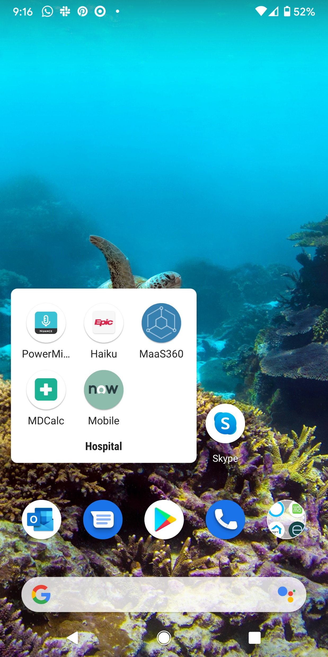
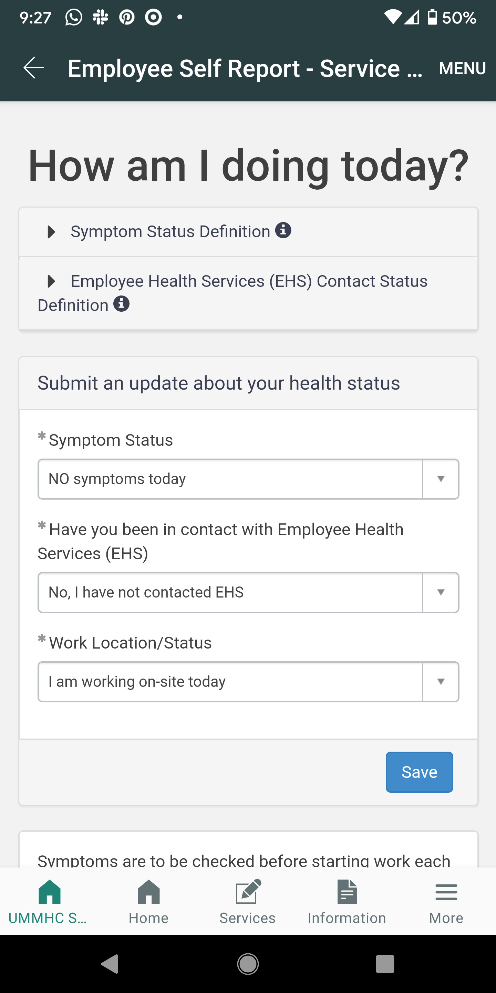
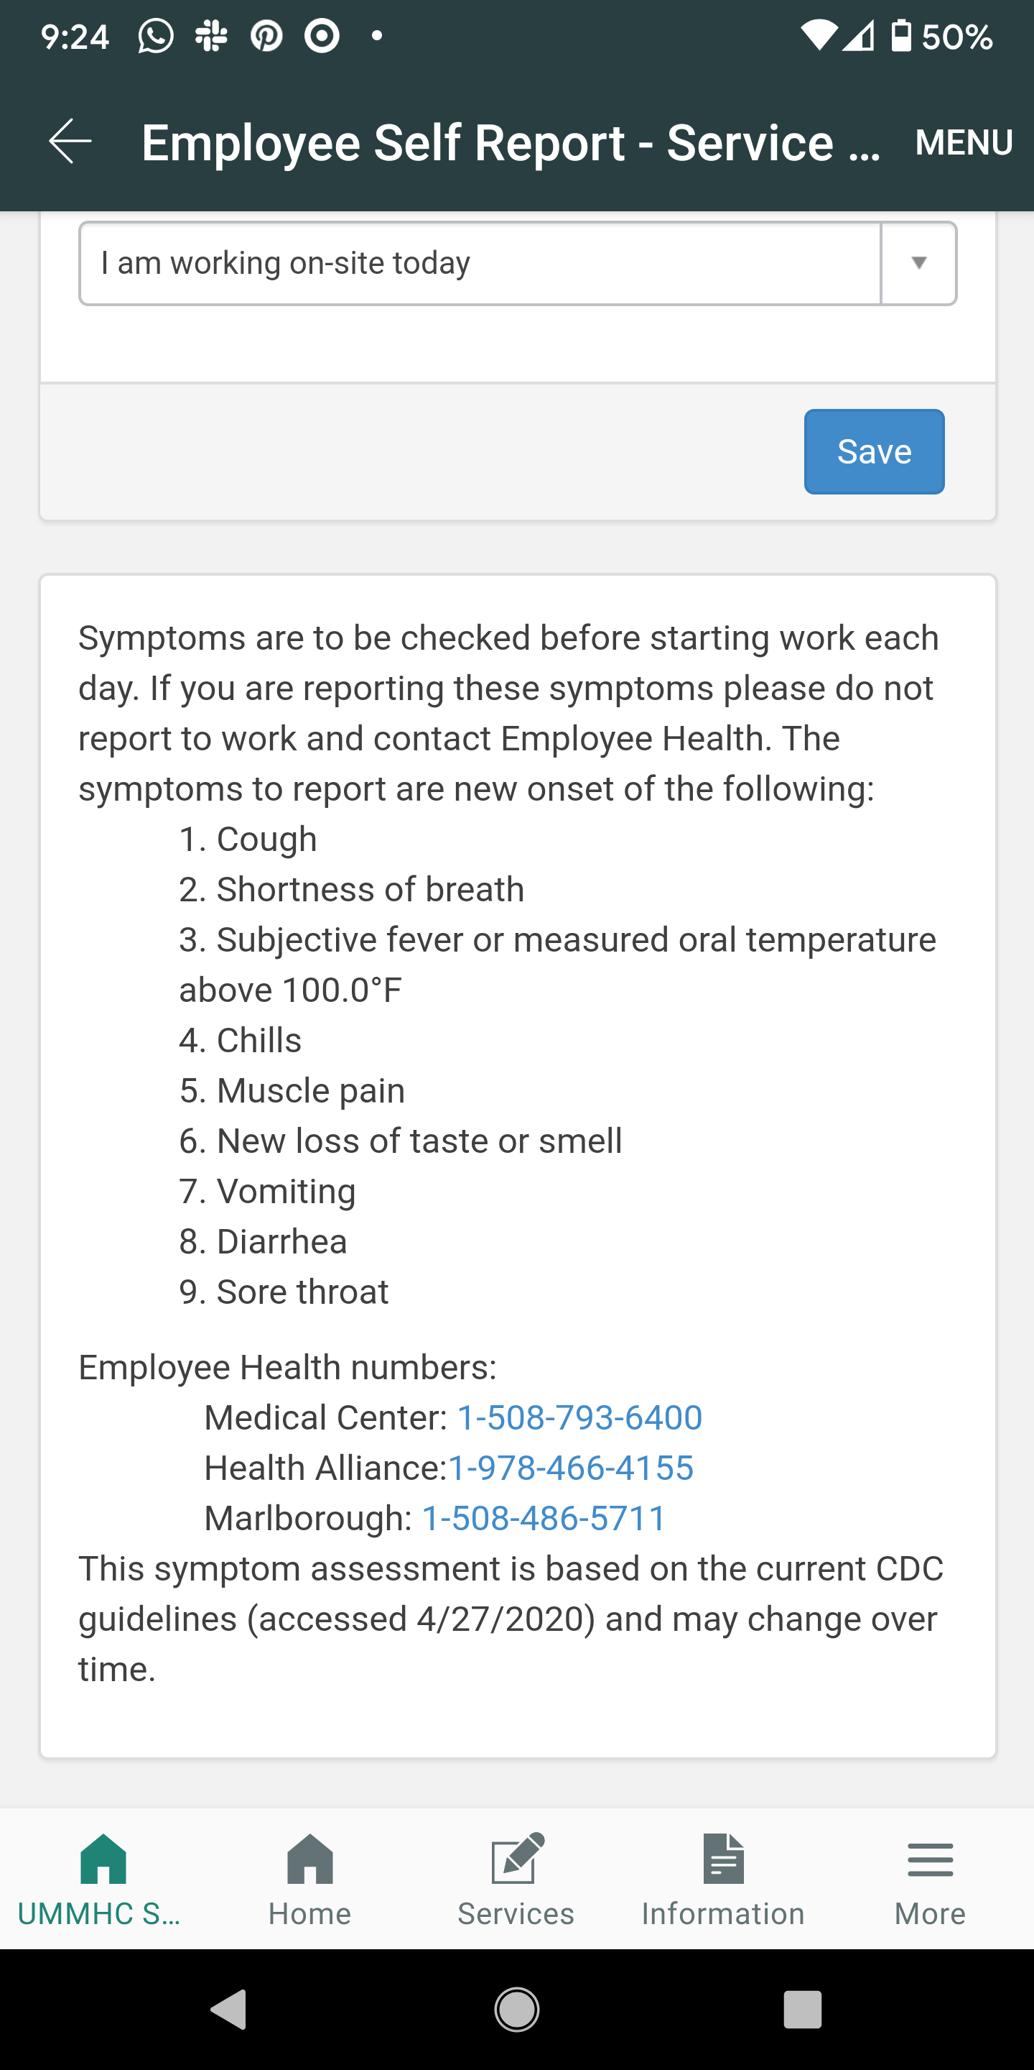
Employee Self Reporting Tool (ESR)

Slide 31
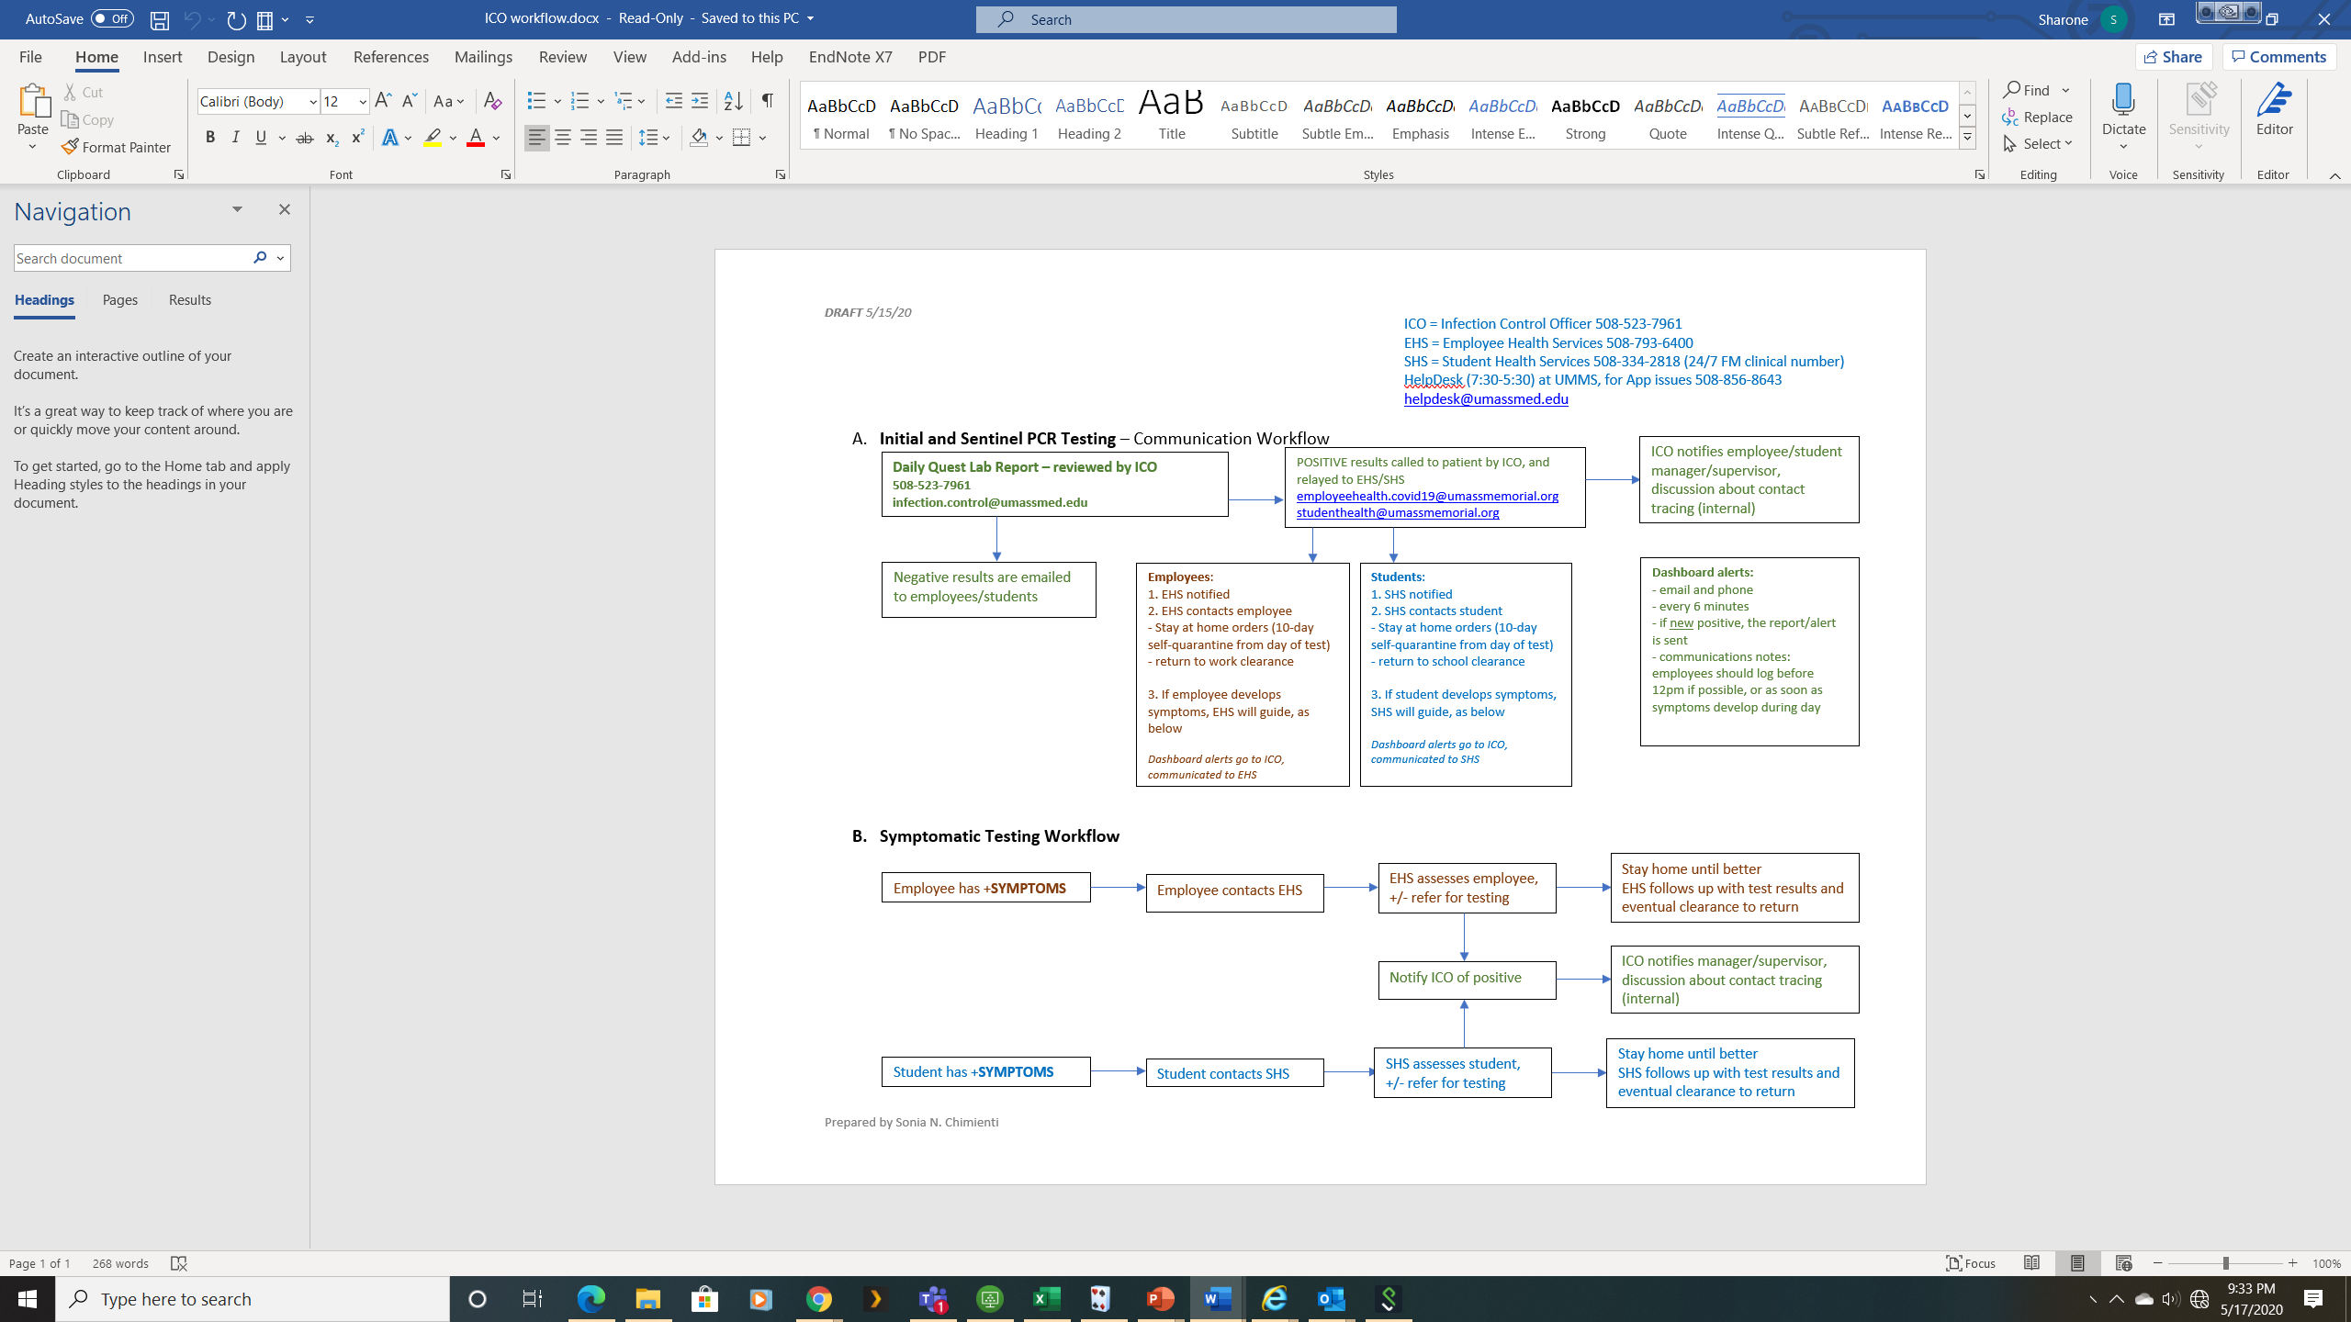
A. Initial and sentinel PCR testing—communication workflow

Slide 32
B. Symptomatic testing workflow

Slide 33
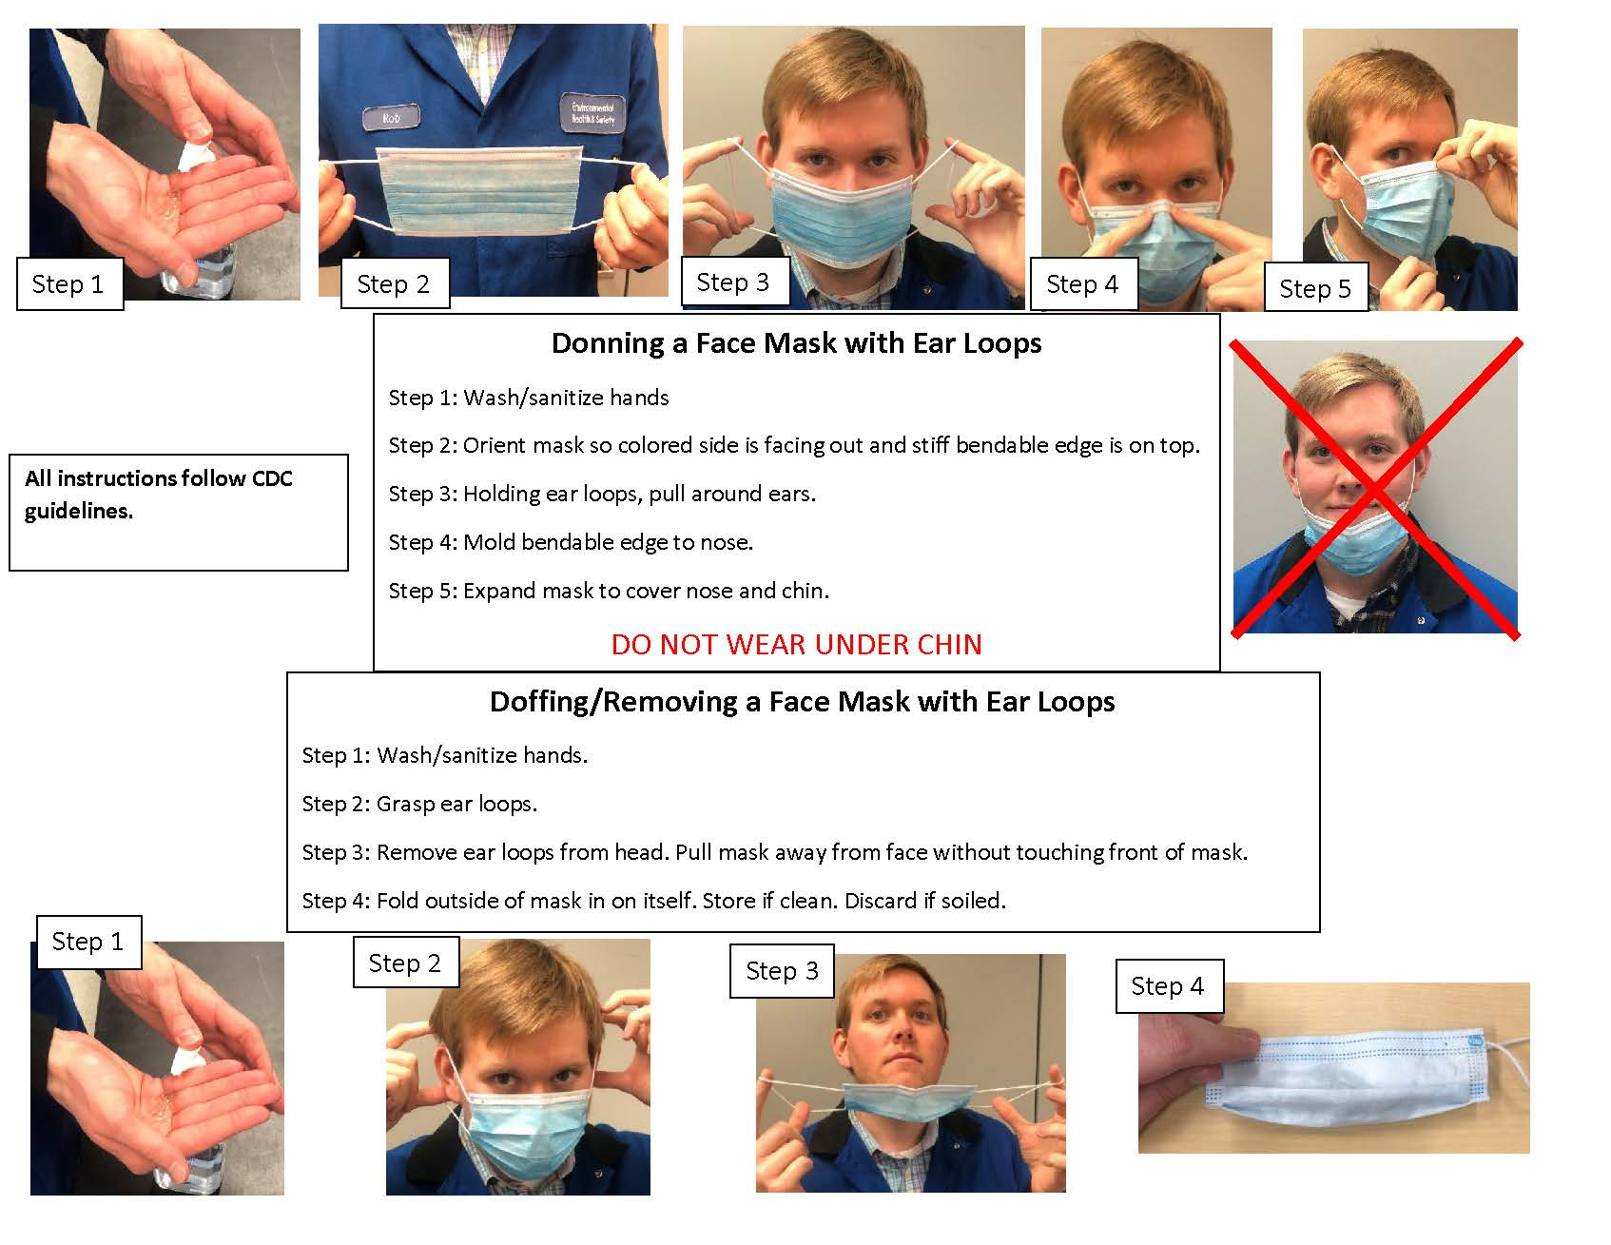

Slide 34
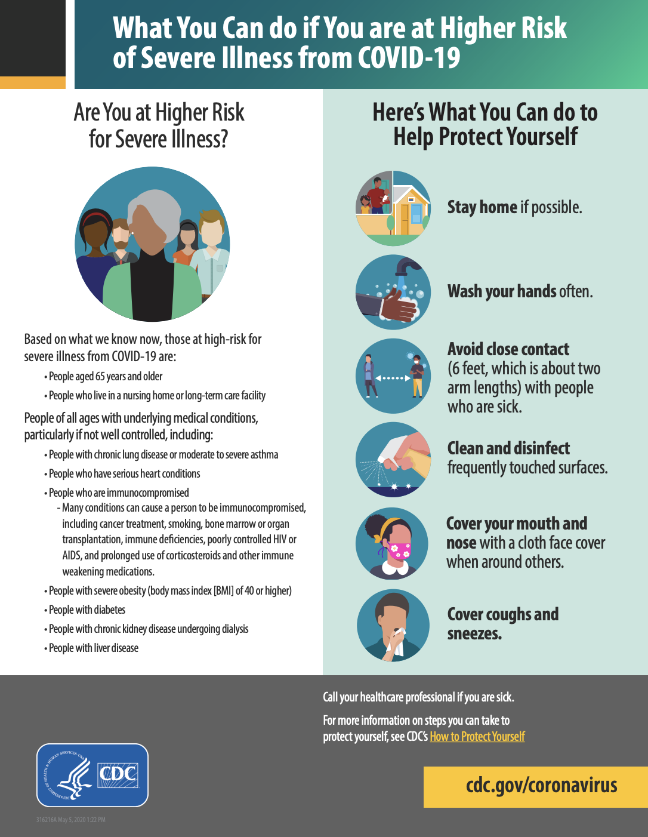
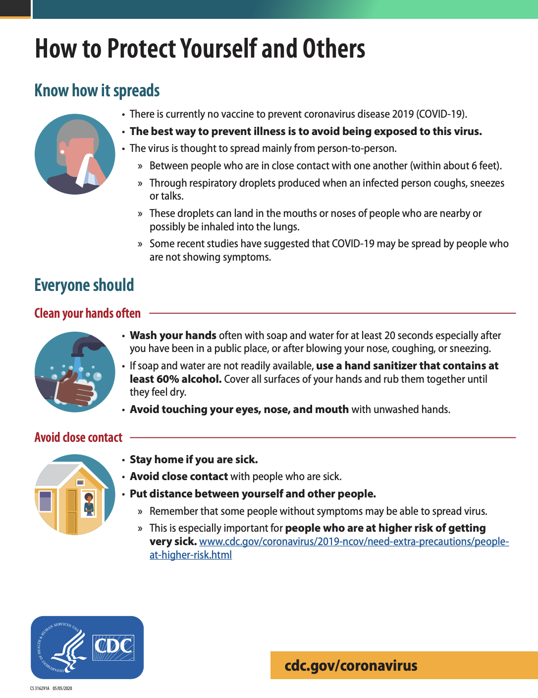
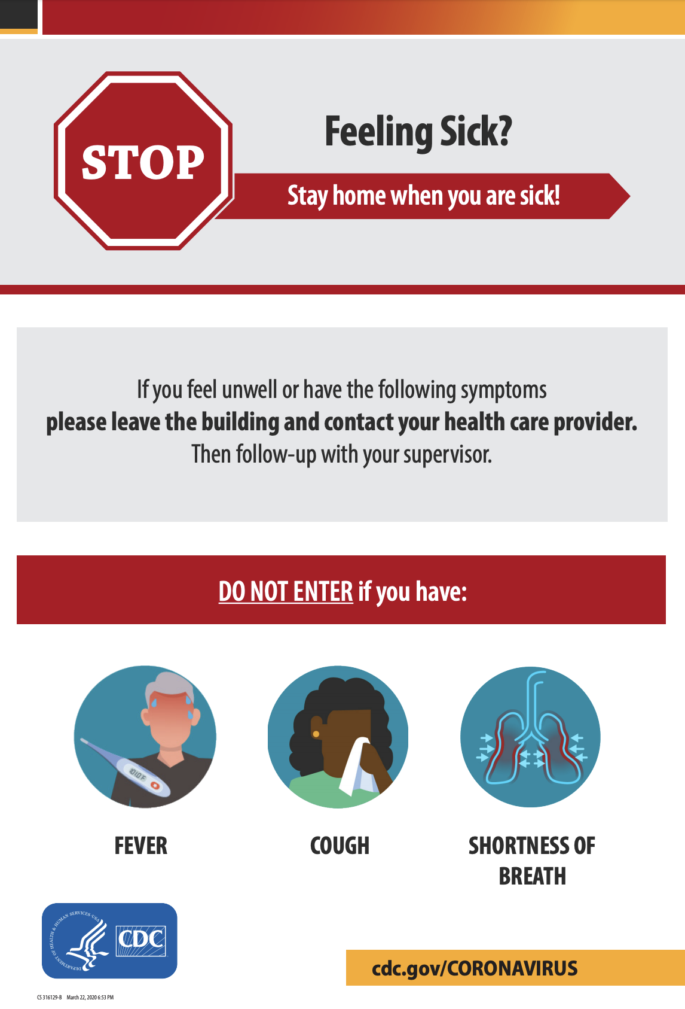

Resources to utilize in the lab
Display CDC posters and fliers to remind employees of important policies

Slide 35
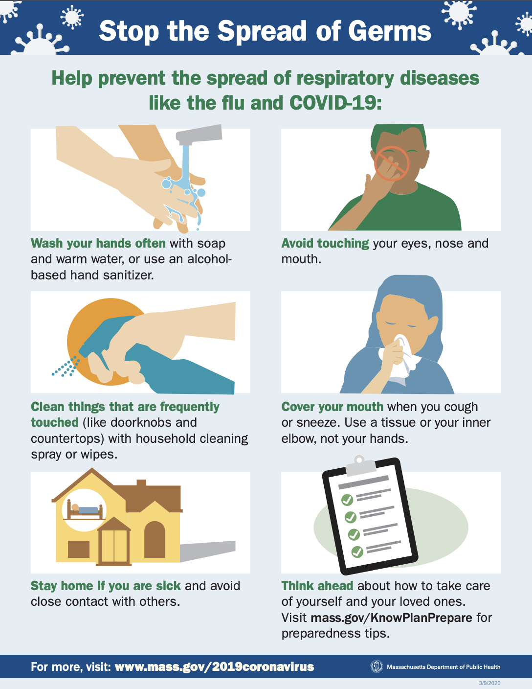
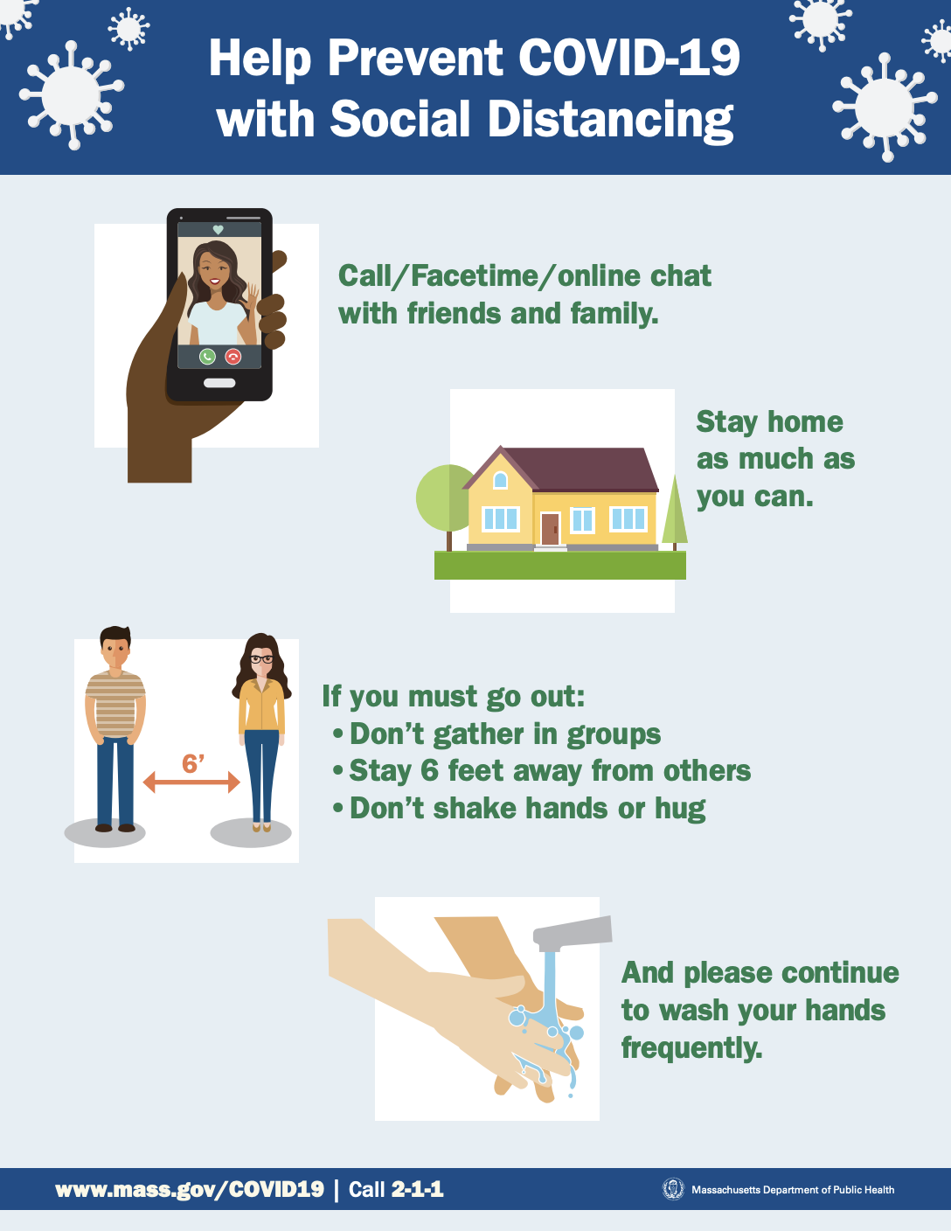
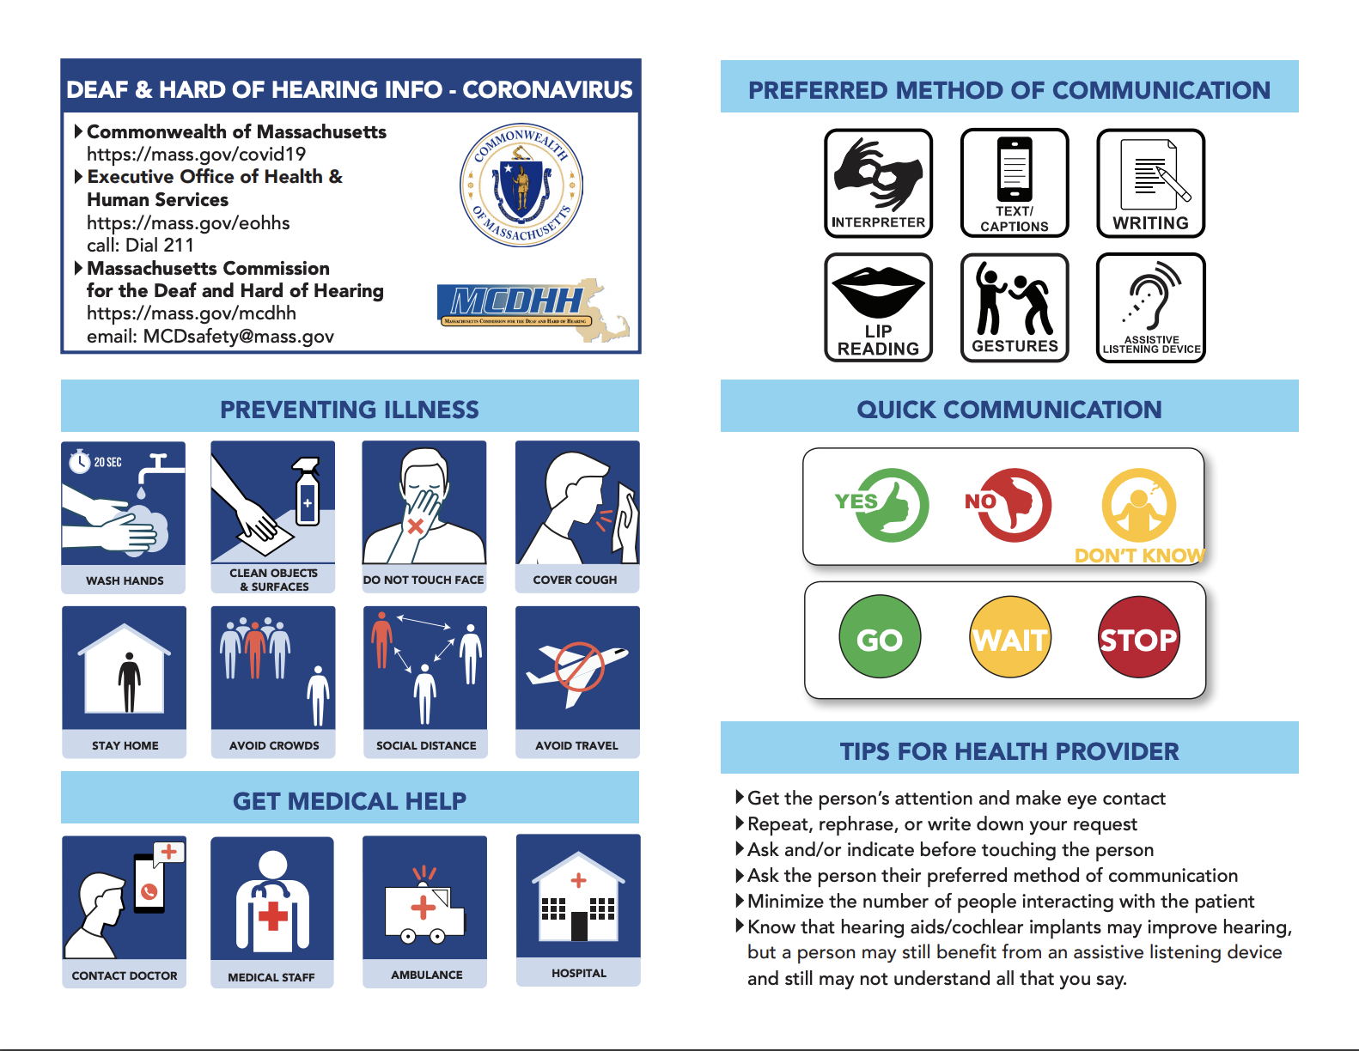
Resources to utilize in the lab
DPH website offers posters,
including some in different
languages

Slide 36

Resources to utilize in the lab
YouTube playlists with useful, shareable videos

Slide 37
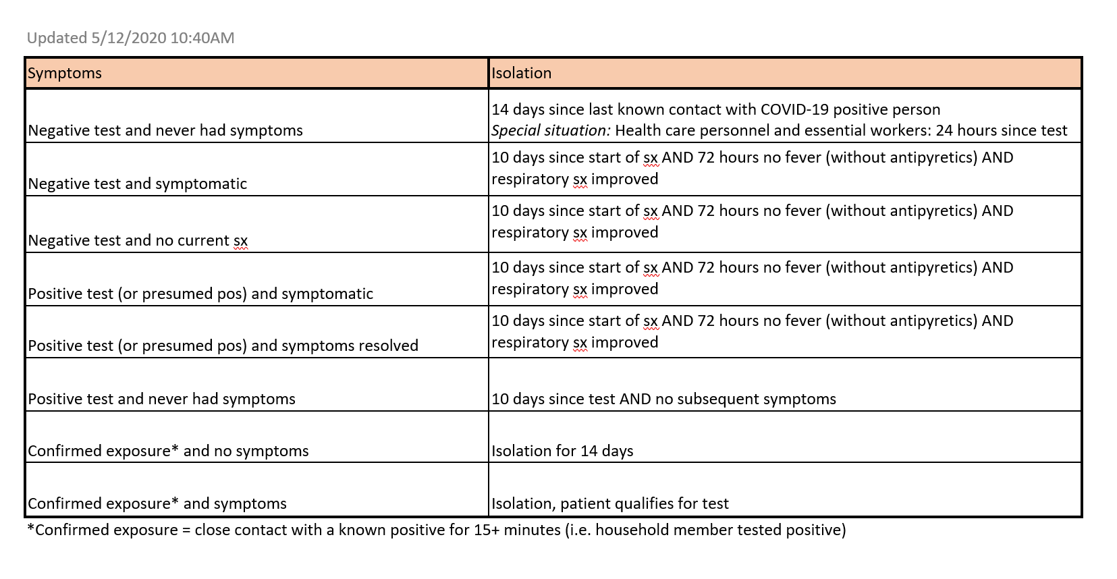

Slide 38
Take home messages
All lab members must be screened for SARS CoV-2 prior to returning to work.
All UMMS lab personnel will be required to self-monitor and report the presence of absence of symptoms of COVID-19 EVERY DAY, starting
on the first day of return to work using the ESR Tool.
STAY HOME IF YOU ARE SICK! If you develop symptoms while at work,
go home and contact EHS/SHS
Social distancing and adherence to universal mask policy
is our collective responsibility.

Slide 39
Contact information, at-a-glance
Infection Control Officer, Dr. Sharone Green: infection.control@umassmed.edu
Employee Health Services: 508-793-6400
Student Health Services: 508-334-2818
Environmental Health & Safety:
www.umassmed.edu/bmp/facilities/environmental-health-and-safety
Accommodations: 774-455-4804

