Slide 1







Beta-Testing Reaching Calm: Exploring Digital Approaches to Address Suicide Risk in Obstetric Settings
CAPES Annual Retreat 2025
Pilot Project

Slide 2
Study team
Project lead: Martha Zimmermann, PhD
Psychiatry & Behavioral Sciences
UMass Chan Medical School
Collaborator: Anna Whelan, MD, FACOG
Obstetrics and Gynecology / Maternal Fetal Medicine
UMass Chan Medical School
Collaborator: Lourah Kelly, PhD
Psychiatry & Behavioral Sciences
UMass Chan Medical School
Collaborator: Nancy Byatt, DO, MS, MBA, DFAPA, FACLP
Psychiatry & Behavioral Sciences
UMass Chan Medical School
Collaborator: Edwin Boudreaux, PhD
Emergency Medicine
UMass Chan Medical School
Consultant: Bengisu Tulu, PhD
Information Technology
Worcester Polytechnic Institute
RCIII: Carolyn Friedhoff, MBE
UMass Chan Medical School
Capstone Student: Lorenc Vangeli, BS
UMass Chan Medical School

Slide 3
Table of contents
Reaching Calm
Study aims
Study progress &
next steps

Slide 4
Reaching Calm
Study aims
Study progress &
next steps

Slide 5

We developed Reaching Calm to prevent perinatal anxiety in obstetric settings
Workflow for obstetric practices
Text messages and web-based app for pregnant people
Training for obstetric professionals
When
Before a crisis
Who
Economically marginalized individuals

Slide 6

Reaching Calm App includes:
Zimmermann… & Byatt (under review)
Notes:
We used these personas and associated design considerations in our development of Reaching Calm, which includes text messages, interactive sessions and a website

Slide 7



Cycle chart
Pregnant & postpartum people
Advisory councils
Obstetric professionals

Slide 8



1 in 10 statistic
Pregnant or postpartum individuals experience thoughts about suicide
1 in 10
Notes:
At least 1 in 5 pregnant or postpartum individuals will experience depression or anxiety disorder, which is associated with adverse health outcomes for the pregnant individual, their children, and families.
At least 1 in 10 (10%) of pregnant and 7-12% of postpartum individuals experience suicidal ideation or behaviors
Mental health issues are the primary contributors to maternal mortality in the U.S., accounting for 22.7% of pregnancy-related deaths. Among these, suicide is a contributing factor at 8.4%,

Slide 9
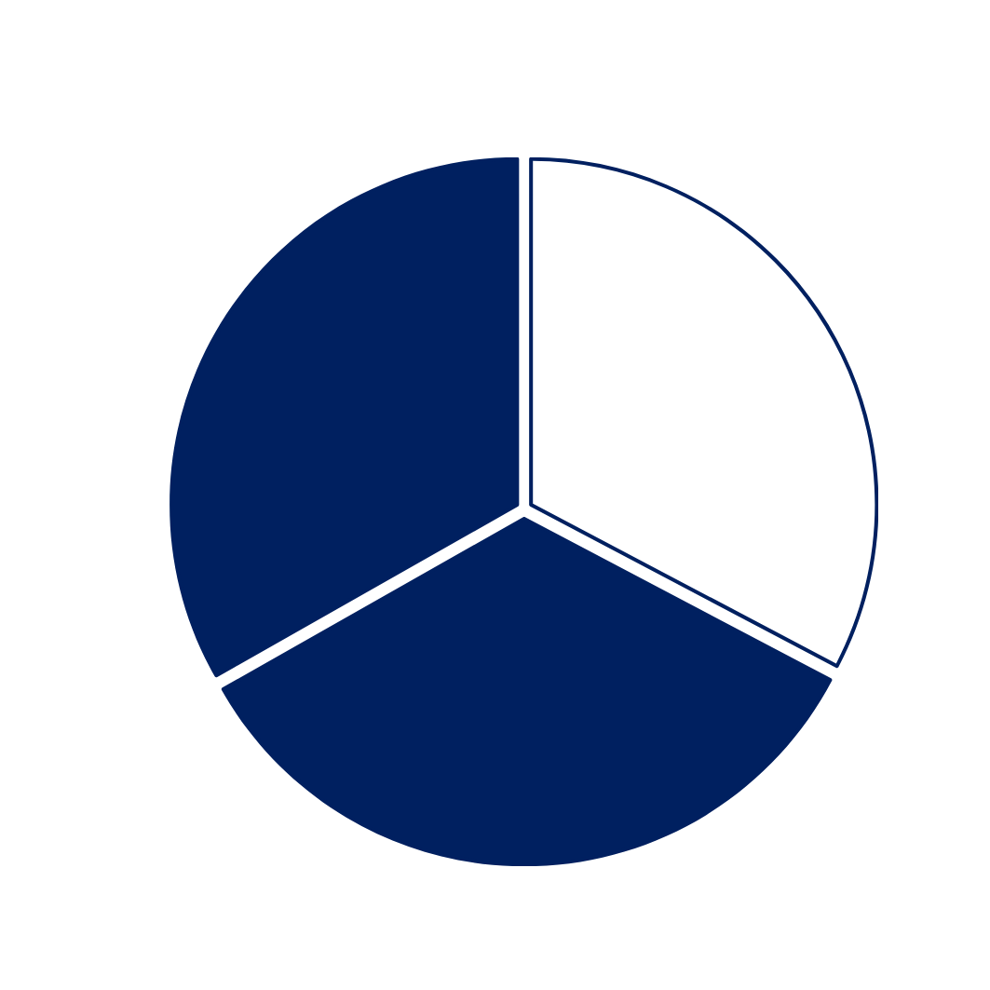
Perinatal anxiety is an under-identified risk factor
As many as two thirds of pregnant individuals experiencing suicidality do not meet criteria for depression (Garman et al., 2019)
Prenatal anxiety symptoms are a stronger predictor of postpartum suicide ideation than depression symptoms (Schafer et al 2024)
Garman et al., 2019
Notes:
At least 1 in 5 pregnant or postpartum individuals will experience depression or anxiety disorder, which is associated with adverse health outcomes for the pregnant individual, their children, and families.
At least 1 in 10 (10%) of pregnant and 7-12% of postpartum individuals experience suicidal ideation or behaviors
Mental health issues are the primary contributors to maternal mortality in the U.S., accounting for 22.7% of pregnancy-related deaths. Among these, suicide is a contributing factor at 8.4%,
Anxiety is a stronger predictor of risk (Schafer et al 2024)

Slide 10
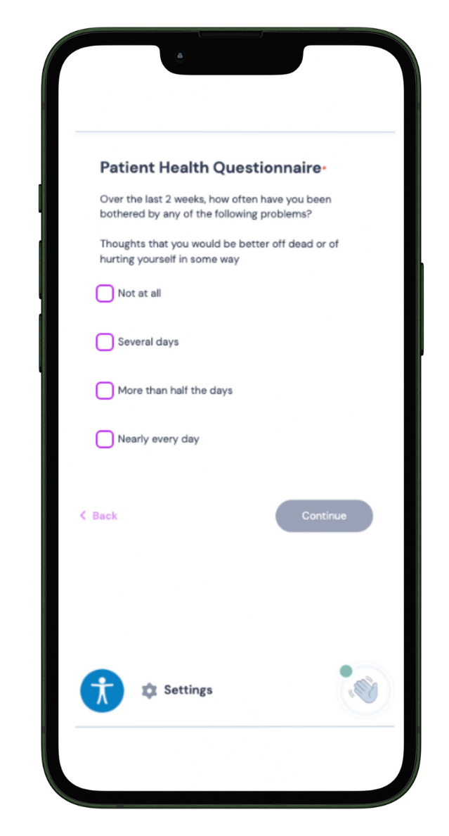
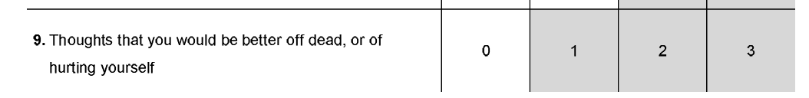
Reaching Calm has an opportunity to identify risk
Notes:
-limitations: this doesn’t tell us a lot of information about what this person is experiencing

Slide 11
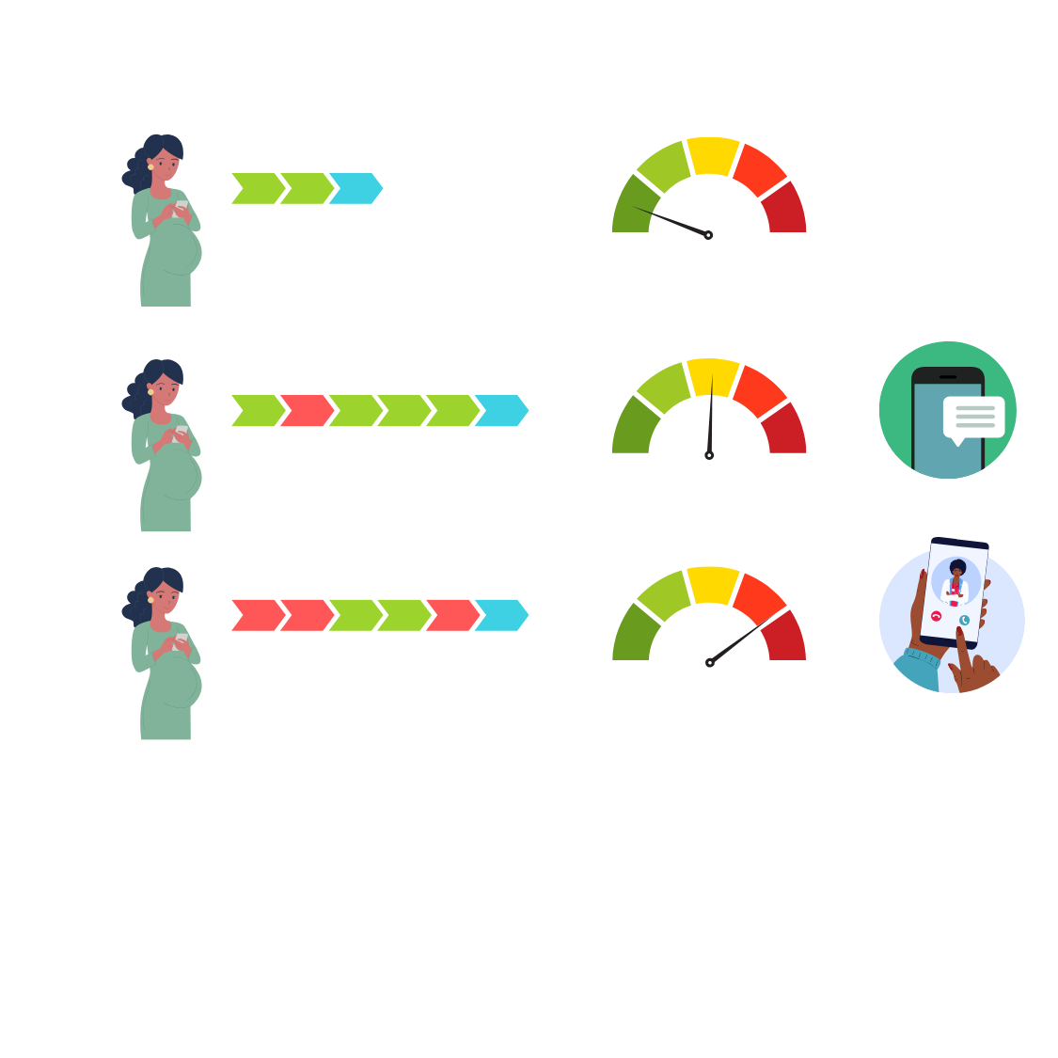
Computerized Adaptive Test (CAT) offer advantages for assessing risk
How much have you been troubled or bothered by psychological or emotional problems?
How much would you avoid going far from home alone because of fear or unpleasant feelings?
How much have you felt like you were going crazy?
Has feeling depressed interfered with what you usually do?
Did you feel you wanted to give up trying?
How often did you feel hopeless?
How much were you distressed by blaming yourself for things?
Did you see the future as very bleak?
Notes:
A CAT is an online questionnaire that adjusts the questions it asks based on the answers a person gives. For example, if someone answers that they are feeling very anxious, the test might ask more questions about anxiety, but skip questions that are less relevant. This makes the assessment quicker, more personalized, and more accurate. It can also provide information about suicide risk based on how the person responds (e.g., low, medium, or high).
Benefits:
Efficiency and Adaptability
The tool customizes assessments in real-time based on patient responses, which reduces both the number of questions asked and the burden on patients and clinicians.
Assessments are administered electronically through a web-enabled tablet, making it easier to integrate into clinical workflows.
High Sensitivity and Specificity
Various models such as CAT-MH® demonstrated higher detection rates for mental health conditions compared to conventional tools.
For example, in recent studies by Caremer et al the tool's modules have been validated for perinatal populations, ensuring relevance and accuracy.
5% more true positive cases of MDD compared to the PHQ-9
Facilitating Clinical Decision-Making
Providers received results through confidential emails and used a decision tree to determine appropriate referrals or prescriptions.
The tool supports clinicians in making informed decisions about referrals to mental health providers or prescribing medication.
4. Addressing Disparities in Mental Health Care
Can be deployed in urban and rural clinics serving predominantly low-income, Medicaid-insured patients who are traditionally underserved mental health populations. Expand screening capabilities to include anxiety, PTSD, and substance use and help address disparities in mental health care experienced by these populations.

Slide 12
Study aims
Reaching Calm
The goal of this pilot project is to Integrate suicide risk assessment into the OB setting by adapting Reaching Calm to include a Computerized Adaptive Test (CAT) suicide risk assessment and explore strategies for intervention.
Study progress &
next steps

Slide 13
List of aims
Aim 1 Adapt Reaching Calm to integrate suicide risk assessment using the CAT and identify acceptable intervention approaches. We will employ community-engaged, user-centered design approaches to characterize user needs and inform adaptations. This iterative process will enhance the acceptability of the intervention, ensuring that it fits seamlessly into OB workflows and meets the needs of perinatal populations.
Aim 2 Beta-test Reaching Calm (digital intervention, training, implementation protocol) at an OB clinic using our previously successful approach to beta-testing. We will recruit perinatal patients (n=30) experiencing elevated distress as assessed by the Generalized Anxiety Disorder-7 scale (GAD-7). We will assess CAT completion, responses, and associated factors.
Aim 3 Explore acceptability and feasibility of remote suicide risk assessment and intervention and identify opportunities for integration with additional CAPES technologies by obtaining feedback through qualitative interviews with a subset of perinatal patients (n=12) and a focus group with OB professionals (n=6).

Slide 14





Study methods
(Aim 2) Beta test
We will recruit 30 participants
(pregnant, at least 18 years or older, at risk for anxiety, English-speaking)
Receive the intervention for 2 weeks on mobile phone or device
12 patients & will be invited for a virtual interview/focus group (Aim 3) Refine
Adapt Reaching Calm to suicide risk assessment and intervention (Aim 1) Adapt
IRB approval 2/27
Conduct provider training and obtain feedback
Eligibility survey & pre-intervention assessment
Post intervention assessment, acceptability/feasibility

Slide 15
Study progress &
next steps
Reaching Calm
The goal of this pilot project is to Integrate suicide risk assessment into the OB setting by adapting Reaching Calm to include a Computerized Adaptive Test (CAT) suicide risk assessment and explore strategies for intervention.
Study aims

Slide 16




Study progress—adapting Reaching Calm
Advisory council feedback
CAPES Lived Experience Advisory Council (2/14)
WeSPARC Insight Advisory Board (5/2)
Integrated the CAT into CIAS
Developed study team alerts
Continuing to develop risk response that involves participant choice
Developing new procedures for informed consent
Consultation with CAPES Ethics Core
Integrated suicide risk assessment into OB training
Prevalence of suicidal ideation
CAT workflow

Slide 17


Study progress—participant enrollment & obtaining feedback
Conducted training with obstetric professionals
17 clinical staff (4/16)
12 ob/gyn residents (4/30)
Obtained feedback and on training via focus groups
Clinical staff (n=5)
Ob/gyn residents (n=3)
Perinatal patient recruitment
3 completed eligibility
  2 GAD-7<5
  1 enrolled

Slide 18
Quote from participant
“I think when it comes to learning, what the hospital provides for us is suicide risk… what to watch for and what to do, but it's never about what to say and how to say it."
–Nurse (Participant #2)
Notes:
“And I think it's because it's so sensitive, you… have to learn how to ask questions in a sensitive way, so people” –
Participant #2 (Nurse)
“We have very fragmented education on mental health.” –
Participant #2 (Nurse)

Slide 19


Next steps
Continuing to refine Reaching Calm
Scripts for professionals including clinic staff
Perinatal patient recruitment
Developing new procedures- eg MyChart

Slide 20

Thank
you!
Center for Accelerating Practices to End Suicide R03
Center for Clinical and Translational Science (UMCCTS) Mentored Career Development (KL2) Training Program
KL2 Mentor Team
  Primary Mentor: Nancy Byatt, DO, BA, MS, DFAPA, FACLP
  Stephenie C. Lemon, PhD, MS
  Edwin Boudreaux, PhD
  Camille A. Clare, MD, MPH
  Elizabeth Peacock-Chambers, MD, MS
CAPES Lived Experience Advisory Council
weSPARC Insight Advisory Council
Study Participants
Collaborators & CAPES
Study Team
  Anna Whelan, MD
  Lourah Kelly, PhD
  Carolyn Friedhoff, MBE
  Xihan Yang PhD
  Lorenc Vangjeli, BS
  Lindsey Ford, BS
KL2 Scientific Advisory Council
  Heather Forkey, MD
  Kimberly A. Yonkers, MD
  Bengisu Tulu, PhD
  Karen Tabb Dina, PhD
martha.zimmermann1@umassmed.edu

