Slide 1

The Recorded Home Oximetry (RHO) Program
Monthly Investigator Meeting
June 2, 2022

Slide 2

RHO Program Implementation Timeline
Feb - Mar 2021
Baseline data collection begins
Mar - May 2021
Initiate site training
Initiate monthly phone calls
May - Aug 2021
Jun 2021 - Feb 2022
Feb - Aug 2022
Aug 2022 - Feb 2023
Complete site training
Reach 33% of eligible families
Reach 66% of eligible families
Feb - Aug 2023
Reach 100% of eligible families
Initiate 18-month implementation
Begin providing monthly feedback reports

Slide 3



 | - Enrolling
 | - Activated but not enrolling
 | - Patient identified, not yet enrolled

Slide 4
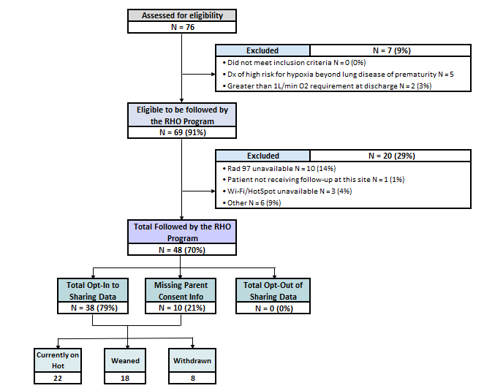
RHO Implementation Trial Consort Diagram
Average HOT Duration:
74 ± 56

Slide 5
Goal

Slide 6
Enrollment by Site
Site Name | 1st patient enrolled | Site IRB Approved | Duration of Implementation in Months | Eligible | Followed | Withdrawn | Active | Weaned | Avg HOT Duration
WAVE 1
Boston Children's Hospital | 7/8/2021 | 10/4/2021 | 10.9 | 9 | 8 (89%) | 1 | 2 | 5 | 94±90
Dartmouth-Hitchcock | Jan. 2022 | 10/4/2021 | 8.0 | 5 | 5 (100%) |  | 5 | 0
Maria Fareri Children's | 11/18/2021 | 7/10/2021 | 6.5 | 2 | 2 (100%) |  | 0 | 2 | 90±52
Massachusetts General Hospital | 7/8/2021 | 10/4/2021 | 10.9 | 5 | 5 (100%) | 1 | 2 | 2 | 90.5±40
University of Maryland | 8/21/2021 | 10/4/2021 | 9.5 | 13 | 9 (69%) | 4 | 1 | 4 | 54±39
Vanderbilt | 4/28/2021 | 7/21/2021 | 10.5 | 6 | 1 (17%) |  | 1 | 0
WAVE 2
Arkansas Children's Hospital | 10/20/2021 | 1/28/2022 | 7.5 | 4 | 4 (100%) | 1 | 2 | 1 | 90
Children's Hospital of Phil. | 5/26/2022 | 10/20/2021 | 7.5 | 10 | 0 (0%) |  | 1 | -1
Cincinnati Children's Hospital |  | 4/15/2022 |  | 0 |  |  | 0 | 0
National Jewish Health |  | 10/4/2021 | 8.0 | 0 |  |  | 0 | 0
Nationwide Children's Hospital | 3/4/2022 | 10/4/2021 | 8.0 | 9 | 9 (100%) |  | 9 | 1 | 60
Peyton Manning Children's Hospital |  |  |  | 0 |  |  | 0 | 0
U. of California, San Diego | 11/10/2021 | 10/4/2021 | 6.8 | 5 | 4 (80%) | 1 | 2 | 2 | 28
U. of Kentucky Children's Hospital |  |  |  | 0 |  |  | 0 | 0

Slide 7
Projected vs. Actual Enrollment Into the RHO Program
Site Name | Site IRB Approved | Estimate per Year | Estimate per Month | Current per Month
WAVE 1
Boston Children's Hospital | 10/4/2021 | 40 | 3.3 | 0.7
Dartmouth-Hitchcock | 10/4/2021 | 20 | 1.7 | 0.6
Maria Fareri Children's | 7/10/2021 | 14 | 1.2 | 0.3
Massachusetts General Hospital | 10/4/2021 | 13 | 1.1 | 0.5
University of Maryland | 10/4/2021 | 20 | 1.7 | 0.5
Vanderbilt | 7/21/2021 | 70 | 5.8 | 0.1
WAVE 2
Arkansas Children's Hospital | 1/28/2022 | 48 | 4.0 | 0.4
Children's Hospital of Phil. | 10/20/2021 | 50 | 4.2 | 0.0
Cincinnati Children's Hospital | 4/15/2022 | 50 | 4.2
National Jewish Health | 10/4/2021 | 250 | 20.8 | 0.0
Nationwide Children's Hospital | 10/4/2021 | Not Provided | Not Provided | 1.3
Peyton Manning Children's Hospital |  | 25 | 2.1
U. of California, San Diego | 10/4/2021 | 65 | 5.4 | 0.6
U. of Kentucky Children's Hospital |  | 50 | 4.2

Slide 8
Barriers to Enrollment
Screening Logs:
  Please ensure your site is screening ALL potentially eligible infants discharged home on respiratory support despite their participation status in the RHO program
  Completion of the screening form in REDCap is essential in the accuracy of the overall denominator and ensuring all eligible infants are captured across all sites
  Proper completion of the screening form would further aid in providing an accurate reach of the RHO program- a primary outcome of the implementation trial

Slide 9
Barriers to Enrollment Continued
Demographic Forms:
  Please ensure your site is filling-out demographic forms for ALL eligible infants discharged on supplemental oxygen despite their participation status in the RHO program
  Completion of the demographics form is essential for the individualized monthly site reports, which are sent out to all active sites on the 15th of each month
  The following forms should be completed in the project’s REDCap for infants who are eligible but aren’t followed by the program but opt-in to data collection
    1. Screening and Eligibility form
    2. Demographics form
    3. Implementation Discharge form (essential to obtain HOT duration on ALL eligible infants for future analysis)
    4. Adverse Events form

Slide 10
Screening Data and Reach of the Overall Implementation
As defined in the projects milestones and objectives we plan to REACH 33% of all eligible families by August 2022
Currently, it appears we are reaching 70% of all eligible infants – this may not be the case if screening data is not accurate

Slide 11
Uptick in Program Exclusion Criteria
Home Care’s not having RAD 97’s available (14%) – with the current supply chain delay’s referrals might need to go to other home care’s that do have RAD 97’s in-stock
  Masimo and RHO Leadership working to engage more available home cares for sites
Increase in social concern exclusions – need to monitor as this may impact generalizability for further dissemination of the program and raised as a potential problem during the DSMB’s review

Slide 12
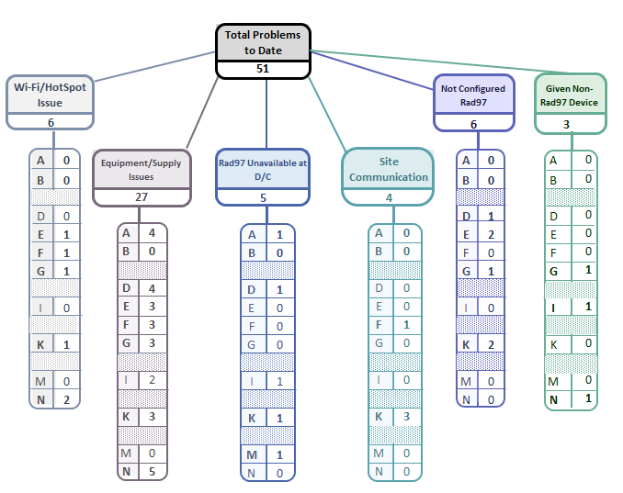
Implementation Related Problems

Slide 14
Deviation Types
Total Reports | Reports with Deviations
998 | 160
Last Months
Notes:
- Most common reason continues to be “provider did not follow recommendation”

Slide 15
Goal

Slide 16
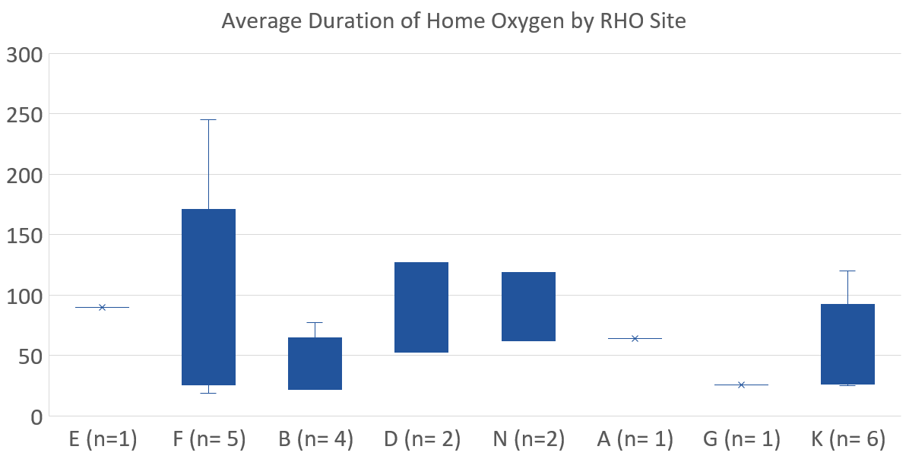

Slide 17
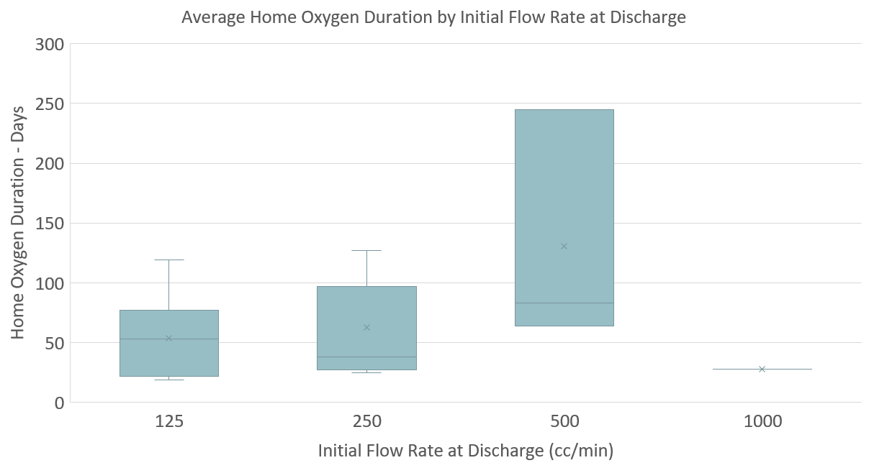
(n= 7)
(n= 11)
(n= 3)
(n= 1)

Slide 18
DSMB Meeting Review
First DSMB Meeting took place on May 17th
Request was made to exclude infants whose underlying etiology for HOT is neurological
The number of readmissions that occur after the recommendation was to “increase” by the RHO algorithm will be monitored. If additional cases occur this may prompt a more thorough review.
Discussed the high percentage of withdrawals (8/44) and all reasons seemed appropriate and didn’t raise concern
Meeting minutes will be distributed once the UMMS IRB acknowledges

Slide 19
Family Engagement Survey
  The Family Engagement Pre and Post Implementation Survey Project has been approved by the UMass IRB
  Waiting on sub-contract acknowledgement to disseminate to sites
  Please reach out to Heather with any questions

Slide 20
REDCap Data Query Reports
Heather is in the process of preparing data query reports for all sites
Reports will go out this week and will have to be addressed within 10 business days
While completing the queries please confirm in the first query that all potentially eligible infants have been screened at your center

Slide 21


RHO Program Website
All resources, including training documents, the RHO manual, and other templates can be found on the RHO website at www.umassmed.edu/rho-program
Navigate to “Member Login” and log in with the following credentials to access the documents
  Username: RHO
  Password: Oximetry14

Slide 22



Closing Thoughts
Questions or Comments?
Are there any suggestions and/or feedback on the progress of the program that you would like to share with the team at this time?

