Slide 1

The Recorded Home Oximetry (RHO) Program
Monthly Investigator Meeting
May 5, 2022

Slide 2

RHO Program Implementation Timeline
Feb - Mar 2021
Baseline data collection begins
Mar - May 2021
Initiate site training
Initiate monthly phone calls
May - Aug 2021
Jun 2021 - Feb 2022
Feb - Aug 2022
Aug 2022 - Feb 2023
Complete site training
Reach 33% of eligible families
Reach 66% of eligible families
Feb - Aug 2023
Reach 100% of eligible families
Initiate 18-month implementation
Begin providing monthly feedback reports

Slide 3



 | - Enrolling
 | - Activated but not enrolling
 | - Patient identified, not yet enrolled

Slide 4
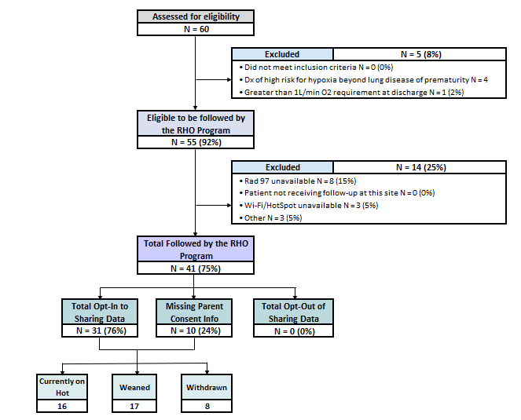
RHO Implementation Trial Consort Diagram
Average HOT Duration:
71 ± 56

Slide 5
Goal

Slide 6
Projected vs. Actual Enrollment Into the RHO Program
Site Name | Site IRB Approved | Estimate per Year | Estimate per Month | Current per Month
WAVE 1
Boston Children's Hospital | 10/4/2021 | 40 | 3.3 | 0.8
Dartmouth-Hitchcock | 10/4/2021 | 20 | 1.7 | 0.8
Maria Fareri Children's | 7/10/2021 | 14 | 1.2 | 0.4
Massachusetts General Hospital | 10/4/2021 | 13 | 1.1 | 0.6
University of Maryland | 10/4/2021 | 20 | 1.7 | 0.7
Vanderbilt | 7/21/2021 | 70 | 5.8 | 0.1
WAVE 2
Arkansas Children's Hospital | 1/28/2022 | 48 | 4.0 | 0.6
Children's Hospital of Phil. | 10/20/2021 | 50 | 4.2 | 0.0
Cincinnati Children's Hospital | 4/15/2022 | 50 | 4.2
National Jewish Health | 10/4/2021 | 250 | 20.8 | 0.0
Nationwide Children's Hospital | 10/4/2021 | Not Provided | Not Provided | 0.7
Peyton Manning Children's Hospital |  | 25 | 2.1
U. of California, San Diego | 10/4/2021 | 65 | 5.4 | 0.8
U. of Kentucky Children's Hospital |  | 50 | 4.2

Slide 7
Barriers to Enrollment
Screening Logs:
  Please ensure your site is screening ALL potentially eligible infants discharged home on respiratory support despite their participation status in the RHO program
  Completion of the screening form in REDCap is essential in the accuracy of the overall denominator and ensuring all eligible infants are captured across all sites
  Proper completion of the screening form would further aid in providing an accurate reach of the RHO program- a primary outcome of the implementation trial

Slide 8
Barriers to Enrollment Continued
Demographic Forms:
  Please ensure your site is filling-out demographic forms for ALL eligible infants discharged on supplemental oxygen despite their participation status in the RHO program
  Completion of the demographics form is essential for the individualized monthly site reports, which are sent out to all active sites on the 15th of each month
  The following forms should be completed in the project’s REDCap for infants who are eligible but aren’t followed by the program but opt-in to data collection
    1. Screening and Eligibility form
    2. Demographics form
    3. Implementation Discharge form (essential to obtain HOT duration on ALL eligible infants for future analysis)
    4. Adverse Events form

Slide 9
Baseline Data
As a reminder, all sites are required to submit their VON and Additional baseline data
Templates and instructions on how to extract and format the data can be found on the RHO website
2/14 sites have submitted both sets of baseline data
Please reach out to Heather with any questions

Slide 10
Clarification on SAE Definition
Modification accepted to clarify definition and reporting of SAE’s
For this study, events related to underlying prematurity and in the opinion of the site investigator not outside the normal course for a preterm infant diagnosed with BPD on HOT and associated equipment
SAE’s are to be reported promptly to Heather and reported to the IRB and DSMB within 72-hours of the occurrence
The first DSMB meeting will occur this month

Slide 11
Family Engagement Survey
  The Family Engagement Pre and Post Implementation Survey Project has been submitted to the UMass IRB
  Once approved, we will send an email to all sites with all appropriate documents to submit to your IRB
  Please reach out to Heather with any questions

Slide 12
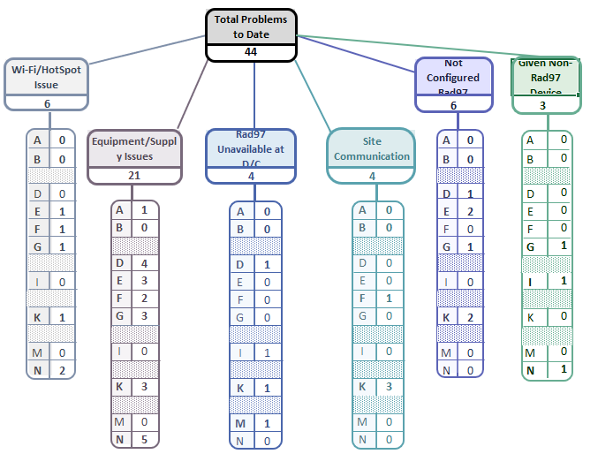
Implementation Related Problems

Slide 14
Deviation Types
Total Reports | Reports with Deviation(s)
854 | 309 (36%)

Slide 15
Goal

Slide 16
Reason’s Why Provider’s Are Not Following the RHO Algorithm’s Recommendation
36% of the time the RHO Algorithm’s Recommendation is not being followed by providers
21 infants (51%) have had at least one report with the recommendation not being followed
  16 infants (39%) had more than one report with the recommendation not being followed
49% of times the provider has felt comfortable maintaining when the recommendation was to “increase” (4% overall)
Need to re-classify “others”

Slide 18
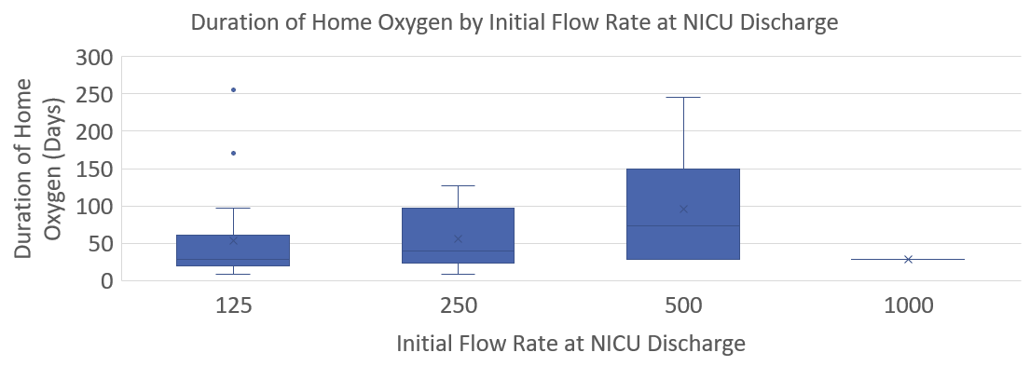
Duration of Oxygen by Initial Flow Rate at Discharge

Slide 19
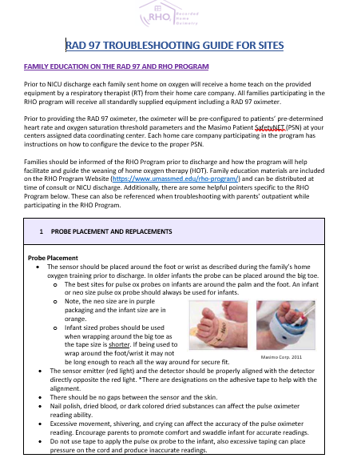
Troubleshooting Guide
Distributed to active sites this week
Will be updated with new information as it becomes available

Slide 20


RHO Program Website
All resources, including training documents, the RHO manual, and other templates can be found on the RHO website at www.umassmed.edu/rho-program
Navigate to “Member Login” and log in with the following credentials to access the documents
  Username: RHO
  Password: Oximetry14

Slide 21



Closing Thoughts
Questions or Comments?
Are there any suggestions and/or feedback on the progress of the program that you would like to share with the team at this time?

