Slide 1

The Recorded Home Oximetry (RHO) Program
Monthly Investigator Meeting
October 13, 2022

Slide 2

RHO Program Implementation Timeline
Feb - Mar 2021
Baseline data collection begins
Mar - May 2021
Initiate site training
Initiate monthly phone calls
May - Aug 2021
Jun 2021 - Feb 2022
Feb - Aug 2022
Aug 2022 - Feb 2023
Complete site training
Reach 33% of eligible families
Reach 66% of eligible families
Feb - Aug 2023
Reach 100% of eligible families
Initiate 18-month implementation
Begin providing monthly feedback reports
Notes:
- Unchecked the goal to reach 66% as we have not fulfilled throughout the milestone period but are on our way

Slide 3



 | - Enrolling
 | - Activated but not enrolling
 | - Patient identified, not yet enrolled

Slide 4
RHO Implementation Trial Consort Diagram
Average HOT Duration:
69 ± 53

Slide 5
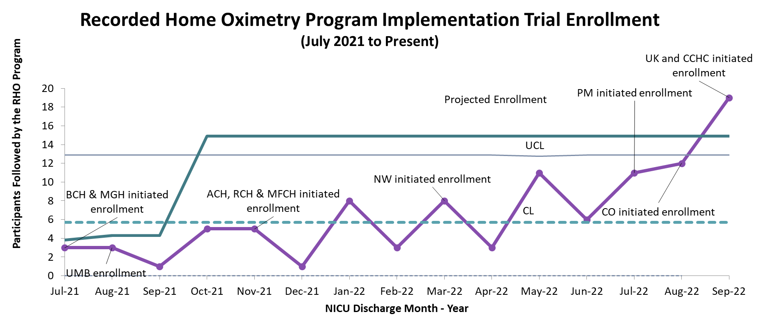
Goal
Notes:
- We need to recalculate our monthly goal now that everyone is live, but this is fine for the purposes of this meeting

Slide 6
Enrollment by Site
Site Name | 1st Patient Enrolled | Duration of Implementation | Estimate Per Year | Estimate Per Month | Current Per Month | Followed | Withdrawn | Weaned from HOT | Active on HOT | Average | SD
Boston Children's | 7/8/2021 | 15.37 | 40 | 3 | 0.7 | 11 | 1 | 7 | 3 | 85.29 | 69.04
Dartmouth-Hitchcock | 1/1/2022 | 9.47 | 20 | 2 | 1.9 | 18 | 1 | 8 | 9
Maria Fareri Children's Hospital | 11/18/2021 | 10.93 | 14 | 1 | 0.2 | 2 | 0 | 2 | 0 | 90.00 | 37.00
Massachusetts General Hospital | 7/8/2021 | 15.37 | 13 | 1 | 0.4 | 6 | 1 | 4 | 1 | 112.00 | 59.33
University of Maryland | 8/21/2021 | 13.90 | 20 | 2 | 1.1 | 15 | 5 | 9 | 1 | 57.67 | 38.39
Vanderbilt | 4/28/2021 | 17.73 | 70 | 6 | 0.1 | 2 | 2 | 0 | 0
Arkansas Children's Hospital | 10/20/2021 | 11.90 | 48 | 4 | 0.8 | 10 | 3 | 3 | 4 | 113.33 | 54.29
Children's Hospital of Philidelphia | 5/26/2021 | 16.80 | 50 | 4 | 0.2 | 3 | 0 | 2 | 1 | 51.00 | 27.36
Cincinnati Children's Hopsital | 9/21/2022 | 0.70 | 50 | 4 | 1.4 | 1 | 0 | 0 | 1
National Jewish Health | 8/24/2022 | 1.63 | 250 | 21 | 3.1 | 5 | 0 | 0 | 5
Nationwide Children's Hospital | 3/4/2022 | 7.40 | 75 | 6 | 3.0 | 22 | 8 | 4 | 10 | 66.00 | 30.21
Payton Manning Children's Hospital | 7/19/2022 | 2.83 | 25 | 2 | 2.1 | 6 | 2 | 2 | 2 | 11.00 | 6.24
U. of California, San Diego | 11/10/2021 | 11.20 | 65 | 5 | 0.5 | 6 | 2 | 3 | 1 | 91.67 | 78.45
U. of Kentucky Children's Hospital |  | 1494.87 | 50 | 4 | 0.0 | 0 | 0 | 0 | 0
Total |  |  |  |  |  | 107 | 25 | 44 | 38 | 75.33 | 22.71

Slide 7
New Centralized Email
Please now send all enrollment updates to RHOProgram@umassmed.edu
All UMMS RHO members have access and can address questions/queries in a timely manner

Slide 8
Higher than Expected Withdrawal Rate
Currently a quarter of patients have been withdrawn from the program
Most common reason being due to RAD 97’s not being available due to supply chain shortages
Withdrawal should be only be considered at a last resort and should be to standard of care, not fully withdrawn from data collection if possible

Slide 9
Implementation Trial Outcomes

Slide 10
Notes:
- Always copy as originally formatted, not a picture.

Slide 12
Implementation Related Problems

Slide 14
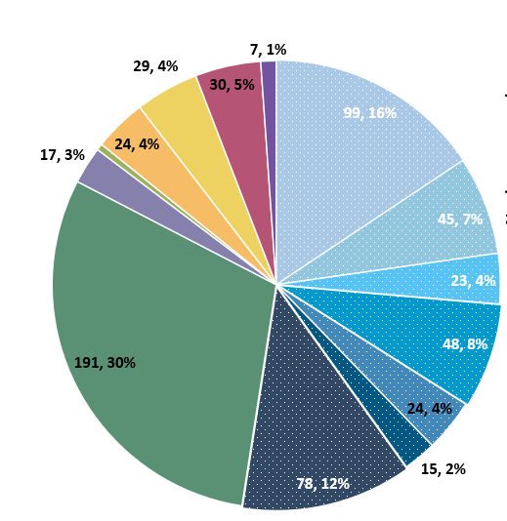
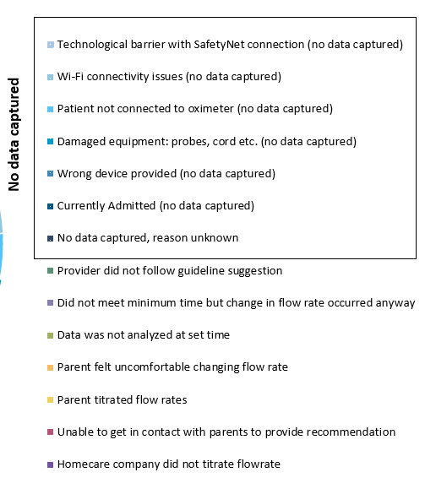
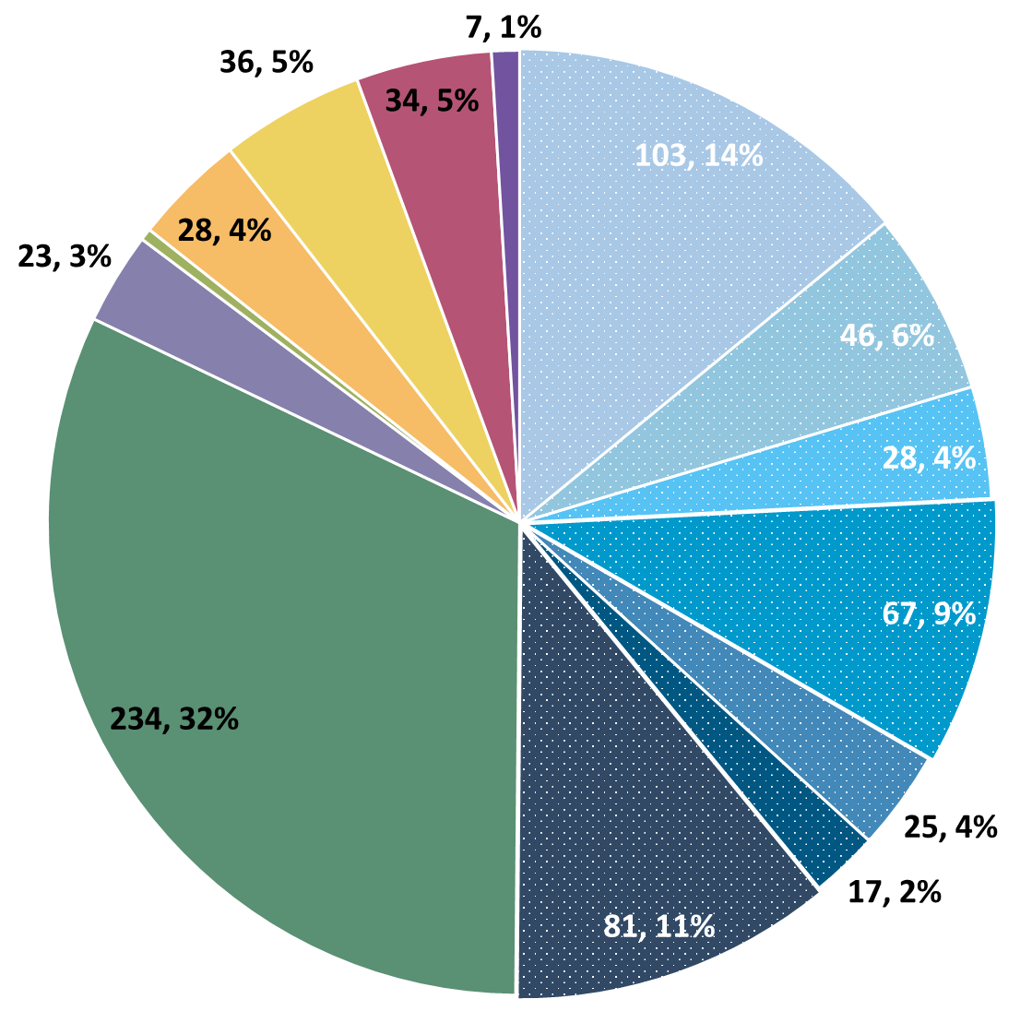
Deviation Types
Total Reports | Reports with Deviations | Reports with Deviations (excluding no data captured)
2097 | 664 | 358
Last Months

Slide 15
Goal

Slide 16
Poor Signal Quality and Concern for Artifact
Umass and Dartmouth teams actively working to analyze total artifact within reports
Data to be presented at next meeting
New report from Masimo will allow us to further exclude potential artifact from our reports
Final stages with engineer

Slide 17
What we are Concluding So Far…
No artifact has been significant enough to change recommendation of RHO Algorithm
Race maybe a contributing factor to the level of low signal quality
Younger corrected gestational ages have higher instances of low signal quality compared to older infants (different than originally predicted)

Slide 18
Spin Off Projects

Slide 19
Family Engagement Survey
The Family Engagement Pre and Post Implementation Survey Project has been approved by the UMass IRB
Instructions to submit to local IRBs sent out on 6/7
Please reach out to Heather and Katie with any questions

Slide 20
Cost of Implementing the RHO Program
PCORI is interested in understanding the cost of implementing successful programs as standard of care – in final stages of pre-award
If awarded, we would be asking sites to complete a short survey with help from their CFO (or appropriate staff) on the cost of implementation at their site
Additionally, site’s will be queried at two-random times to collect data on the time spent carrying out RHO related tasks (bi-weekly phone calls, documentation, or telehealth visits)

Slide 21
Factors That Affect HOT Duration A SDoH Approach

Slide 22
Project Purpose
Purpose: To identify if factors of social determinants of health affect home oxygen duration and weaning in premature infants discharged on home oxygen therapy (HOT)
Global Aim: Understand environmental and demographic influences
Specific Aims: Asses if there is a relationship between COI (zip code), insurance type, housing type, race, ethnicity, possible other environmental factors and demographic factors related to GIS analysis
Methods: Extract address data for trial + implementation study participants, map to GIS data, survival analyses for duration of HOT

Slide 23
Using GIS Data To Tell The Story
COI - The Child Opportunity Index (COI) measures and maps the quality of resources and conditions that matter for children to develop in a healthy way in the neighborhoods where they live
  Composite index measured at the census tract level that captures neighborhood resources and conditions that matter for children's healthy development in a single metric.
  29 indicators spanning 3 domains: education, health and environment, and social and economic.
  Each zip code receives a ranking of one of 5 outcomes from very low to very high opportunity
EJI - EJScreen is an environmental justice mapping and screening tool that provides EPA with a nationally consistent dataset and approach for combining environmental and demographic indicators

Slide 24
We Ask For Your Help!
Population:
  Original cohort - ~150, use as a pilot
  Add implementation infants as they accrue - We would love to identify interested collaborating partners!
What it would involve
  Separate IRB submission for address extraction - secondary use of retrospective data, waiver of content
    Covered under current DUA
  Extraction of addresses of study participants from EHR
  Participation/review of presentation and manuscript from analysis

Slide 25
We Ask For Your Help!
Timing:
  If interested let us know by end of October
  Plan to use Nov-Dec to submit IRBs, remainder of AY to obtain data and conduct analyses

Slide 26
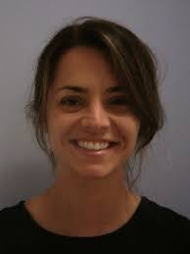
Thank You!
Fellow Research Project
Kristen.Richard@childrens.harvard.edu
Jonathan.Levin@childrens.harvard.edu

Slide 27


RHO Program Website
All resources, including training documents, the RHO manual, and other templates can be found on the RHO website at www.umassmed.edu/rho-program
Navigate to “Member Login” and log in with the following credentials to access the documents
  Username: RHO
  Password: Oximetry14

Slide 28



Closing Thoughts
Questions or Comments?
Are there any suggestions and/or feedback on the progress of the program that you would like to share with the team at this time?

