Slide 1

The Recorded Home Oximetry (RHO) Program
Monthly Investigator Meeting
September 1, 2022

Slide 2
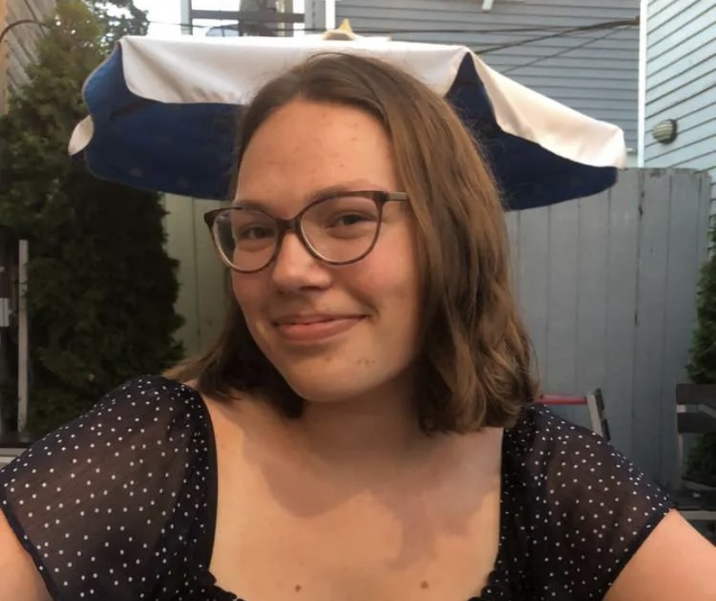
Welcome Katie!
To the RHO UMMS Team
Katie Edeburn is joining as the new RA at UMMS
Katie will be responsible for RHO downloads, maintaining the REDCap etc. (same activities Crystal and Maria were responsible)
We are thrilled to welcome her!

Slide 3

RHO Program Implementation Timeline
Feb - Mar 2021
Baseline data collection begins
Mar - May 2021
Initiate site training
Initiate monthly phone calls
May - Aug 2021
Jun 2021 - Feb 2022
Feb - Aug 2022
Aug 2022 - Feb 2023
Complete site training
Reach 33% of eligible families
Reach 66% of eligible families
Feb - Aug 2023
Reach 100% of eligible families
Initiate 18-month implementation
Begin providing monthly feedback reports

Slide 4



 | - Enrolling
 | - Activated but not enrolling
 | - Patient identified, not yet enrolled

Slide 5
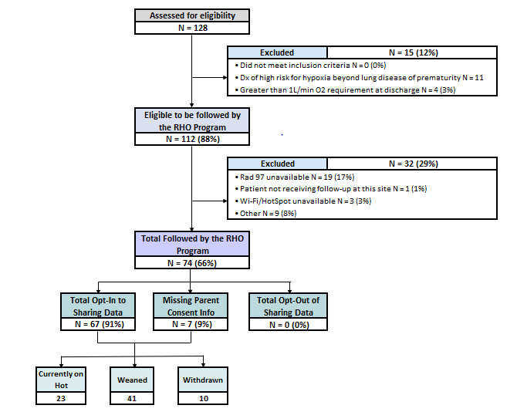
RHO Implementation Trial Consort Diagram
Average HOT Duration:
70 ± 53

Slide 6
Goal

Slide 7
Enrollment by Site
Site Name | 1st patient enrolled | Site IRB Approved | Duration of Implementation in Months | Eligible | Followed | Withdrawn | Active | Weaned | Avg HOT Duration
WAVE 1
Boston Children's Hospital | 7/8/2021 | 10/4/2021 | 10.9 | 9 | 8 (89%) | 1 | 2 | 5 | 94 ± 90
Dartmouth-Hitchcock | Jan. 2022 | 10/4/2021 | 8.0 | 11 | 11 (100%) |  | 7 | 4 | 42.3 ± 30.2
Maria Fareri Children's | 11/18/2021 | 7/10/2021 | 6.5 | 2 | 2 (100%) |  | 0 | 2 | 90 ± 52
Massachusetts General Hospital | 7/8/2021 | 10/4/2021 | 10.9 | 6 | 5 (83%) | 1 | 2 | 2 | 90.5 ± 40
University of Maryland | 8/21/2021 | 10/4/2021 | 9.5 | 14 | 11 (79%) | 4 | 1 | 6 | 54 ± 39
Vanderbilt | 4/28/2021 | 7/21/2021 | 10.5 | 7 | 2 (29%) |  | 2 | 0
WAVE 2
Arkansas Children's Hospital | 10/20/2021 | 1/28/2022 | 7.5 | 4 | 4 (100%) | 1 | 2 | 1 | 90
Children's Hospital of Phil. | 5/26/2022 | 10/20/2021 | 7.5 | 13 | 2 (15%) |  | 2 | 0
Cincinnati Children's Hospital |  | 4/15/2022 |  | 0 |  |  | 0 | 0
National Jewish Health |  | 10/4/2021 | 8.0 | 0 |  |  | 0 | 0
Nationwide Children's Hospital | 3/4/2022 | 10/4/2021 | 8.0 | 17 | 13 (76%) | 4 | 9 | 3 | 56 ± 18
Peyton Manning Children's Hospital |  |  |  | 0 |  |  | 0 | 0
U. of California, San Diego | 11/10/2021 | 10/4/2021 | 6.8 | 7 | 3 (43%) | 1 | 2 | 1 | 28
U. of Kentucky Children's Hospital |  |  |  | 0 |  |  | 0 | 0

Slide 8
Projected vs. Actual Enrollment Into the RHO Program
Site Name | Site IRB Approved | Estimate per Year | Estimate per Month | Current per Month | Estimated enrollment to Date
WAVE 1
Boston Children's Hospital | 10/4/2021 | 40 | 3.3 | 0.7 | 13.3
Dartmouth-Hitchcock | 10/4/2021 | 20 | 1.7 | 1.4 | 1.7
Maria Fareri Children's | 7/10/2021 | 14 | 1.2 | 0.3 | 4.7
Massachusetts General Hospital | 10/4/2021 | 13 | 1.1 | 0.5 | 4.3
University of Maryland | 10/4/2021 | 20 | 1.7 | 0.7 | 5.0
Vanderbilt | 7/21/2021 | 70 | 5.8 | 0.2 | 23.3
WAVE 2
Arkansas Children's Hospital | 1/28/2022 | 48 | 4.0 | 0.4
Children's Hospital of Phil. | 10/20/2021 | 50 | 4.2 | 0.3 | 4.2
Cincinnati Children's Hospital | 4/15/2022 | 50 | 4.2
National Jewish Health | 10/4/2021 | 250 | 20.8 | 0.0 | 20.8
Nationwide Children's Hospital | 10/4/2021 | Not Provided | Not Provided | 1.5 | 0.0
Peyton Manning Children's Hospital |  | 25 | 2.1
U. of California, San Diego | 10/4/2021 | 65 | 5.4 | 0.4 | 5.4
U. of Kentucky Children's Hospital |  | 50 | 4.2

Slide 9
Update on Action Item’s from Our Last Meeting
Poor Signal Quality: Received new report information from Masimo to include low signal quality. UMMS and Dartmouth teams working on analyzing a sub-set of patients to determine impact of low signal quality.
Supply Chain Shortage: Masimo production of RAD 97’s is ramping back up. Most home cares with outstanding orders should receive in the next several weeks.

Slide 10
Family Engagement Survey
  The Family Engagement Pre and Post Implementation Survey Project has been approved by the UMass IRB
  Instructions to submit to local IRBs sent out on 6/7
  Please reach out to Heather with any questions

Slide 11
New Centralized Email
Please now send all enrollment updates to RHOProgram@umassmed.edu
All UMMS RHO members have access and can address questions/queries in a timely manner

Slide 12
Cost of Implementing the RHO Program
PCORI is interested in understanding the cost of implementing successful programs as standard of care
If awarded, we would be asking sites to complete a short survey with help from their CFO (or appropriate staff) on the cost of implementation at their site
Additionally, site’s will be queried at two-random times to collect data on the time spent carrying out RHO related tasks (bi-weekly phone calls, documentation, or telehealth visits)

Slide 15
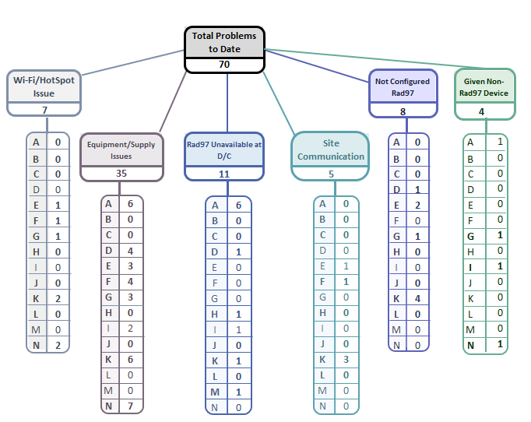
Implementation Related Problems

Slide 17
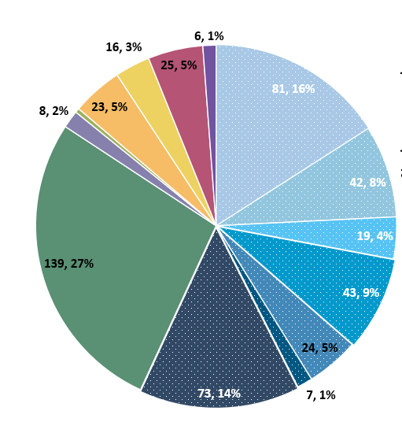
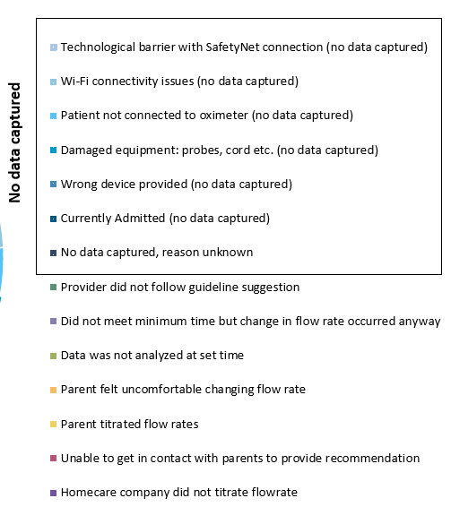
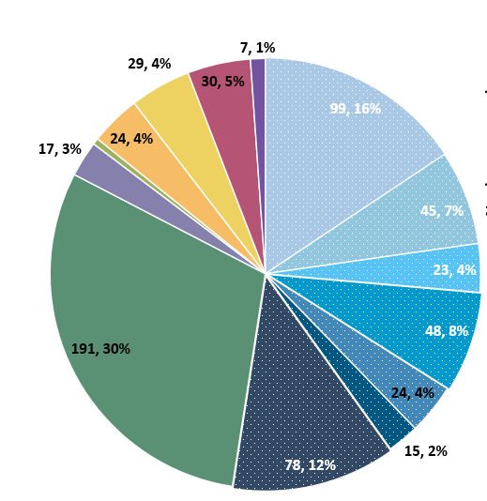
Deviation Types
Total Reports | Reports with Deviations | Reports with Deviations (excluding no data captured)
1,742 | 633 | 294
Last Months

Slide 18
Goal
88%

Slide 19
Compliance Rate’s and Individual Infant’s Duration of HOT

Slide 21
How does Initial Flow Rate Impact Duration?

Slide 22
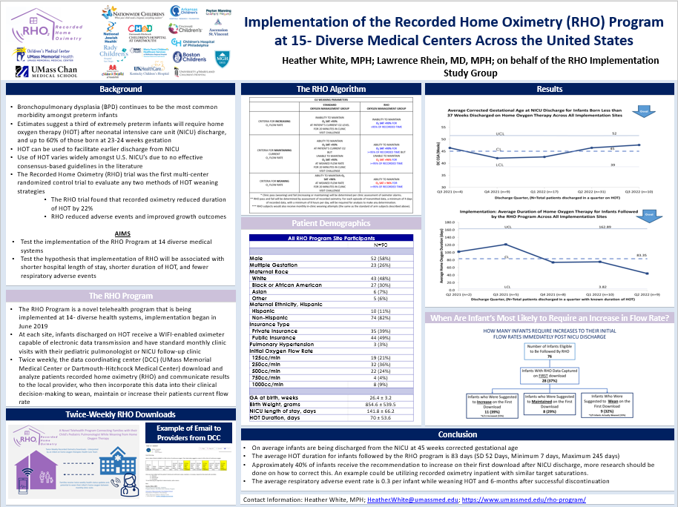
RHO to be Presented as a Poster at the Annual VON Conference

Slide 23
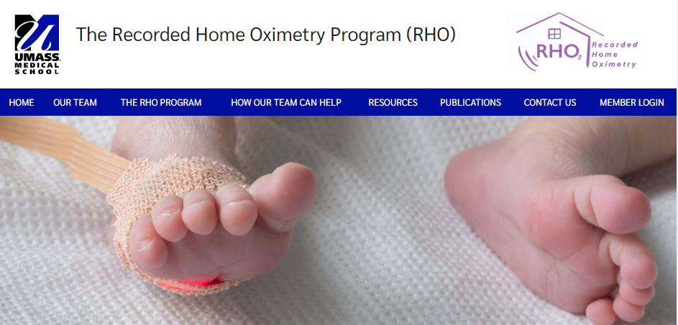

RHO Program Website
All resources, including training documents, the RHO manual, and other templates can be found on the RHO website at www.umassmed.edu/rho-program
Navigate to “Member Login” and log in with the following credentials to access the documents
  Username: RHO
  Password: Oximetry14

Slide 24



Closing Thoughts
Questions or Comments?
Are there any suggestions and/or feedback on the progress of the program that you would like to share with the team at this time?

