Slide 1

The Recorded Home Oximetry (RHO) Program
Monthly Investigator Meeting
July 7, 2022

Slide 2

RHO Program Implementation Timeline
Feb - Mar 2021
Baseline data collection begins
Mar - May 2021
Initiate site training
Initiate monthly phone calls
May - Aug 2021
Jun 2021 - Feb 2022
Feb - Aug 2022
Aug 2022 - Feb 2023
Complete site training
Reach 33% of eligible families
Reach 66% of eligible families
Feb - Aug 2023
Reach 100% of eligible families
Initiate 18-month implementation
Begin providing monthly feedback reports

Slide 3



 | - Enrolling
 | - Activated but not enrolling
 | - Patient identified, not yet enrolled

Slide 4
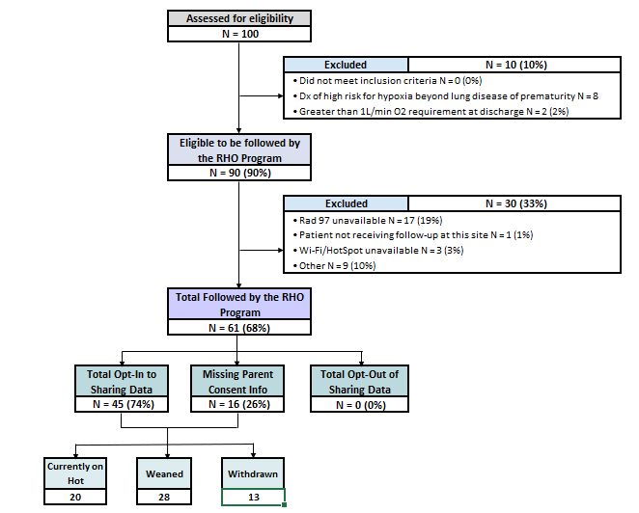
RHO Implementation Trial Consort Diagram
Average HOT Duration:
74 ± 55

Slide 5
Goal

Slide 6
Enrollment by Site
Site Name | 1st patient enrolled | Site IRB Approved | Duration of Implementation in Months | Eligible | Followed | Withdrawn | Active | Weaned | Avg HOT Duration
WAVE 1
Boston Children's Hospital | 7/8/2021 | 10/4/2021 | 10.9 | 9 | 8 (89%) | 1 | 2 | 5 | 94 ± 90
Dartmouth-Hitchcock | Jan. 2022 | 10/4/2021 | 8.0 | 11 | 11 (100%) |  | 7 | 4 | 42.3 ± 30.2
Maria Fareri Children's | 11/18/2021 | 7/10/2021 | 6.5 | 2 | 2 (100%) |  | 0 | 2 | 90 ± 52
Massachusetts General Hospital | 7/8/2021 | 10/4/2021 | 10.9 | 6 | 5 (83%) | 1 | 2 | 2 | 90.5 ± 40
University of Maryland | 8/21/2021 | 10/4/2021 | 9.5 | 14 | 11 (79%) | 4 | 1 | 6 | 54 ± 39
Vanderbilt | 4/28/2021 | 7/21/2021 | 10.5 | 7 | 2 (29%) |  | 2 | 0
WAVE 2
Arkansas Children's Hospital | 10/20/2021 | 1/28/2022 | 7.5 | 4 | 4 (100%) | 1 | 2 | 1 | 90
Children's Hospital of Phil. | 5/26/2022 | 10/20/2021 | 7.5 | 13 | 2 (15%) |  | 2 | 0
Cincinnati Children's Hospital |  | 4/15/2022 |  | 0 |  |  | 0 | 0
National Jewish Health |  | 10/4/2021 | 8.0 | 0 |  |  | 0 | 0
Nationwide Children's Hospital | 3/4/2022 | 10/4/2021 | 8.0 | 17 | 13 (76%) | 4 | 9 | 3 | 56 ± 18
Peyton Manning Children's Hospital |  |  |  | 0 |  |  | 0 | 0
U. of California, San Diego | 11/10/2021 | 10/4/2021 | 6.8 | 7 | 3 (43%) | 1 | 2 | 1 | 28
U. of Kentucky Children's Hospital |  |  |  | 0 |  |  | 0 | 0

Slide 7
Projected vs. Actual Enrollment Into the RHO Program
Site Name | Site IRB Approved | Estimate per Year | Estimate per Month | Current per Month | Estimated enrollment to Date
WAVE 1
Boston Children's Hospital | 10/4/2021 | 40 | 3.3 | 0.7 | 13.3
Dartmouth-Hitchcock | 10/4/2021 | 20 | 1.7 | 1.4 | 1.7
Maria Fareri Children's | 7/10/2021 | 14 | 1.2 | 0.3 | 4.7
Massachusetts General Hospital | 10/4/2021 | 13 | 1.1 | 0.5 | 4.3
University of Maryland | 10/4/2021 | 20 | 1.7 | 0.7 | 5.0
Vanderbilt | 7/21/2021 | 70 | 5.8 | 0.2 | 23.3
WAVE 2
Arkansas Children's Hospital | 1/28/2022 | 48 | 4.0 | 0.4
Children's Hospital of Phil. | 10/20/2021 | 50 | 4.2 | 0.3 | 4.2
Cincinnati Children's Hospital | 4/15/2022 | 50 | 4.2
National Jewish Health | 10/4/2021 | 250 | 20.8 | 0.0 | 20.8
Nationwide Children's Hospital | 10/4/2021 | Not Provided | Not Provided | 1.5 | 0.0
Peyton Manning Children's Hospital |  | 25 | 2.1
U. of California, San Diego | 10/4/2021 | 65 | 5.4 | 0.4 | 5.4
U. of Kentucky Children's Hospital |  | 50 | 4.2

Slide 8
Uptick in Program Exclusion Criteria and Withdrawals to Standard of Care
Home Care’s not having RAD 97’s available (19%) – with the current supply chain delay’s referrals might need to go to other home care’s that do have RAD 97’s in-stock
  Masimo and RHO Leadership working to engage more available home cares for sites
  For active home cares who recently placed an order for RAD 97s it is about 5-7 weeks for delivery

Slide 9
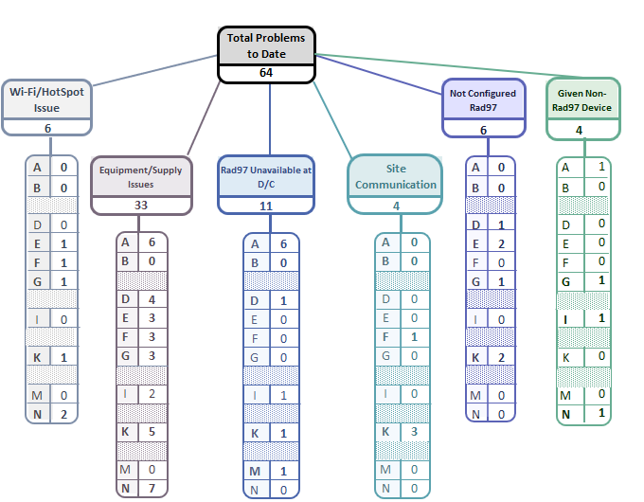
Implementation Related Problems

Slide 11
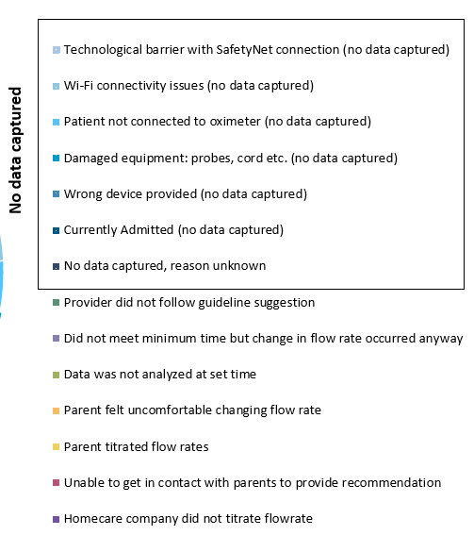
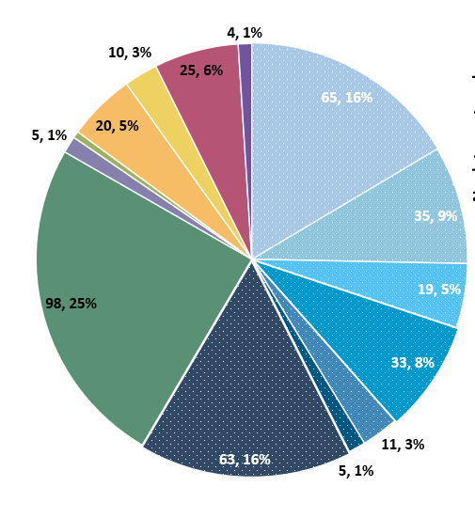
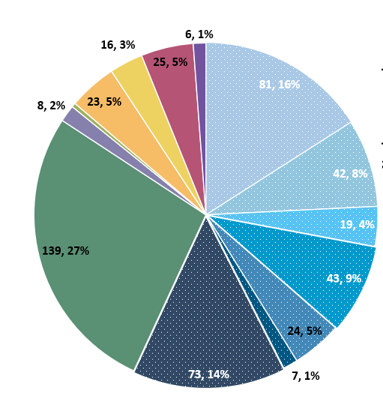
Deviation Types
Total Reports | Reports with Deviations | Reports with Deviations (excluding no data captured)
1,138 | 508 | 208
Last Months

Slide 12
Goal
88%

Slide 13
Reason’s Why Provider’s Are Not Following the RHO Algorithm’s Recommendation
12% of the time the RHO Algorithm’s Recommendation is not being followed by providers
42% of times the provider has felt comfortable maintaining when the recommendation was to “increase” (5% overall)
What are everyone’s thoughts on improving?

Slide 14
N=32

Slide 15
HOW MANY INFANTS REQUIRE INCREASES IMMEDIATELY POST DISCHARGE
Number of Infants Eligible to Be Followed By RHO
61
Infants With RHO Data Captured on FIRST download
23 (38%)
Infants who Were Suggested to Increase on the First Download
11 (48%)
*6/10 Increased (60%)
Infants who Were Suggested to Maintained on the First Download
7 (30%)
Infants Who Were Suggested to Wean on the First Download
5 (22%)
*2/5 Infants Actually Weaned
*Download was counted only if 1500 minutes were captured to make recommendation

Slide 16
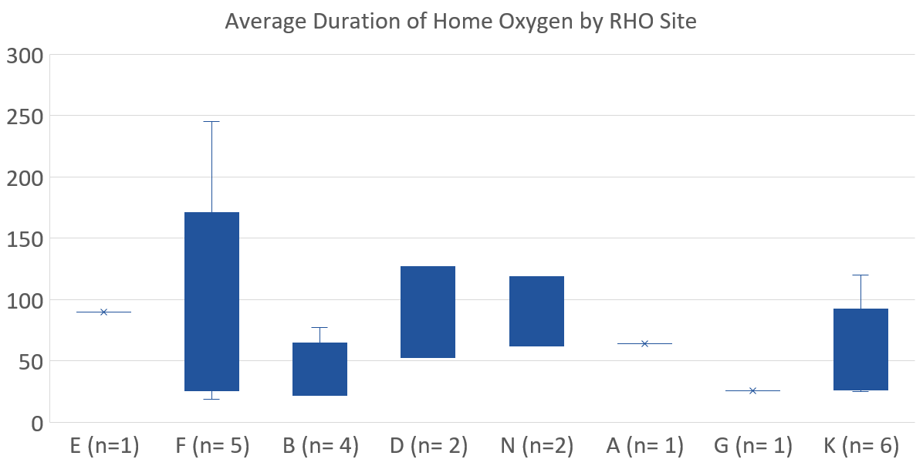

Slide 17
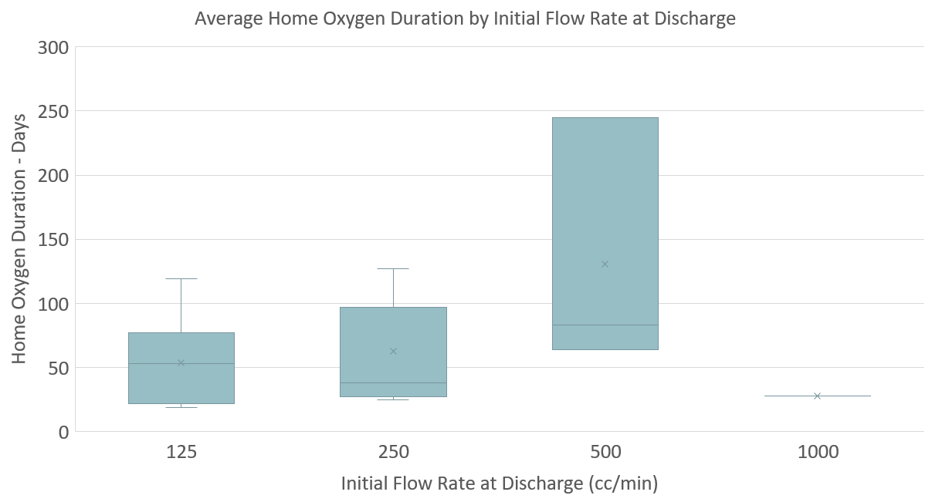
(n= 7)
(n= 11)
(n= 3)
(n= 1)

Slide 18
Family Engagement Survey
  The Family Engagement Pre and Post Implementation Survey Project has been approved by the UMass IRB
  Instructions to submit to local IRBs sent out
  Please reach out to Heather with any questions

Slide 19
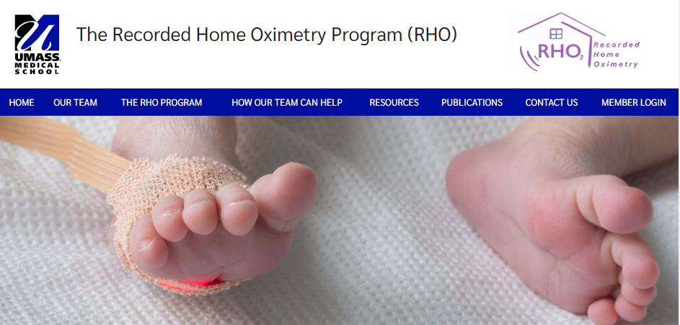

RHO Program Website
All resources, including training documents, the RHO manual, and other templates can be found on the RHO website at www.umassmed.edu/rho-program
Navigate to “Member Login” and log in with the following credentials to access the documents
  Username: RHO
  Password: Oximetry14

Slide 20



Closing Thoughts
Questions or Comments?
Are there any suggestions and/or feedback on the progress of the program that you would like to share with the team at this time?

