Slide 2
ADVANCING BEHAVIORAL HEALTH: CHALLENGES AND OPPORTUNITIES IN A CHANGING HEALTH CARE ENVIRONMENT
Pamela S. Hyde, J.D.
Administrator
Substance Abuse and Mental Health Services Administration
UMass Medical School
Psychiatry Research Day
Worcester, MA • April 29, 2013

Slide 3
TODAY’S DISCUSSION
CHANGING HEALTH CARE ENVIRONMENT
BEHAVIORAL HEALTH AS PUBLIC HEALTH
SAMHSA’S STRATEGIC INITIATIVES
1
2
3

Slide 4
CHANGING HEALTH CARE ENVIRONMENT
Prevention/Wellness Rather Than Illness
Behavioral Health is Essential to Health
Quality Rather Than Quantity – saving costs through better care rather than less care
Inclusive – Everyone’s Eligible for Something
Public Payers’ Roles Changing
Implications for State’s Role

Slide 5
WHY BEHAVIORAL HEALTH MATTERS TO PUBLIC HEALTH – 1
BH Affects Most Americans
  Half will meet criteria for MI or substance abuse
  Half know someone in recovery from addiction (23 M +)
  One in four Americans will experience mental illness
Increases Risks for/Co-Exists with Other Diseases, Yet is Preventable
  HIV/AIDS, STDs, diabetes, cardiovascular disease, obesity, asthma, hypertension
  More adverse childhood experiences (ACEs) = more health/BH conditions in adulthood
  Half of adult mental illness begins before age 14 and three-quarters before age 24

Slide 6
PREVALENCE OF BH CO-MORBIDITIES
(MEDICAID-ONLY BENEFICIARIES W/DISABILITIES)
Boyd, C., Clark, R., Leff, B., Richards, T., Weiss, C., Wolff, J. (2011, August).
Clarifying Multimorbidity for Medicaid Programs to Improve Targeting and Delivering Clinical Services. Presented to SAMHSA, Rockville, MD.

Slide 7
WHY BEHAVIORAL HEALTH MATTERS TO PUBLIC HEALTH - 2
High Impact on Health Systems – Practice and Costs
  ~ ¼ of pediatric visits and community hospital stays
  ~ 1/5 of ER visits involve illicit drugs (21 percent) or alcohol (19 percent)
  2010: Medicare spent 5 x more on beneficiaries age 65+ w/SMI & SUDs than similar beneficiaries w/out these diagnoses
  2010: Of Medicare beneﬁciaries w/out SMI, 17 percent were hospitalized; 46 percent of those w/SMI diagnosis; 88 percent of those with SMI/SUDs
  One of 5 top diagnoses in 30-day readmissions
    22 percent of Medicare beneﬁciaries age 65+ w/ SMI compared to 13 percent of those w/out SMI
    Co-occurring SMI/SUDs – 34 percent rehospitalized w/in 30 days

Slide 8
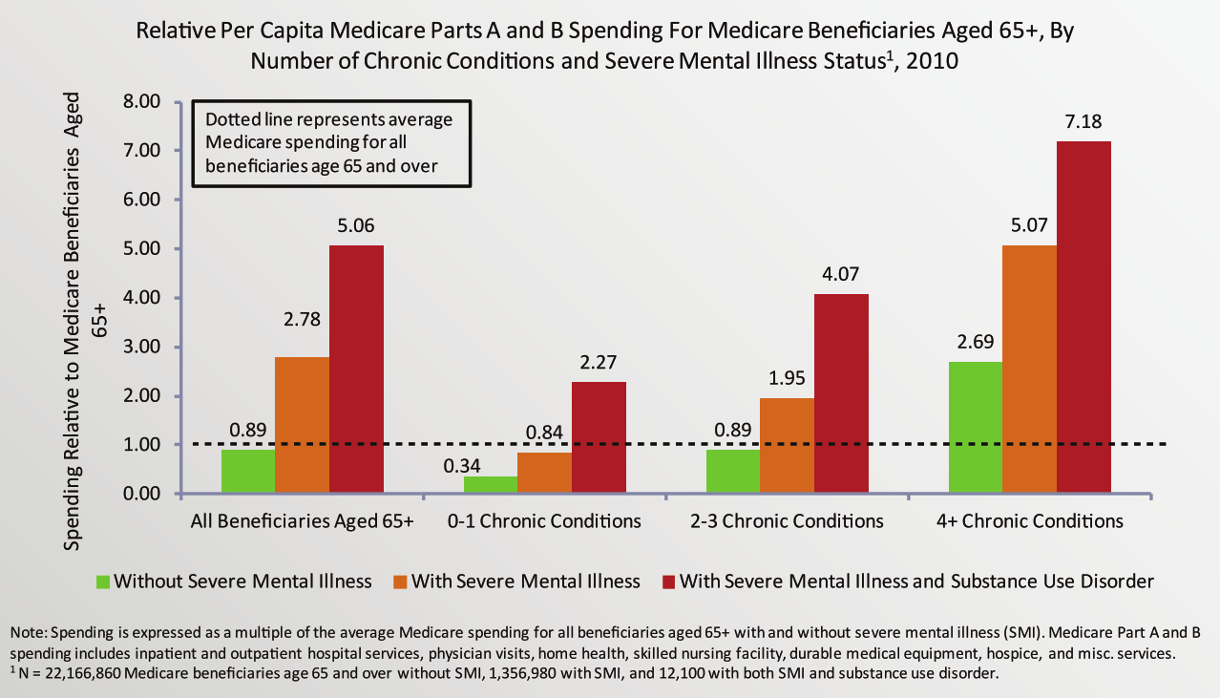
MEDICARE BENEFICIARES AGE 65+ WITH SMI AND SUD HAD SIGNIFICANTLY HIGHER MEDICARE SPENDING

Slide 9
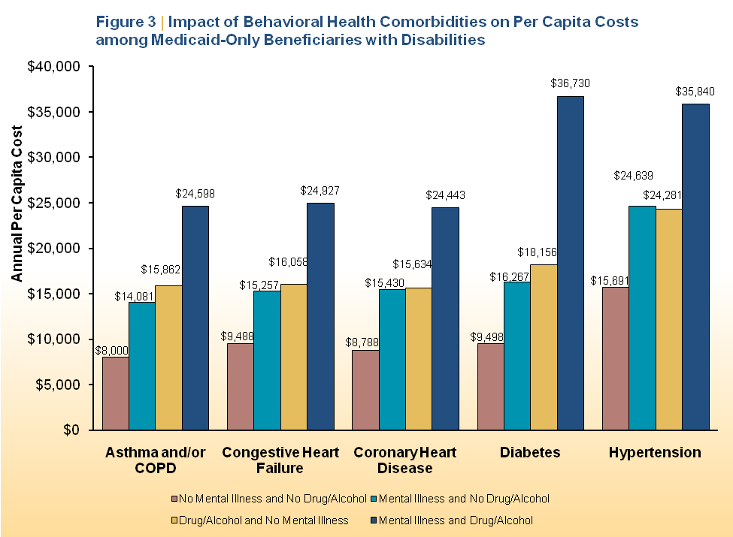
BH CO-MORBIDITIES: IMPACT ON COSTS
(MEDICAID-ONLY BENEFICIARIES W/ DISABILITIES)
Boyd, C., Clark, R., Leff, B., Richards, T., Weiss, C., Wolff, J. (2011, August).
Clarifying Multimorbidity for Medicaid Programs to Improve Targeting and Delivering Clinical Services. Presented to SAMHSA, Rockville, MD.

Slide 10
WHY BEHAVIORAL HEALTH MATTERS TO PUBLIC HEALTH - 3
High # BH-Related Premature Deaths/Preventable Illnesses
  Persons w/BH conditions die 8+ years younger, mostly from preventable health issues
  Half of all tobacco deaths occur among those w/BH conditions
  More deaths from suicide than HIV/AIDS and traffic accidents combined; plus breast cancer for all BH-related deaths
Study out of Germany using Composite International Diagnostic Interview and DSM-IV
  Much higher annualized death rates for women: 4.6-fold ↑ for females and 1.9-fold ↑ for males compared to age/gender-specific general pop
  Mean age of death 20 years ↓ for both genders
  Inpatient treatment had no impact on premature mortality

Slide 11
WHY BEHAVIORAL HEALTH MATTERS TO PUBLIC HEALTH - 4
High Impact of Disparities (race, gender, ethnicity, LGBT, poverty) and Social Issues/Costs (homelessness, jails, child welfare)
  Most homeless and jailed individuals have BH needs; relatively few receive treatment; most are in or released to the community
  LGBT population – elevated rates of tobacco use, certain cancers, depression and suicide deaths/attempts
  Majority of foster children have drug-involved parents
  Ethnic minorities more likely to be uninsured, have ↑ rates of certain disorders or incidence (e.g., suicide, drinking)
  Persons with BH needs more likely to be uninsured and to “churn,” creating issues within the health delivery system

Slide 12
PUBLIC PERCEPTION OF VALUE
Public Willing to Pay 40 percent LESS . . .
  To avoid mental illnesses (MI) compared to avoiding medical illness, even when MI (including SUDs) are recognized as burdensome*
Mental Illnesses Account for 15.4 Percent of Total Burden of Disease**
  Yet MH expenditures in U.S. account for only 6.2 percent of total health expenditures
  SA expenditures account for only about 1 percent
  * Source: NICHD, 2011
  ** Source: World Health Organization

Slide 13
WHY DOES IT MATTER?
Public sees social consequences of behavioral health rather than health consequences
  Homelessness, gangs, jails, tragedies (e.g., mass casualty shootings), disability, lost productivity, high government costs
M/SUDs seen as matter of will instead of diseases or conditions to be prevented, treated and recovered from
  Compare diabetes – not just about eating choices
Universal Knowledge of First Aid for Health Conditions; Don’t Teach or Know Signs, Symptoms, How to Get Help for MH or SA Issues

Slide 14
BH AS A SOCIAL PROBLEM LEADS TO
INSUFFICIENT RESPONSES
Increased Security & Police Protection
Tightened Background Checks & Access to Weapons
Legal
Control of Perpetrators & Their Treatment
More Jail Cells, Shelters, Juvenile Justice Facilities
Institutional System & Provider Oversight

Slide 15
SAMHSA’S STRATEGIC INITIATIVES
AIM: Improving the Nation’s Behavioral Health (1-4)
AIM: Transforming Health Care in America (5-6)
AIM: Achieving Excellence in Operations (7-8)
1
Prevention
2
Trauma and Justice
3
Military Families
4
Recovery Support
5
Health Reform
6
Health Information Technology
7
Data, Outcomes & Quality
8
Public Awareness & Support

Slide 16

STRATEGIC INITIATIVE: PREVENTION
Substance Abuse and Mental Illness; Build Emotional & Behavioral Health
Suicide Prevention
Prevent Underage Drinking
Prescription Drug Abuse/Misuse

Slide 17

SUICIDE AND MENTAL ILLNESS:
TOUGH REALITIES
17
50 Percent of Those Who Die By Suicide Had Major Depression – Suicide rate of people with major depression is 8 times that of the general population
90 Percent of Individuals Who Die By Suicide
Had a Mental Disorder

Slide 18

MISSED OPPORTUNITIES = LIVES LOST
77 percent of individuals who die by suicide had visited their primary care doctor within the year
45 percent had visited their primary care doctor within the month
18 percent of elderly patients visited their primary care doctor on same day as their suicide
THE QUESTION OF SUICIDE WAS SELDOM RAISED

Slide 19

MISSED OPPORTUNITIES = LIVES LOST
Individuals Discharged from An Inpatient Unit or Emergency Room Continue to Be at Risk for Suicide
  ~10 percent of individuals who died by suicide had been discharged from an ED within previous 60 days
  ~ 8.6 percent hospitalized for suicidality are predicted to eventually die by suicide

Slide 20

SUICIDE AND SUBSTANCE ABUSE: TOUGH REALITIES
20
~30 % of Deaths by Suicide Involved Alcohol Intoxication At or Above Legal Limit
4 Other Substances Identified in ~10% of Tested Victims
  Amphetamines, cocaine, opiates (prescription & heroin), marijuana

Slide 21

SURGEON GENERAL’S NATIONAL STRATEGY FOR SUICIDE PREVENTION (NSSP)
Annually, 11 M+ Americans Seriously Consider Suicide
  8 M make a plan
  2.5 M > 14 years attempt
America Loses ~100 People/24 Hrs
  38,000 in 2010 – not to battles of war, acts of terrorism, mass casualty events, or natural disasters
  Half w/ firearms; many w/prescription drugs
  America lost more service members to
  suicide (349) than to combat (229) in 2011
NSSP – Public/Private Partnership
  Survivors, practitioners, funders, advocates, standard setters
  Released 9/10/12 – World Suicide Prevention Day
  Data, standards, screening, high impact models,
  awareness, high need populations, payment policies
  SAMHSA’s Garrett Lee Smith Suicide Prevention Grants

Slide 22
PRESCRIPTION DRUGS
Most Prevalent Illicit Drug Problem After Marijuana
  ~22 M persons initiated nonmedical pain reliever use since 2002
  ~1 in 22 (4.6 percent) reported misuse/abuse of prescription pain relievers (2010 & 2011)
  US represents 4.5 percent of world’s population, yet consumes 99 percent of world’s hydrocodone (International Narcotics Control Board)
Emergency Room Visits
  Non-medical use of ADHD stimulant medications nearly tripled from 5,212 to 15,585 visits; (2005 – 2010)
SU Treatment Admissions
  Benzodiazepine and narcotic pain reliever abuse ↑ 569.7 percent (2000 to 2010)

Slide 23
SOME FAMILY AND FRIENDS
AREN’T HELPING
Marijuana: ~ 70 percent of 523,000 teens aged 12-14 received the drug for free the last time they used
  Over half (55.6-percent) received from friends
  Over 10 percent received from someone in their family
Prescription Pain Relievers: 54 percent of persons 12 and ↑ who used non-medically received them from a friend or relative for free
Alcohol: ~20 percent of the time, parents, guardians, or other adult family members provided alcohol for underage drinkers

Slide 24
SAMHSA’s WORK – WITH PARTNERS
W/ Office of National Drug Control Policy (ONDCP) – Prescription Drug Prevention Plan
W/ ASPE and CMS – Data Analysis
W/ FDA, DEA, NIDA – Prescriber Training, Report to Congress, Public Awareness
W/ ASTHO – Opioid Overdose Prevention Toolkit
W/ ONC and DOJ – Grants to States for Prescription Drug Monitoring Programs (PDMPs) Interoperability with Health Information Exchanges (HIEs) and between States
W/ States – Grants for Prevention of Prescription Drug Abuse and Underage Drinking

Slide 25
STRATEGIC INITIATIVE: TRAUMA AND JUSTICE
Trauma-Informed Care; Trauma-Specific Screening and Services
  Common definitions, principles, data
  Consolidated technical assistance approach
Childhood trauma in Juvenile Justice/Child Welfare
Grants for Adult Trauma Screening Brief Interventions – GATSBI
  New services research grant program proposed to test new brief intervention (BI) models for women
  Screen for trauma and interpersonal violence in emergency rooms, primary care offices, OB/GYN offices; provide BI
Court Collaboratives/Early Diversion to Prevent Penetration into Corrections or Judicial Systems
BH Impact of Disasters/Tragedies

Slide 26
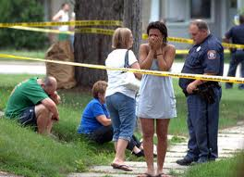


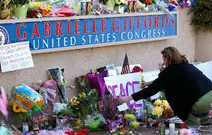

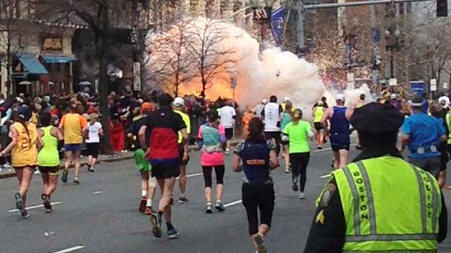




TRAGEDIES
Grand Rapids, MI
2011 – 8 Lost
Nickel Mines, PA
2007 – 6 Lost
Aurora, CO
2012 - 12 Lost
Tucson, AZ
2011 – 6 Lost
Newtown, CT 2012 – 26 Lost
Asher Brown
2010 – 1 Lost
13 yrs old
Boston, MA
2013 – 3 Lost
Virginia Tech, VA
2007 - 33 Lost
Columbine High School
Littleton, CO
1999 - 15 Lost
Red Lake Band of Chippewa, MN, 2005 – 10 Lost

Slide 27
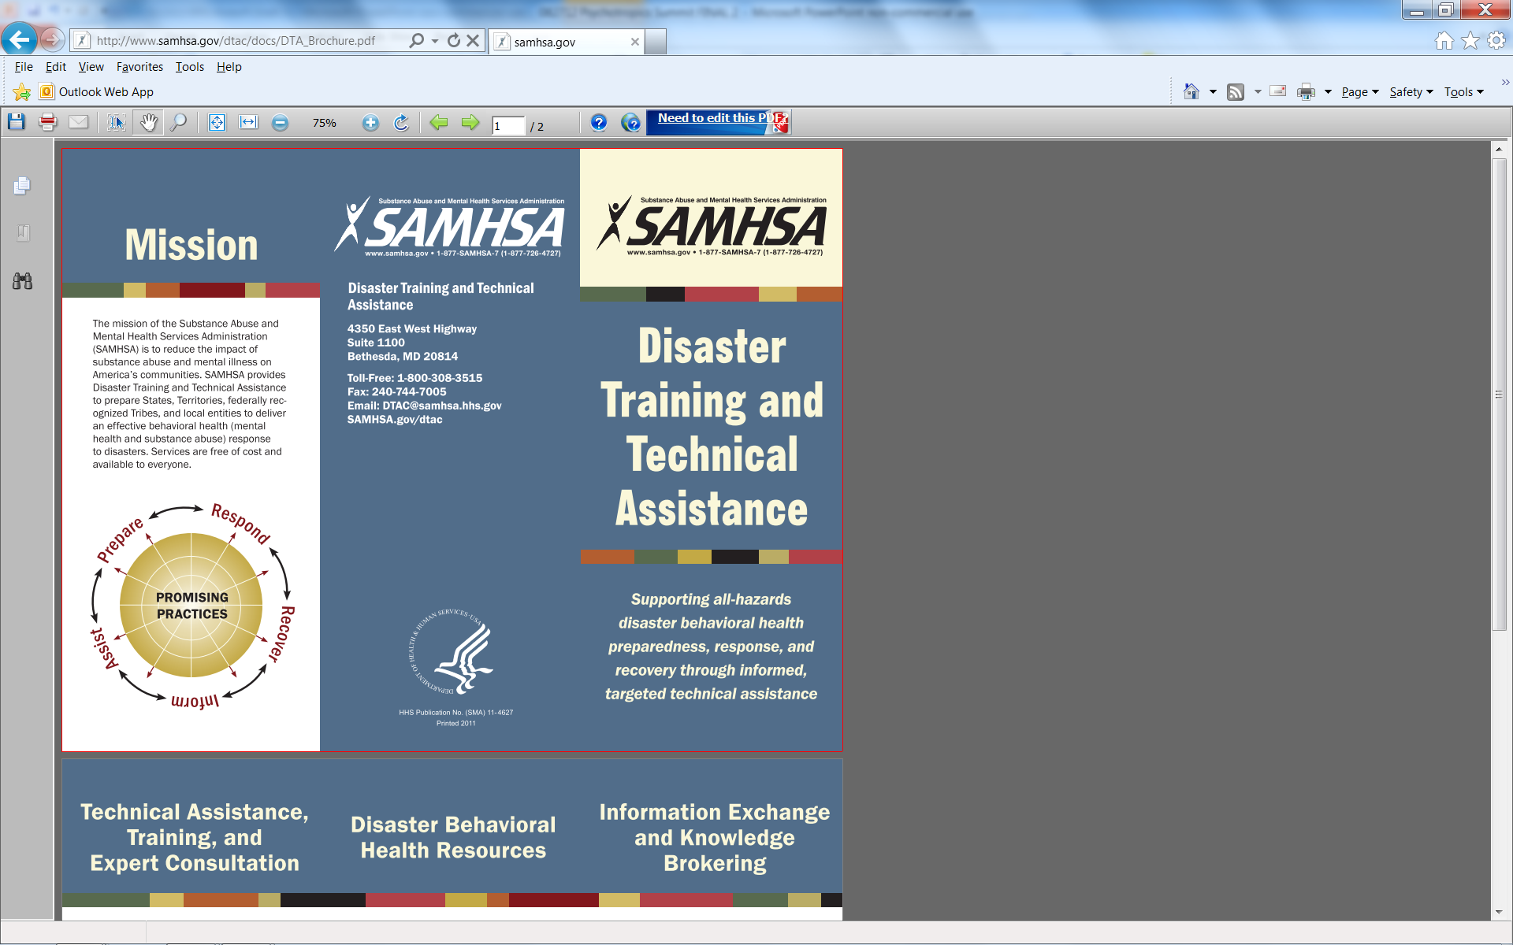
SAMHSA’s DISASTER TECHNICAL ASSISTANCE CENTER (DTAC): NATURAL AND HUMAN-CAUSED DISASTERS
Technical Assistance, Training, and Expert Consultation
  Review state/local all-hazards disaster BH plans
Disaster BH Resources
  >1,800 tip sheets, publications, studies, and articles
Information Exchange and Knowledge Brokering
  Connects those seeking technical assistance w/peers and experts in BH field
www.samhsa.gov/dtac

Slide 28
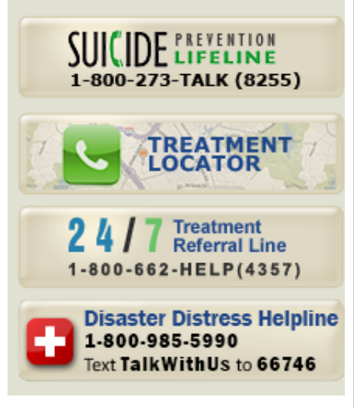
ADDITIONAL SAMHSA RESOURCES & WORK
www.samhsa.gov
www.suicidepreventionlifeline.org
www.samhsa.gov/treatment
www.disasterdistress.gov
Research efforts with Assistant Secretary for Preparedness and Response (ASPR) and NIH

Slide 29
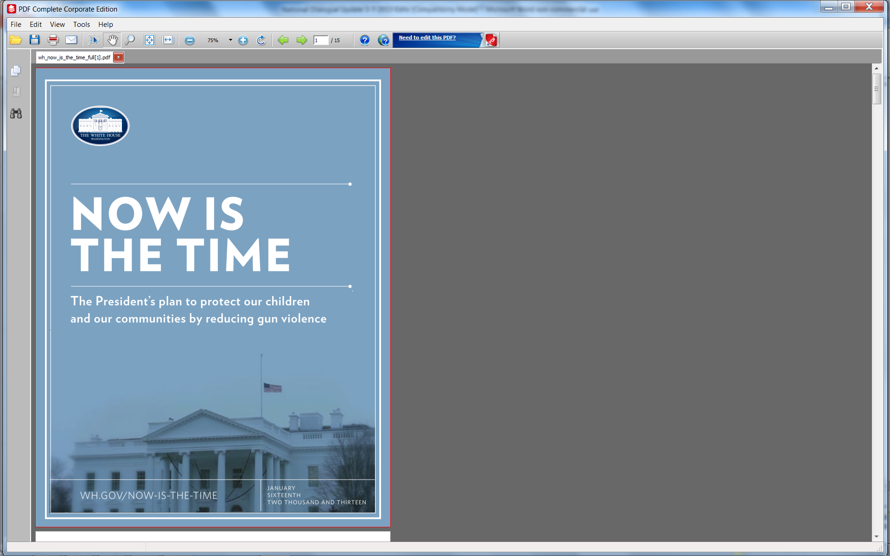
THE PRESIDENT’S PLAN: MENTAL HEALTH AS A PUBLIC HEALTH ISSUE
Less than half of people w/BH conditions receive the care they need
23 Executive Actions to Reduce Access to Guns and Increase Mental Health Services
FY 2014 Budget Mental Health Proposals -- $235 M
National Dialogue on Mental Health – to be launched this Spring
“We are going to need to work on making access to mental health care as easy as access to a gun.”
--President Obama

Slide 30
PRESIDENT’S EXECUTIVE ACTIONS ON GUN VIOLENCE – MAJOR IMPLICATIONS FOR BH
Among the 23 Executive Actions
  No. 17: "Release a letter to health care providers clarifying that no federal law prohibits them from reporting threats of violence to law enforcement authorities.”
    January 16: Letter issued by Secretary Sebelius
  No. 2: "Address unnecessary legal barriers, particularly relating to the Health Insurance Portability and Accountability Act, that may prevent states from making information available to the background check system.” – Advance Notice of Proposed Rule-Making (ANPRM)
    ANPRM available for review at: https://federalregister.gov/a/2013-01073
    Comments can be submitted to: http://www.regulations.gov/
    Comments due June 7, 2013

Slide 31
PROHIBITORS: GUN CONTROL ACT
18 U.S.C. 922(g) & (n)
(g)(1) Are Convicted of a Crime Punishable by Imprisonment for a Term Exceeding One Year
(g)(2) Are Fugitives From Justice
(g)(3) Are Unlawful Users of or Addicted to Any Controlled Substance
(g)(4) Have Been Adjudicated as Mental Defectives or Been Committed to a Mental Institution
(g)(5) Are Aliens and Are Illegally or Unlawfully in the United States
(g)(6) Have Been Discharged From the Armed Forces Under Dishonorable Conditions
(g)(7) Have Renounced Their United States Citizenship
(g)(8) Are Subject to a Court Order Restraining Them From Committing
Domestic Violence
(g)(9) Have Been Convicted in Any Court of a Qualifying Misdemeanor Crime of Domestic Violence
(n) Are Under Indictment/Information for a Crime Punishable by Imprisonment for a Term Exceeding One Year

Slide 32
STRATEGIC INITIATIVE:
MILITARY FAMILIES
Access to Community-Based BH Care
  President’s Executive Order – VA pilots; peers; suicide prevention; quality measures; National Research Action Plan (PTSD, TBI, suicide prevention)
  TRICARE – credentialing and service package for current military personnel
  State policy academies – 30 + states/territories and DC – National Guard, Reservists, families not otherwise covered
Military Culture Training
  With HRSA and private partners – National Council/SAAS
Promote Emotional Health/Resilience of Veterans, Services Personnel, and Military Families
  Programs & evidence-based practices in HHS programs

Slide 33
STRATEGIC INITIATIVE:
RECOVERY SUPPORT
Individuals
and Families
HOME
↑ Permanent
Housing
COMMUNITY
↑ Peer/Family/
Recovery Network
Supports
PURPOSE
↑ Employment/
Education
HEALTH
↑ Recovery

Slide 34
STRATEGIC INITIATIVE:
HEALTH REFORM
Essential Health Benefits (EHBs) – Parity
Enrollment and Eligibility – Qualified Health Plans (QHPs)
Uniform Block Grant Application – TA to States
Services, Payment Policies, Quality/Measures
  Medicaid (health homes, rules/regs, good & modern services, screening, prevention)
  Medicare (duals, partial hospitalization, same day billing)
Primary/Behavioral Health Care Integration (PBHCI)
HIV/AIDS Prevention and Mental Health Treatment

Slide 35
ESSENTIAL HEALTH BENEFITS (EHB)
10 BENEFIT CATEGORIES
Ambulatory patient services
Emergency services
Hospitalization
Maternity and newborn care
Mental health and substance use disorder services, including behavioral health treatment
Prescription drugs
Rehabilitative and habilitative services and devices
Laboratory services
Preventive and wellness services and chronic disease management
Pediatric services, including oral and vision care

Slide 36
PARITY/ACA: PROJECTED REACH
 | Individuals who will gain MH, SUD, or both benefits under the ACA including federal parity protections | Individuals with existing MH and SUD benefits who will benefit from federal parity protections | Total individuals who will benefit from federal parity protections as a result of the ACA
Individuals currently in individual plans | 3.9 million | 7.1 million | 11 million
Individuals currently in small group plans | 1.2 million | 23.3 million | 24.5 million
Individuals currently uninsured | 27 million | n/a | 27 million
Total | 32.1 million | 30.4 million | 62.5 million
NOTE: These estimates include individuals and families who are currently enrolled in grandfathered coverage
Source: ASPE Research Brief, February 2013

Slide 37
IN 2014: MILLIONs MORE AMERICANS WILL have health coverage OPPORTUNITIES
Currently, 37.9 Million Are Uninsured <400% FPL*
    18.0 M – Medicaid expansion eligible
    19.9 M – ACA exchange eligible**
    11.019 M (29%) – Have BH condition(s)
    http://www.samhsa.gov/healthreform/enrollment.aspx
Source: 2010 NSDUH
**Eligible for premium tax credits and not eligible for Medicaid
Notes:
Spoke to David in the hall: Don’t use the 6-10 million figure with M/SUDs any more at all. The 32 million more Americans figure is correct. 05/08/2012

Slide 38
ACA: HHS
ENROLLMENT ASSISTANCE ACTIVITIES
Consumer Assistance Grants
  Employed directly by Medicaid agency or Exchange entity
  Support state development of appeals assistance services and claims dispute processes
Marketplace Assisters
  Employed directly by Medicaid agency or Exchange entity, or funded by grant or contract to fulfill additional non-navigator assistance requirement
Navigator Program (2014)
  Include at least one consumer-focused non-profit
  Required for and financed by each Exchange
  FOA for FFE/SPE Navigators out now
  At least 13 States engaged in public planning work (Feb. 27, 2013)
  AR, WA, WV, CA, CO, CT, DC, HI, MN, NV, OR, VT

Slide 39
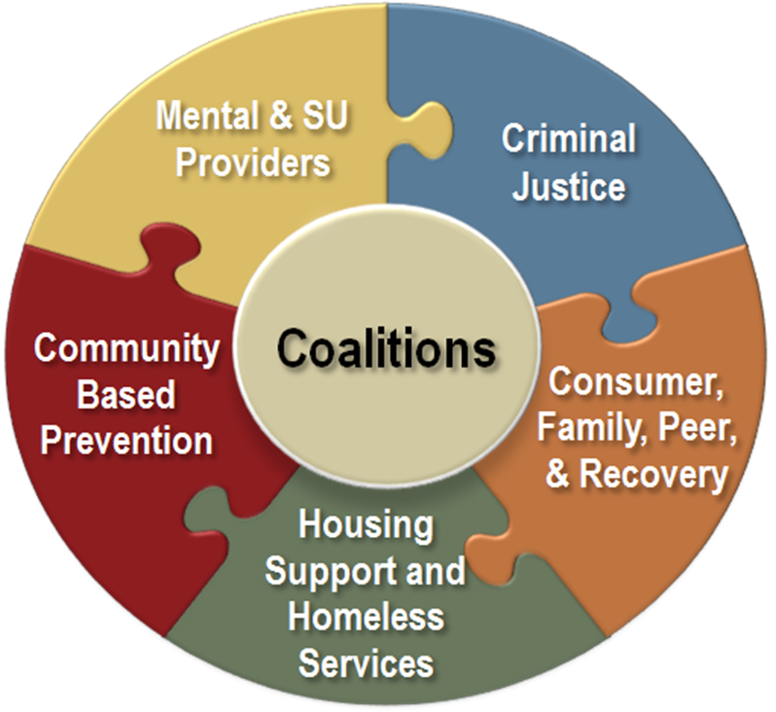
SAMHSA ENROLLMENT STRATEGY
Collaborate w/national organizations whose members/constituents interact regularly w/individuals who have M/SUDs to create and implement enrollment communication campaigns
Promote and encourage use of CMS marketing materials
Provide T/TA in developing enrollment communication campaigns using these materials
Provide training to design and implement enrollment assistance activities
Channel feedback and evaluate success
Notes:
Among members and constituents
Based on these findings, SAMHSA has developed a behavioral health enrollment strategy.

Slide 40
QUALIFIED HEALTH PLANS (QHPs)
Providers Sufficient to Deliver Services
  “Including mental health & substance use disorders services”
MH Providers More Likely to be Experienced in Billing/Being Part of Networks than SA Providers
Community MH/SA Providers Heavily Dependent on Declining Fund Sources
  Non-insurance based federal, state, local, private pay

Slide 41
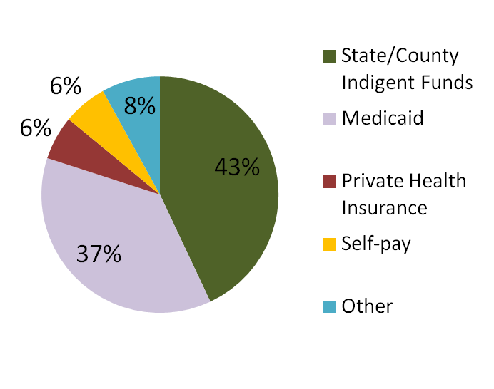
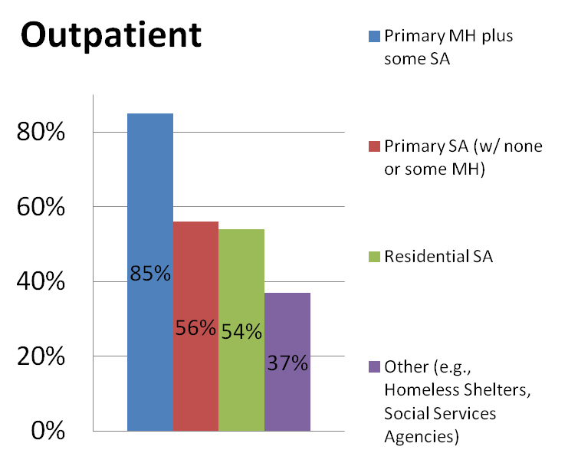
PROVIDERS ACCEPTING HEALTH INSURANCE PAYMENTS
SA TREATMENT FACILITIES ACCEPTANCE OF INSURANCE PAYMENTS *
SOURCE OF FUNDS FOR CMHCS**
*Source: NSATSS **Source: 2011 NCCBH BH Salary Survey
Notes:
Outpatient substance abuse treatment services are less likely to accept health insurance payments.
For example:
85% of outpatient facilities that primarily offer MH services accept health insurance payments
While only 56% of outpatient, 54% of residential, and only 37% of other types of substance abuse treatment facilities such as homeless shelters accept insurance.
However, acceptance of health insurance does not automatically translate to changes in the composition of a provider’s revenue stream.
- For example:
Community Mental Health Centers are likely to accept Medicaid and private insurance payments but remain dependent on other sources of financing.
For example, 43% of the funding for CMHCs comes from State/County Indigent Funds compared to 37% from Medicaid and only 6% from private health insurance.
Sources and notes:
SUBSTANCE ABUSE TREATMENT FACILITIES ACCEPTANCE OF INSURANCE PAYMENTS
National Survey of Substance Abuse Treatment Services (N-SSATS) . N-SSATS is designed to collect information from all facilities in the United States, both public and private, that provide substance abuse treatment.
SOURCE OF FUNDS FOR CMHCS
The 2011 National Council for Community Behavioral Health Care - Behavioral Health Salary Survey examines the compensation practices of mental health and addictions treatment services nationwide.
NOTE: “Other” includes Medicare (4%) and philanthropic donations/grants (4%)

Slide 42
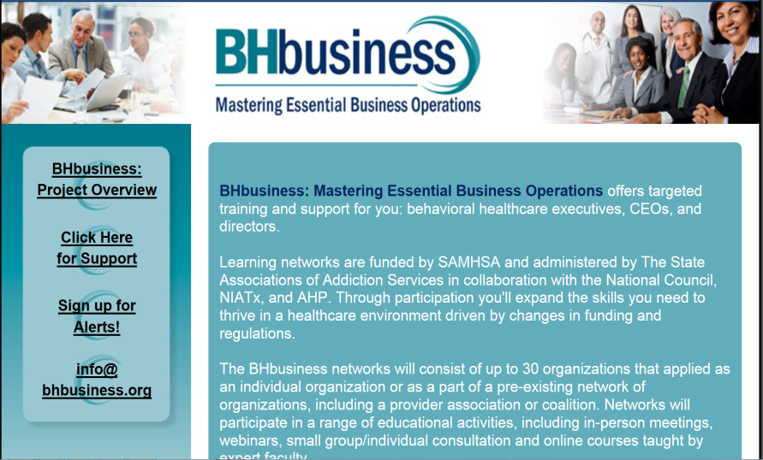
FOCUS: PROVIDER READINESS
BHbusiness Networks
Partnership between SAAS, NIATx, the National Council, and Advocates for Human Potential (AHP)
TA to help 900+ provider orgs/year in 5 areas of practice
  Strategic business planning in an era of health reform
  3rd-party contract negotiations
  3rd-party billing and compliance
  Health insurance eligibility determinations and enrollment
  Health information technology adoption

Slide 43
BH AND PRIMARY CARE INTEGRATION: SAMHSA, HRSA, AHRQ, CMS/CMMI
Joint or Coordinated Products, TA, Grants
Models of Integrated Care
  Primary – SBIRT approach; integrated care approach
  Specialty – Before, After or AS primary care
Clinical Practice Issues
  Capacity
  Workforce competencies
  System issues
  Office flow issues
Payment – Financing – Cost Issues
Metrics re Value (Quality and Cost)

Slide 44
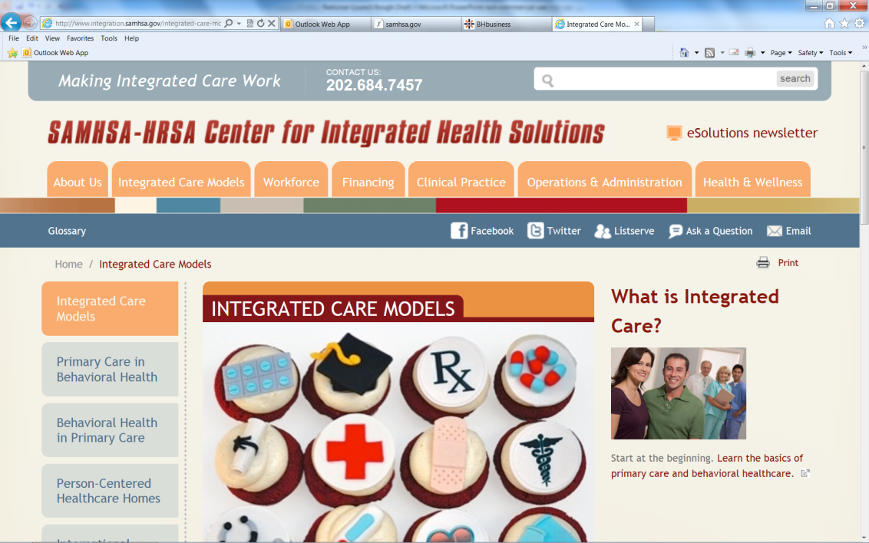
SAMHSA/HRSA – CENTER FOR INTEGRATED HEALTH SOLUTIONS (CIHS)
Goal: Promote planning and development of integrated PC and BH care for those w/SMI and/or addiction disorders, whether seen in specialty or PC settings (bi-directional)
Purpose: Serve as a national training and technical assistance center on bi-directional integration of PC and BH care and related workforce development needs

Slide 45
SAMHSA’s WORK WITH
OTHER FEDERAL PROGRAMS
AHRQ Center for Integration Models: Developing models of integrated BH care in primary care settings
CMS/CMMI Innovative Financing Models for Integration: Grants to test models
SAMHSA’S Primary/BH Integration (PBHCI) Grants: Physical health of adults w/ SMI and TA for bi-directional integration
HRSA FQHCs: Integrating BH screening, brief intervention and treatment
Medicare Accountable Care Organizations: Payment for integrated care and outcomes
CMS Health Homes: Whole person care for persons with specific characteristics or health conditions
CMS Partnership for Patients: Reducing hospital readmissions; increasing quality

Slide 46
STRATEGIC INITIATIVE: HEALTH INFORMATION TECHNOLOGY
Develop Infrastructure for EHRs
  Public domain software
  Privacy and confidentiality guidelines
  Data standards
Provide Incentives, Technical Assistance, Tools
  To facilitate adoption of HIT and EHRs with BH functionality – general and specialty health care
Increase Capacity for Exchange/Analysis of EHR data
  To assess quality of care/improve patient outcomes
  Example: Interoperability of PDMPs for prescription drugs
SAMHSA’s Behavioral Health Exchange Initiative grant

Slide 47



SAMHSA’s NEW IT APPROACHES
Apps re enrollment messaging for persons w/ BH conditions
Beginning to work on development of a mobile health app to support persons in recovery from co-occurring M/SUDs
Coming development of a suicide prevention app and an app to support alcohol prevention among youth
Working toward a free, open source consent management and data segmentation tool designed to integrate w/existing EHR and HIE systems (Consent2Share)
SAMHSA/VA demonstration completed; working toward real world pilot
Standards based implementation guide (summer 2012) w/ ONC’s Standards and Interoperability Data Segmentation for Privacy Initiative

Slide 48
STRATEGIC INITIATIVE:
DATA, OUTCOMES, AND QUALITY
National Behavioral Health Quality Framework (NBHQF)
  Part of National Quality Strategy (NQS) to improve health care
Consolidation and Improvement of SAMHSA Data Collection, Analysis and Reporting Capacity
Use of Data for Decision-Making
Use of SAMHSA Tools to Improve Practices
  Models (e.g., SPF, coalitions, SBIRT, SOCs, suicide prevention)
  Emerging science (e.g., oral fluids testing)
  Technical assistance capacity (e.g., trauma)
  Partnerships (e.g., HIT meaningful use; CMS, CDC, ACF)
  Services research as appropriate

Slide 49
NBHQF: OVERVIEW
Three Aims Concordant with NQS:
  Better Care: Improve overall quality by making behavioral health (BH) care more person-, family-, and community-centered; and reliable, accessible, and safe
  Healthy People/Healthy Communities: Improve U.S. health by supporting (*and disseminating, added by SAMHSA) interventions to address behavioral, social, environmental determinants of positive BH; and delivering higher quality BH care
    Affordable (Accessible) Care: Increase the value and availability of BH care for individuals, families, employers, and government

Slide 50
NBHQF ORGANIZATION: GOALS
Six Goals*
  Evidence-based/effective prevention, treatment, recovery
  Person/family-centered
  Coordinated (within BH; between BH and other health care)
  Promote healthy living
  Safe
  Accessible/affordable
  *Parallels NQS; derived from IOM’s Quality Chasm Report

Slide 51
NBHQF ORGANIZATION:
THREE DOMAINS
Impact of each goal will be tracked across three domains with measures for each cell:
    Payer – public (e.g., SAMHSA, CMS, states) and private (e.g., commercial insurers, QHPs)
    Provider and Practitioner
    Population – individual, family, community
Notes:
The framework will help implement practices and track progress to assure patients, families, and communities are healthier and satisfied due to collective investments to prevent, treat, and support recovery for behavioral health conditions.

Slide 52
NBHQF: CRITERIA FOR MEASURES
Measures should be:
  Endorsed by NQF where possible; or other objective entity (e.g., NCQA, USPSTF, JACHO, CARF) or consensus of experts
  Relevant to NQS priorities
  Address “high-impact” health conditions
  Promote alignment with program attributes and across programs, including health and social programs
  Reflect a mix of measurement types: outcome, process, cost/appropriateness, and structure
  Apply across patient-centered episodes of care
  Account for disparities
  Promote parsimony

Slide 53
MEASURES – EXAMPLE 1
GOAL 4: Identify and disseminate specific indicators, interventions, and status reports on healthy living by community, advancing mechanisms to access health promotion and risk-reduction activities to assist communities to utilize best practices to enable health living
PAYER | PROVIDER/ PRACTITIONER | POPULATION
GPRA: 2.3.62 Number of states (excluding Puerto Rico) reporting retail tobacco sales violation rates below 10% or % of retailers in compliance with prohibition against underage tobacco sales | Number of practitioners/ providers conducting SBIRT for tobacco use NQF#1406: Risky Behavior Assessment or Counseling by Age 13 NQF#1507: Risky Behavior Assessment or Counseling by Age 13 | Percentage of population who smoke Percentage of adolescents smoking for the first time in the past month

Slide 54
MEASURES – EXAMPLE 2
Goal 1: Increase the use of evidence-based practices (EBPs) to promote the most effective
prevention, treatment, and recovery practices for behavioral health disorders
PAYER | PROVIDER/ PRACTITIONER | POPULATION
# of states with up-to-date suicide prevention plans Amount of lost productivity due to alcohol use % of persons identified with addiction successfully in recovery NQF#0004: Initiation and Engagement of Alcohol and other Drug Dependence Treatment – MU-1 and CMS Medicaid adult core NQF#0710-0711-0712: Depression Utilization of PHQ-9 and Remission at 6 and 12 months – proposed MU-2 | % of practitioners/programs screening for depression and suicide % of practitioners/programs (including EAPs) using SBIRT (not yet NQF endorsed) NQF#0104: Major Depressive Disorder/Suicide Risk Assessment (adult) – proposed MU-2 NQF#1364/1365: Child/Adolescent Major Depressive Disorder Diagnostic Evaluation and Suicide Risk Assessment – 1365 proposed MU-2 NQF#0418: Screening for Clinical Depression – proposed MU-2 | # of individuals seriously considering, planning, attempting and/or dying by suicide % of adults drinking more than recommended daily amounts or binge drinking % of individuals in need of substance abuse treatment receiving it in specialty settings

Slide 55
SAMHSA’s NATIONAL BEHAVIORAL HEALTH Barometer
Annual Snapshot of BH in the Nation
  By nation, region, and state
  Key indicators from SAMHSA’s population and treatment facility data sets, other HHS key surveillance data, and state-identified indicators
  Point-in-time data reflecting current status
  Trend over time to paint a picture of progress or emerging issues
Notes:
The framework will help implement practices and track progress to assure patients, families, and communities are healthier and satisfied due to collective investments to prevent, treat, and support recovery for behavioral health conditions.

Slide 56



INNOVATIVE USE OF TECHNOLOGY
Single, cloud-based platform to manage functions currently handled separately in three different systems – Common Data Platform (CDP)
Community Early Warning and Monitoring System (C-EMS) - web-based framework for communities to respond quickly to emerging issues using targeted interventions
Data Portal to a secure, remote access system that allows approved researchers access to restricted-use BH data while protecting confidentiality

Slide 57
STRATEGIC INITIATIVE:
PUBLIC AWARENESS AND SUPPORT
Increase Public Understanding of and Access to Services
Provide Information for BH Workforce
↑ Social Inclusion and ↓ Discrimination
Cohesive SAMHSA Identity and Media Presence
  SAMHSA branding – for public to know where to go
  Common fact sheets
  Single 800 #
  Consolidation of websites
  Social media

Slide 58


CONNECTING AND CHANGING LIVES
Project Evolve – consolidates all SAMHSA sites into one, easy to navigate site at SAMHSA.gov
From ~ 90 sites down to one, collective and clear SAMHSA voice
www.SAMHSA.gov being redesigned so all information can be viewed the same from a PC, tablet, or smartphone
Over 22,000 likes on Facebook (www.facebook.com/samhsa)
Over 26,000 followers on Twitter (@samhsagov)
YouTube (http://www.youtube.com/user/SAMHSA)
Flickr (http://www.flickr.com/photos/samhsa/)
Blog (http://blog.samhsa.gov/)
RSS Feed (http://blog.samhsa.gov/feed/)

Slide 59
SAMHSA BUDGET
$3,466 M
Total Program Level includes: Budget Authority, PHS Evaluation Funds, and Prevention Funds (PPHF).
*FY 2012 represents Full Year CR post rescission.
**FY 2013 represents Full Year CR less rescission, less sequestration.
***FY 2014 includes $1.5 million in data request and publication user fees.
Notes:
Budget History
As you can see on the bar chart, SAMHSA has maintained approximately level funding since FY 2010.
In comparing FY 2014 with FY 2012, BA funding increased by $1.0 million, PHS increased by $35.0 million, and Prevention Fund decreased by $34.0 million.
The difference between FY 2013 and FY 2012 BA funds is $175 million. This includes $7 million for the .2% rescission and $168 million for the 5% sequester cut.
HHS funds SAMHSA $14.7 million with PPHF, and $37.9 million with the Secretary’s Emergency Transfer for a total of $52.6 million. This increases total funding for FY 2013 to $3,355.1 million.

Slide 60
SAMHSA: A PUBLIC HEALTH AGENCY
Mission: To reduce the impact of substance abuse and mental illness on America’s communities
Roles:
  Leadership and Voice – Influencing Public Policy
  Data and Surveillance
  Public Education and Communications
  Regulation and Standard Setting
  Practice/Services Improvement and Financing
  Funding - Service Capacity/System Development (esp. to test new approaches)

Slide 61
SAMHSA’S VISION
A Nation that Acts on the Knowledge that:
  Behavioral health is essential to health
  Prevention works
  Treatment is effective
  People recover
A nation of communities free of substance abuse and mental illness and fully capable of addressing behavioral health issues that arise from events or physical conditions

