Slide 1

The Recorded Home Oximetry (RHO) Program
Monthly Investigator Meeting
September 2, 2021

Slide 2
Site Selection for Implementation Waves
Wave 1
Dartmouth Hitchcock Medical Center
Boston Children’s Hospital
Massachusetts General Hospital
Maria Fereri Children’s Hospital
University of Maryland
Vanderbilt
Wave 2
Arkansas Children’s Hospital
Children’s Hospital of Philadelphia
Cincinnati Children’s Hospital
National Jewish Health
Nationwide Children’s Hospital
Peyton Manning Children’s Hospital
University of California, San Diego
University of Kentucky

Slide 3

RHO Program Implementation Timeline: Wave 1 Sites
February 2021
Baseline data collection begins
March 2021
Initiate site training
Initiate monthly phone calls
May 2021
June-August 2021
February 2022
August 2022
Complete site training
Reach 33% of eligible families
Reach 66% of eligible families
February 2023
Reach 100% of eligible families
Initiate 18-month implementation
Begin providing monthly feedback reports

Slide 4
RHO Program Implementation Timeline: Wave 2 Sites
March 2021
Baseline data collection begins
May 2021
Initiate site training
August 2021
December 2021-February 2022
August 2022
February 2023
Complete site training
Reach 33% of eligible families
Reach 66% of eligible families
August 2023
Reach 100% of eligible families
Initiate 18-month implementation
Begin providing monthly feedback reports

Slide 5
Site Training Planning
Wave 1 Site Visits Completed
4/8 Wave 2 Visits Completed
6/8 Wave 2 Site Completed

Slide 6
Updates on IRB Approval
Due to delays in SMART IRB Approval Umass IRB will be initiating site specific approval letters
Please work on getting your IRBs to review and determine their willingness to cede approval

Slide 7
Home Care Companies Providing Masimo RAD 97s
100% of sites have met the target amount of home cares!

Slide 8

Regulatory Documents
CITI Certificates
As the lead site we are required to have both Human Subject Research and Good Clinical Practice CITI certificates for each member of your site’s research team.
Please send the certificates to Maria Matoshi

Slide 9
Site Progress on Implementation Start-Up
Site Name | Contract Executed | cIRB Approval | Local IRB Approval | Regulatory Documents | pSite Communication Plan Agreement | Site Training Completed | Site Implementation Date | First Enrollment Date | Downloading Schedule
Boston Children's Hospital | ᴏ | ᴏ | ᴏ | ᴏ | ᴏ | ᴏ | 6/1/2021 | 7/8/2021 | M/T
Dartmouth-Hitchcock | ᴏ | ᴏ | ᴏ | ᴏ | ᴏ | ᴏ | 6/1/2021 |  | T/F
Maria Fareri Children's | ᴏ | N/A | ᴏ | ᴏ | N/A | ᴏ | 6/1/2021 |  | M/T
Massachusetts General Hospital | ᴏ | ᴏ | ᴏ | ᴏ | ᴏ | ᴏ | 6/1/2021 | 7/7/2021 | M/T
University of Maryland | ᴏ | ᴏ | ᴏ | ᴏ | ᴏ | ᴏ | 6/1/2021 |  | M/T
Vanderbilit | ᴏ | N/A | ᴏ | ᴏ | N/A | ᴏ | 6/1/2021 |  | T/F
Arkansas Children's Hospital | ᴏ | ᴏ | ᴏ | ᴏ | ᴏ | ᴏ | 8/1/2021 |  | TBD
Children's Hospital of Phil. | ᴏ | ᴏ | ᴏ | ᴏ | ᴏ | ᴏ | 8/1/2021 |  | TBD
Cincinatti Children's Hospital | ᴏ | ᴏ | ᴏ | ᴏ | ᴏ | ᴏ | 8/1/2021 |  | TBD
National Jewish Health | ᴏ | ᴏ | ᴏ | ᴏ | ᴏ | ᴏ | 8/1/2021 |  | TBD
Nationwide Children's Hospital | ᴏ | ᴏ | ᴏ | ᴏ | ᴏ | ᴏ | 8/1/2021 |  | TBD
Peyton Manning Children's Hospital | ᴏ | ᴏ | ᴏ | ᴏ | ᴏ | ᴏ | 8/1/2021 |  | TBD
U. of California, San Diego | ᴏ | ᴏ | ᴏ | ᴏ | ᴏ | ᴏ | 8/1/2021 |  | TBD
U. of Kentucky Children's Hospital | ᴏ | ᴏ | ᴏ | ᴏ | ᴏ | ᴏ | 8/1/2021 |  | TBD

Slide 10

REDCap User Access Groups
Please notify Heather if you have completed a REDCap user request and have not been given an account

Slide 11
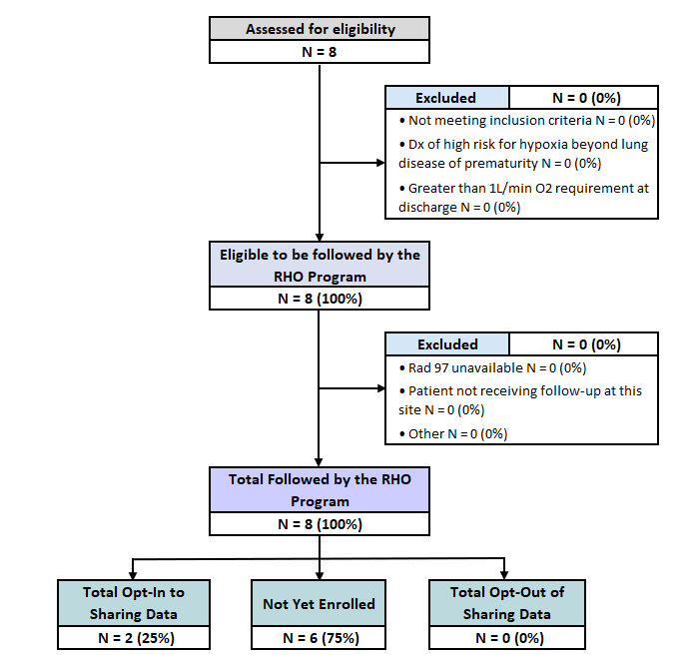
RHO Implementation Trial Consort Diagram

Slide 12
Screening and Eligibility
Please screen all potentially eligible babies in REDCap once site goes live
For screening and eligibility questions please email Heather and Maria

Slide 13
Identifying Barriers and Growing Pains of Implementing the RHO Program

Slide 14
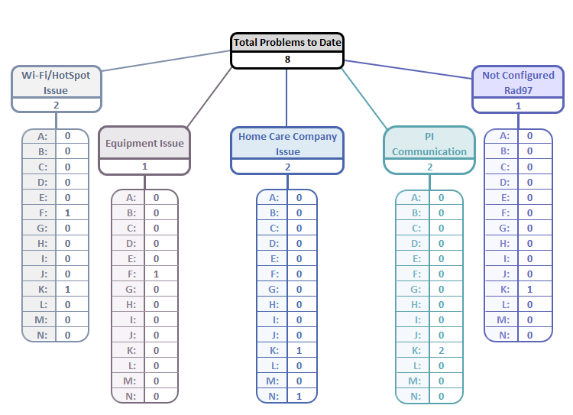
Implementation Related Problems
We will continue to track ongoing problems related to implementation
The goal will be to identify problems early and avoid the same problems at other sites

Slide 15
Current Problems
PI Communication
  Once the oximeter is delivered, assign RHO ID and notify the data coordinating center prior to NICU discharge
  Point Personnel: Heather White & Maria Matoshi
Hello [insert name of DCC contact],
We have an upcoming home oxygen discharge that will be followed by [name of pulmonologist or site name] on [anticipated discharge date]. Their ID number is [ID number] and their oximeter serial number is [oximeter serial number].
Parents [did/did not] opt out of their child’s data being collected as part of the RHO implementation project. This patient [is/is not] diagnosed with PPHN.
Best,
[insert name here]

Slide 16
Common Questions from Sites
The number of probes given to families may be limited by insurance.
Parents reported that the probes stopped working
Parents should be educated on the usage of replacement tapes. Replacement tapes significantly improve the quality and life of the probes.
Replacement tape replaces the tan tape that goes over the actual sensor lights. Parents can switch the tape every day. The white sensor can be cleaned with alcohol wipes after removing the current tan tape.

Slide 17
Common Questions from Sites
Ask parents when the wean was made. The flow rate decision will be made based on the flow rate that infant spent the most time on in the most current data epoch.
What should I do if parents self-weaned?
If the wean happened by accident the decision should be made based on the most recent flow rate.
The decision making based off the most current flow rate would not be considered a deviation.

Slide 18


RHO Program Website
All resources, including training documents, the RHO manual, and other templates can be found on the RHO website at www.umassmed.edu/rho-program
Navigate to “Member Login” and log in with the following credentials to access the documents
  Username: RHO
  Password: Oximetry14

Slide 19

New Training Materials Coming Soon
RAD 97 Troubleshooting Guide
Clarifications to operational definition list
More to come!

Slide 20



Closing Thoughts
Questions and Comments

