Slide 1
The Recorded Home Oximetry (RHO) Program
Monthly Investigator Meeting
July 1, 2021

Slide 2
Site Selection for Implementation Waves
Wave 1
Dartmouth Hitchcock Medical Center
Boston Children’s Hospital
Massachusetts General Hospital
Maria Fereri Children’s Hospital
University of Maryland
Vanderbilt
Wave 2
Arkansas Children’s Hospital
Children’s Hospital of Philadelphia
Cincinnati Children’s Hospital
National Jewish Health
Nationwide Children’s Hospital
Peyton Manning Children’s Hospital
University of California, San Diego
University of Kentucky

Slide 3

RHO Program Implementation Timeline: Wave 1 Sites
February 2021
Baseline data collection begins
March 2021
Initiate site training
Initiate monthly phone calls
May 2021
June-August 2021
February 2022
August 2022
Complete site training
Reach 33% of eligible families
Reach 66% of eligible families
February 2023
Reach 100% of eligible families
Initiate 18-month implementation
Begin providing monthly feedback reports

Slide 4
RHO Program Implementation Timeline: Wave 2 Sites
March 2021
Baseline data collection begins
May 2021
Initiate site training
August 2021
December 2021-February 2022
August 2022
February 2023
Complete site training
Reach 33% of eligible families
Reach 66% of eligible families
August 2023
Reach 100% of eligible families
Initiate 18-month implementation
Begin providing monthly feedback reports

Slide 5
Site Training Planning
Wave 1 Site Visits Completed
2/8 Wave 2 Visits Completed
4/8 Wave 2 Site Visits Scheduled
Masimo coordinating times to meet with sites identified home care companies
  Heather has also been conducting information sessions with each site’s designated home care companies

Slide 6
Updates on IRB Approval
Due to delay in SMART IRB submissions of wave 2 sites please start the process with your IRB’s now
If your IRB is requiring written informed consent- do not cede approval to UMMS
If referring hospitals are to provide VON data separate IRB will be executed- Heather working on protocol
pSite forms will be disseminated once individual site IRB has ceded approval

Slide 7
Questions or concerns regarding IRB approval?
Site specific problems we can help with?

Slide 8
Home Care Companies Providing Masimo RAD 97s
57% of sites have met the target amount of home cares!

Slide 9
Site Progress on Implementation Start-Up
Site Name | Contract Executed | cIRB Approval | Local IRB Approval | Regulatory Documents | pSite Communication Plan Agreement | Site Training Completed | Site Implementation Date | First Enrollment Date | Downloading Schedule
Boston Children's Hospital | ᴏ | ᴏ | ᴏ | ᴏ | ᴏ | ᴏ | 6/1/2021 |  | M/T
Dartmouth-Hitchcock | ᴏ | ᴏ | ᴏ | ᴏ | ᴏ | ᴏ | 6/1/2021 |  | T/F
Maria Fareri Children's | ᴏ | N/A | ᴏ | ᴏ | N/A | ᴏ | 6/1/2021 |  | M/T
Massachusetts General Hospital | ᴏ | ᴏ | ᴏ | ᴏ | ᴏ | ᴏ | 6/1/2021 |  | M/T
University of Maryland | ᴏ | ᴏ | ᴏ | ᴏ | ᴏ | ᴏ | 6/1/2021 |  | M/T
Vanderbilit | ᴏ | N/A | ᴏ | ᴏ | N/A | ᴏ | 6/1/2021 |  | T/F
Arkansas Children's Hospital | ᴏ | ᴏ | ᴏ | ᴏ | ᴏ | ᴏ | 8/1/2021 |  | TBD
Children's Hospital of Phil. | ᴏ | ᴏ | ᴏ | ᴏ | ᴏ | ᴏ | 8/1/2021 |  | TBD
Cincinatti Children's Hospital | ᴏ | ᴏ | ᴏ | ᴏ | ᴏ | ᴏ | 8/1/2021 |  | TBD
National Jewish Health | ᴏ | ᴏ | ᴏ | ᴏ | ᴏ | ᴏ | 8/1/2021 |  | TBD
Nationwide Children's Hospital | ᴏ | ᴏ | ᴏ | ᴏ | ᴏ | ᴏ | 8/1/2021 |  | TBD
Peyton Manning Children's Hospital | ᴏ | ᴏ | ᴏ | ᴏ | ᴏ | ᴏ | 8/1/2021 |  | TBD
U. of California, San Diego | ᴏ | ᴏ | ᴏ | ᴏ | ᴏ | ᴏ | 8/1/2021 |  | TBD
U. of Kentucky Children's Hospital | ᴏ | ᴏ | ᴏ | ᴏ | ᴏ | ᴏ | 8/1/2021 |  | TBD

Slide 10

REDCap User Access Groups
Please notify Lindsey and Heather once you have been granted UMass REDCap approval to be added to your site’s data access group

Slide 11
Timing of Data Collection
Pre-Implementation Data
Goal to send VON and additional outpatient variable data within 3 months of implementation go-live
Implementation Data
Screening and Eligibility: Prior to NICU discharge
Demographics: At or around time of NICU discharge
Home Oximetry Data Form: In real-time by your site’s DCC
Adverse Events: Upon learning of adverse event
Implementation Discharge: Upon HOT discontinuation
Emailed to UMass RHO Study Team
Uploaded into RHO REDCap through DAG

Slide 12
Timing of Data Collection
Pre-Implementation Data
Goal to send VON and additional outpatient variable data within 3 months of implementation go-live
Implementation Data
Screening and Eligibility: Prior to NICU discharge
Demographics: At or around time of NICU discharge
Home Oximetry Data Form: In real-time by your site’s DCC
Adverse Events: Upon learning of adverse event
Implementation Discharge: Upon HOT discontinuation
Emailed to UMass RHO Study Team
Uploaded into RHO REDCap through DAG
At 6-months post-discontinuation of HOT
Notes:
We will be supplying the timeline and dates forms are to be collected in monthly site reports
Adverse events are to be followed for 6-months post discontinuation of HOT

Slide 13
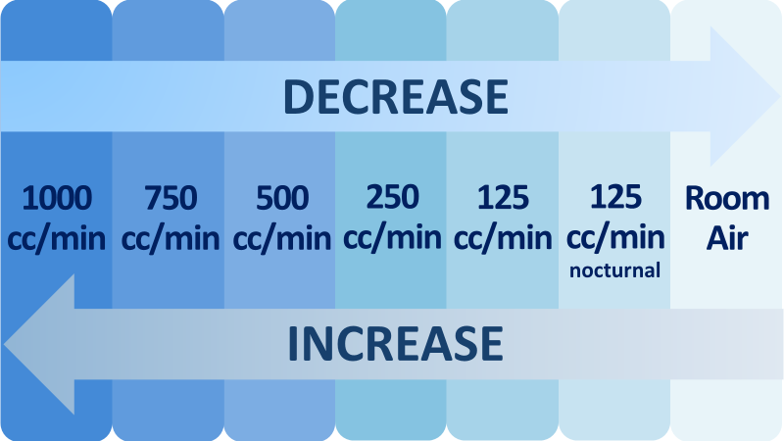
Weaning Increments and Decrements of the RHO Program
Oxygen flow rates will be weaned in 50% decrements (or increased 50% increments)
What are your sites normal titrations?
Sprints?
Lowest comfortable continuous oxygen flow rate?

Slide 14



Closing Thoughts
Questions and Comments

