Slide 1

The Recorded Home Oximetry (RHO) Program
Monthly Investigator Meeting
February 3, 2022

Slide 2

RHO Program Implementation Timeline
Feb - Mar 2021
Baseline data collection begins
Mar - May 2021
Initiate site training
Initiate monthly phone calls
May - Aug 2021
Jun 2021 - Feb 2022
Feb - Aug 2022
Aug 2022 - Feb 2023
Complete site training
Reach 33% of eligible families
Reach 66% of eligible families
Feb - Aug 2023
Reach 100% of eligible families
Initiate 18-month implementation
Begin providing monthly feedback reports

Slide 3



 | - Enrolling
 | - Activated but not enrolling
 | - Patient identified, not yet enrolled

Slide 4
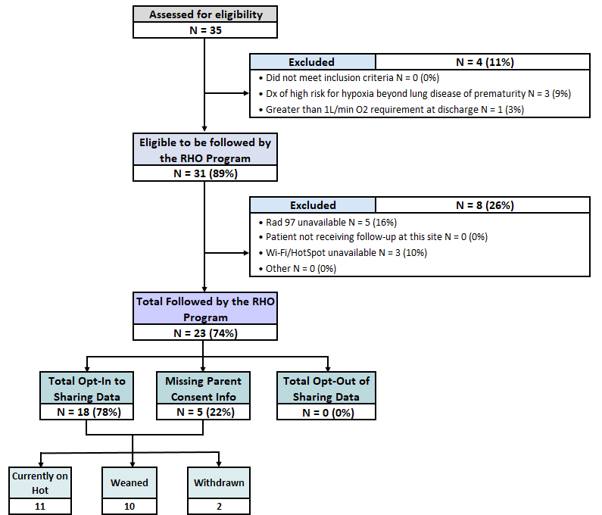
RHO Implementation Trial Consort Diagram
Average HOT Duration: 56±34

Slide 5
Goal

Slide 6
Projected vs. Actual Enrollment Into the RHO Program
Site Name | Estimate per Year | Estimate per Month | Current per Month | Eligible to Date | Followed to Date N(%)
WAVE 1
Boston Children's Hospital | 40 | 3.3 | 0.7 | 6 | 5 (83)
Dartmouth-Hitchcock | 20 | 1.7 | 0.0 | 0 | 0
Maria Fareri Children's | 14 | 1.2 | 0.8 | 2 | 2 (100)
Massachusetts General Hospital | 13 | 1.1 | 0.4 | 3 | 3 (100)
University of Maryland | 20 | 1.7 | 1.3 | 8 | 7 (88)
WAVE 2
Arkansas Children's Hospital | 48 | 4.0 | 1.1 | 3 | 3 (100)
Children's Hospital of Phil. | 50 | 4.2 | 0.0 | 5 | 0
Cincinnati Children's Hospital | 50 | 4.2 | 0.0 | 0 | 0
National Jewish Health | 250 | 20.8 | 0.0 | 0 | 0
Nationwide Children's Hospital | Not Provided | Not Provided | 0.0 | 0 | 0
Peyton Manning Children's Hospital | 25 | 2.1 | 0.0 | 0 | 0
U. of California, San Diego | 65 | 5.4 | 1.1 | 4 | 3 (75)
U. of Kentucky Children's Hospital | 50 | 4.2 | 0.0 | 0 | 0
*Only showing sites with executed contracts

Slide 7
Barriers to Enrollment
Screening Logs:
  Please ensure your site is screening ALL potentially eligible infants discharged home on respiratory support despite their participation status in the RHO program
  Completion of the screening form in REDCap is essential in the accuracy of the overall denominator and ensuring all eligible infants are captured across all sites
  Proper completion of the screening form would further aid in providing an accurate reach of the RHO program- a primary outcome of the implementation trial

Slide 8
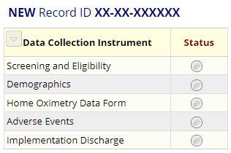
REDCap User Access Groups
10/14 sites have access to their Data Access Group (DAG)
7/7 enrolling sites have access to their DAG
6/7 enrolling sites filled out demographic forms for their patients

Slide 9
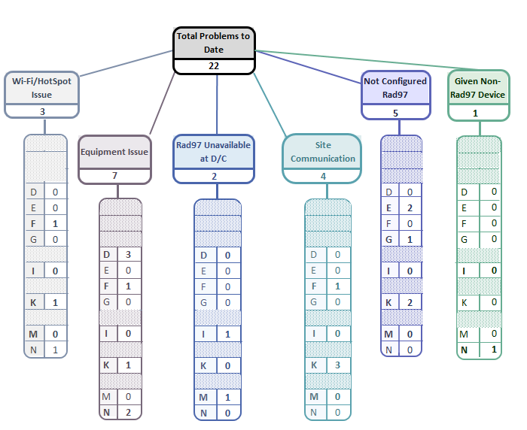
Implementation Related Problems

Slide 10
Goal

Slide 11


RAD 97 Configuration
Please make sure that the light of the wi-fi symbol is green
If it is blue , either:
  the device is not configured to our SafetyNet
  the device is connected to Guest Network
  the Wi-Fi signal is too low
Solution
The providing homecare company should contact their local Masimo account manager for assistance
If the issue persists, let the RHO Leadership know and we will contact Masimo’s leadership

Slide 12
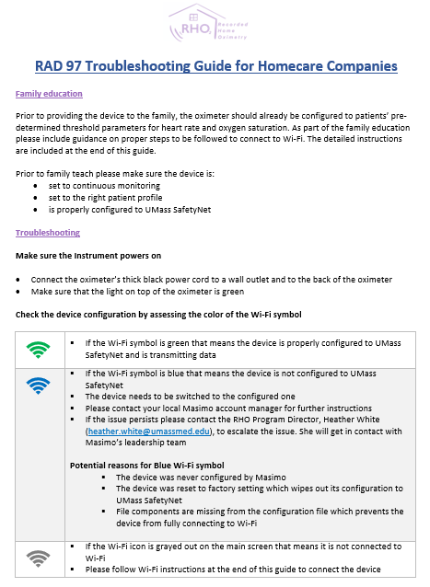
Troubleshooting Guides
Were disseminated to sites last week
Home care companies to receive their own version based on their role

Slide 13
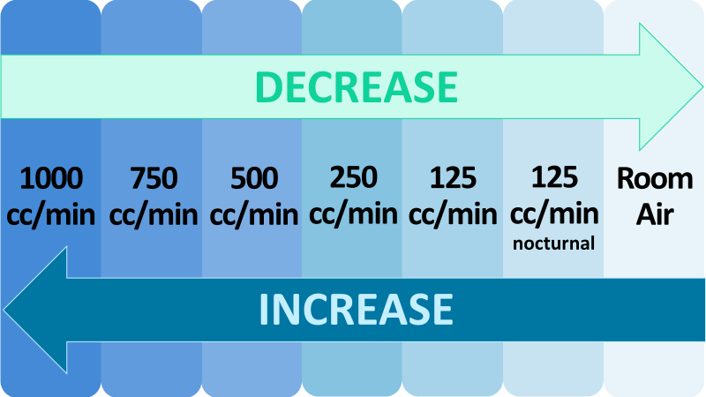
Oxygen Flow Rate Variations Between Sites
The RHO program at UMass has been operating within set oxygen flow rate parameters
Need to decide on the protocol for infants on <125 cc/min flow rate close to discharge:
  a) Cannot participate
  b) Increase the flow rate to 125 cc/min at discharge
  c) Accommodate <125 cc/min flow rate in the protocol
Poll Results: Total of 9/14 Responses
  Option A: 2 (22%)
  Option B: 3 (33%)
  Option C: 1 (11%)
  Option A +B: 1 (11%)
  Option B+ C: 2 (22%)

Slide 14
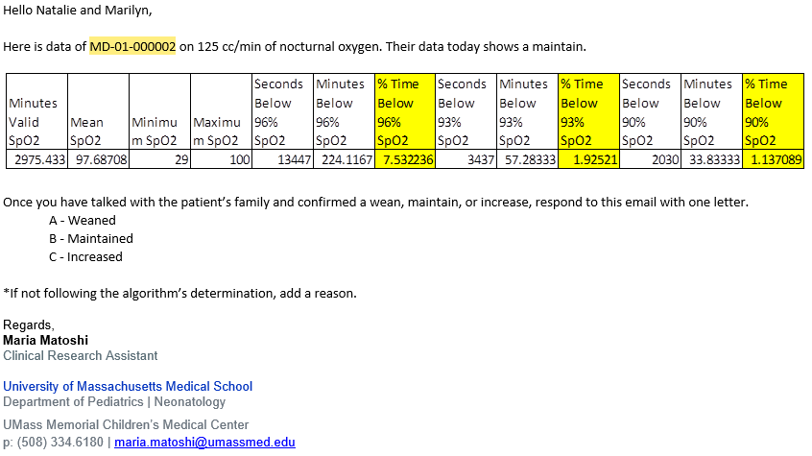
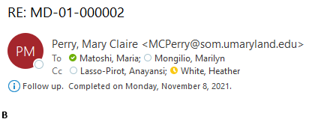
Responses to Bi-Weekly emails
Email from UMass:
If you are following the algorithm’s determination, you only need to respond with one letter.
A – Weaned
B – Maintained
C – Increased
If you are not following the algorithm’s determination, please type the appropriate letter and a reason for not following the algorithm’s determination.
To ensure proper documentation of the data, please be sure to respond to the bi-weekly emails. If we don’t receive a response, we will ask for clarification on the subsequent email
Response from a Site:

Slide 15
Deviation Types
Total Reports | Reports with Deviation(s)
432 | 139 (32%)
No Data Captured

Slide 17
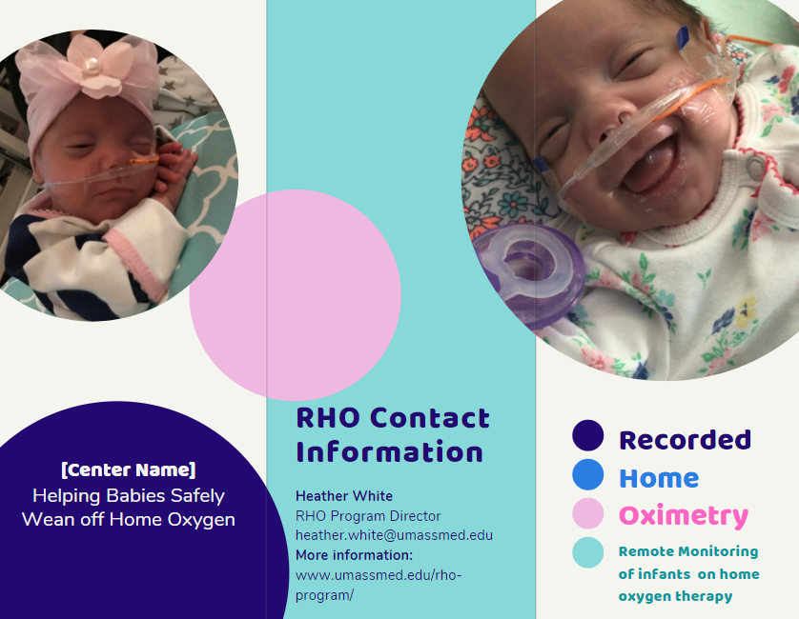
Parent Advisory Board Meeting
Bi-annual Parent Advisory Board meeting will be held on
Agenda Items:
    RHO Implementation progress
    Family Expectations of Weaning
    Family Communication
    Disseminating the RHO Program
PAB Suggestions
  Informational Brochure (including data and numbers)
  Invitation to Virtual Music Classes
  Facebook support group
  *Please be sure to notify Heather of families who would be interested in joining

Slide 18

Invoicing
Our grants office will be reaching out to all sites for invoices
Please notify Heather who the primary delegate at your site

Slide 19
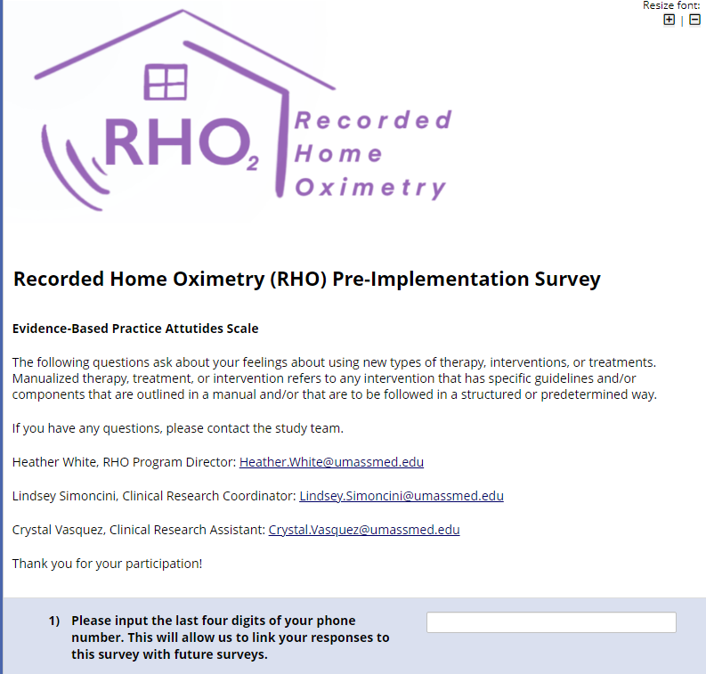
RHO Pre- Implementation Provider Survey
Please be sure to enter a 4-digit identification number to allow us to link your responses to this survey with future surveys
  4-digit ID should be something you could easily remember, as it will be used again for future surveys (preferably last four digits of your cell phone)
Please disseminate the REDCap link to ALL study staff at your site who are involved in the RHO program
REDCap Link: https://arcsapps.umassmed.edu/redcap/surveys/?s=AA4XKYM7KH

Slide 20


RHO Program Website
All resources, including training documents, the RHO manual, and other templates can be found on the RHO website at www.umassmed.edu/rho-program
Navigate to “Member Login” and log in with the following credentials to access the documents
  Username: RHO
  Password: Oximetry14

Slide 21



Closing Thoughts
Questions or Comments?

