Slide 1

The Recorded Home Oximetry (RHO) Program
Monthly Investigator Meeting
December 2, 2021

Slide 2

RHO Program Implementation Timeline
Feb - Mar 2021
Baseline data collection begins
Mar - May 2021
Initiate site training
Initiate monthly phone calls
May - Aug 2021
Jun 2021 - Feb 2022
Feb - Aug 2022
Aug 2022 - Feb 2023
Complete site training
Reach 33% of eligible families
Reach 66% of eligible families
Feb - Aug 2023
Reach 100% of eligible families
Initiate 18-month implementation
Begin providing monthly feedback reports

Slide 3



 | - Enrolling
 | - Activated but not enrolling
 | - Patient identified, not yet enrolled
Contract under review at the site
Contract under review at the site

Slide 4
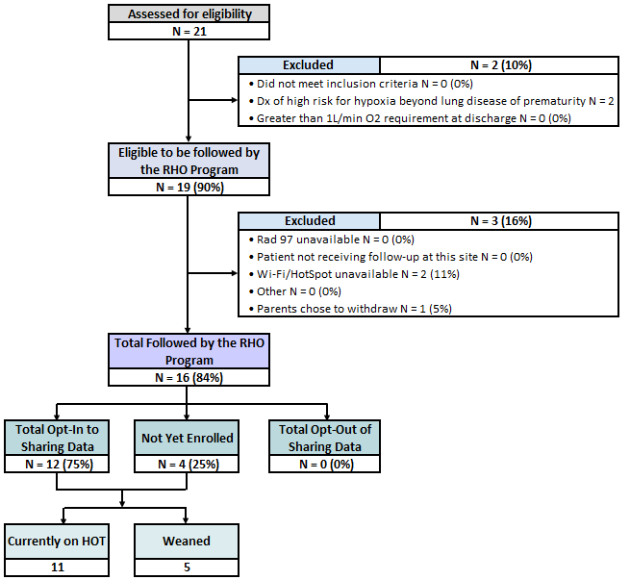
RHO Implementation Trial Consort Diagram
Average HOT Duration: 61±29

Slide 5
Goal

Slide 6
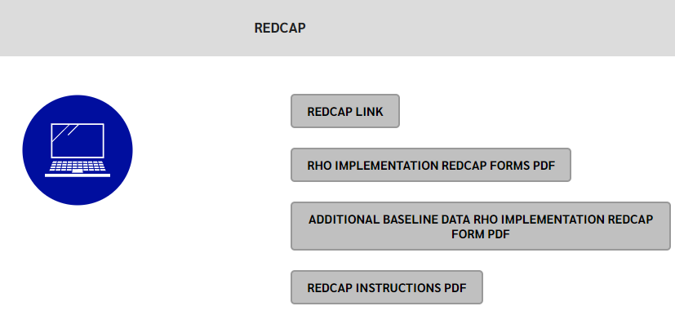
REDCap User Access Groups
Everyone who will be responsible for data entry in REDCap needs to complete a REDCap user request
If you don’t log into your REDCap account for longer than 90 days your account will be suspended

Slide 7
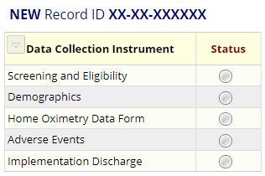
REDCap User Access Groups
9/14 sites have access to their Data Access Group (DAG)
6/6 enrolling sites have access to their DAG
4/6 enrolling sites filled out demographic forms for their patients

Slide 8
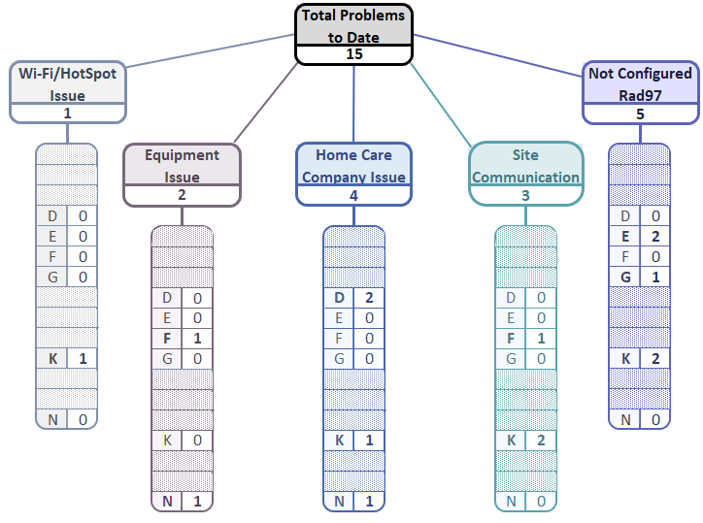
Implementation Related Problems

Slide 9
Implementation Related Problems
Goal

Slide 10
Before Going Live
A consistent barrier to implementation has been home care companies not being prepared for “Go-Live”
When your first implementation baby is identified please reach out to your home care companies and notify them that your site is anticipating your first patient that will need a configured RAD 97

Slide 11

Relationship with Homecare Companies
What is your current relationship with homecare companies?
Who on your team contacts homecare companies regarding troubleshooting issues?

Slide 12


RAD 97 Configuration
Please make sure that the light of the wi-fi symbol is green
If it is blue – the device is not configured to our SafetyNet
Solution
The providing homecare company should contact their local Masimo account manager for assistance
If the issue persists, let the RHO Leadership know and we will contact Masimo’s leadership

Slide 13
Deviation Types
Updated on 11-29-2021

Slide 15
RHO NICU Graduate Music Class
Implementation site families will be invited to the UMass NICU Graduate Music Class starting January 2022
Flyer will be disseminated to sites following this meeting
Share with families with oxygen dependent infants
The family led discussion is monitored by Dr. Rhein and Heather (will do break out groups if participation is large enough)

Slide 16


RHO Program Website
All resources, including training documents, the RHO manual, and other templates can be found on the RHO website at www.umassmed.edu/rho-program
Navigate to “Member Login” and log in with the following credentials to access the documents
  Username: RHO
  Password: Oximetry14

Slide 17



Closing Thoughts
Questions or Comments?

