Slide 1

The Recorded Home Oximetry (RHO) Program
Monthly Investigator Meeting
January 6, 2021

Slide 2

RHO Program Implementation Timeline
Feb - Mar 2021
Baseline data collection begins
Mar - May 2021
Initiate site training
Initiate monthly phone calls
May - Aug 2021
Jun 2021 - Feb 2022
Feb - Aug 2022
Aug 2022 - Feb 2023
Complete site training
Reach 33% of eligible families
Reach 66% of eligible families
Feb - Aug 2023
Reach 100% of eligible families
Initiate 18-month implementation
Begin providing monthly feedback reports

Slide 3



 | - Enrolling
 | - Activated but not enrolling
 | - Patient identified, not yet enrolled

Slide 4
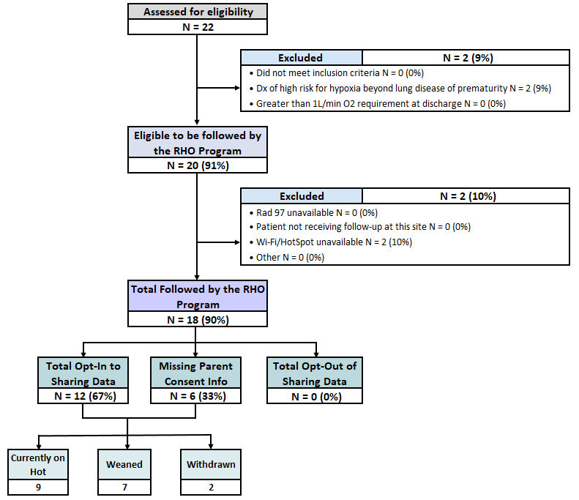
RHO Implementation Trial Consort Diagram
Average HOT Duration: 52±29

Slide 5
Goal

Slide 6
Projected vs. Actual Enrollment Into the RHO Program
Site Name | Estimate per Year | Estimate per Month | Current per Month
WAVE 1
Boston Children's Hospital | 40 | 3.3 | 0.8
Dartmouth-Hitchcock | 20 | 1.7 | 0.0
Maria Fareri Children's | 14 | 1.2 | 0.3
Massachusetts General Hospital | 13 | 1.1 | 0.3
University of Maryland | 20 | 1.7 | 1.3
WAVE 2
Arkansas Children's Hospital | 48 | 4.0 | 1.1
Children's Hospital of Phil. | 50 | 4.2 | 0.0
Cincinnati Children's Hospital | 50 | 4.2 | 0.0
National Jewish Health | 250 | 20.8 | 0.0
Nationwide Children's Hospital | Not Provided | Not Provided | 0.0
Peyton Manning Children's Hospital | 25 | 2.1 | 0.0
U. of California, San Diego | 65 | 5.4 | 0.6
U. of Kentucky Children's Hospital | 50 | 4.2 | 0.0
*Only showing sites with executed contracts

Slide 7
Barriers to Enrollment
What are some of the barriers your teams are facing for enrollment?
Has the demographic of infants going home on HOT changed?
Screening Logs:
  Please ensure your site is screening all potential eligible infants discharged home on respiratory support

Slide 8
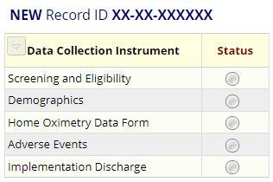
REDCap User Access Groups
9/14 sites have access to their Data Access Group (DAG)
6/6 enrolling sites have access to their DAG
5/6 enrolling sites filled out demographic forms for their patients

Slide 9
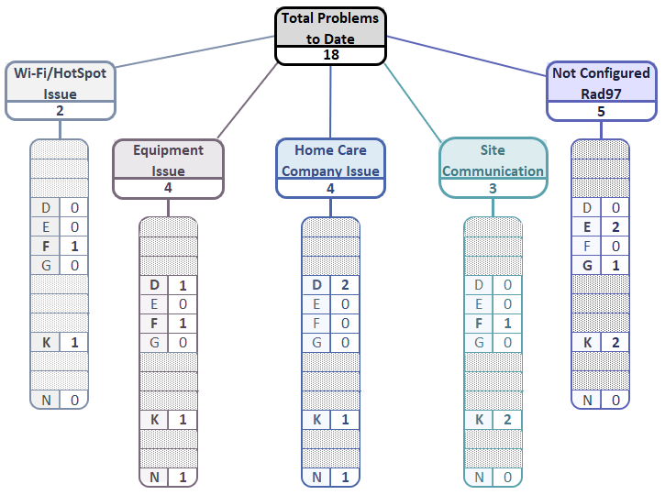
Implementation Related Problems

Slide 10
Implementation Related Problems
Goal

Slide 11


RAD 97 Configuration
Please make sure that the light of the wi-fi symbol is green
If it is blue , either:
  the device is not configured to our SafetyNet
  the device is connected to Guest Network
  the Wi-Fi signal is too low
Solution
The providing homecare company should contact their local Masimo account manager for assistance
If the issue persists, let the RHO Leadership know and we will contact Masimo’s leadership

Slide 12
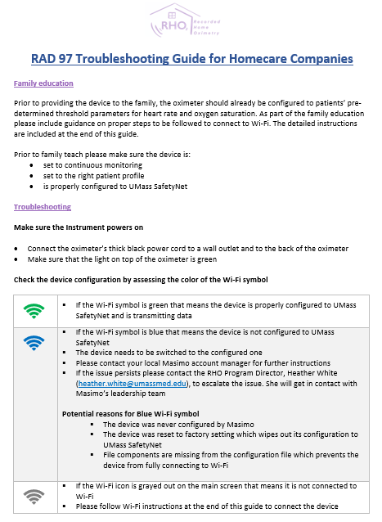
Troubleshooting Guides
We will disseminate troubleshooting guides for homecare companies and sites following this meeting

Slide 13
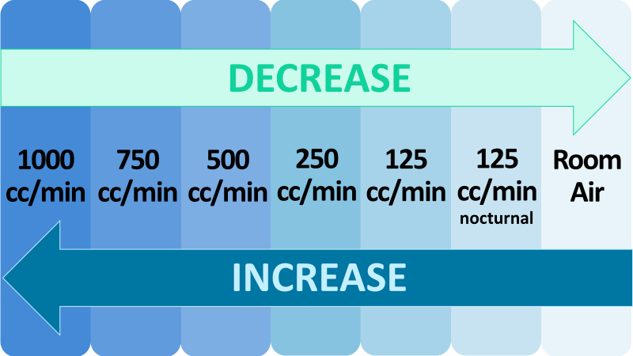
Oxygen Flow Rate Variations Between Sites
The RHO program at UMass has been operating within set oxygen flow rate parameters
Need to decide on the protocol for infants on <125 cc/min flow rate close to discharge:
  a) Cannot participate
  b) Increase the flow rate to 125 cc/min at discharge
  c) Accommodate <125 cc/min flow rate in the protocol

Slide 14
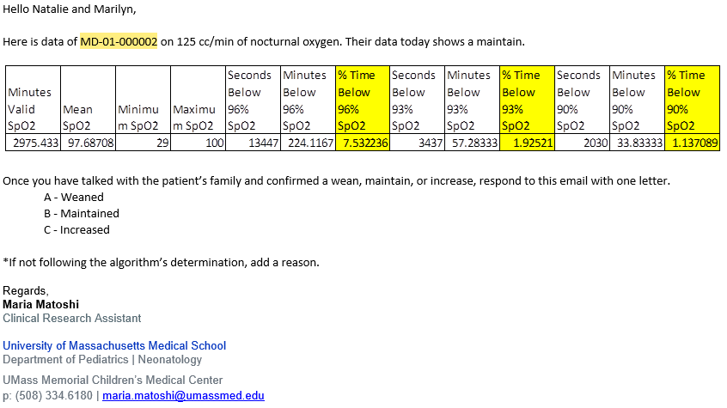
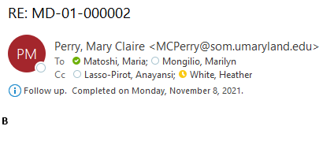
Responses to Bi-Weekly emails
Email from UMass:
If you are following the algorithm’s determination, you only need to respond with one letter.
A – Weaned
B – Maintained
C – Increased
If you are not following the algorithm’s determination, please type the appropriate letter and a reason for not following the algorithm’s determination.
If we don’t receive a response we will ask for clarification on the subsequent email
Response from a Site:

Slide 15
Deviation Types
Total Reports | Reports with Deviation(s)
361 | 118 (33%)
No Data Captured

Slide 17
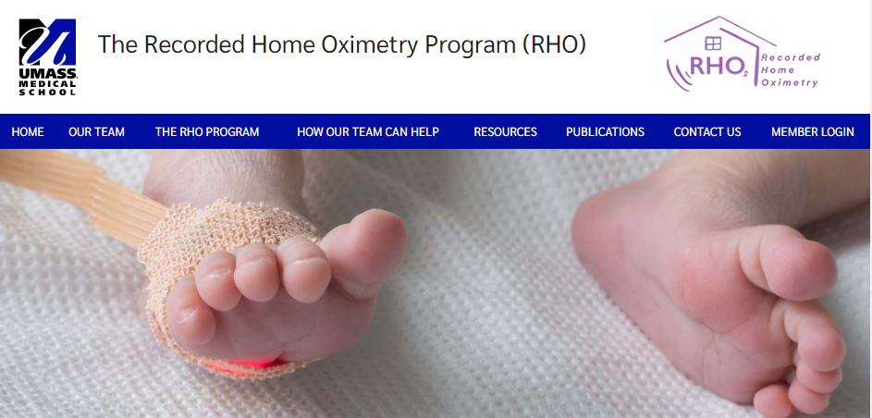

RHO Program Website
All resources, including training documents, the RHO manual, and other templates can be found on the RHO website at www.umassmed.edu/rho-program
Navigate to “Member Login” and log in with the following credentials to access the documents
  Username: RHO
  Password: Oximetry14

Slide 18



Closing Thoughts
Questions or Comments?

